Slide 1





Workshop on the development of MEL framework of the National Strategic Plan on Combatting Trafficking in Persons 2024-2028
5 to 7 November 2028
ASEAN-ACT is funded by the Australian Government, implemented by DT Global

Slide 2

Day 1
5 November 2024

Slide 3
Session 1
Welcome and opening remarks

Slide 4

Welcome remarks
Opening remarks

Slide 5
Participant introduction
  Please tell us about yourself (brief introduction)
  Name, position title and agency/organisation

Slide 6
Objectives of this workshop
  To provide clearer understanding of what is Monitoring, Evaluation, and Learning (MEL) and why it is important.
  To discuss and develop the details of the MEL framework of the National Strategic Plan on Combatting Trafficking in Persons 2024–2028 (NSP), using the zero draft as a guide.
  To discuss and confirm data collection and reporting process, including plan of action/activities outlined on Section D of the NSP (Monitoring and Evaluation).

Slide 7
Session 2
National Strategic Plan on Combatting Trafficking in Persons 2024-2028

Slide 8
Insert or shift to NCCT’s presentation

Slide 9

Questions?
Comments?

Slide 10

Break at 10:15
(for 15 minutes)

Slide 11
Session 3
Purpose and scope of Monitoring, Evaluation and Learning (MEL)

Slide 12
M&E is an intrinsic part of the program cycle (annual)
Decide what needs to be done differently
Plan work and M&E
Do work and do M&E
Gather results of M&E
Reflect on the results of our work
Start here
Program cycle
Communicate results to stakeholders
Notes:
Monitoring and evaluation (or M&E) is an important part of the program cycle.
We start at the top circle – that is ‘decide what needs to be done differently’. How do we do this? Anybody who would like to share how we can decide what needs to be done?
The next step is to ‘plan the work and M&E’ – involves planning and developing the M&E framework
After planning – then we do the work and also do monitoring
While doing the work, or implementing activities and projects, we gather results of the M&E
In between gathering results and reflecting on the results of our work – we communicate the results to stakeholders and donors. Can you give us example on how we communicate?
Then we do reflection – in form of workshops, meetings or dialogues – within or among staff and also with our partners
WE use the reflection and what we learned in revising our approach and multi-year projects – to plan for the next year, or in redesigning the program.

Slide 13
Definition
MONITORING
EVALUATION
On-going collection of information
Primarily for program or project management
Can be done at different levels
Done less frequently than monitoring
Focused more on impact and high-level outcomes
More analytical – involves judgements or merit or worth
Draws on monitoring data
Notes:
Monitoring and evaluation is known worldwide as a means to get information on the progress of our programs and projects. There are differences between monitoring and evaluation, though the distinction is blurred and the terms have been defined in various ways. We use monitoring to describe an ongoing process of collecting routine data that is usually conducted, or at least managed by staff and project partners/implementers. Monitoring occurs at different levels can include monitoring high level indicators as well as monitoring activities. Project or program monitoring is usually conducted internally by program staff.

Slide 14
Focus
MONITORING
EVALUATION
Collecting evidence to see if we are on track to achieve our intended results
For improvement so we can correct the program or project implementation
For accountability so funders can determine whether milestones were delivered
Mid-term – assess adequacy of progress towards outcome, to assess how well the program or project is going mid term
Final evaluation – if the program or project is worthwhile, to demonstrate what has or has not been achieved, to understand how to design and implement better programs in future

Slide 15

Purpose of monitoring
To help manage programs
To discover if program is on track in terms of delivery, know progress and inform continuous improvement
To collect data to facilitate routine reporting to others, support transparency and accountability

Slide 16
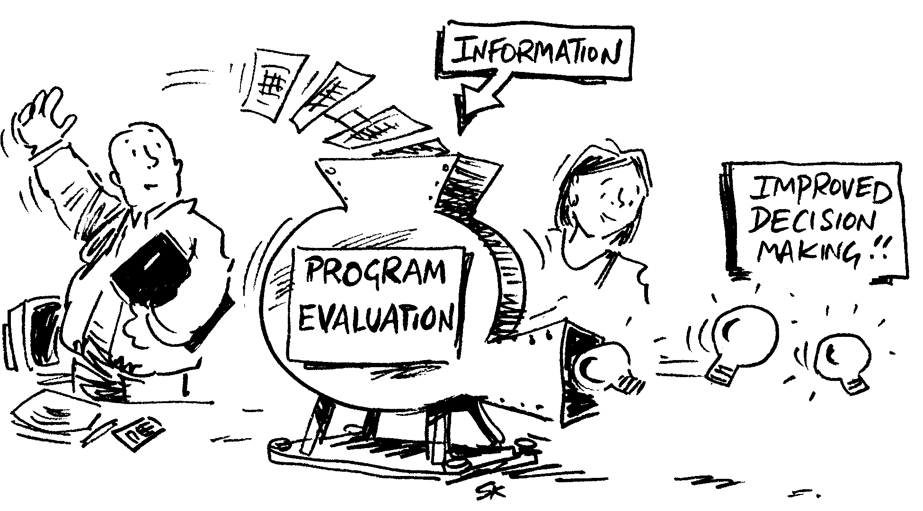
Who is it for?
  Monitoring and Evaluation (M&E) is for project, program or organisational teams – it helps in managing performance.

Slide 17

What is a monitoring and evaluation framework or plan?
  A monitoring and evaluation framework or plan describes the monitoring framework and the process or plan on how to implement the framework.
  Learning is included in the plan when it includes a process of reflecting and using monitoring data in program improvement and redesign.

Slide 18

How does M&E fits with learning?
Organisational learning can be:
Reproductive – we get better over time through practice
Developmental – based on new and different experiences, we start to understand our problems and tasks differently

Slide 19
M&E contributes to learning when …
M&E is about more than just reporting
M&E information is relevant to what the program is trying to achieve, and linked to opportunities for action
Staff and stakeholders actively engage with performance information
The M&E team stimulates and facilitates learning processes

Slide 20

The secrets to creating a meaningful MEL framework
  Develop a program logic or theory of change
  Monitor meaningful things
  Using the logic, identify some medium-term results that will provide evidence
  Use existing data wherever possible
  Include reporting requirements
  Make sure that key stakeholders are involved in reflecting on their achievements and using the data

Slide 21
Process to developing a meaningful monitoring plan
  Clarify the scope of the M&E framework
  Develop monitoring questions and/or indicators from the logic or theory of change
  Identify and list all existing methods or available data
  Identify performance expectations
  Identify questions that cannot be adequately addressed with existing data collection system
  Choose new methods or data collection systems
  Consider how data will be collated, analysed and reported
Notes:
This is a generic process that is commonly used in developing a meaningful MEL framework.
On the zero draft of the MEL framework, we use the National Strategic Plan to clarify the scope of the framework and to build the theory of change.
We will use this generic steps to discuss the zero draft, fill-up the gaps in draft framework and gather inputs from this workshop.

Slide 22
Generic outline or contents of a MEL framework or MEL plan
  Background and purpose of M&E
  Description of theory of change
  Scope of M&E
  Evaluation criteria and evaluation questions
  Indicators and measures of success
  Monitoring methods and tools
  Reporting and learning approaches
  Resources and responsibilities
Notes:
In developing a MEL framework – the framework is documented and includes the following sections. The list on this slide is a common topics included in a MEL framework.

Slide 23

Boundaries and scope
It is important to define what you are developing the MEL framework for, ask questions such as:
What is the purpose?
What is the coverage?
What to include and exclude?
What are the timelines?

Slide 24

The National Strategic Plan
M&E scope
Timelines: 2024 to 2028
Coverage: counter-trafficking activities outlined in the Plan for implementation by relevant ministries, institutions and units at national and sub-national levels
Includes: existing data collections related to trafficking in persons

Slide 25
Purpose and type of M&E
Generic main purposes for doing M&E
Improving – to improve the program or activities, as being implemented
Proving – being accountable for the funds invested
Knowledge – testing and establishing a knowledge base for future strategies/plans or for other stakeholders to access

Slide 26
One of the ‘core values’ of the National Strategic Plan
Systemic and sustainable Monitoring and Evaluation (page 21)
M&E system to determine the quantity and quality of activity implementation
With indicators to measure impacts, achievements, document experiences and good lessons for new initiatives
Monitor progress, challenges, opportunities, the need to change, modify activities or how to carry out activities
Compile and disseminate good experiences and lessons learned during the implementation of planned activities

Slide 27

Audience or users
People who require evaluative information or intended users of the MEL framework
Primary – people who will analyse, reflect and inform their decision making as a result of their involvement in the M&E process.
Secondary – people who may read the reports, but we will not necessarily tailor the M&E framework specifically to their needs.

Slide 28

TASK: define the purpose
  Brainstorm ideas on your table in view of the NSP, use the worksheet:
  Do you agree with the draft objectives or purpose of the MEL framework?
  What important objective(s) have we missed?
  Use the worksheet to record your discussion or answers.

Slide 29
Draft main objectives of the MEL framework
  To inform the strategic direction of NCCT and its member agencies based on evidence and information generated through this MEL framework
  To capture and understand progress of intended outcomes, through consistent and quality reporting to the NCCT
  To capture, share and promote good practices and lessons learned
  To determine the quantity and quality of activity implementation set out in the National Strategic Plan
  Refer to the NSP and draft MEL Framework (section 3.1)

Slide 30
TASK: confirm MEL audience
  Brainstorm ideas on your table in view of the NSP:
  Refer to draft audience list (Table 1 of draft MEL framework)
  Have we missed any important audience? Who are they and what are their information needs?
  Use the worksheet to record your discussion or answers.

Slide 31
Draft MEL users
  Primary users
  NCCT General Secretariat
  NCCT member agencies and institutions
  Municipal/Provincial Committee for Counter Trafficking
  Secondary users
  Other international, regional and national development partners
  Other stakeholders, including private sector and counter-trafficking community
  Other government officers outside of the justice system
  Victim-survivors
  Refer to the NSP and draft MEL Framework (Table 1)

Slide 32
Principles
Accepted rule of action or conduct
Rules, ideas or values that guide the MEL framework
Foundation of a MEL framework, and helps in determining the MEL approach

Slide 33
Examples of MEL principles
  Clear and provide direction
  Be selective, in stages and start small
  Stakeholder participation
  Ensure findings and evidence are used
  Continuous improvement
  Use existing data collection system
  Build capacity
  Align with NSP principles

Slide 34
TASK: vote for principles
  Brainstorm ideas on your table, discuss ideas on MEL principles for the NSP
  Read the list examples of MEL principles
  On the designated blank sheet, write other principles we missed among the example list that you believe are important to include.
  Using 6 dots you have, vote for the key MEL principles. You can use more than 1 dot for a principle.
  What are the principles underpinning the MEL framework?

Slide 35

Lunch

Slide 36

Energiser

Slide 37
Session 4
Outcomes and key evaluation questions

Slide 38

What is a theory of change?
  A powerful thinking tool that helps us consider:
  How outcomes can be achieved
  Articulate a clear narrative for the choice of intervention
  It helps us in monitoring, evaluate and report on progress
Notes:
A theory of change is a thinking tool that helps us to understand and communicate the outcomes that we can expect from our activities delivered under the National Strategic Plan.
It shows ‘cause and effect’ relationships between activities and outcomes.
It also helps us monitor and evaluate the National Strategic Plan because we can focus on measuring and evaluating the extent to which the outcomes have been achieved.

Slide 39
Key definitions in the theory of change
Outcomes hierarchy | Definition
Goals | Broader goals that the NSP outcomes are expected to contribute towards
End-of-program outcomes End-of-strategy outcomes | The desired final results of the strategies or the NSP – that should be achievable if the assumptions hold true
Intermediate Outcomes | Medium-term outcomes that contributes to the achievement of long-term outcomes or end-of-strategy outcomes (includes practice and policy changes)
Immediate outcomes | Short-term outcomes that occur as a result of outputs, within a 2-year timeframe (changes in attitudes, skills)
Outputs | Things that are a direct result of activities, answers ‘what did we do?’
Activities | Actions taken or work performed through which inputs are mobilised, actions outlined in the NSP

Slide 40

Why do theory of change?
  Two main reasons:
  Design – as part of a planning process to clarify the logic of the program (or project), often when the program is in a stage of development or re-development
  Evaluation – to provide a framework to monitor and evaluate and report on the performance of a program

Slide 41
Monitoring for
What happened or completed outputs
What was achieved or outcomes
What was learned
What was the impact
Notes:
To further explain, we monitor for ---
These are what we look for or what we collect on an ongoing basis, or we collect regularly.
To monitor achievements of the NSP

Slide 42

People-centred theory of change
  Describes how we hope to bring about significant and lasting changes through our projects or program or set of activities
  Includes a focus on who we intend to engage with - our stakeholders
  Describes the desired practice change for intended stakeholders
  Is flexible – a framework to guide our thinking

Slide 43
Why people-centred?
  Focuses on who we are targeting
  Social change is about people
  People-centred is less abstract
  It helps distinguish between the different levels of impact experienced
  Can uncover groups or actors that are critical to your projects’ success
  Leads us to develop a logical program logic or theory of change

Slide 44
Our stakeholders
  It is important to distinguish between:
  Who is involved in implementation
  Who will help you achieve change
  Who your project or strategic plan is targeting for change

Slide 45

What is an end-of-strategy outcome?
  The end-of program outcome or end-of-strategy outcome (EOSO) is the designed final results of the National Strategic Plan that should be achievable by 2028, if the assumptions hold true.

Slide 46
Four strategies
Strategy 1. Prevention – Promoting prevention of all forms of human trafficking, exploitation and child sexual abuse
Strategy 2. Law enforcement – Improving quality and the effectiveness of criminal justice system in response to all forms of human trafficking
Strategy 3. Victim protection and service provision – Improving quality and effectiveness of victim protection
Strategy 4. Cooperation – Strengthening cooperation, formulation and enforcement of the implementation of laws, policies and legal standards
Notes:
From the four strategies statements, we derived or converted into outcome statements – to reflect 4 end-of-strategy outcomes.

Slide 47
Draft end-of-strategy outcomes (EOSO)
EOSO 1. Prevention – Targeted people, especially vulnerable groups have reduced vulnerability to all forms of human trafficking
EOSO 2. Law enforcement – Justice system has quality and effective responses to all forms of human trafficking
EOSO 3. Victim protection and service provision – Victim-survivors received quality and appropriate support services
EOSO 4. Cooperation – Counter-trafficking stakeholders have enhanced cooperation in preventing, suppressing crimes and in supporting victim-survivors
Notes:
In a ‘people-centred approach’ to monitoring – we restated the strategies into end-of-strategy outcomes statements (EOSO).
The stakeholder or target stakeholders are identified or mentioned in the EOSO – the outcome starts with those you want to influence in your strategy.
For EOSO prevention – it is ‘targeted people’
For law enforcement – it is the justice system
For EOSO 3 – it is victim survivors
On cooperation – you would like to influence counter-trafficking stakeholders

Slide 48
What are immediate or intermediate outcomes in the theory of change?
  Intermediate outcomes are necessary preconditions to achieve the broader goals
  Are stepping-stones towards the achievement of long-term outcomes
  We usually have more opportunity to influence these intermediate outcomes than the long-term outcomes, which can be affected by a number of factors
Notes:
In the hand-out diagram of theory of change – you will find under EOSOs are the intermediate outcomes, and below the intermediate outcomes are immediate outcomes.
Refer to hand out definition of outcomes hierarchy – copy of slide #38 “key definitions in the theory of change”

Slide 49
Examples of outcomes
  Government have laws and policies in place to counter trafficking in persons
  Child victims of TIP are placed in safe and suitable shelter
  Individualised return and reintegration plans are developed
  TIP victims receive access to care and treatment at mental health care services
  Training participants are applying what they learned from the training on victim identification

Slide 50
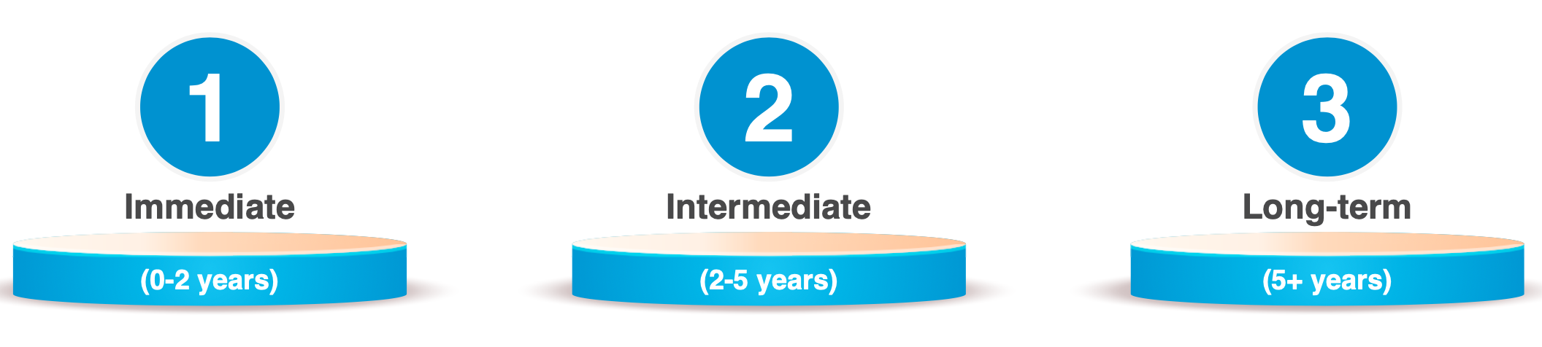
Suggested outcomes timeframes
Notes:
These timeframes have been tested through consultation and reflect broad estimates of how long it may take to achieve each outcome. It recognised that, depending on the context, timeframes for achievement of outcomes may vary with some immediate outcomes having been achieved already and others taking more than two years to deliver.

Slide 51

Tips in writing outcome statements
  Worded as an end-state – what change will look like, not how it will be achieved
  Active voice and use the name of the actor or stakeholder (relate to people-centred approach)
  Succinct – 10 words or less
  Avoid double-barreled (two part) statements
  No jargon or ambiguity
  Plain or simple language
  See examples of theory of change – ASEAN BWP 2.0 and Philippines Strategic Plan

Slide 52
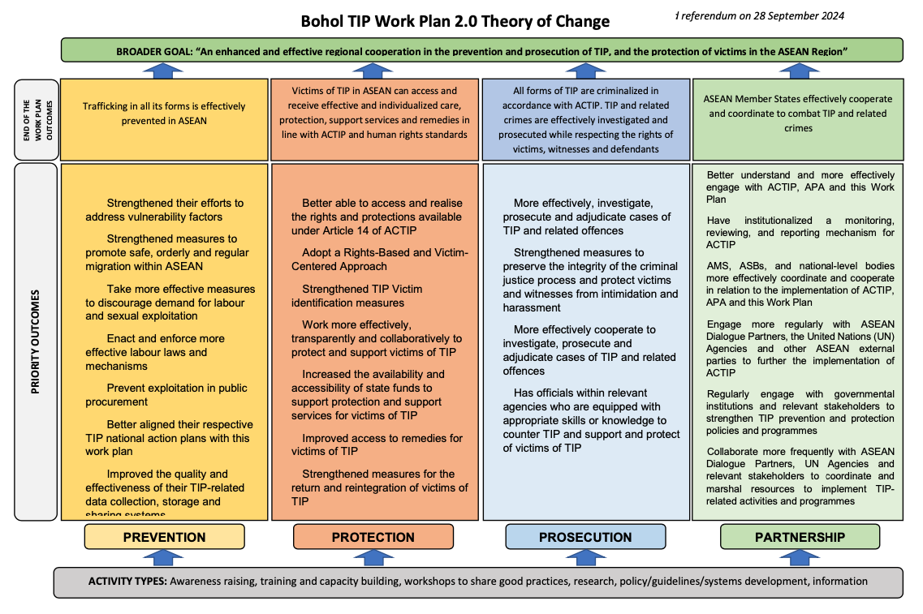
Notes:
Copy of ASEAN Bohol Work Plan 2.0 Theory of Change – refer to hand out for translated version

Slide 53
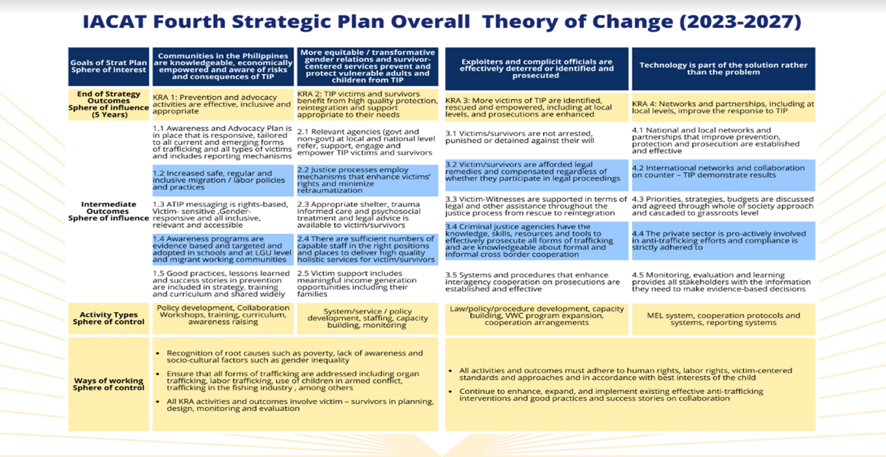
Notes:
Copy of Philippines theory of change – see translated version on your hand out

Slide 54
Group activity
  Divide into 6 groups
  Each group will be assigned a strategy (one of four) to discuss
  Use the NSP to refer to specific strategy and related activities outline in the NSP (Appendix 3)
  Review the draft EOSO and draft intermediate outcomes

Slide 55
TASK: consider intermediate outcomes and EOSOs
  Within group assigned strategy:
  Do you agree with the statement of EOSO? Update as needed.
  In view of related strategy and planned activities in the NSP, what will be the intended priority outcomes or results by the end of 2028? You can revise the draft outcomes and/or add new outcomes. Write your proposed new outcomes on a white paper.

Slide 56

Plenary discussion

Slide 57
Break at 15:00
(for 15 minutes)

Slide 58
Evaluation criteria
Most recent style of M&E tends to organise the framework around a set of high-level key evaluation questions that refer to specific criteria.
It is important to select only those that would be useful for the evaluation.

Slide 59

Evaluation Criteria
  Effectiveness
  Relevance
  Efficiency
  Sustainability
  Appropriateness
  Partnership
  Contribution
Notes:
Refer to handout with list of evaluation criteria and definition. The handout also includes corresponding question.

Slide 60

Key evaluation questions
  What are key evaluation questions or KEQ?
  Relate to objectives or evaluation criteria
  Carefully crafted questions
  Are used to guide the M&E framework
  Form the basis of data collection
  Not the same as survey questions

Slide 61
Sub-questions
  What are sub-questions?
  Also relate to specific evaluation criteria
  Carefully crafted monitoring questions
  Reflect further refinement of the KEQ
  Help provide sufficient information to make judgement at the KEQ level
  Things we need to know to answer the KEQ

Slide 62

Example: BWP 2.0 Key Evaluation Questions
How well are we delivering the Work Plan? (Efficiency, Relevance, Coherence)
What outcomes and results are we seeing from delivering the Work Plan? (Effectiveness, Impact, Sustainability)
What are we learning about good practices, ACTIP implementation and lessons?

Slide 63
Key points on M&E from the National Strategic Plan
Determine the quantity and quality of activity implementation
Monitor progress, challenges and opportunities
Compile and disseminate good experiences and lessons learned during the implementation of planned activities
Cooperation is a fundamental principle and core of all strategies

Slide 64
Draft criteria and KEQs
  Derived from the NSP:
  Effectiveness: How effective are our strategies under the auspices of the National Strategic Plan, in achieving its intended outputs and outcomes?
  Contribution: To what extent and how have we effectively contributed towards TIP prevention, prosecution of traffickers and protection of TIP victims?
  Partnership: To what extent are cooperation and partnership improving our response to TIP prevention, law enforcement and victim protection?

Slide 65
TASK: identify criteria and KEQs
  Brainstorm ideas on your table:
  Do you agree with the proposed 3 criteria – Effectiveness, Contribution and Partnership?
  If asked to prioritise criteria to measure performance against the NSP, what will be your top 3 criteria.
  Use list of criteria definition and record your responses in the worksheet.
  Note that we will organise the framework (data collection and reporting) around the priority criteria.

Slide 66
Plenary discussion

Slide 67

End of day 1 THANK YOU

Slide 68


aseanact.org

