Slide 1








Risks and Rewards: Outcomes of Labour Migration in South-East Asia
Siem Reap, Cambodia
24-25 May 2018
Notes:
Her Excellency Chou Bun Eng, Vice Minister, Ministry of Interior, Vice Chairperson of the NCCT
Her Excellency San Arun, Vice Minister, Ministry of Women’s Affairs, Chairperson of the COMMIT Taskforce
Excellency, delegates from CLM countries
Dear participants from development organizations, private sector institutions, donor agencies – ladies and gentlemen.
My name is Akhara, I’m working for a labour migration project (PROMISE) at IOM Phnom Penh, Cambodia. It is my privilege and honor to be a panelist in this very important discussion. I’m going to briefly talk about outcomes of a research entitled Risks and Rewards: Outcomes of Labour Migration in South-East Asia. This study was conducted by the ILO TRIANGLE in ASEAN programme and Rapid Asia, with additional financial and technical support provided by the IOM PROMISE project.
There is really a wealth of data in this report, and I am only going to be able to provide a taste of it today, so I hope that you will find out about the report and read further if you are interested in the findings.

Slide 2


Contents
Rationale
Research Approach
Selected Key Findings
Conclusion and Key Recommendations

Slide 3

Migration is increasing within ASEAN and its outcomes are not well understood
Share of intra-ASEAN migrants by countries of origin and destination (1990-2015)
Notes:
The rationale for this study is that migration within ASEAN is increasing dramatically and yet the outcomes are still poorly understood. As you can see from this chart, the number of migrants headed to other countries in the ASEAN region has increased more than fivefold since 1990, reaching nearly 6.9 million. Millions more are employed without legal status and are not captured in official data.
While assumptions are often made about the end result of migration in ASEAN and how best to ensure a safe and rewarding experience for migrant workers, more rigorous collection and analysis of empirical data has been very limited. This study was conducted to help fill the knowledge gap on the outcomes of migration into low-skilled work within the region.

Slide 4
Research Questions
Pre-migration
Information, pre-departure orientation, skills training
Migration Process
Channels used, costs paid, contracts, migration problems
1. What are the socio-economic
Outcomes of migration?
2. What conditions and practices contribute to more positive or negative outcomes?
Working Conditions
Job matching, wages, labour rights, abuses
Employment, remittance use, poverty, empowerment
Return and reintegration
Notes:
The research sought to answer two key questions. First, what are the social and economic outcomes of migration within ASEAN for migrant workers?
And second, what conditions and practices contribute to more positive or negative migration outcomes?
To answer these questions we examined the changes in migrants lives from before to after migration, including their employment status, economic situation, and social and psychological well-being. Then we traced them back through their journeys, to examine the factors along the way that were most important to shaping their experiences.

Slide 5
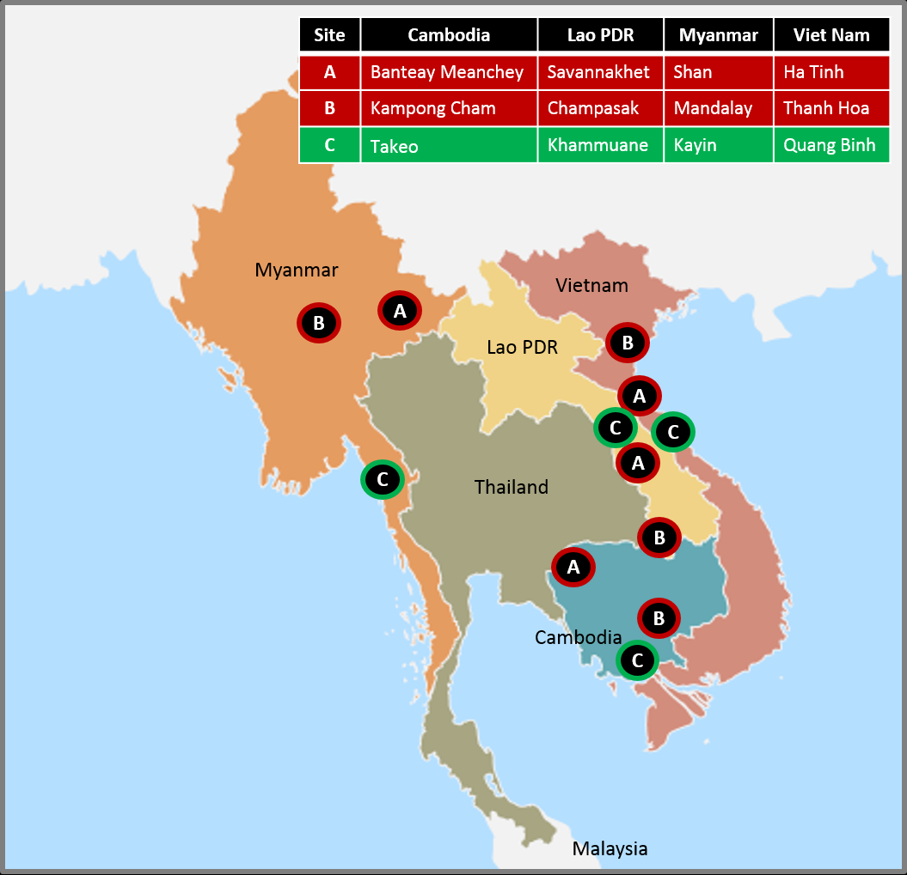
Research Sample
Survey of return migrant workers (n=1,808)
In-depth interviews of return migrant workers (n=60)
Key informant interviews with tripartite stakeholders (n=36)
Notes:
We interviewed a total of 1,808 return migrant workers from Cambodia, Laos, Myanmar and Viet Nam who had been employed in Thailand or Malaysia. In addition, 96 qualitative interviews were conducted with return migrant workers and tripartite stakeholders.
The survey locations in each of the 4 countries are shown here on the map. A total of 3 provinces were selected in each country, among which two are planned intervention areas for the ILO and IOM and the other is designated as a control site where no activities will be implemented (marked in green on the map). This will provide the basis for assessing impact in the future.

Slide 6

Selected Key Findings
Notes:
In tracing migrants’ experiences back, we first looked at their preparations before going abroad.

Slide 7
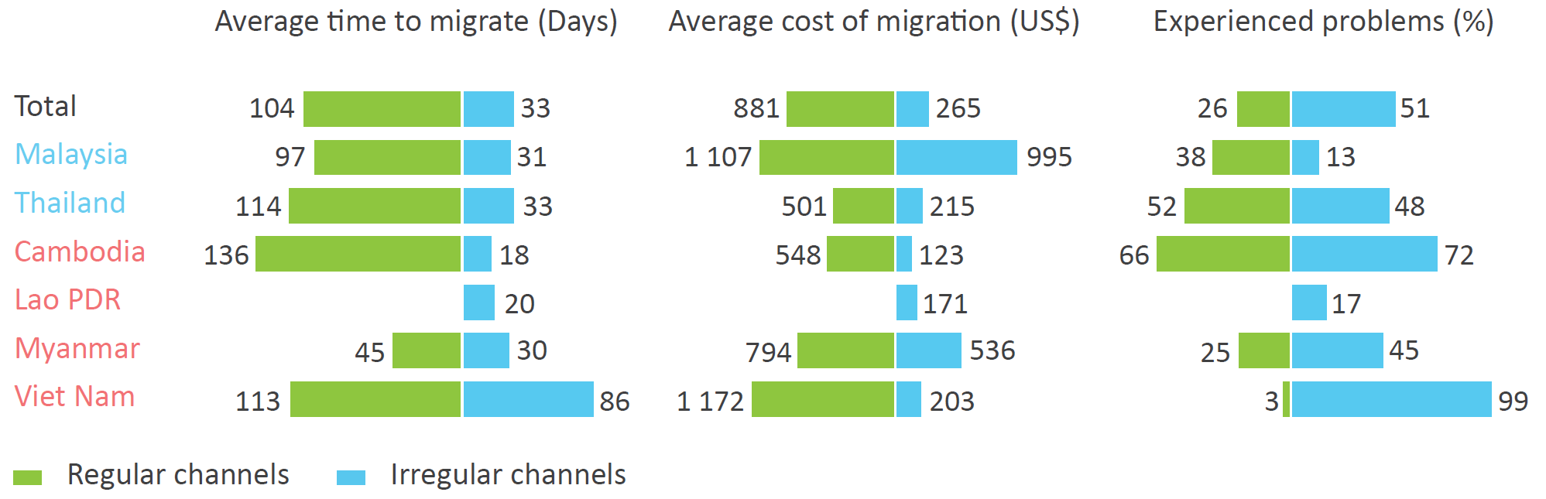
Effectiveness of Regular and Irregular
Migration Channels
Notes:
A central question that the research sought to answer was whether regular migration leads to more beneficial outcomes for migrant workers, as it is a commonly accepted practice to encourage regular migration as a protection strategy against exploitation and abuse.
The majority of migrant workers across the four countries of origin used irregular channels at 74 per cent. Migrating irregularly was 71 days quicker and US$616 cheaper than using regular channels but more frequently led to problems, particularly with lack of legal status.
Although these findings suggest that migrants have the opportunity to weigh the costs and benefits of all of the options and decide to take greater risks in exchange for ease and affordability, the reality is more complex.
With limited access to information, training, and regular migration channels, as well as scarce resources, migrant workers must make use of the migration channels available to them. For many, it becomes a matter of “choosing” the least worst option.

Slide 8
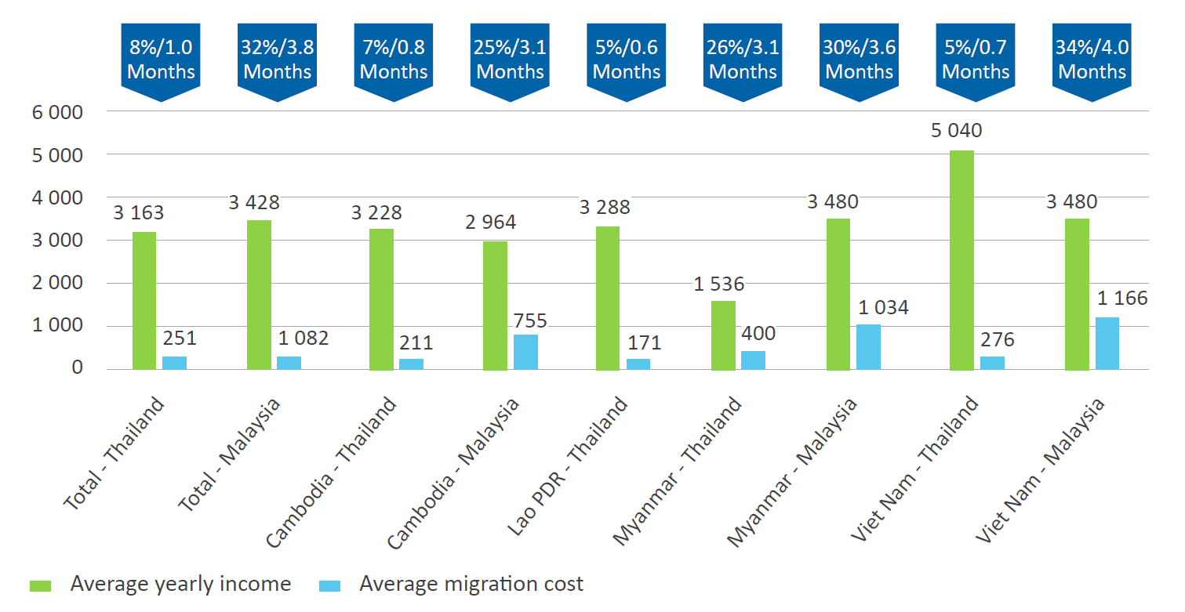
Recruitment costs as a proportion of annual income in USD by corridor
Notes:
The majority of migrant workers across the four countries of origin used irregular channels at 74 per cent. Migrating irregularly was 71 days quicker and US$616 cheaper than using regular channels but more frequently led to problems, particularly with lack of legal status.
Although these findings suggest that migrants have the opportunity to weigh the costs and benefits of all of the options and decide to take greater risks in exchange for ease and affordability, the reality is more complex.
With limited access to information, training, and regular migration channels, as well as scarce resources, migrant workers must make use of the migration channels available to them. For many, it becomes a matter of “choosing” the least worst option.
42% took out a loan to cover mig costs = on average USD560. it took on average 8 month to pay back.

Slide 9
Contract Substitution with
Written Employment Contracts
Notes:
Signing a written employment contract before migrating was also found to be ineffective in protecting migrant workers. One out of five migrant workers who had signed a written contract experienced contract substitution.
As with several of the other aspects of regular migration examined, written employment contracts currently fail to deliver on their promise of fair working conditions.

Slide 10
Labour Rights Abuses and Access to Justice
Notes:
During their employment, 59% of migrant workers experienced some form of labour rights violation and had very limited access to legal remedies.
This suggests that the problem is not that migrant workers are making the wrong choices but that they are very vulnerable to abuse regardless of their decisions. They are a group of workers to which a largely different set of rules apply during their time abroad. The risks are even greater for women migrants because their work is often undervalued and affords fewer labour protections.

Slide 11
Average Monthly Wages in Thailand and Malaysia Compared to the Legal Minimum
Notes:
Wage related abuses were some of the most common forms of labour rights violations found during the study. The average migrant works 64 hours per week for pay that is well-below the minimum wage in Thailand and Malaysia if overtime is considered.
It can be conservatively estimated that migrant workers are underpaid by an average of US$68 in Thailand and US$60 in Malaysia every month, which suggests that wage theft is a very widespread practice.
The study also found that a significant wage gap of 14 per cent exists between women migrants and men migrants. While there are differences between sectors and countries, a central conclusion is that women migrants earn less for the same type of work across all corridors and occupations.

Slide 12
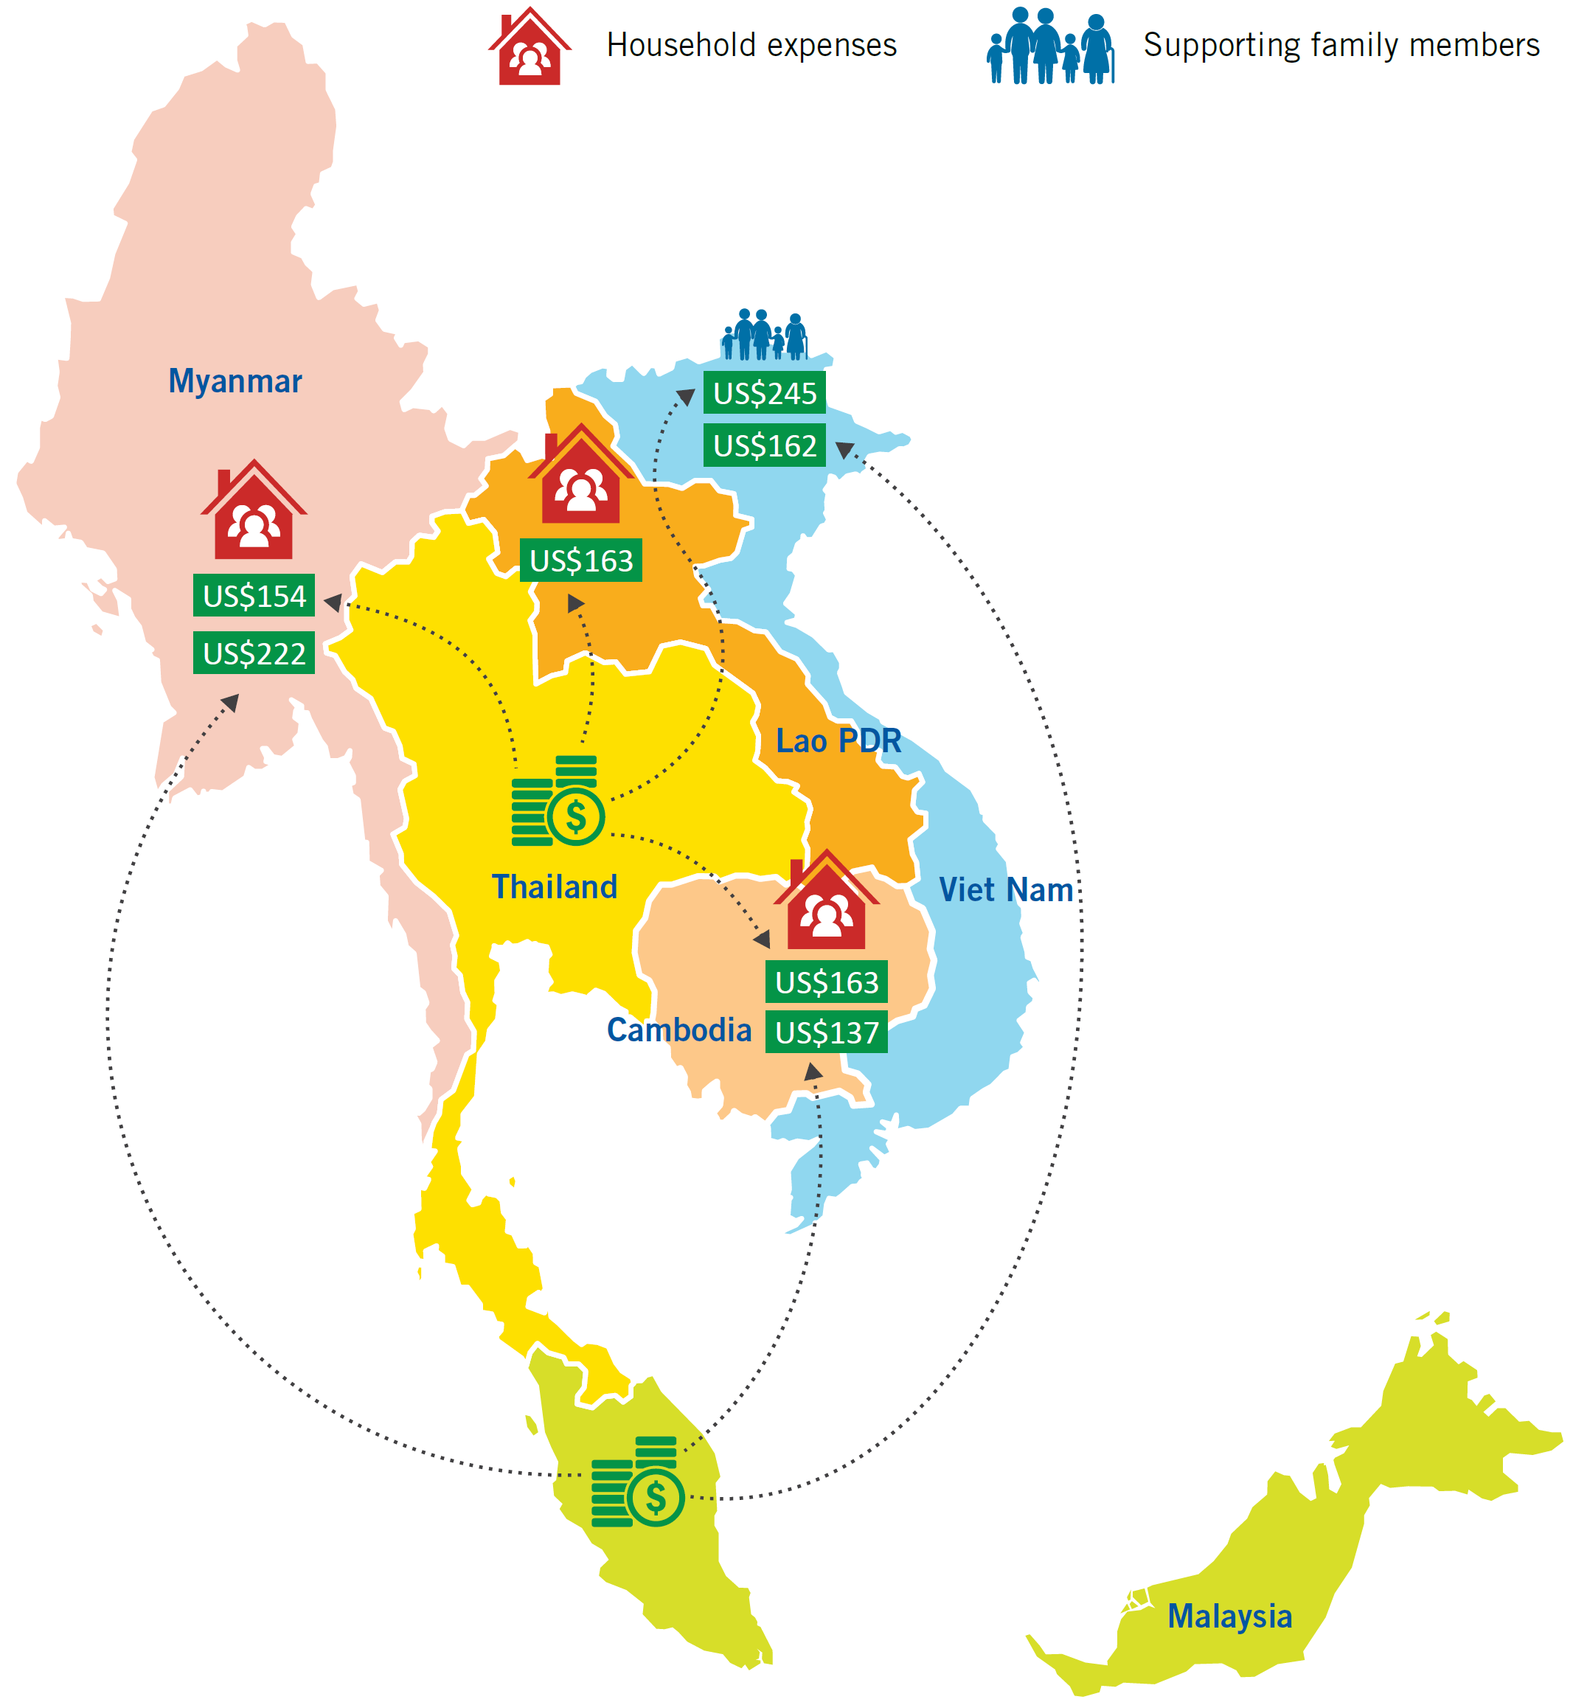
Average Remittance Amounts and Most Common Uses
Notes:
The majority of migrant workers and their families used remittances for purposes that are considered “non-productive”. In particular, the funds received were used for household expenses and purchase of consumer products. This finding is understandable given that in many cases, remittances were the main or sole form of income for recipients.
Non-productive use of remittances should not be applied as a value judgement as the importance of using remittances to pay for immediate household needs cannot be discounted and consumption can contribute to economic growth. Moreover, it is important for governments to acknowledge that remittances are privately held funds, and that it is entirely at the discretion of migrant workers as to how they make use of them.

Slide 13
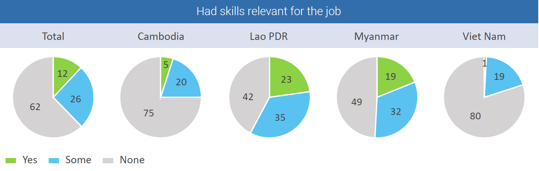
Relevant job skills by country of origin
Notes:
The study also found that a significant wage gap of 14 per cent exists between women migrants and men migrants. Sectoral segregation contributes to the difference in wages but discriminatory wage setting practices are also evident, with women migrants earning less for the same type of work.
The gap was 73% in domestic work, 24% in construction,18% in agriculture and 12% in fisheries. An important explanation for the very large wage gap in domestic work is that employment in different types of domestic work is largely separated by gender in South-East Asia. Those jobs viewed as women’s work usually receive lower pay.

Slide 14
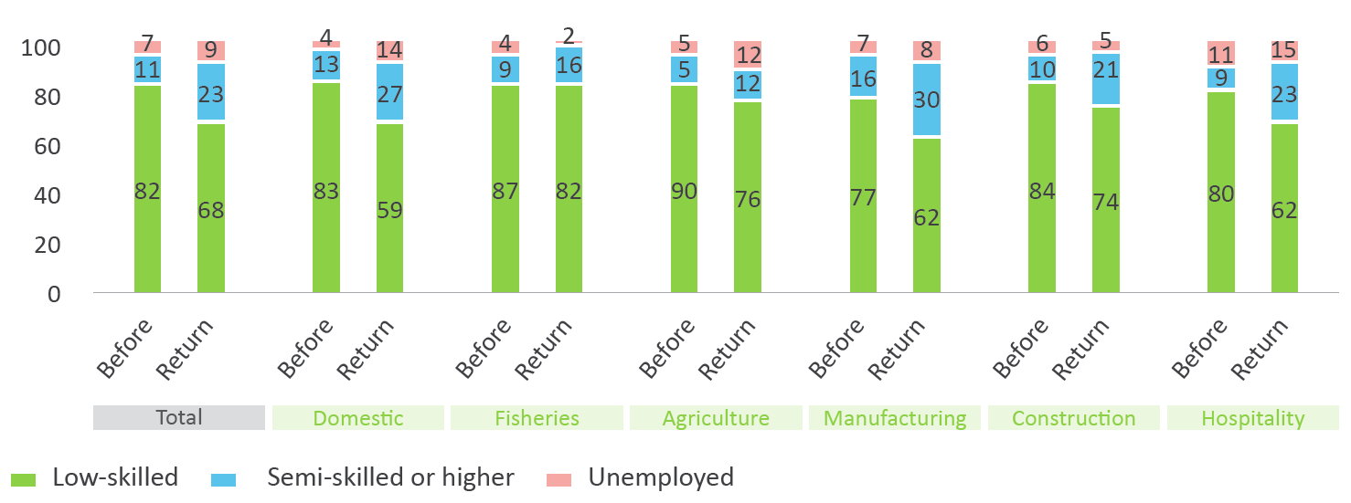
Skill level of work before migration and upon return
Only 16% of migrants who had developed skills felt that they were applicable upon return
Notes:
Through improved livelihoods, the study found that labour migration can have a lasting impact on poverty, reducing those living below the international poverty line by 11 per cent from before to after migration.
The results were particularly striking in Viet Nam and Myanmar, where poverty was reduced by 17 per cent and 13 per cent respectively. While it should be noted that both countries have experienced rapid economic growth during the time period researched, the results suggest that labour migration has significant potential to contribute to poverty alleviation in countries of origin.

Slide 15
Labour Migration as a Ladder out of Poverty
Notes:
Through improved livelihoods, the study found that labour migration can have a lasting impact on poverty, reducing those living below the international poverty line by 11 per cent from before to after migration.
The results were particularly striking in Viet Nam and Myanmar, where poverty was reduced by 17 per cent and 13 per cent respectively. While it should be noted that both countries have experienced rapid economic growth during the time period researched, the results suggest that labour migration has significant potential to contribute to poverty alleviation in countries of origin.

Slide 16
Conclusion
Socio-economic benefits of labour migration not maximized in ASEAN but positive outcomes can be achieved
Lack of assurance means labour migration often a gamble for migrant workers
Improving odds of a positive outcome requires changes to policy and practice by duty bearers rather than behaviour of migrant workers
Need to shift approach to labour migration governance in ASEAN, reframing the goal as increased number of migrants who have holistically beneficial labour migration experience
Notes:
The findings of the study show that although the socio-economic benefits of labour migration have not been maximized within the ASEAN region, positive outcomes can be achieved if migrant workers are provided with opportunities to enhance their job skills, avoid large debts, receive the minimum wage and find gainful employment upon return.
Lack of assurance of obtaining these conditions contributes to a situation where labour migration within ASEAN is often a considerable gamble for migrant workers and their family members. To a great extent, improving the odds of a positive outcome requires changes to policy and practice by governments, employers, and recruitment agencies rather than to the behaviour of migrant workers.
To support greater realization of positive results, a shift in labour migration governance is needed within ASEAN towards a more migrant-centred approach. The goal should be reframed as an increased number of migrant workers who have a holistically beneficial labour migration experience rather than simply expanding national remittance accounts or reducing human trafficking.

Slide 17
Key recommendations
Develop regular migration channels that are less costly, time-consuming and complex
Shift the costs paid for recruitment from worker to employer
Ensure that women and men migrant workers are fully covered by labour and social protection laws regardless of their employment sector
Enhance the portability of social protection benefits for migrant workers
Expand access to justice for migrant workers
Apply stricter sanctions for employers and recruitment agencies that violate migrant workers’ rights
Provide skills training that matches employer requirements; and enable skill validation for low and semi-skilled workers
Expand the services provided to migrant workers to assist with return and reintegration, including for skill validation and retention

Slide 18

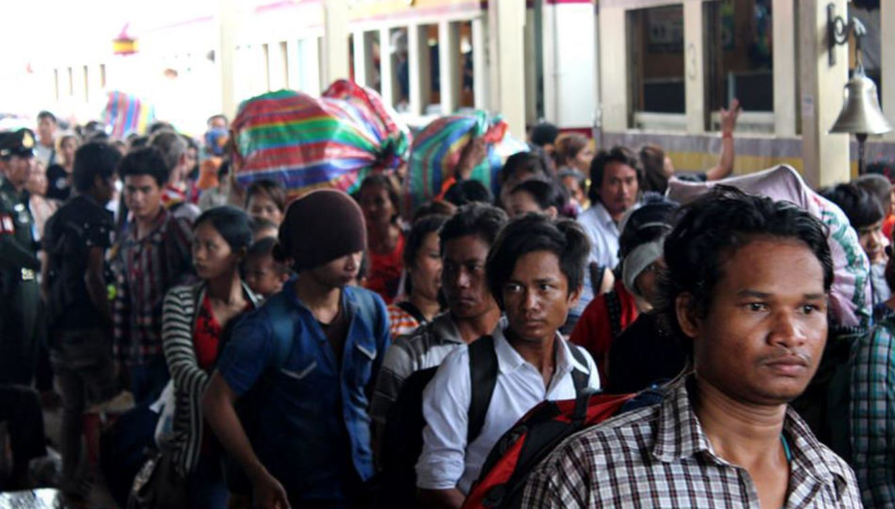

THANK YOU!

