Slide 1
Promoting Fair and Ethical Recruitment
UN Guiding Principles

Slide 2
Outline
UNDP’s Business and Human Rights in Asia
UN Guiding Principles on Business and Human Rights
Introduction of tools

Slide 3
UNDP Business and Human Rights in Asia

Slide 4
UNDP Business and Human Rights in Asia
For more info: https://bizhumanrights.asia-pacific.undp.org/content/bizhumanrights/en/home/our-work.html

Slide 5
UNDP Business and Human Rights in Asia

Slide 6
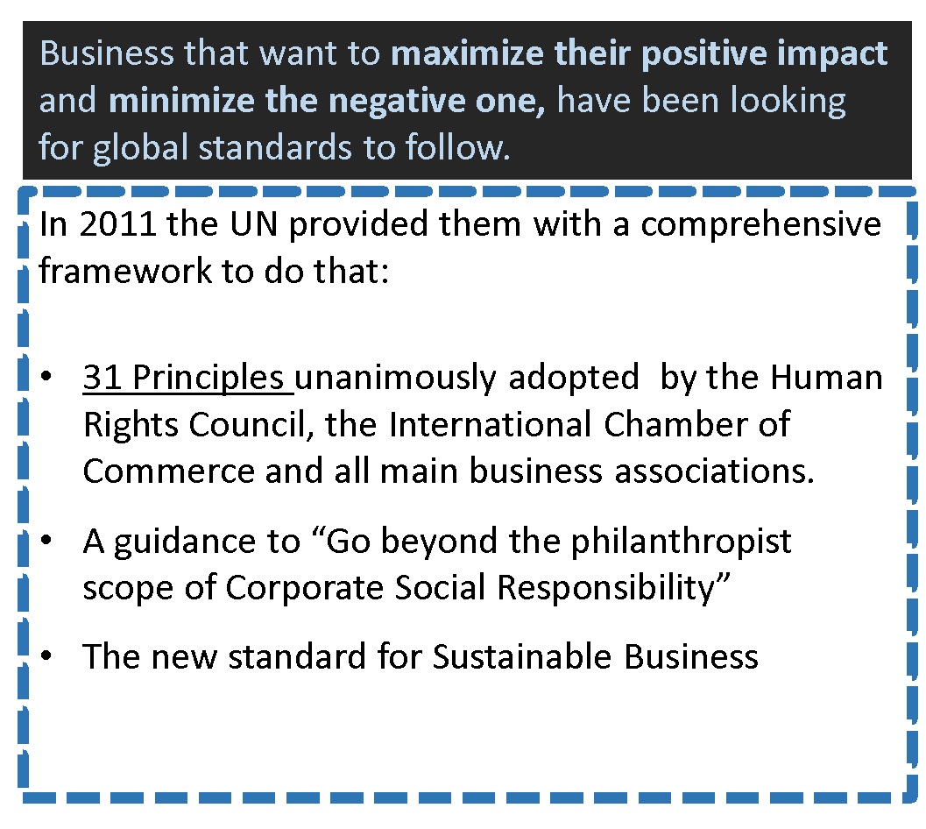

Slide 7
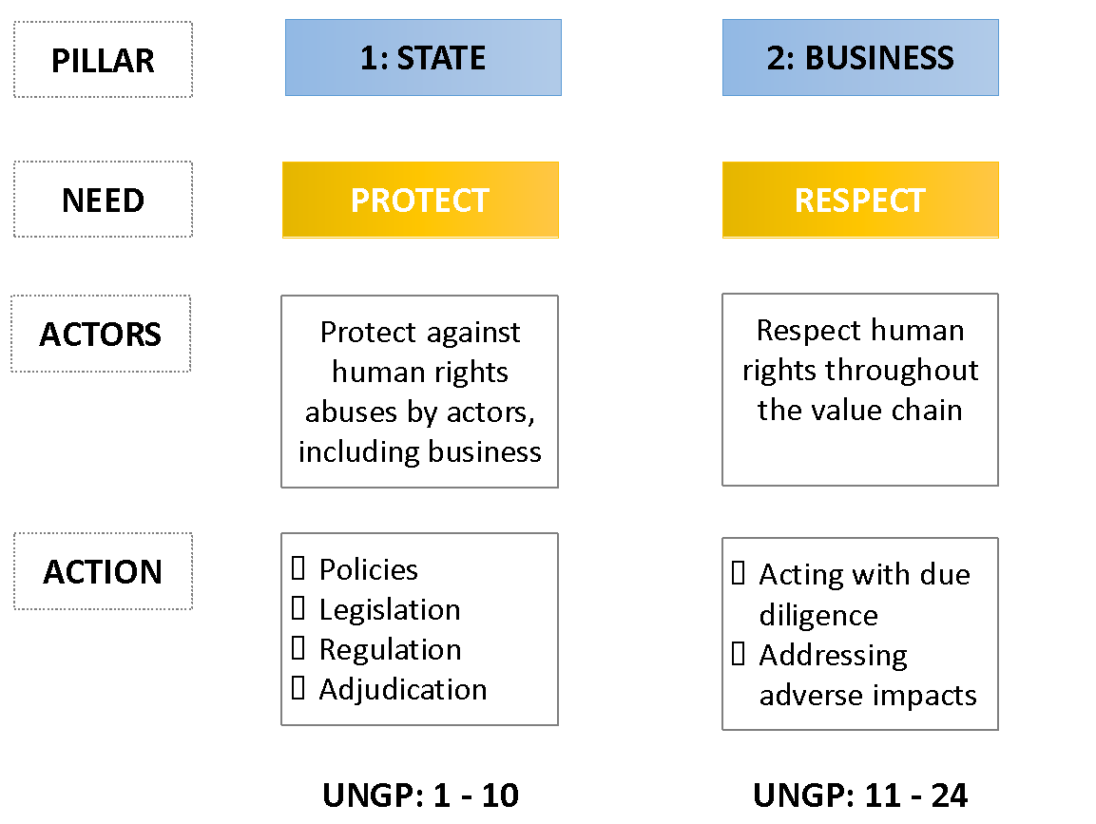
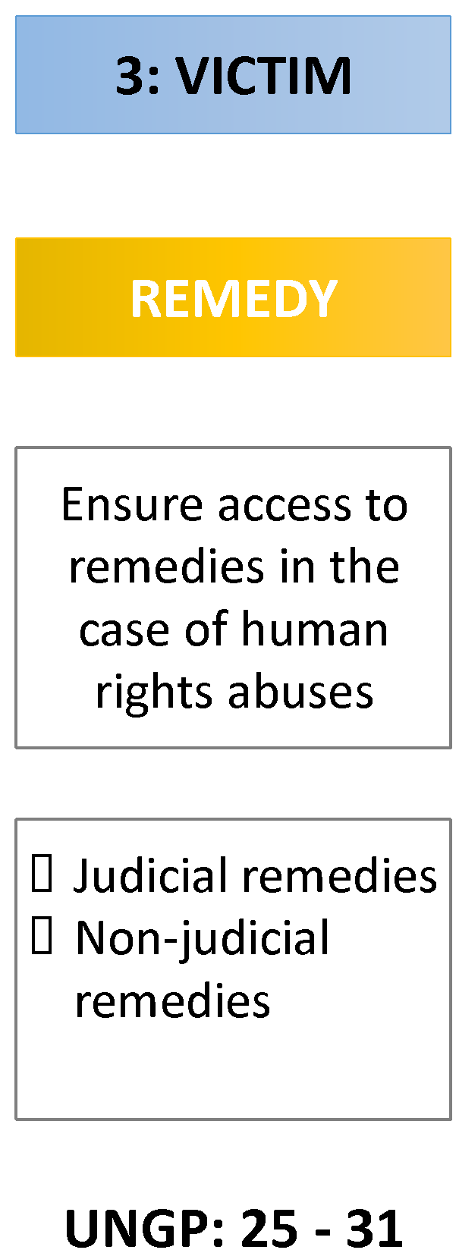
UN Guiding Principles
UNGPs Introduction (in Khmer): https://www.youtube.com/watch?v=UHTEvt15l04

Slide 8
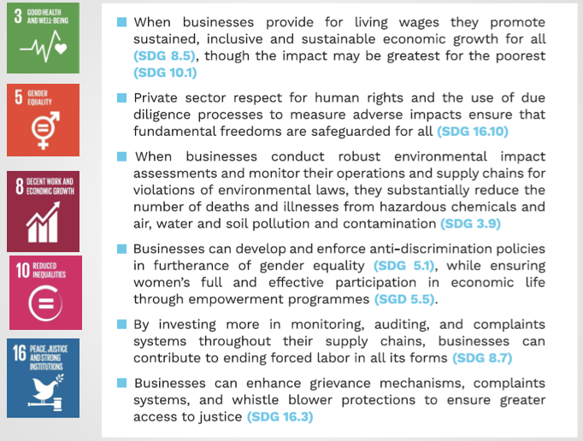
UN Guiding Principles and SDGs

Slide 9
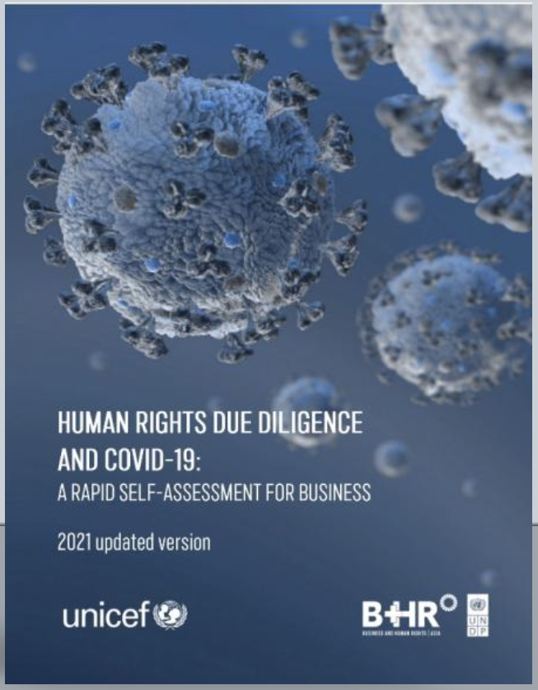
C19 Rapid Assessment
Objective: to provide guidance to businesses who are seeking to manage the human rights impacts of their operations during the COVID-19 pandemic
Available here: https://www.undp.org/publications/human-rights-due-diligence-and-covid-19-rapid-self-assessment-business

Slide 10
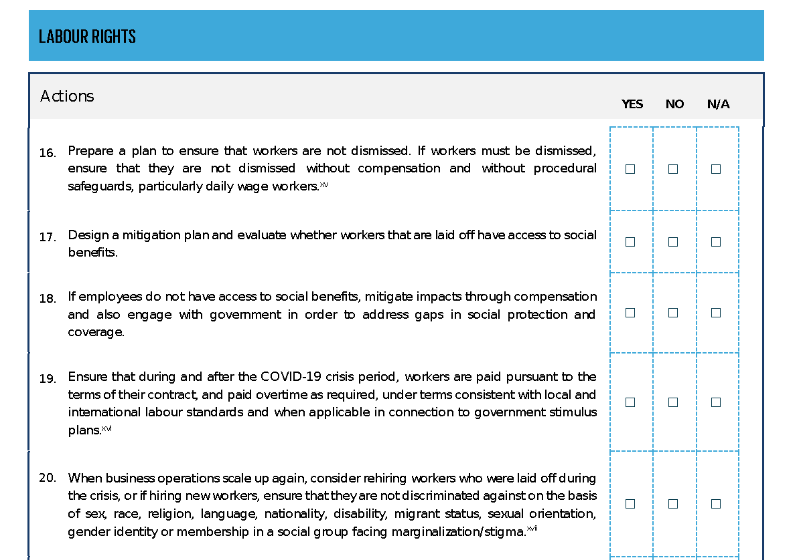
C19 Risk Assessment

