Slide 1


INDONESIAN IMMIGRATION RESPONSES TO
TRAVELLING CHILD SEX OFFENDERS
Andro Eka Putra © Directorate General of Immigration 2019

Slide 2
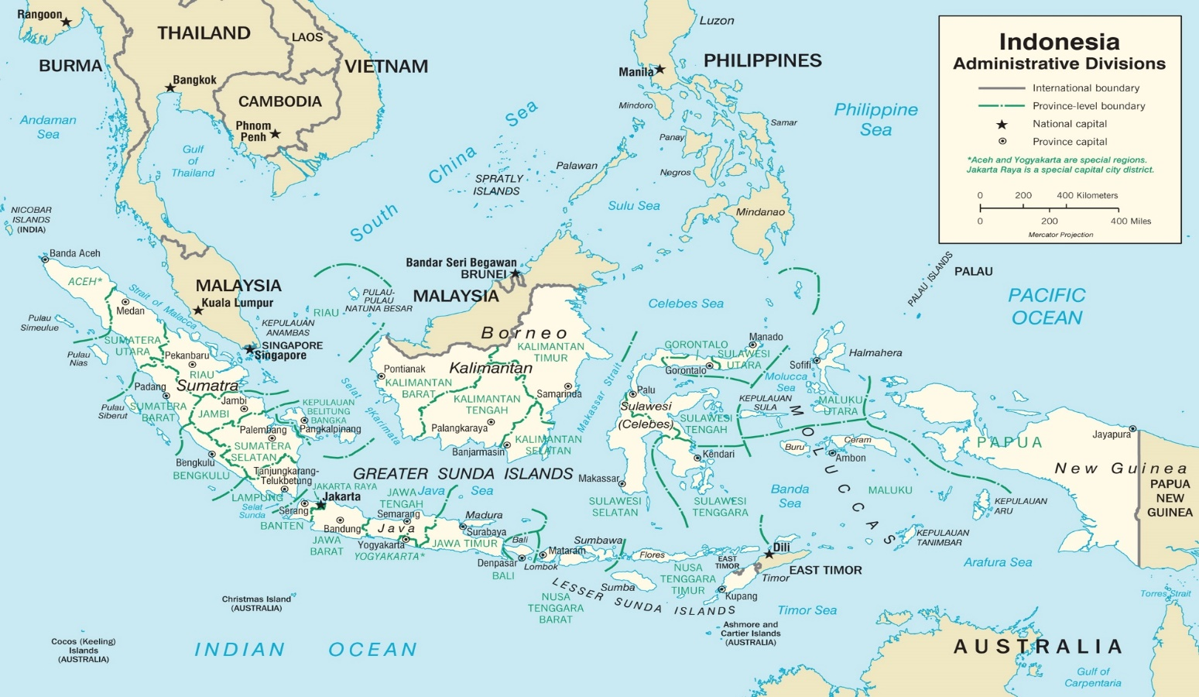
Let’s take a look at Indonesia

Slide 3

TOURISM IN INDONESIA
Tourism is one of the important sectors to boost Indonesia’s economic development
In 2015, the government introduced an ‘open door policy’
The number of foreign tourists to Indonesia has increased significantly over the year (from 8,5 million people in 2015 to 15,8 million people in 2018)
Notes:
https://www.thejakartapost.com/news/2019/02/01/indonesia-welcomed-15-8m-foreign-tourists-last-year-bps.html
Tourism will be targeted to almost 8 % of the Indonesian per capita GDP
Share about President Jokowi’s open door policy in 2015
IVAs 2015:8,5 million people; 2016 11,5; 2017 12,6
Top five countries to Bali: China, Australia, India, UK, Japan

Slide 4


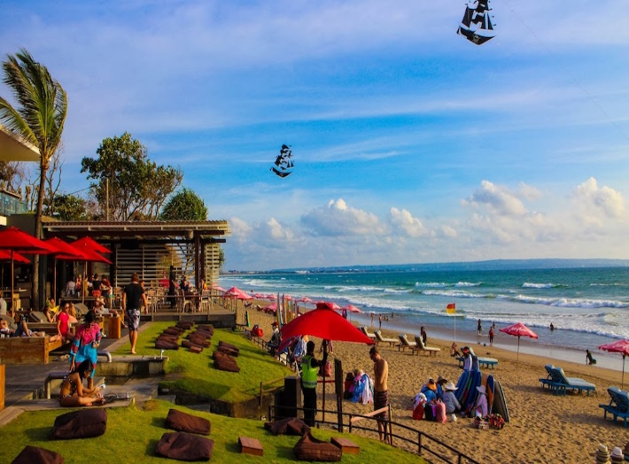
Bali - Indonesia
Notes:
Bali has its attractive surroundings both coastal and mountains.
Its beauty of nature has attracts many people to come to Bali for several reasons including holiday and honeymoon.
For some tourists, holiday in Bali is considered cheap

Slide 5
WHO ELSE IS
TRAVELLING ACROSS
OUR BORDER?

Slide 6
INDONESIA: THE NUMBER ONE DESTINATION FOR AUSTRALIAN CHILD-SEX OFFENDERS
Rank | Country | Jan - Mar 2013 | April - Jun 2013 | Jul - Sep 2013 | Oct - Dec 2013 | Jan - Mar 2014 | Apr - Jun 2014 | Jul - Sep 2014 | Oct - Dec 2014 | Total
1 | Indonesia |  |  | 55 | 108 | 62 | 68 |  |  | 293
2 | New Zealand |  |  | 34 | 51 | 37 | 39 |  |  | 161
3 | Thailand |  |  | 29 | 58 | 31 | 30 |  |  | 148
4 | Singapore |  |  | 16 | 65 | 19 | 19 |  |  | 119
5 | Malaysia |  |  | 9 | 48 | 16 | 24 |  |  | 97
6 | Philippines |  |  | 23 | 24 | 19 | 24 |  |  | 90
7 | Vietnam | 2 | 4 | 9 | 16 | 9 | 14 | 7 | 7 | 68
8 | New Caledonia/ Vanuatu |  |  | 11 | 31 | 11 |  |  |  | 53
9 | Fiji |  |  | 11 | 23 | 14 |  |  |  | 48
10 | Papua New Guinea |  |  | 16 |  | 17 |  |  |  | 33
Destinations visited by registered Australian child sex offenders in a 12 month period between 2013-2014
Notes:
Child sex offenders come to Indonesia from all around the world (Asia, Europe, United States, Africa and Australia).
As was discussed earlier, a child sex offender can be ANYONE.
But, in 2014, we received helpful information from the Australian Federal Police giving us an insight into the alarming situation of Australian child sex offenders.
Anyone in Australia who has been convicted of a child sex crime goes onto a national database. And, before they travel overseas, they had to notify the authorities.
Based on this database, the Australian Police identified an alarming problem. In 2013, Indonesia was the most common travel destination for Australia’s registers child sex offenders. Yes, they were choosing to vacation in Bali.
In fact, in a 12 month period between 2013/2014, almost 300 Australian registered offenders travelled to Indonesia. And, this is ONLY the number of registered offenders. We need to remember that most people who sexually abuse children have never been caught (so they don’t have a criminal conviction and do not appear in these numbers).
These figures are alarming. But, what is even more worrying is the potential harm even one child sex offender can cause.
Please don’t think these crimes don’t happen in Indonesia. Let me share some real case examples.

Slide 7
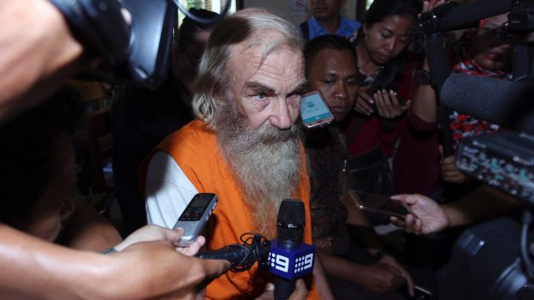
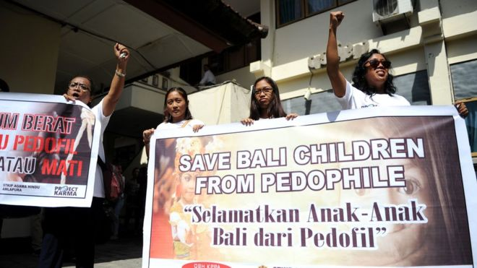
INDONESIA – CASE EXAMPLE
Robert Andrew Fiddes Ellis
Australian.
Stayed in Denpasar, Bali since 2013 using the Indonesian Retirement Visa scheme.
In 2016 sentenced to 15 years jail in Bali.
http://www.smh.com.au/world/accused-australian-paedophile-robert-ellis-says-he-doesnt-deserve-jail-20161018-gs59yd.html
Notes:
Provide details of the Robert Andrew Fiddes Ellis case in Bali.
Discuss details of the case, the delusional thoughts and behaviours of child sex offenders.

Slide 8
WHAT IS IMMIGRATION INDONESIA DOING ABOUT TRAVELLING CHILD SEX OFFENDERS?

Slide 9
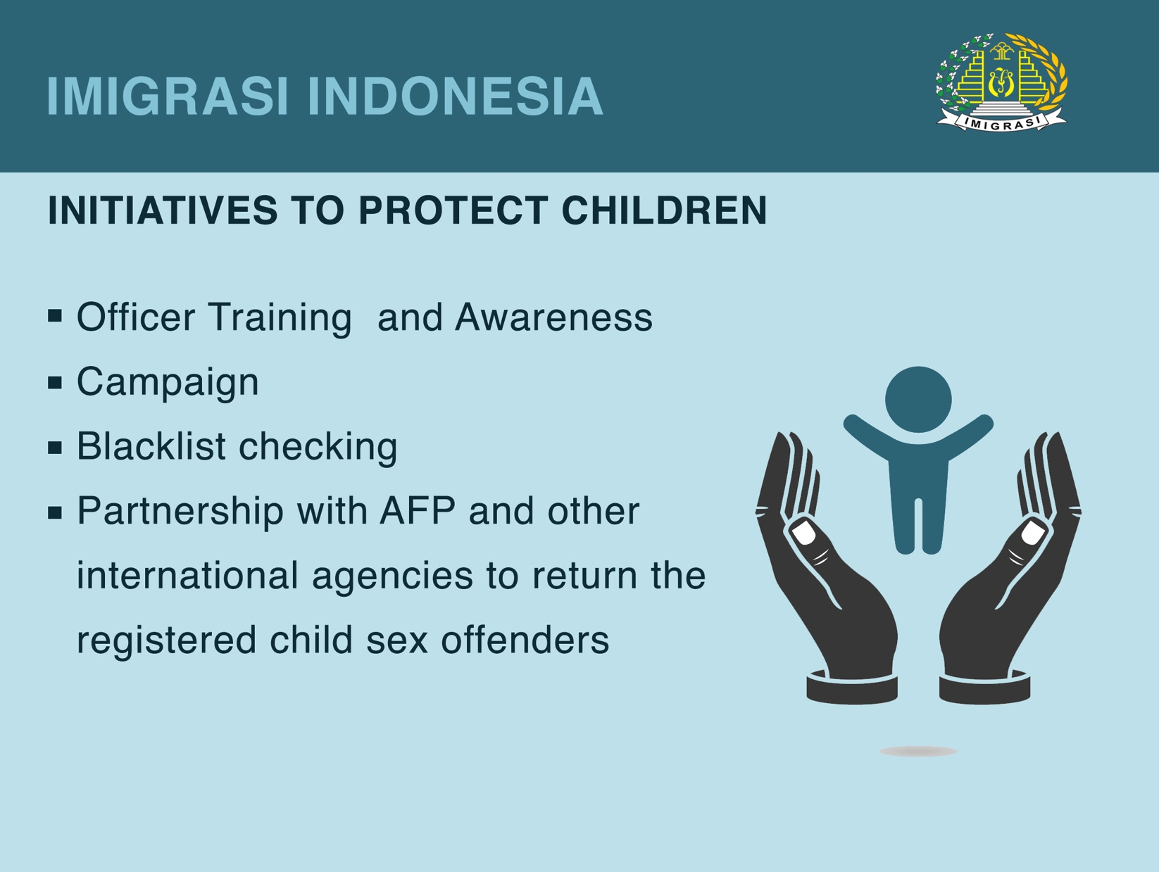

Slide 10

PARTNERSHIP BETWEEN
IMIGRASI AND AFP TO PREVENT ENTRY OF
KNOWN AUSTRALIAN CSOS
Start from people to people channel
Informal networking
Sharing intelligence information
Taking actions
Supported by the headquarter (Directorate General)

Slide 11
Deal with angry CSOs
Threats from the CSOs, such as: intimidating an officer using a lawyer
Previously difficult to track CSOs’ passenger/s
Found a case whereby an Australian registered offender has been
married to an Indonesian
SOME CHALLENGES?

Slide 12
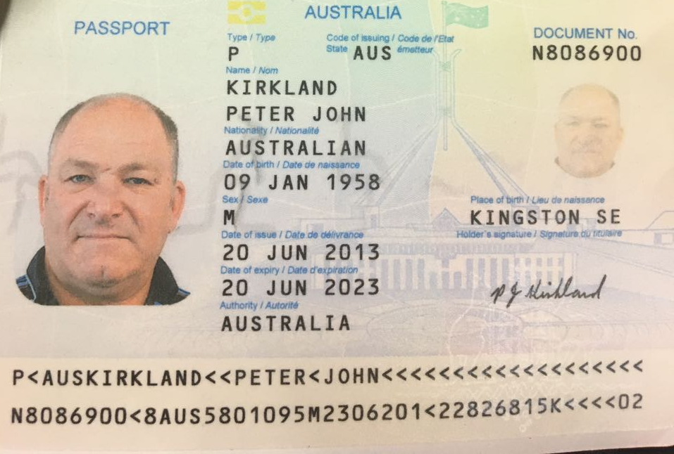
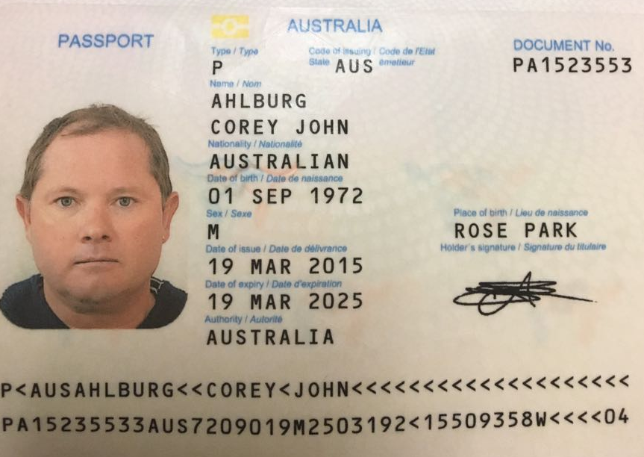
REGISTERED CHILD SEX OFFENDERS
Peter John Kirkland
Corey J Ahlburg

Slide 13
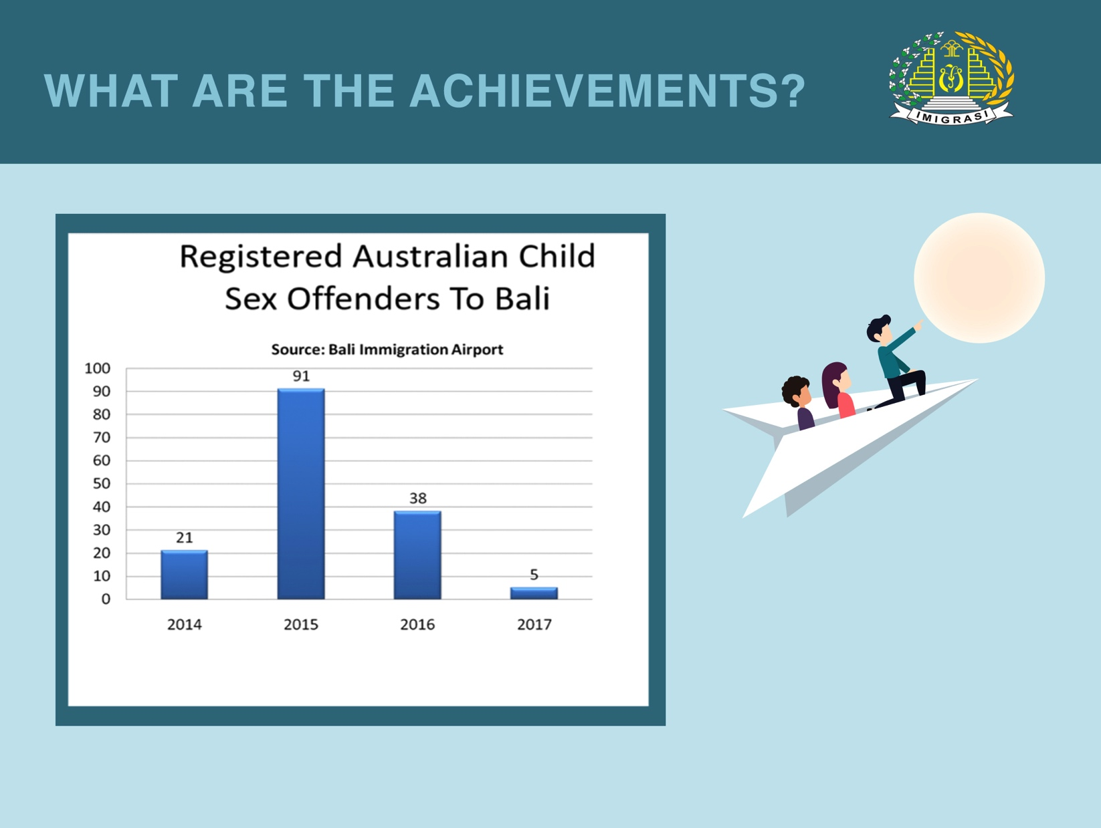
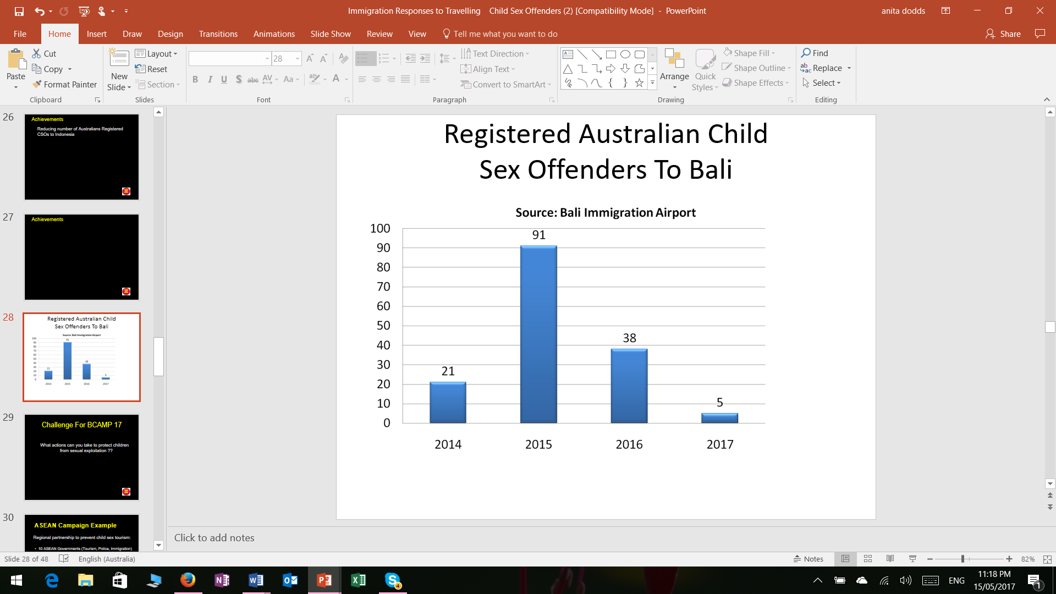

WHAT ARE THE ACHIEVEMENTS?

Slide 14

IMMIGRATION IS THE FRONTLINE IN
PROTECTING CHILDREN FROM TRAVELLING CHILD
SEX OFFENDERS

Slide 15

Notes:
EMPHASISE:
Child protection starts with us.
If you don’t take responsibility, who will?
REMINDER:
HANDOUT 8 – DID YOU KNOW?
Discuss the key facts about child sexual exploitation as a reminder.

Slide 16


ANDRO EKA PUTRA
HEAD OF IMMIGRATION COOPERATION
WITH THE INDONESIAN REPRESENTATIVE
OFFICE REGIONAL 1 SECTION
DIRECTORATE GENERAL OF IMMIGRATIONandroekaputra@yahoo.com

