Slide 1
PROTECTING CHILDREN FROM FOREIGN CHILD SEX OFFENDERS Phnom Penh 2019

Slide 2
Welcome
Notes:
Welcome the participants
Introduce VIPs, Project Partners and Guest Speakers

Slide 3
Who are you?
Notes:
ACTIVITY: PARTICIPANT INTRODUCTIONS
HANDOUT: ENTRY SURVEY
Explain the importance of assessing the usefulness of the training. Advise the participants they can assist by completing a short survey at the beginning and conclusion of the training. Distribute the survey and allow time for participants to complete.

Slide 4
Learning Agreement
Switch phones to silent
Keep to schedule
Contribute to discussions
Ask questions
Notes:
ACTIVITY: DEVELOPING A LEARNING AGREEMENT
Ask the group, ‘What rules should we adopt to help make this an enjoyable and productive training for everyone?’
Mobile phones on silent.
Ask questions if I don’t understand anything.
Begin breaks on time/return from breaks on time.
Respect others when they speak.
Sensitive experiences of others won’t be shared outside the class room.

Slide 5
Why are we here?
Notes:
BRIEF OVERVIEW
EXPLAIN: We are working in the greatest era of human mobility. People are travelling more than ever before. Most international travellers are responsible citizens who make a positive impact during their travel. But, we are also aware of the negative side of travel.
DISCUSS: Today and tomorrow, we’re going to share about an increasing international concern – travelling child sex offenders. And online child sex offenders.
But, first we’re interested to know what you already know.

Slide 6
Notes:
GROUP ACTIVITY:
Explain Thailand’s motto for foreign travellers.

Slide 7
What will I learn?
What is child sexual exploitation in tourism?
What is online child sexual exploitation?
How can we protect children in Cambodia?
What can we do to prevent, detect and respond to these crimes against children in Cambodia?
Notes:
DISTRIBUTE
HANDOUT –Training Agenda
EXPLAIN
Provide an overview of the key topics that will be covered during the training.
ASK
Ask the participants if they have any questions.
Advise the participants to let you know if there is anything missing from the agenda which could help them to address these issues in their workplace.

Slide 8
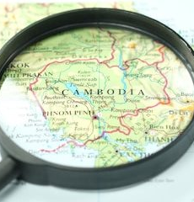
Cambodia is not immune from transnational child sex crimes
Notes:
EXPLAIN
Often we think that transnational crimes such as Child Sex Tourism or Online Child Sexual Exploitation happen in other countries.
But, Cambodia is not immune from transnational child sex crimes.

Slide 9
Transnational child sex crimes
Sexual Exploitation of Children in Travel and Tourism
Online Sexual Exploitation of Children
Child Sex Trafficking
Notes:
EXPLAIN
What are the key transnational child sex crimes?

Slide 10
Why do we need to talk about sex?
Notes:
.EXPLAIN
Acknowledge the taboo of sexual discussions, but respect that discussion on sex for the purpose of child protection is essential.
Ensure the class understands that this training will involve discussion about child sexual exploitation and use sexual terminology.
Advise that if anyone feels uncomfortable, they can advise the trainer.

Slide 11
What is child abuse?
Child abuse and exploitation is a global problem.
Millions of children are harmed every year.
Many of these children experience multiple and compounding forms of abuse.
Notes:
EXPLAIN
Child abuse and exploitation are not particular to any country. These problems occur in every country of the world.
UNICEF advises that ‘millions of children worldwide from all socio-economic backgrounds, across all ages, religions and cultures suffer violence, exploitation and abuse every day, and millions more are at risk’.
It is common for children to experience multiple forms of abuse on a regular basis – rather than isolated cases of abuse.
For example, a child may be neglected by the parents and move to the streets where they are become victims of physical assault and suffer emotional abuse.

Slide 12
What types of abuse exist?
Notes:
HANDOUT: What is Child Abuse? Poster
EXPLAIN
The World Health Organisation explains that ‘Child abuse constitutes all forms of physical and/or emotional ill-treatment, sexual abuse, neglect or negligent treatment or commercial or other exploitation, resulting in actual or potential harm to the child’s health, survival, development or dignity in the context of a relationship of responsibility, trust or power.’
Child abuse can be distinguished in four key sub groups:
Physical Abuse
Physical abuse occurs when a person purposefully injures or threatens to injure a child. This includes hitting, punching, shaking, kicking, burning, shoving, suffocating, holding/tying down, poisoning or restricting a child’s movement.
Emotional Abuse
Emotional abuse is persistent and severe emotional mistreatment. Emotional abuse attacks a child’s self esteem. It can take the form of name calling, threatening, ridiculing, intimidating or isolating a child. It is important to remember that all forms of child abuse have an emotional impact.
Sexual Abuse
Sexual abuse occurs when someone involves a child in a sexual activity by using their power over them or taking advantage of their trust. Child sexual abuse includes sexual touching; making abusive images/photographs/videos of children; forcing children to watch or take part in sexual acts; or forcing/coercing children to have sex or engage in sexual acts with other children or adults.
Neglect
Neglect is the extreme failure to provide a child with important aspects of care such as protecting them from exposure to danger or withholding medical attention, or the basic things needed for their growth and development (such as food or shelter).

Slide 13
What is child sexual exploitation?
Notes:
HANDOUT – What is Child Sexual Exploitation?
EXPLAIN
Child sexual exploitation occurs when someone involves a child in a sexual activity by using their power over them or taking advantage of their trust.
Child sexual exploitation includes all forms of unwanted sexual behaviour. This can involve touching or no contact at all.
Child sexual exploitation includes:
making abusive images/photographs/videos of children.
forcing children to watch or take part in sexual acts.
forcing/coercing children to have sex or engage in sexual acts with other children or adults.

Slide 14
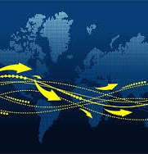
Child sexual exploitation is a rapidly growing transnational crime
Notes:
EXPLAIN
Many of us think about child sex crimes within the family or within our country. But, Child Sexual Exploitation is no longer a domestic crime.
It involves criminals and criminal networks that operate around the world. Today, more than ever before, our children are at risk from international child sex offenders.
Tourism and digital technology make it much easier for criminals to access our children for sexual exploitation.

Slide 15
Why should I protect children?
Notes:
ACTIVITY
Ask participants to stand-up (or put their hand-up, if more suitable for the audience) if they have children.
While these participants remain standing, address the seated participants and ask them to stand if they have a sister, brother, niece or nephew under 18.
ASK
Most of us either have children or have relatives who are still children. All of us have been children. So, we know, from our own experience, the situation of children.
EMPHASISE
We all have a responsibility to protect children from sexual exploitation. Today, we will learn about the risks and how we can protect children in the tourism sector and online environment. We’ll also learn what other officers around he world are doing to protect children.

Slide 16
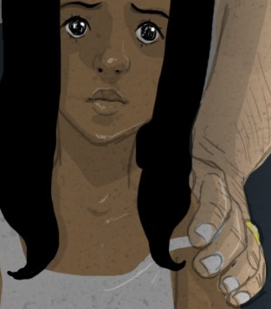
What is Child Sexual Exploitation in Travel and Tourism?
Notes:
EXPLAIN
Provide a brief explanation of child sex tourism.
Tourism is one of the fastest growing industries in the world. Tourism promotes positive and enjoyable themes such as holidays, recreation, leisure, adventure and fun. So, we might wonder how child abuse and tourism are connected.
But there are key risks to children that are directly related to tourism.

Slide 17
What is child sexual exploitation in travel and tourism?
The commercial sexual exploitation of children by men or women who travel from one place to another (usually from a richer country to one that is less developed) and there engage in sexual acts with children.

Slide 18
What is Online Child Sexual Exploitation?
Notes:
EXPLAIN
Mass use of the Internet and new technologies have amplified the production and circulation of illegal child sexual abuse materials and have increased
the incidence of grooming for sexual abuse and the conduct of other forms of exploitation, including live streaming of child sexual abuse.
The growth of the internet and digital technology has presented many global benefits.
However, there is a dark side, and rapid growth of technology presents inherent risks for children.

Slide 19
What is online sexual exploitation of children?
Any form of sexual abuse and exploitation that has a link to the internet and related devices.
Including acts of sexual abuse that are photographed or video-/audio-recorded and then uploaded and made available online.
Notes:
EXPLAIN
Mass use of the Internet and new technologies have amplified the production and circulation of illegal child sexual abuse materials and have increased
the incidence of grooming for sexual abuse and the conduct of other forms of exploitation, including live streaming of child sexual abuse.
Online child sexual exploitation involves:
Sending, uploading or accessing child sexual abuse images through telecommunications services such as computers with internet connectivity or mobile phones.
Grooming and procuring children for sexual exploitation over the internet.

Slide 20
Child Sexual Exploitation in Travel and Tourism
Notes:
EXPLAIN
This morning we will examine child sex tourism in more detail (including the victims, offenders, cases, examples).
Then, this afternoon we will examine online child sexual exploitation.

Slide 21
What is this?
Notes:
EXPLAIN
This map shows the chart of international plane routes.
Volume of international air traffic is rapidly expanding.

Slide 22
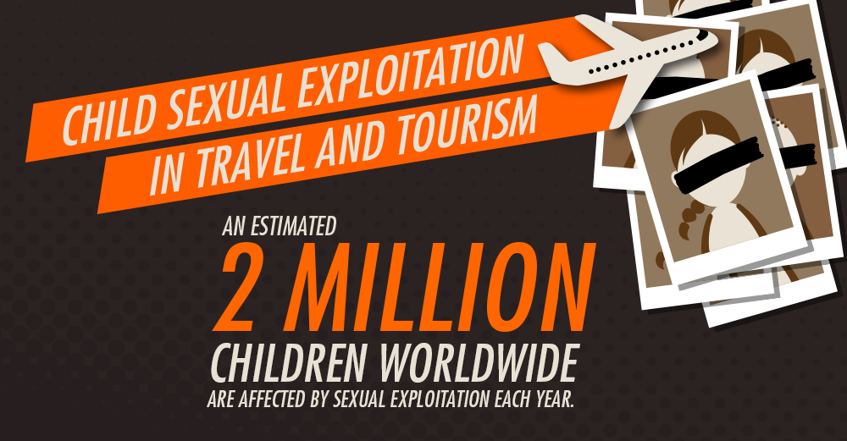

Slide 23
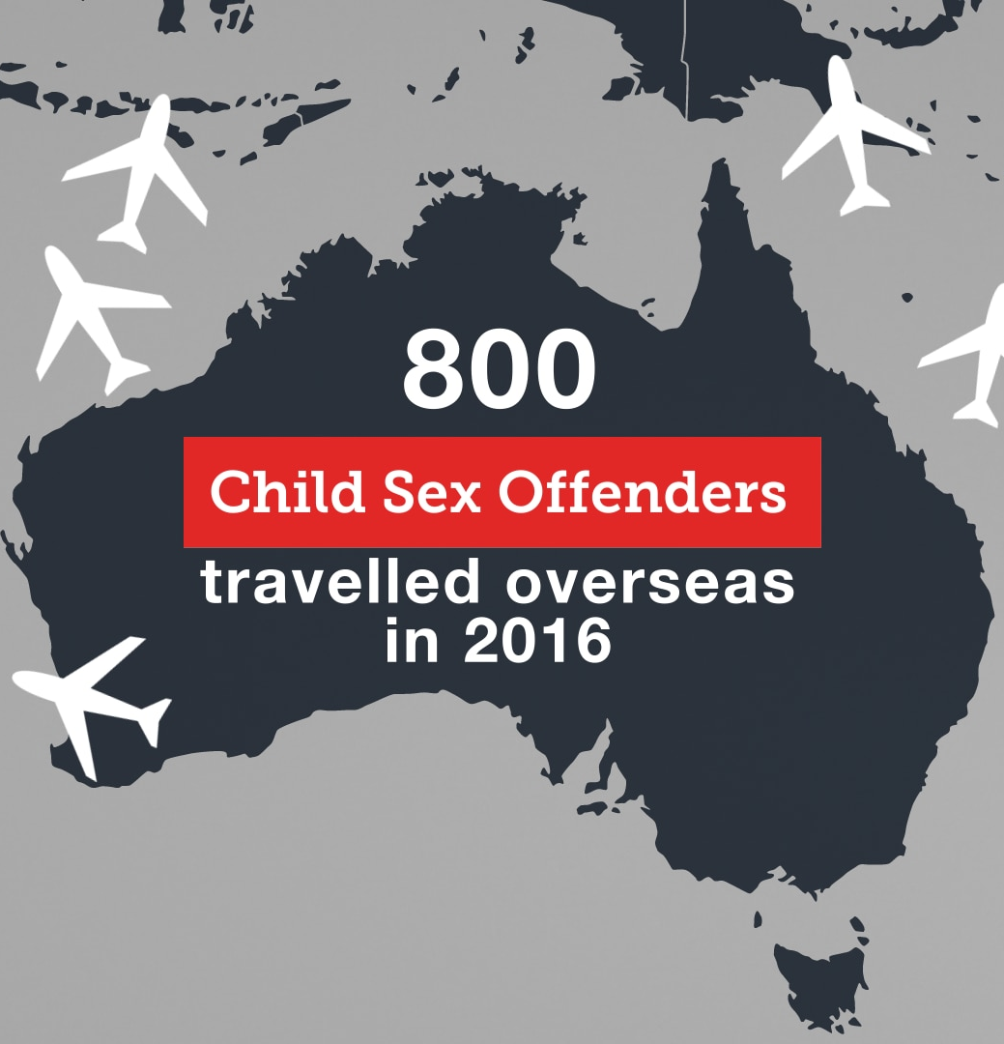
Who is crossing your border?
Notes:
ASK: Do you know who is crossing your border and entering Cambodia.
For example, 800 Australian known offenders travelled overseas in 2016
How many travelled from other countries?
And note that most offenders do not have a criminal record, so the numbers are actually much higher.

Slide 24
What is child sexual exploitation in travel and tourism?
The commercial sexual exploitation of children by men or women who travel from one place to another (usually from a richer country to one that is less developed) and there engage in sexual acts with children.
Notes:
EXPLAIN:
Read and explain the definition of child sexual exploitation in travel and tourism.
EXPLAIN:
The majority of travellers are responsible citizens who wish to make a positive contribution during their travel. However, some tourists cause harm when their travel and a small percentage travel to sexually exploit children. The damage caused by these travellers is horrific.

Slide 25
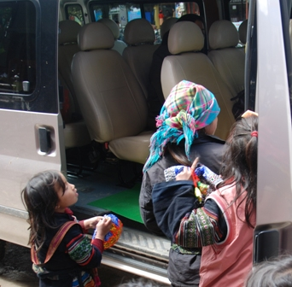
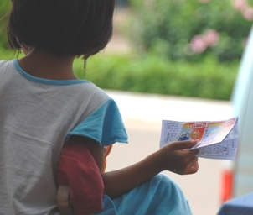
How are children exploited in tourism?
Notes:
EXPLAIN
Children’s vulnerability to exploitation is heightened by multiple factors including poor economic status, lack of education, difficult family situation, homelessness, migration, family debt, weak law enforcement, and their experience of other forms of abuse (such as neglect).
Due to the economic pull factors of the tourism sector, there is a strong correlation between child exploitation and tourism.
Both girls and boys are vulnerable to multiple forms of exploitation resulting from travel and tourism, including:
Begging
Working as street vendors (selling souvenirs, snacks, lottery tickets, cigarettes, postcards, shoe shine).
Working in the tourism industry at a young age (including in restaurants, cafes, karaoke clubs, bars, hotels) where they lack adequate conditions and miss out on going to school).
Sexual exploitation by foreign tourists who seek to have sex with children while they are travelling .
Children earning money from tourists are less likely to go to school and face heightened vulnerability to other forms of exploitation, including sexual abuse.

Slide 27
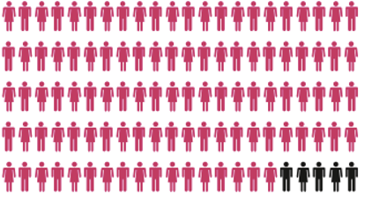
95% of travellers encounter local children in tourism areas.
Notes:
EXPLAIN:
Tourists regularly interact with local children on their holidays.
In a recent survey, 95% of travellers said that they encounter and interact with local children in tourism areas while they are on holidays.

Slide 28
How do tourists interact with local children?
ACTIVITY:
Make a list of the ways that tourists interact with local children.
Notes:
ACTIVITY
Ask participants to write a list of the ways in which tourists might encounter and engage with local children.
Invite participants to share their answers. Write the answers on the white board or flip chart and try to categorise whether the interaction is direct/indirect, on the street or through their clients, etc.
ANSWERS CAN INCLUDE:
Taking photographs, playing together, when visiting the capital – passing by schools, during home stay visits, giving gifts to local children, visiting local schools, etc.

Slide 29
How does tourism facilitate child sexual exploitation?
Notes:
EXPLAIN
When they are travelling, offenders utilise services of the travel and tourism industry (e.g. hotels, guesthouses, taxis, etc).
When child sex offenders face strict laws in their own countries regarding access to children, they target countries with less stringent protocols.
Poor socio-economic conditions make children vulnerable in destination countries; children may be from displaced communities and other marginalised social groups, may have also been victims of other forms of abuse/neglect, working children in tourism destinations, minority groups.
Travelling child sex offenders use a variety of methods:
some make advance arrangements to abuse children in specific locations;
some take advantage of holiday environments to abuse;
some travel abroad to locations where children are reported to be available for sex;
some use the internet to abuse children in foreign countries;
some work as volunteers/teachers/doctors abroad and abuse children they meet through their work in NGOs, orphanages, schools, medical clinics, etc.

Slide 30
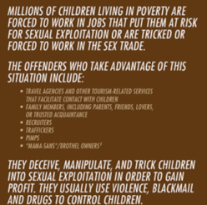
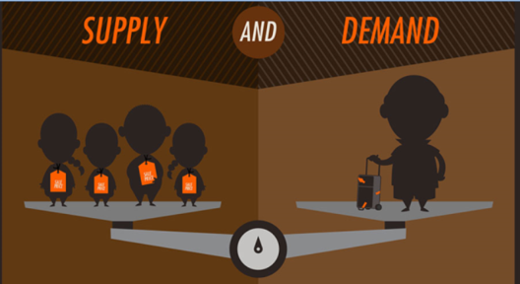
What are the causes?
Notes:
EXPLAIN:
Child sexual exploitation involves demand and supply.
Briefly discuss some of these factors.
Importantly, please point out that poverty is NOT the only cause of child sexual exploitation in travel and tourism.

Slide 31
Why does child sexual exploitation happen in tourism destinations?
OFFENDERS
DEMAND
Psychosocial problems
Lack of inhibitors
Absence of deterrents
Criminal deviancy
Sexual perversion
Cultural ignorance
Cultural supremacy
Gender discrimination
CHILDREN
SUPPLY/ACCESS
Economic problems
Poverty
Debt recovery
Corruption
Poor Education
Urban Migration
Family Breakdown

Slide 32
What have you seen or heard?
Do you know of any cases of child sexual exploitation relating to foreign child sex offenders?
Notes:
ACTIVITY: GROUP DISCUSSION
Ask the group what they have seen or heard in their workplace, in their neighbourhood, in their community, in the media regarding child sexual exploitation that is linked to tourism.
If participants don’t have examples from their own countries, ask what they know from other countries.
FACILITATOR NOTE
Participants may discuss other forms of sexual abuse such as rape, adult prostitution, incest, etc. In these instances, acknowledge that these are also serious crimes against children, but steer the discussion back to the definition and focus on child sexual exploitation in tourism.
Listen to the stories that the participants share before moving to the next slide.

Slide 33
Where are foreign offenders travelling?

Slide 34
Who are the offenders?
Notes:
ACTIVITY
Ask the participants to describe or draw a travelling child sex offender. What are their characteristics?
Then, breakdown the stereotype and explain that it’s important that we look beyond the stereotype.

Slide 35
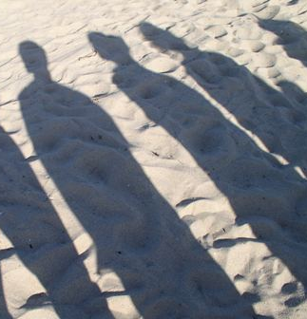
Who are the offenders?
‘Tourists, travellers or foreign residents who commit sexual abuse in the country or countries in which they are visiting or living.’
Notes:
EXPLAIN:
A child sex offender can be ANYONE!

Slide 36
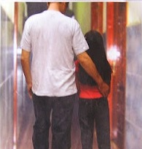
Who are the offenders?
Child-sex offenders can be:
men or women
highly educated or poorly educated
single or married
wealthy travellers or budget backpackers
professionals including doctors and teachers
old people and young people
tourists, expatriates, diplomats, business travellers,
volunteers
any nationality
Notes:
EXPLAIN
Travelling child sex offenders are tourists, travellers or foreign residents who commit child sexual abuse or exploitation in the country or countries in which they are visiting or living.
There is no stereotype of a travelling child sex offender. Travelling child sex offenders come from all countries and all walks of life.
They may be expatriates living in a foreign country, business travellers or short term tourists.
They may be working in a professional field (such as teachers or doctors – professions in which offenders can build a relationship with children before they abuse them).
They can be men or women.
They can be adults of any age.
It is not possible to identify a travelling child sex offender by their appearance. Instead, it is important to be aware of risky situations for children and suspicious behaviour displayed by adults.
NOTE
It is important to note that children are most likely to be abused by those known to them – and child sexual exploitation is not just a ‘foreign’ problem.
CASE STUDIES
Provide case study examples from Asia and internationally.

Slide 37
How do offenders operate?
Offenders use many methods to exploit children, including:
Making advance arrangements.
Taking advantage of holiday environments.
Travel to places where children are available for sexual abuse.
Use the internet to abuse children in foreign countries.
Work as volunteers or professionals to abuse children they meet through their work.
Use local procurers and networks to find and abuse children.
Notes:
SHARE:
Share some case examples to outline how offenders operate.

Slide 38
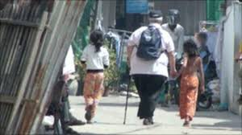
What could be happening here?
Notes:
ACTIVITY: PHOTO REVIEW
Show each image and ask the participants what might be happening in the scene.
TRAINER NOTES
The purpose of this activity is to encourage the participants to begin recognising activities/behaviours which indicate that children are may be vulnerable or at risk of exploitation.
Keep the discussion focused on recognising the indicators (as other scenarios follow in which participants determine what action they will take).
Encourage participants to identify both legitimate and illegal scenarios. For example, scenario one might be a situation of potential risk, it might also be a situation where the man has an Asian wife and this is his biological child.

Slide 39
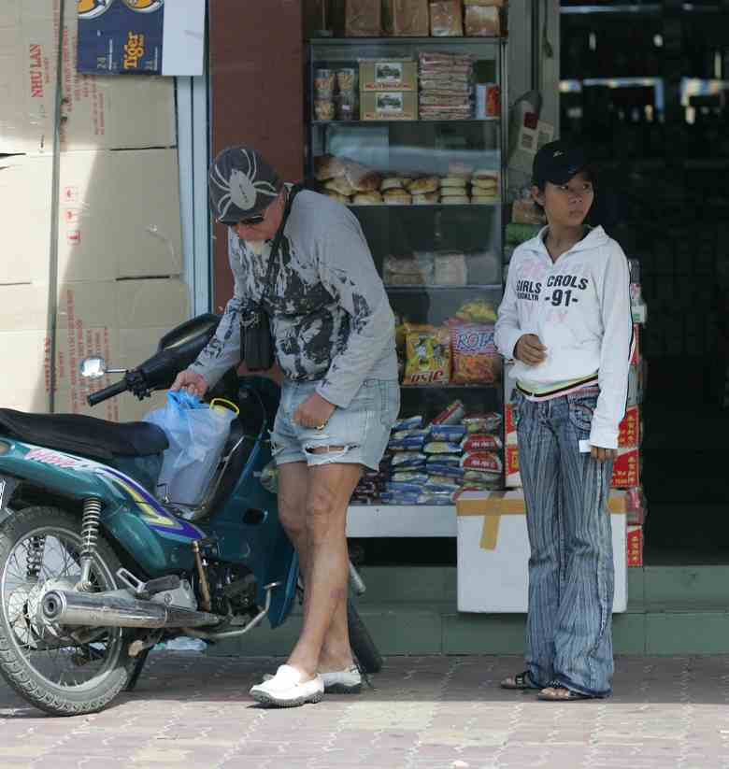
What could be happening here?

Slide 40
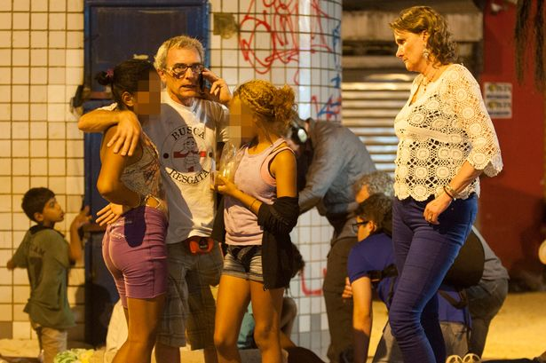
What could be happening here?

Slide 41
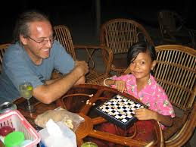
What could be happening here?

Slide 42
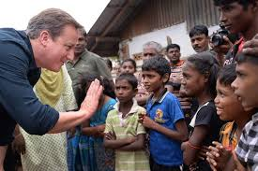
What could be happening here?
Notes:
Yes, this is a photo of ex-British PM David Cameron meeting children at an NGO project. This is an important reminder that we need to be careful of our perceptions.
It is important to remind participants not to make false accusations. Emphasise that it is their role to take appropriate action to prevent risk.

Slide 43
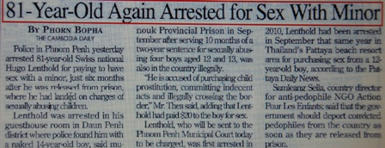
Who are the offenders? Case studies
Notes:
EXPLAIN
Tourists interaction with children can have a positive impact, but there are also risks. Let’s look at what’s been happening in other countries.
HANDOUT – Media Case Studies
Distribute the media case studies, and invite the participants to read.
ASK
From reading these articles, what do you notice about:
The nationality of the offenders?
The age/gender of the offenders?
The age/gender of the victims?
The way in which the offenders lured/enticed the children?

Slide 44
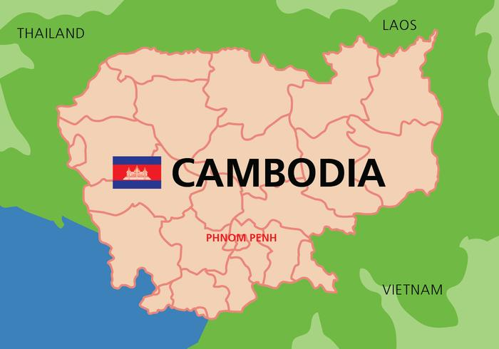
Let’s take a look at Cambodia.

Slide 45
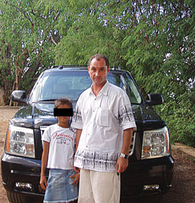
Cambodia
Notes:
A Russian pedophile controversially pardoned in Cambodia's largest-known child sex scandal will be deported after he was arrested at the home of a teenage girl.
Alexander Trofimov, who built a $US300 million ($A309.71 million) tourist resort in the country, was arrested at the house of an underaged girl outside of Phnom Penh, police spokesman Kirt Chantharith told AFP, adding authorities will try to deport him shortly.
"Police arrested him (on Monday) ... while he was hiding with a local family," Chantharith said, adding that the Russian "loved the family's daughter, who is 11 or 12 years old".

Slide 46
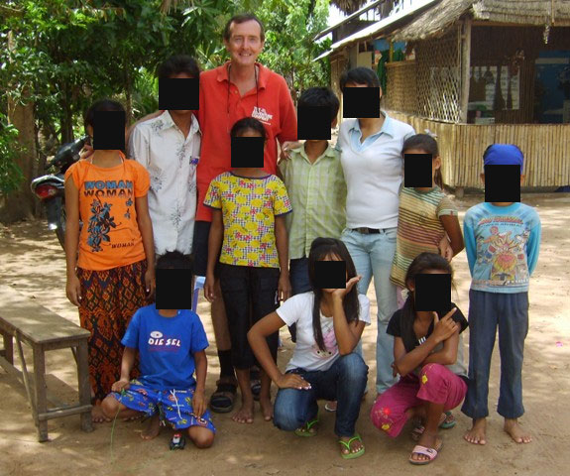
Cambodia
Notes:
The British founder of a Cambodian orphanage is facing prosecution for sexually assaulting a boy in his care. Nicholas Griffin, 52, was held when police raided his isolated base in countryside near Siem Reap, in the north-west of the country. Up to 100 children were moved to a safe house in an operation that involved British and local investigators. Mr Griffin, originally from Wales, left Britain in 2006 before founding the Cambodia Orphan Fund, one year later. He faces a potential 10-year jail sentence over a claim he sexually assaulted a 15-year-old boy.

Slide 47
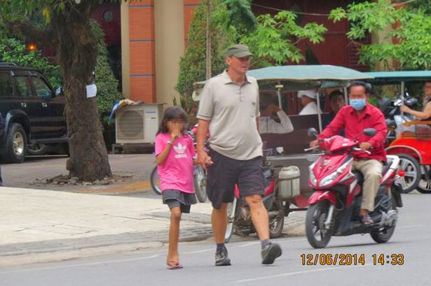
Cambodia
Notes:
The moment suspected paedophile was snapped hand-in-hand with Cambodian 11-year-old girl
Michael Jones, 55, has been charged with carrying out indecent acts against minors and paying for child prostitution

Slide 48
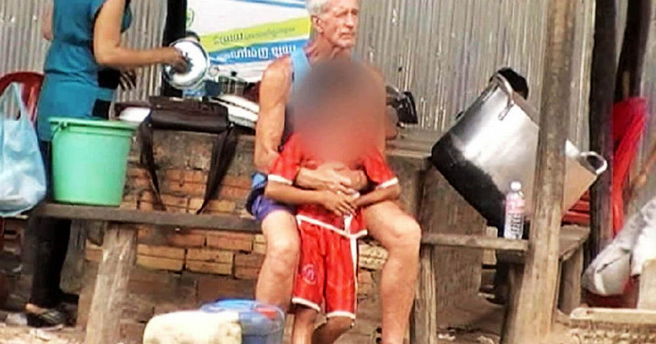
Cambodia
Notes:
Exposed: Devious Brit pervs who fly to poverty stricken Cambodia to prey on kids
Undercover investigation reveals how disturbingly simple it is for sick men to "buy" girls and boys for sex

Slide 49
Who are the victims?
Notes:
EXPLAIN
Victims can be any children aged 17 and under.
(All ASEAN countries are signatory to the Convention of the Rights of the Children which recognises a child as anyone under 18.)

Slide 50
Who are the victims?
The victims are children:
Girls and boys.
Aged between 0-17 years old.
Any economic bracket – although frequently poor.
Any education level – although often little schooling.
Children with disabilities may be at increased risk.
Often victims of other forms of abuse and exploitation.
Notes:
EXPLAIN
It is important to remember that victims can be boys and girls. According to the UN Convention on the Rights of the Child, a child is anyone under the age of 18 years old. Victims can be any age between 0 – 18 years. Around the Asian region, law enforcers are reporting that the age of victims is becoming lower and lower.
Child victims tend to come from disadvantaged circumstances. They are often poor, living on the streets/beach, not attending school, from ethnic minority communities or broken families. Victims have often experienced other forms of abuse in the home or on the streets.
However, victims may also come from middle and higher income families. They can be influenced by materialism and consumerism (often linked to peer pressure). And, they may be unaware of the dangers relating to their situation.
Children should never be seen as responsible for their exploitation. Children are always victims. Adults are responsible for protecting children from this abuse.

Slide 52
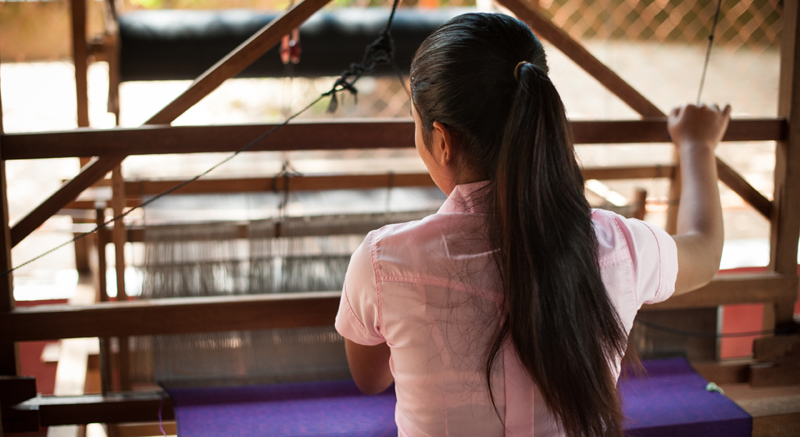
Srey’s Story
Notes:
SHARE

Slide 53
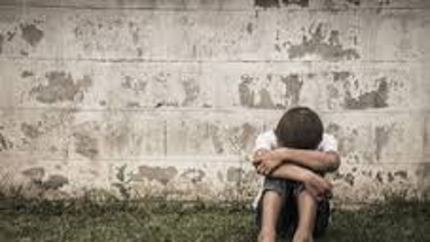
Vinh’s Story
Notes:
SHARE

Slide 54
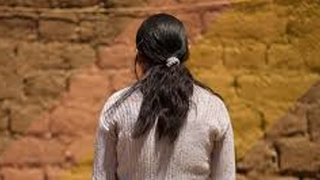
Thao’s Story
Notes:
SHARE

Slide 55
What is the impact of foreign child sex offenders?
ACTIVITY:
In your team, discuss the impact of foreign child sex offenders
Children
Families
The tourism sector
The local community
Team One
Team Three
Team Four
Team Two
Notes:
EXPLAIN
There is significant evidence that exploitation and abuse has serious affects on children which result long-term adverse consequences. The consequences of exploitation and abuse also extend beyond the immediate victims and affect families, communities and the tourism sector.
ACTIVITY
Divide the class into four groups.
Ask each team to consider the impact for the corresponding group listed on the PowerPoint slide. For example, Team One will prepare a list of the impact on children. Team Two will prepare a list outlining the impact on families, etc.
Provide each group with flip chart paper and marker pens. Allow 5 minutes to complete the task.
DISCUSS
Working back from Team Four to Team One, ask each team to share their list with the group.
After each group presents, ask the other groups if they have anything to add.
Conclude with Team One presenting on the impact on children.
Highlight the significant impact on children.

Slide 56
Notes:
Show Video

Slide 57
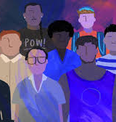
Child Sex Tourism: Speak-Up Video
https://youtu.be/ULn9BUkLAcA
Notes:
SHOW VIDEO

Slide 58
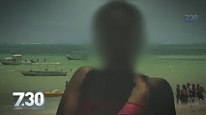
In Kenya . . .
https://www.youtube.com/watch?v=ncDAJavLL9I
Notes:
Introduce Video:
EXPLAIN:
Child sexual exploitation is occurring in tourism destinations around the world.
The following video provides an insight into the situation in Mombasa.

Slide 59
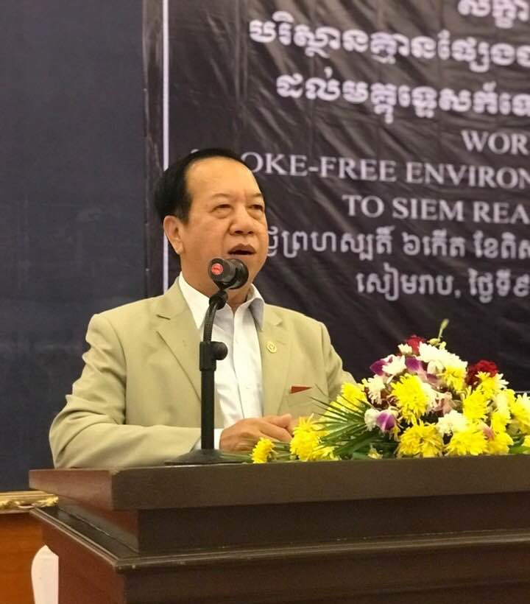
Protecting Cambodia’s Children H.E. Under Secretary Hor Sarun Ministry of Tourism
Notes:
Introduce

