Slide 1
Online Child Sexual Exploitation
Notes:
EXPLAIN

Slide 2
ONLINE QUIZ:
How many mobile phones per 100 people in Cambodia?
In every 100 hundred people, how many use the internet in the Cambodia?
Notes:
ASK
How much do you know about the growth of ICTs in Cambodia?
ACTIVITY: QUIZ
Hold a quick tourism quiz to energise the participants and get them thinking about the enormity of ICTs in Cambodia.

Slide 3
Notes:
ASK
What is this? Explain it’s the digital useage around the world.

Slide 4
What is online child sexual exploitation?
Any form of sexual abuse and exploitation that has a link to the Internet and related devices.
Including acts of sexual abuse that are photographed or video-/audio-recorded and then uploaded and made available online.
Notes:
REMIND
Remind the participants about the definition which was shared in the morning

Slide 5
What is online child sexual exploitation?
Online child sexual exploitation includes:
the production, possession and distribution of child sexual abuse material online;
the grooming of potential child victims online with the intention of sexual exploitation; and,
the live streaming of child sexual exploitation and abuse.
Notes:
EXPLAIN
It is an uncomfortable reality that while technology offers incredible possibilities to our societies, never before has it been easier for those who want to sexually exploit children to make contact with potential victims around the world, share images of their abuse and encourage each other to commit further crimes.
The sheer volume of child sexual abuse material online is almost inconceivable. Tens of thousands of victims of child sexual abuse depicted in this material are unidentified and may still be at risk. Evidence suggests that online child sexual exploitation is seriously harmful to victims, creating long lasting feelings of shame and powerlessness as they grow up.

Slide 6
What types of child sexual exploitation happen online?
Online grooming.
Sextortion.
Live streaming and webcam exploitation.
Production, distribution and accessing of child abuse materials (CAM – also known as child pornography).
Children sold online for sexual abuse offline.
Notes:
EXPLAIN
Explain all forms of online child sexual exploitation.
CAM includes any acts of sexual abuse that are photographed or video-/audio-recorded and then uploaded and made available online.
Sextortion and blackmail are linked.
CAM is not just images, video and audio. It can also include the sharing of sexually explicit written materials relating to child sexual exploitation and cartoons.
Sexting.

Slide 7
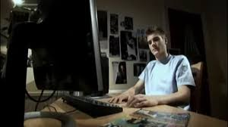
Online Grooming
Matt’s Story
https://www.youtube.com/watch?v=nDBDUX7KPT0
Notes:
EXPLAIN
What is grooming?
HANDOUT – How do Child Sex Abusers Operate?
VIDEO
Show the video of Matt’s story

Slide 8
Sextortion
https://youtu.be/a440H146l14
Notes:
EXPLAIN
Sextortion is a relatively new form of online sexual exploitation in which non-physical forms of coercion are utilized, such as blackmail, to acquire sexual content (photos/videos) of the child, obtain money from the child or engage in sex with the child.
Who are the child victims?
78% of the incidents involved female children and 12% involved male children (In 10% of incidents, child gender could not be determined);
The average age at the time of the incident was approximately 15 years old, despite a wider age-range for female children (8-17 years old) compared to male children (11-17 years old); and
In 22% of the reports, the reporter mentioned being suspicious of, or knowing that, multiple children were targeted by the same offender.
Who are making the reports to the CyberTipline?
Of the various reporter types, Internet company-reports (32%), self-reports (27%) and parent/guardian-reports (22%) were the most common. Other reporter types included peers (e.g. friends, romantic partners; 6%), authority figures (e.g. police, teachers; 5%) and online strangers to the child (2%).
There were important differences in reporter types based on children’s gender and age:
While male children were significantly more likely than female children to self-report and to have parent/guardian-reports, female children were significantly more likely than male children to have peer- and Internet company-reports. Authority figures and strangers were equally likely to report for male and female children.
While self- and Internet company-reports were more likely among older children, parent/guardian- and stranger-reports were more likely among younger children. Peer-reports were equally likely among older and younger children.
Why, where, when and how is sextortion occurring?
Why?
Based on the information known by the CyberTipline reporter, sextortion appears to have occurred with one of three primary objectives (In 12% of reports, the objective could not be determined):
To acquire additional, and often increasingly more explicit, sexual content (photos/videos) of the child (76%)
To obtain money from the child (6%)
To have sex with the child (6%)
Where?
Sextortion most commonly occurred via phone/tablet messaging apps, social networking sites, and during video chats.
In 41% of reports, it was suspected or known that multiple online platforms were involved in facilitating communication between the offender and child. These reports seemed to indicate a pattern whereby the offender would intentionally and systematically move the communication with the child from one online platform type to another.
Commonly, the offender would approach the child on a social networking site and then attempt to move the communication to anonymous messaging apps or video chats where he/she would obtain sexually explicit content from the child. The child would then be threatened to have this content posted online, particularly on social media sites where their family and friends would see, if the child did not do what the offender wanted.
When?
In 34% of incidents, there was enough information to determine whether sextortion occurred immediately after the offender received content of the child or whether it was delayed. Of these cases in which it was known, most (85%) incidents occurred immediately after the offender obtained sexually explicit content of the child.
However, in 15% of these incidents in which there was enough information to determine, the sextortion was delayed up to several years after the offender acquired the sexually explicit material.
How?
Many different manipulation tactics were used by offenders, often in combination, to acquire sexual content (images and/or videos) of the child, obtain money from the child or have sex with the child. The most common tactics were:
Threatening to post previously acquired sexual content online (71%); and
Threatening to post previously acquired sexual content online specifically for family and friends to see (29%).
Some other tactics include:
Reciprocation, whereby the offender coerced the child into providing sexual content by promising reciprocity
Developing a bond with the child through flattery and praise
Secretly recording sexually explicit videos of the child during video chats
Using multiple online identities against a given child, such as being the person blackmailing for sexual content as well as pretending to be a supportive friend to the child or a sympathetic victim of the same offender
Pretending to be younger and/or a female
Threatening to physically hurt or sexually assault the child or their family
Threatening to create sexual content of the child using digital-editing tools
Accessing the child’s account without authorization and stealing sexual content of the child
Threatening to commit suicide if the child does not provide sexual content
Creating a fake profile as the child and posting sexual content of the child
Pretending to be a modeling agent to obtain sexual content of the child
Threatening to post sexually explicit conversations with the child online
What are the effects of sextortion?
In 18% of CyberTipline sextortion reports, it was indicated that the child victim had experienced a negative outcome as the result of the victimization, such as hopelessness, fear, anxiety and depression. In 28% of these reports with negative outcomes (5% of all sextortion reports), the child had engaged in self-harm, had been suicidal, or had attempted suicide as a result of the victimization.
There was no difference between male and female children in negative outcomes of sextortion, or how commonly they were indicated in the CyberTipline reports.
In reports that indicated that the child had experienced a negative outcome, it was common that concern was expressed for other potential victims of sextortion; caring about others and wanting to prevent others from the same victimization was a common reason for making a report.

Slide 9
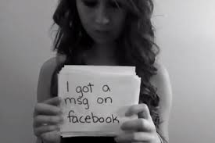
Sextortion
Amanda Todd’s Story
https://www.youtube.com/watch?v=ni-Y3wU92iU
Notes:
HANDOUT – Netherlands arrest in Amanda Todd webcam blackmail case.

Slide 10
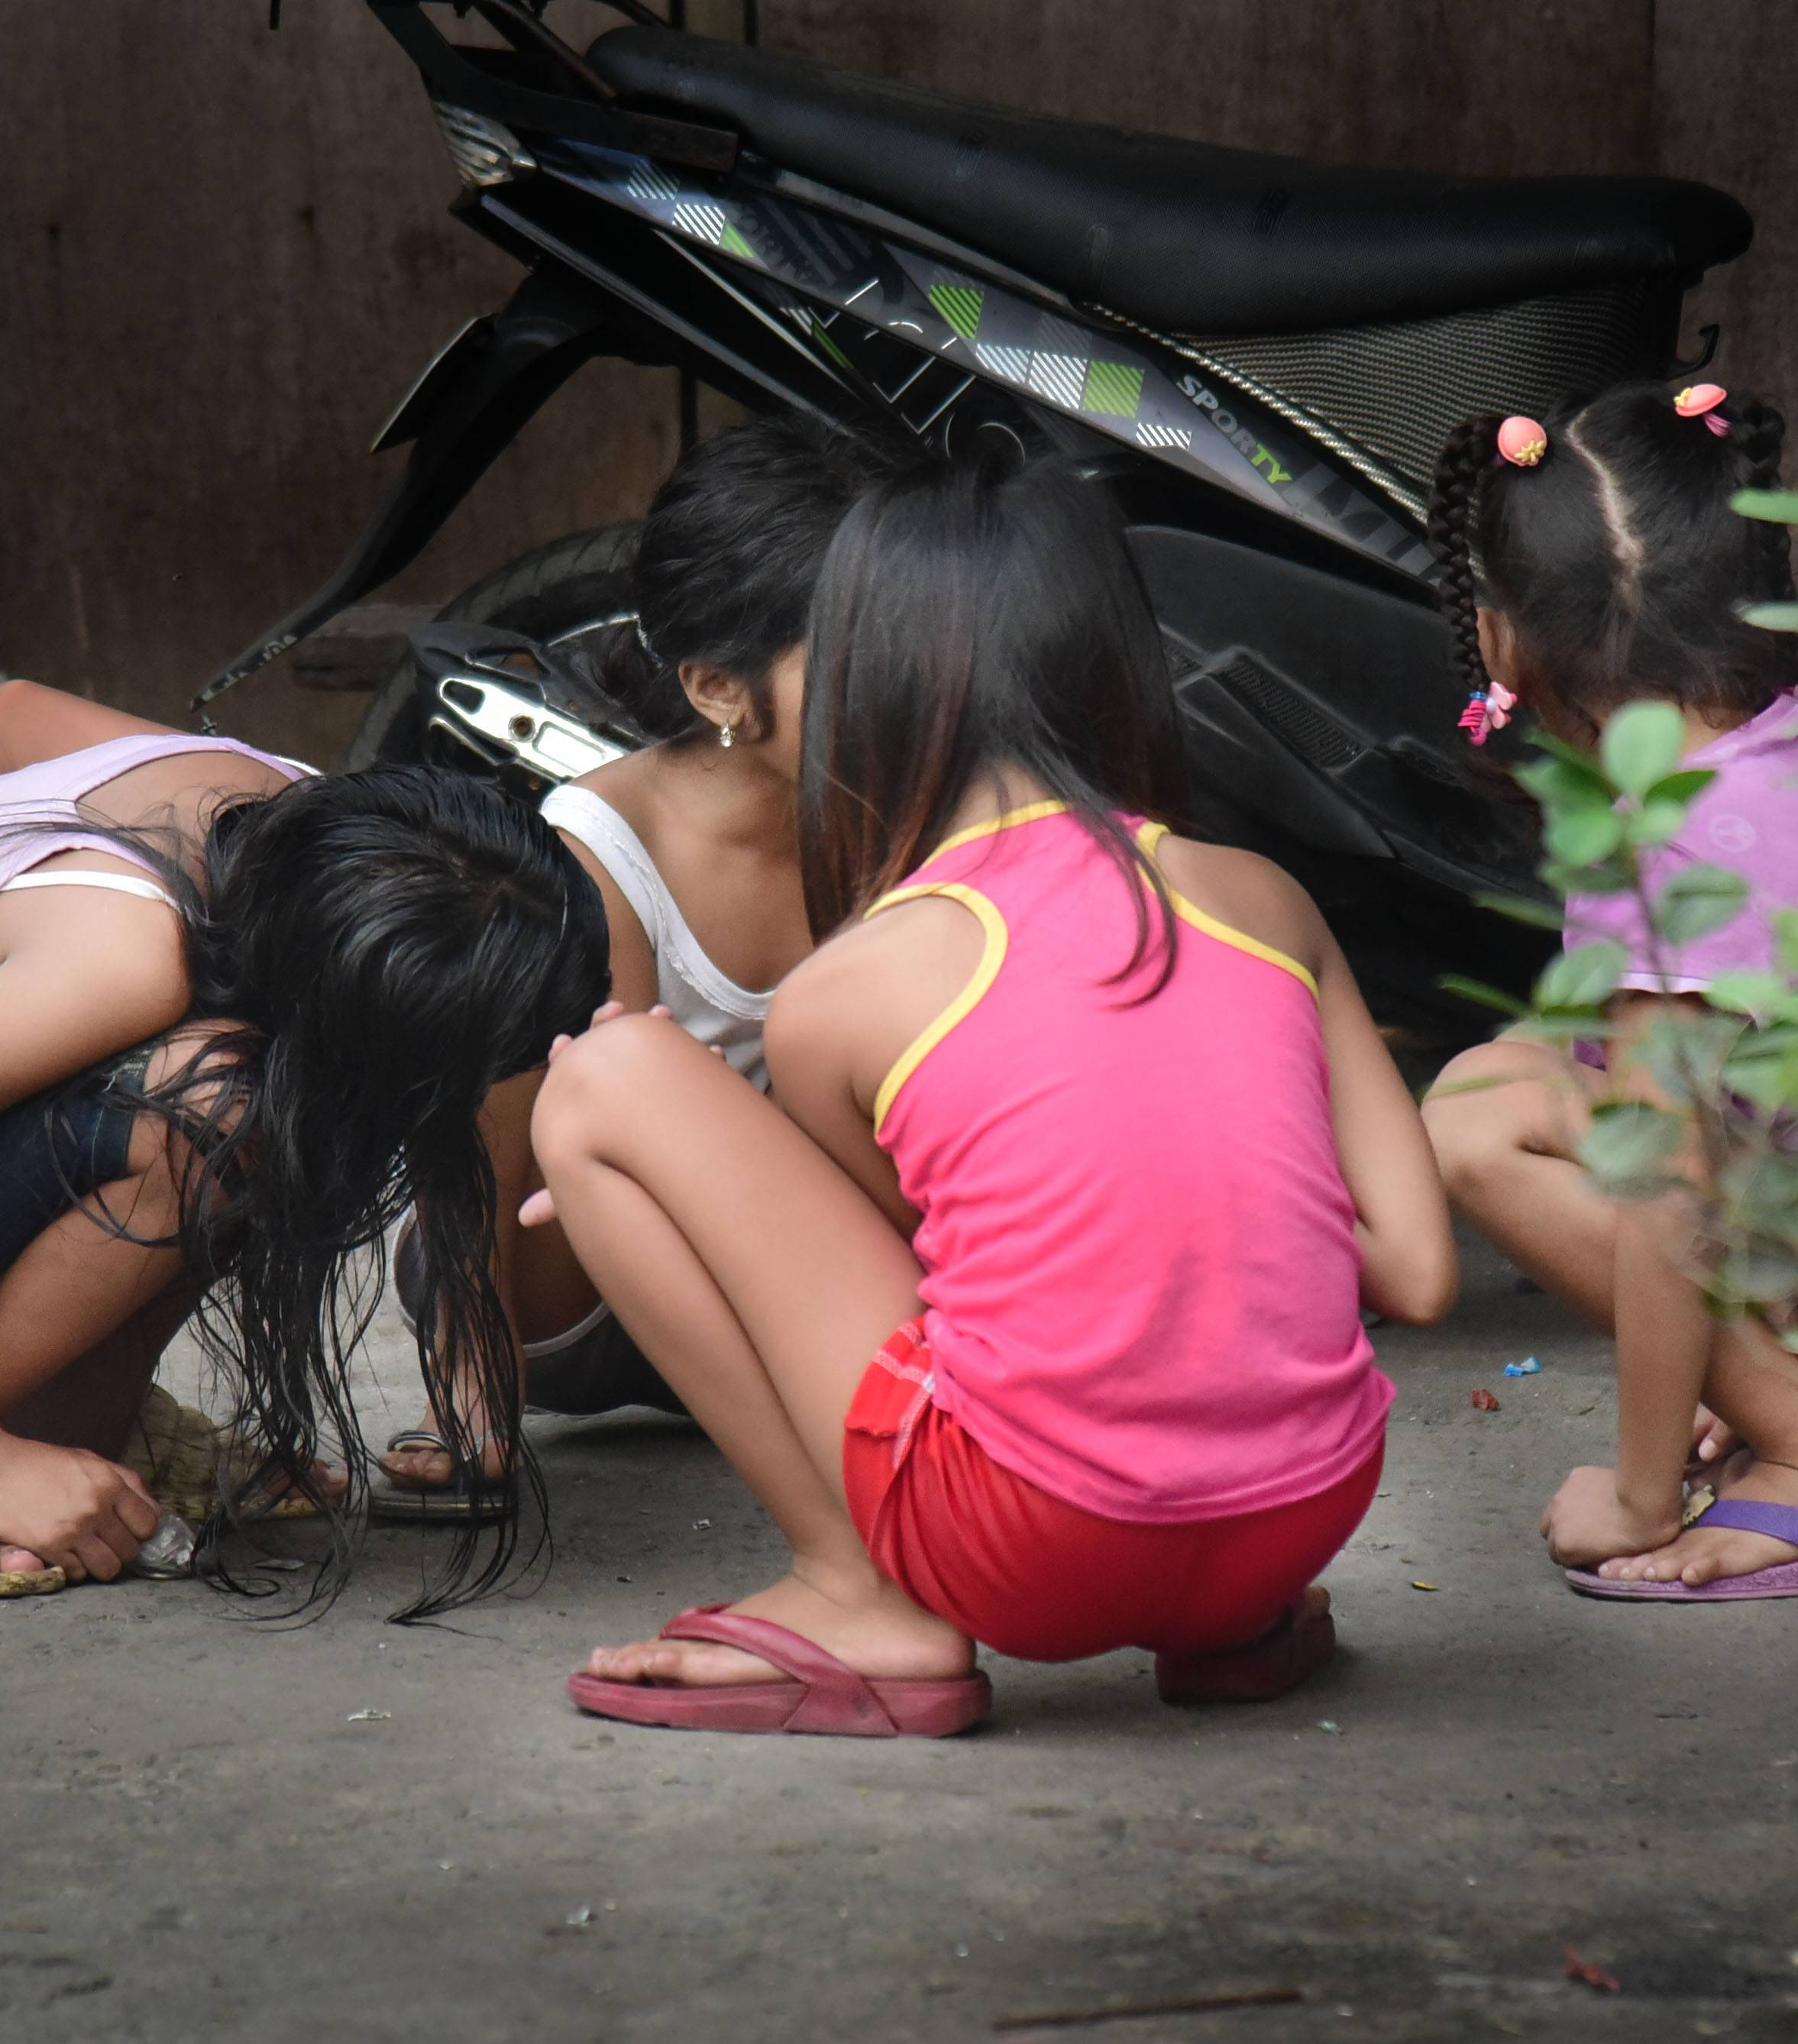
Live Streaming and Webcam Exploitation
Roslyn’s Story

Slide 11
Live Streaming and Webcam Exploitation
Rosalyn’s Story
“Rosalyn”, is at a shelter in the Philippines. She and her six siblings were rescued during a cybercrime police raid six years ago when their parents were caught forcing the two oldest girls to perform in live streaming of child sexual abuse in their home.
Rosalyn was drawn into online sexual abuse by a neighbour, and her parents were paid for Rosalyn’s acts. Her younger sister began to perform online as well, financing the parents’ ability to purchase their own computer system. Using this, they continued to force their two older daughters to participate in live-streaming of child sexual abuse in front of a webcam in their home.
Rosalyn is now an advocate for online safety and agreed to share her story to help raise awareness of child sexual exploitation online.
Source: WePROTECT

Slide 12
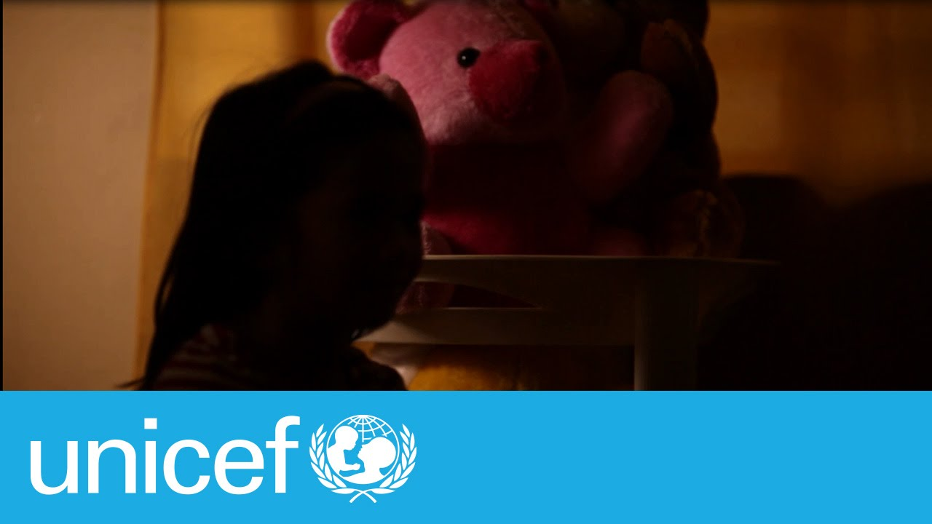
Live Streaming and Webcam Exploitation
Lorna’s Story
https://www.youtube.com/watch?v=Jg8_TvxTBE4

Slide 13
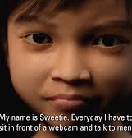
Live Streaming and Webcam Exploitation
http://www.bbc.com/news/uk-24818769
Notes:
EXPLAIN:
Mention about the high level of demand.
Sometimes it is difficult to imagine the volume of child sex offenders. But, recent work by the Dutch Police and the NGO Terres Des Hommes, identified a huge amount of predators seeking sexual encounters with children online. This is particularly concerning in terms of online abuse and in-person abuse.
SHOW VIDEO

Slide 14
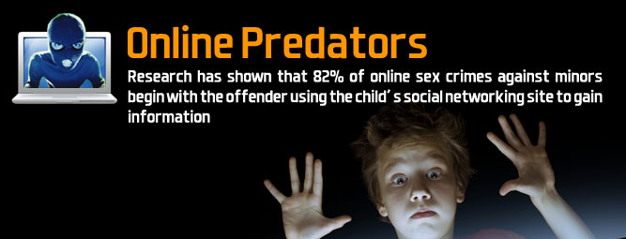
Who are the offenders?
Notes:
EXPLAIN
Like child sex tourists, an online child sex offender can be anyone. Men, women, business people, people with children, etc
Most child sex offenders are not part of any criminal network and usually operate alone, driven solely by their sexual interest in children.
However, this does not mean that offenders act in isolation from each other. They communicate among themselves within like-minded groups in cyberspace, using a variety of online tools, from IRC, ICQ, Yahoo newsgroups/forums to social networks, peer-to-peer file sharing networks, secure email and TOR. Even though it is commonly accepted that child sexual exploitation (CSE) offenders do not form typical organised crime groups, they still organize themselves in an analogous hierarchy on such platforms. This is usually the case on platforms where offenders exchange child abuse material (CAM), either in video, pictures or even text format.

Slide 15
Who are the victims?
Notes:
EXPLAIN
All children who use ICTs can be at risk of online sexual exploitation.
Even if children don’t use ICTs, they can be at risk (eg, an offender takes images of sexual abuse and posts them online).

Slide 16
What do you know about the situation in Cambodia?
Notes:
ASK
Ask participants to share whether they have seen or heard about online child sexual exploitation cases in Cambodia.
Even if we don’t know it’s happening, our children are at risk.

