Slide 1

What do you know about the situation in Cambodia?
Notes:
ASK
Ask participants to share whether they have seen or heard about online child sexual exploitation cases in Cambodia.
Even if we don’t know it’s happening, our children are at risk.

Slide 2
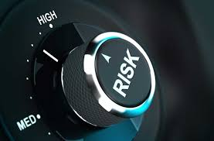
Are we at risk?

Slide 3
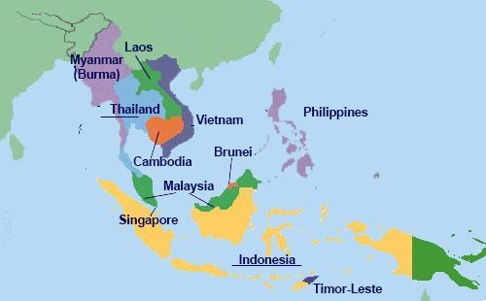
South East Asia is not immune from transnational child sex crimes
Notes:
EXPLAIN
Often we think that transnational crimes such as Child Sex Tourism happen in other countries.
But, ASEAN is not immune from transnational child sex crimes.

Slide 4

Is Cambodia a target?
Notes:
ACTIVITY
Ask participants whether they think their country is at risk of child sex tourism.

Slide 5
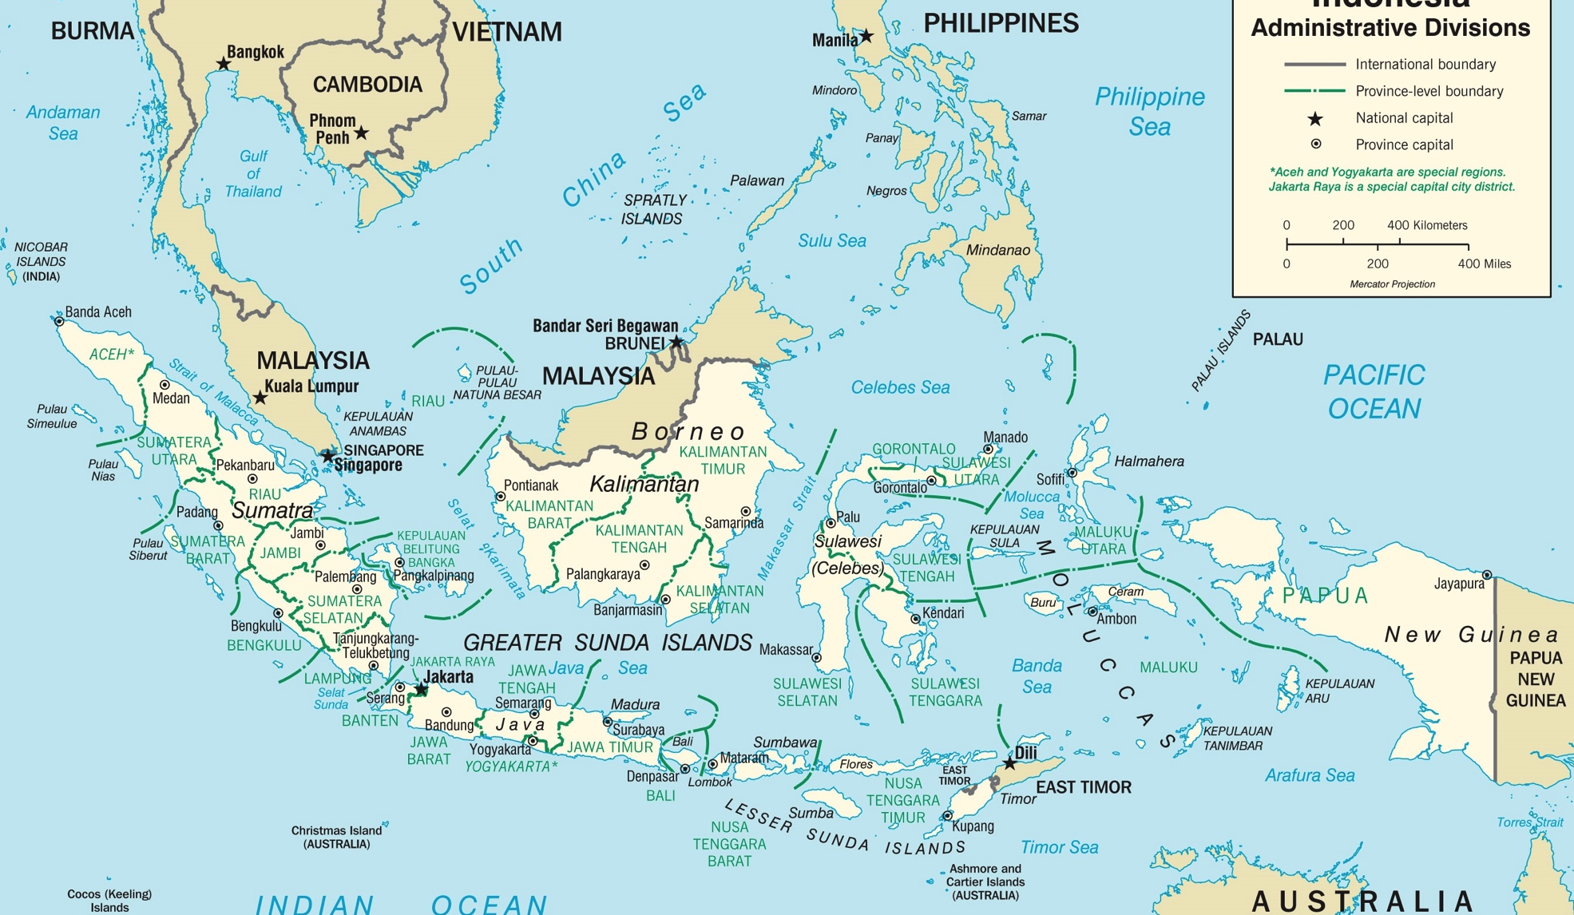
Let’s take a look at Indonesia.

Slide 6

TOURISM QUIZ:
Who has been to Indonesia? Where?
What is the population of Indonesia?
How many tourists came to Indonesia in 2018?
Name some popular tourist destinations in Indonesia?
Notes:
ACTIVITY: QUIZ
Hold a quick tourism quiz to energise the participants and get them thinking about Indonesia..

Slide 7

Tourism in Indonesia
Tourism is one of the important sectors to boost Indonesia’s economic development
The number of IVAs to Indonesia has increased every year.
  2015: 8,5 million people
  2016: 11,5 million people
  2017: 12,6 million people
Top five countries visiting Indonesia:
1. RRC 2. Singapore 3. Australia 4.Malaysia 5. Japan
Notes:
Tourism will be targeted to almost 8 % of the Indonesian per capita GDP
Share about President Jokowi’s open door policy in 2015
IVAs 2015:8,5 million people; 2016 11,5; 2017 12,6
Top five countries to Bali: China, Australia, India, UK, Japan

Slide 8
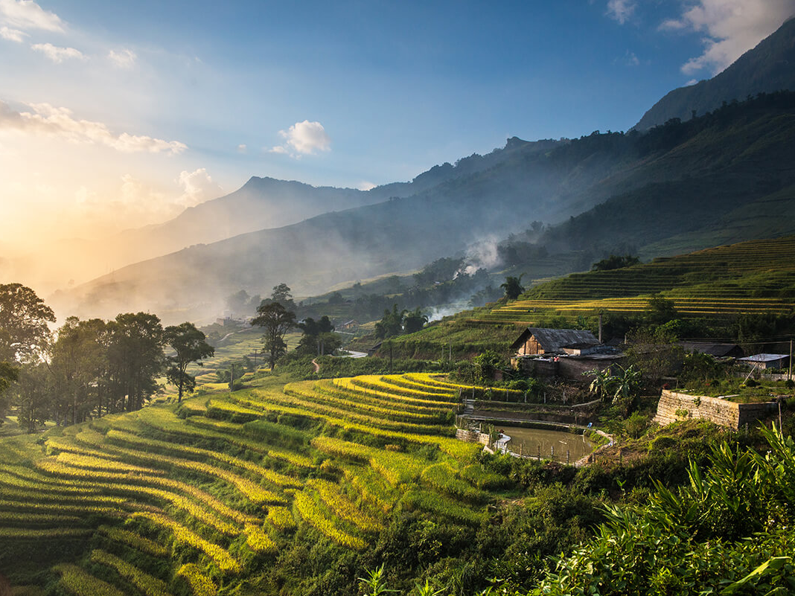
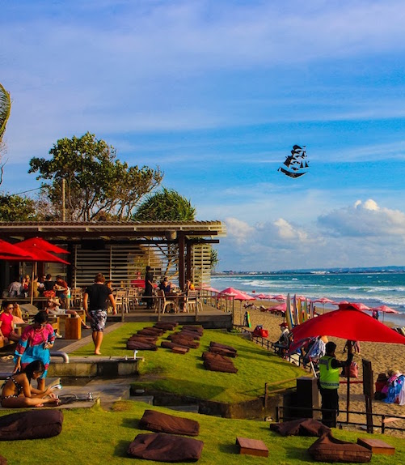
Bali, Indonesia
Notes:
Bali has its attractive surroundings both coastal and mountains.
Its beauty of nature has attracts many people to come to Bali for several reasons including holiday and honeymoon.
For some tourists, holiday in Bali is considered cheap

Slide 9
Why was Indonesia the top destination for Australian child sex offenders?
Rank | Country | Jan - Mar 2013 | April - Jun 2013 | Jul - Sep 2013 | Oct - Dec 2013 | Jan - Mar 2014 | Apr - Jun 2014 | Jul - Sep 2014 | Oct - Dec 2014 | Total
1 | Indonesia |  |  | 55 | 108 | 62 | 68 |  |  | 293
2 | New Zealand |  |  | 34 | 51 | 37 | 39 |  |  | 161
3 | Thailand |  |  | 29 | 58 | 31 | 30 |  |  | 148
4 | Singapore |  |  | 16 | 65 | 19 | 19 |  |  | 119
5 | Malaysia |  |  | 9 | 48 | 16 | 24 |  |  | 97
6 | Philippines |  |  | 23 | 24 | 19 | 24 |  |  | 90
7 | Vietnam | 2 | 4 | 9 | 16 | 9 | 14 | 7 | 7 | 68
8 | New Caledonia/ Vanuatu |  |  | 11 | 31 | 11 |  |  |  | 53
9 | Fiji |  |  | 11 | 23 | 14 |  |  |  | 48
10 | Papua New Guinea |  |  | 16 |  | 17 |  |  |  | 33

Slide 10
Risk factors for Child Sex Tourism in Indonesia
Poverty and unemployment
Learning English language skills and competition
High level of engagement between foreigners and locals
Trust between local children and foreigners
Other countries not preventing the travel of their registered offenders
Relaxed beach lifestyle
Initial low awareness of risks
Low level surveillance
Easy opportunities for foreigners to work/volunteer in organizations where children are located (schools, orphanages, medical centres, etc)

Slide 11
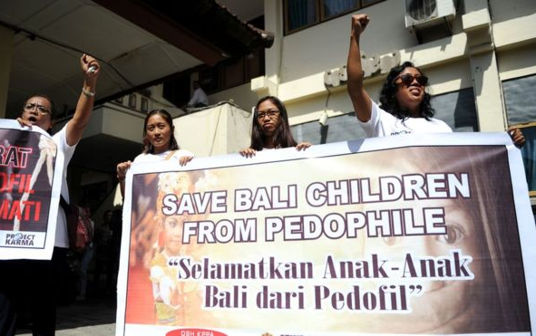

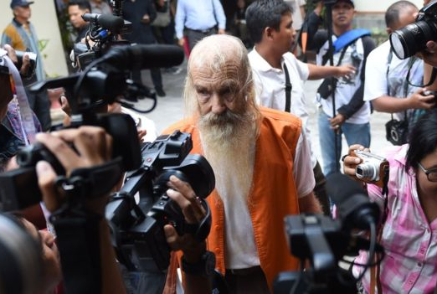
Indonesia – Case Example
Robert Ellis
Australian
Indonesian Retirement Visa
Lived in Denpasar, Bali since 2013
In 2016 sentenced to 15 years jail in Bali
Notes:
EXPLAIN: Provide details of the Robert Andrew Fiddes Ellis case in Bali.
HANDOUT – MEDIA ARTICLE – ROBERT FIDDES ELLIS
Discuss details of the case.

Slide 12
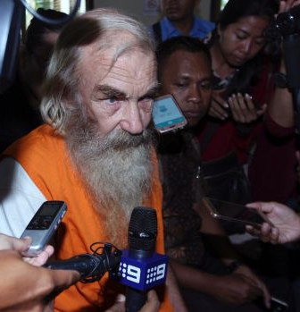
Indonesia
Case Example
Robert Ellis
http://www.smh.com.au/world/accused-australian-paedophile-robert-ellis-says-he-doesnt-deserve-jail-20161018-gs59yd.html
Notes:
AUDIO – play the media audio sound from the interview with Robert Ellis.
EXPLAIN the delusional thoughts and behaviours of child sex offenders.

Slide 13
ACTIVITY:
Put yourself in the position of an international child sex offender.
What makes Cambodia an attractive target for foreign offenders?
Notes:
ACTIVITY
Ask participants to put themselves in the position of an international child sex offender.
Ask, what makes our countries an attractive target for your crimes.
Child sex tourism – attractions for child sex offenders include: low awareness, police not trained, emergence of low budget accommodation, anonymous on distant islands, children friendly with tourists, law, children have limited awareness of risky, limited community awareness, huge use of ICTs, customer demand for foreign children
What are the risk factors in Cambodia?
Low Salary
High population of tourists
Authorities have low awareness
Corruption of authorities
East of access to children and schools
Easy to meet children in the street
Society open to foreigners
Perception that foreigners are friends

Slide 14
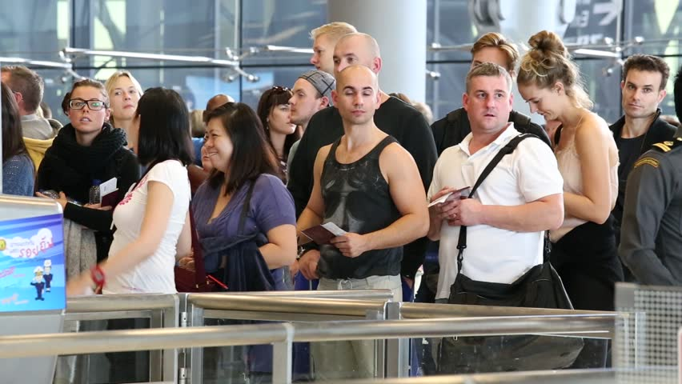
But, what are the challenges?

Slide 15
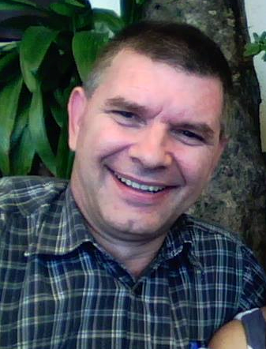
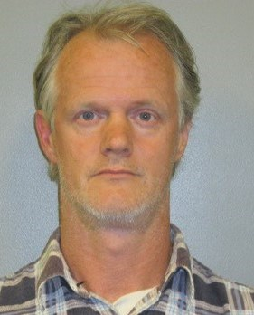
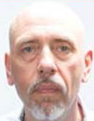
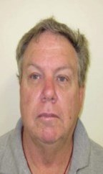
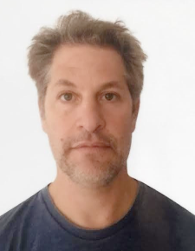
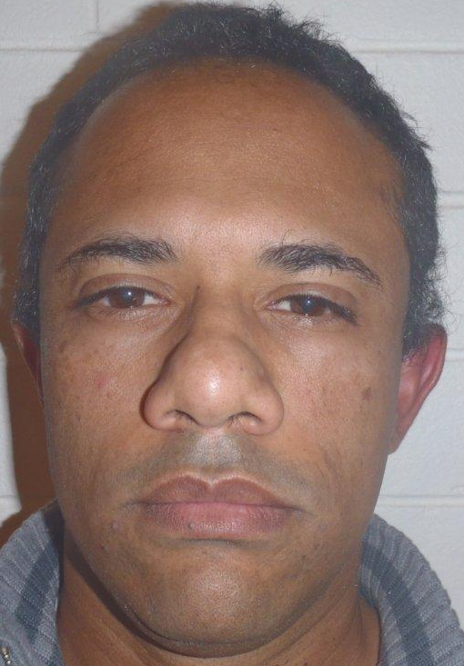
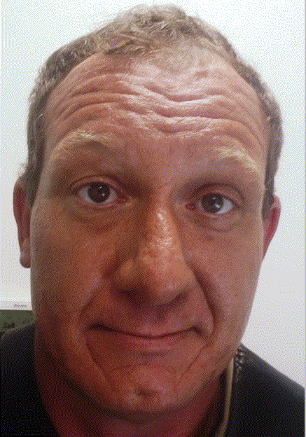
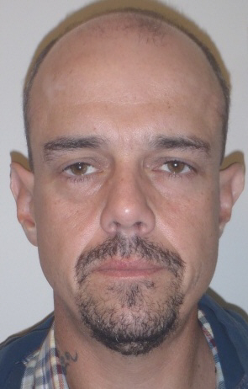
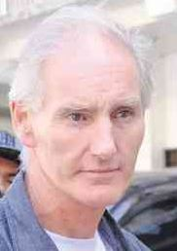
Who is the foreign child sex offender?

Slide 16
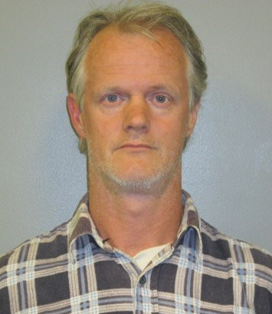
Is this a child sex offender?
Notes:
KRISTIANSEN, Paul –Aggravated sexual assault on child under 16 years x 2
KRISTIANSEN was the one who had a number of entries into the country without our knowledge. We only have three recorded entries for him.
As a result of information from one HCMC hotel manager who reported that KRISTIANSEN had stayed at the hotel on many previous occasions, MPS Immigration was able to identify two previous undetected entries into HCMC from Jakarta and Indonesia.
Corresponding AFP records document two outbound travel movements from Australia where on those occasions he failed to notify the registrar of his travel intentions and Australian Customs traced the ticketing only as Sydney-Jakarta.
On these two occasions KRISTIANSEN stayed in Vietnam for 11 days and returned directly to Sydney.
Concerning stay locations.

Slide 17
Is this a child sex offender?
Notes:
This is NOT an offender. This is a sample passport photo from the Australian Government.

Slide 18
Is this a child sex offender?
Notes:
Trevor Lake
Australian national Lake was the country manager for a boutique travel company called Trails of Indochina headquartered in HCMC.
30 July 2014, arrested in Siem Reap filming himself in the act with 15yrs old.
Pending sentencing.

Slide 19
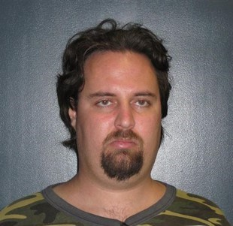
Is this a child sex offender?
Notes:
David Robinson
Convicted in 2008 of possessing CEM and computer hacking.
Not on the NCOS System.
Residing in HCMC for four years.
Twice AFP Post received referrals from NGO regarding indicative behaviour at a local orphanage.

Slide 20
Is this a child sex offender?
Notes:
Zoltan Madai
Resident of Vietnam for 8 years.
English school teacher in Vung Tau Province.
Reported to Post by Queensland Police Service re: arrest of a male friend who used to reside here in Vietnam with him - now serving life in USA (Roderick Skinner) for sustained long term sexual abuse of an adopted son.

Slide 21
Is this a child sex offender?
Notes:
This is NOT an offender. This is a sample passport photo from the NZ Government.

Slide 22
Is this a child sex offender?
Notes:
SMIT ROMERO, Juan Pablo, 1 x Indecent dealings with child under 13 years of age, 1 x Deprivation of Liberty, 1 x Aggravated indecent assault
SMIT ROMERO has made 5 visits to Vietnam since October 2014.
The visits are frequent (less than 2 months between visits) with one visit being 16 days after his previous visit.
One visit was for one night only. It transpired that this visit was to meet a prostitute that SMIT ROMERO flew to HCMC from near Hanoi.

Slide 23
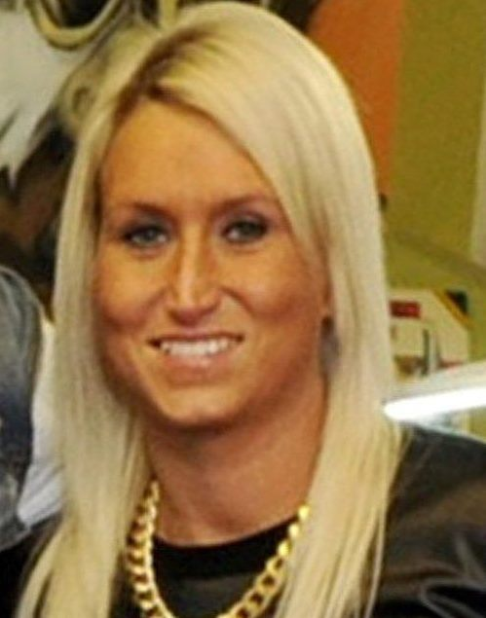
Is this a child sex offender?
Notes:
A British woman has started a nine year prison sentence after she drugged and abused a child on webcam streamed to America.
Sarah Gotham, 34, from Plymouth, indecently touched the girl while another woman in California watched on Skype.

Slide 24
Is this a child sex offender?
Notes:
. BEESLEY John Trevor, born 5 December 1953.
Convictions for 3 x Indecent treatment of children under 16 years of age,
1 x Carnal knowledge of children under 16
1 x Maintain a sexual relationship with a child
AOCC notification 3 times.
However VN immigration checks showed he has been here 9 times. Entering from Jakarta, Indonesia.
Concerning stay locations.

Slide 25
Is this a child sex offender?
Notes:
BROWNING, William Alexander, 10 x Indecently deal with and 2 x sexual penetration of a child by defacto.
BROWNING has visited Vietnam 5 times since we began keeping records in January 2013.
Each of the visits has been between 14 and 30 days in duration.
Each visit is made approximately every 5 months from the previous visit.
Stay locations are varied but most would be considered high risk for child sex offending based on location.

Slide 26
Is this a child sex offender?
Notes:
BERESHEZCKIY, James David
4 x indecent dealing with a child under 13 years of age and 3 x sexual penetration of a child under 13 years of age.
High risk travel patterns. Of the three times that he has visited Vietnam, every time he has exited the country through the border crossings at Lao Bao (Laos) or Moc Bai (Cambodia).
Only once was he ticketed to HCMC hence one AOCC, the remaining entries have only been subsequently detected by inbound Vietnam travel movements – entered from Hong Kong twice before.

Slide 27
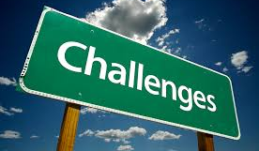
What are the challenges for police?
Internet and digital technology are changing the scope, opportunity, form, impact and scale of child sexual exploitation:
Cyber criminals move much faster than police.
New technologies complicate police methods of identification.
Anonymizing tools, encryption, remote storage make it difficult to detect offenders.
Children are increasingly online, but unaware of safe behaviours, so they share inappropriate images of themselves.
Increasing Internet/4G in developing countries resulting in more live-distant abuse.

Slide 28

How does this issue relate to me?
Notes:
EXPLAIN
Some of you may be wondering why you’re here. And, some of you may be wondering how this topic is relevant to your country.
Depending on your work, some of you may see a direct connection with child protection. Others may be wondering how this is relevant to your work.

Slide 29
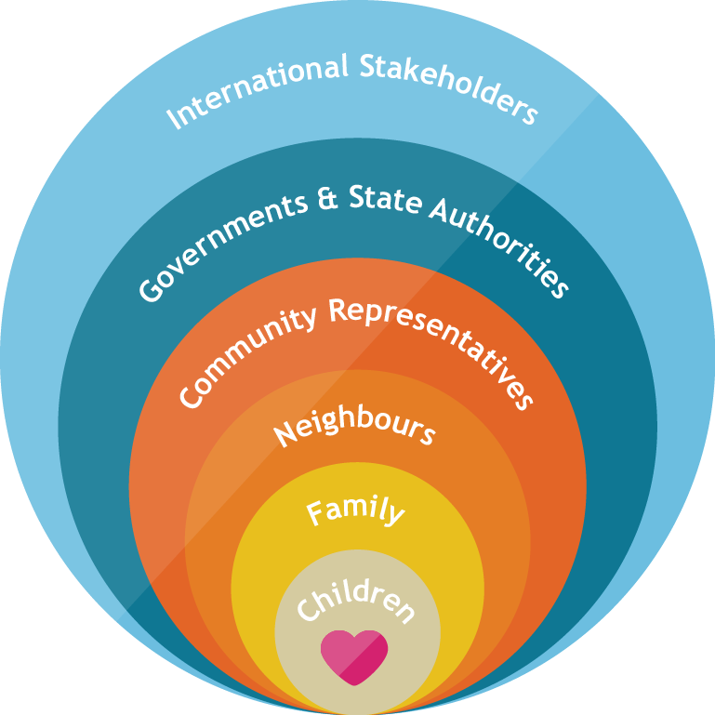
Child protection is everyone’s business
Notes:
EXPLAIN
Every year, around the world, millions of children experience abuse and sexual exploitation. Child protection involves preventing and responding to all forms of violence, exploitation and abuse against children. (UNICEF, 2008)
People often believe that it’s only those organisations who work directly with children who can build a protective environment to prevent sexual exploitation. But, in fact, we can all play an important role – and it must be a combined effort.
In tourism destinations around the world, children, their parents, teachers, governments, responsible tourists and expatriates, and the tourism sector are making a significant impact to prevent child sexual exploitation.
Each individual here today, through your role has a particularly important role to play in enhancing the protective environment for children.
During today’s session, we’ll talk about how you can make the local environment safer for children.
Protecting children isn’t the responsibility of one person or group. We are all responsible and many of us have multiple roles. As parents, neighbours, tourism staff, teachers, NGOs, government officials, we have varying responsibilities for protecting children.
ASK
Where do you fit in this spectrum? Encourage participants to share their answers by detailing the multiple levels in which they fit?
There are varying responsibilities under each level of the child protection system.

Slide 30
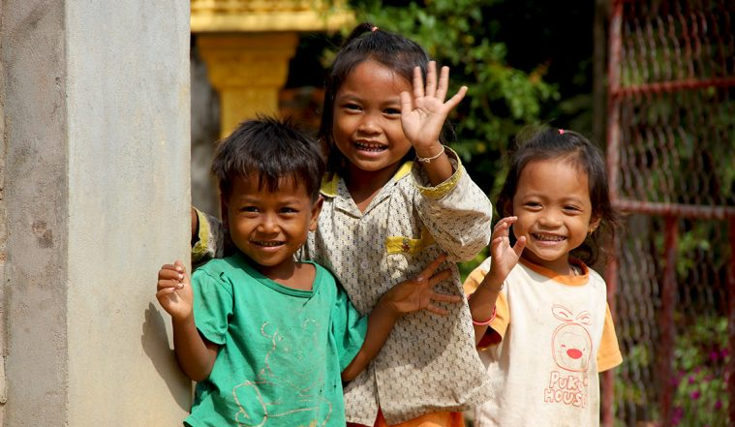
What are children’s rights?
Cambodia is a signatory to the international Convention on the Rights of the Child.
All children have rights to:
    Survival
    Development
    Participation
    Protection
Notes:
EXPLAIN
In addition to human rights, to which every person is entitled, children also have their own specific rights which address their specific needs.
The United Nations Convention on the Rights of the Child (CRC) is an international legal instrument which specifically states that children have the right to survival, development, protection and participation.
Cambodia is a signatory to the CRC. This means that the Government has agreed to uphold all of these rights.
Child Safe Tourism is directly related to children’s right to PROTECTION. This involves protection from all forms of abuse and exploitation. Although, all child rights are inherently connected.
The tourism industry has an impact on the lives of children. So, as tourism develops, their rights must be protected.
Specific articles in the CRC relate to abuse and exploitation – including articles 19, 34 and 36.
HANDOUT:
Distribute the Simple Version of the CRC

Slide 31
What are the international instruments?
INSTRUMENT | CAMBODIA RATIFICATION STATUS
Convention on the Rights of the Child: 1990 | Ratification/Accession: 15 Oct 1992a
Optional Protocol to the Convention on the Rights of the Child on the sale of children, child prostitution and child pornography: 2002 | Signature: 27 June 2000 Ratification/Accession: 30 May 2002
C182 International Labour Organization Worst Forms of Child Labour Convention: 2000 | Ratification/Accession: 2006
The Protocol to Prevent, Suppress and Punish Trafficking in Persons, Especially Women and Children, supplementing the United Nations Convention against Transnational Organized Crime: 2003 | Signature: 11 Nov 2001 Ratification/Accession: 2 July 2007
Notes:
EXPLAIN
Around the world, governments have signed up to international frameworks and instruments which relate to child protection.
Cambodia has taken important steps to demonstrate commitment to child protection by signing/ratifying the key instruments.

Slide 32
What are my child protection obligations?
As adults, we all have a responsibility to children.
All children have rights to protection from all forms of exploitation in accordance with the international Convention on the Rights of the Child (CRC).
Child sexual exploitation is against the law in all South East Asian countries.
Notes:
EXPLAIN
All adults have a responsibility to protect children.
As responsible citizens (parents, neighbours, community members) and government officials (police, tourism ministry, gender ministry):
We have a duty to uphold children’s rights.
We have a duty to follow the law relating to child protection.

Slide 33

What personal actions can I take to protect children?
Notes:
ACTIVITY
Today we’ve spoken about horrifying crimes. As we reflect on the enormity of the exploitation of children, it can seem overwhelming. But, we can all take action to protect children from sexual exploitation.
Ask participants to put aside their official hat and consider simple steps they can take to protect children in their personal life. Brainstorm for three minutes, then discuss.

Slide 34

Notes:
EMPHASISE:
Child protection starts with us.
If you don’t take responsibility, who will?
REMINDER:
HANDOUT – DID YOU KNOW?
Discuss the key facts about child sexual exploitation as a reminder.

Slide 35
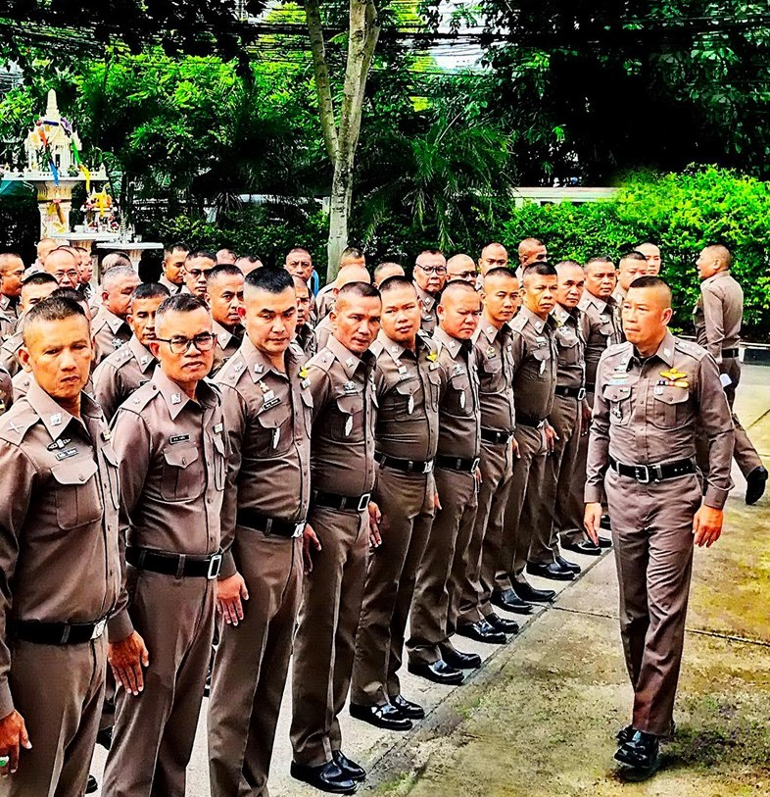
So, what is our official responsibility?
As Government representatives, we have a legally
binding responsibility to protect children from all forms
of sexual exploitation.
Notes:
EXPLAIN
Whether you work in law enforcement or another government department, you have a legally binding responsibility to protect children from sexual exploitation.
ASK
Why does government have a responsibility for child protection?
Facilitator should invite answers from/discussion with the participants.
ANSWER:
All ASEAN countries are signatory to the United Nations Convention on the Rights of the Child. All ASEAN governments have ‘committed themselves to protecting and ensuring children's rights and they have agreed to hold themselves accountable for this commitment before the international community. Like all State parties to the Convention, we are obliged to develop and undertake all actions and policies in the light of the best interests of the child.

Slide 36
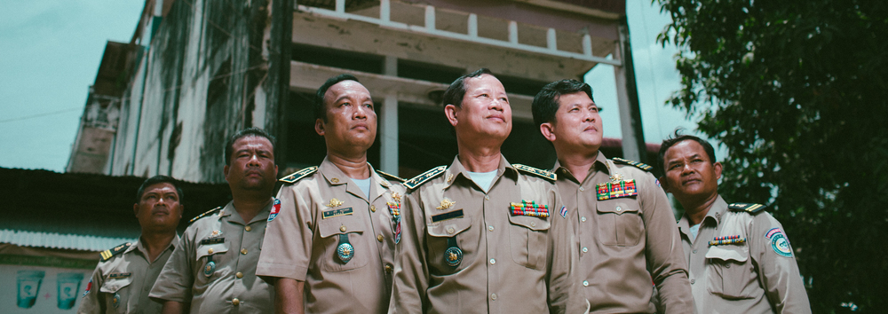
So, what can Police do?
Notes:
ASK: Rhetorical question about what Immigration Officers can do to prevent
travelling CSOs.

Slide 37
What else can we do?
Notes:
EXPLAIN
So, if we can’t identify child sex offenders by their appearance, how are we meant to protect children?

