Slide 1
Investigation skills to prevent, detect, disrupt foreign child sex offenders D/Sgt Jarryd Dunbar Australian Federal Police NSW Joint Anti Child Exploitation Team

Slide 2
Session Overview
This session will cover the following topics as they relate to investigating travelling foreign child sex offenders:
Law Enforcement Challenges;
Intelligence;
Surveillance;
Search Warrants;
Evidence Handling;
Victim Management;
Witness Management;
Suspect Management;
Canvassing;
Suspect Interviews; and
Prevention.
Notes:
This session will cover the following topics as they relate to investigating travelling foreign child sex offenders:
Law Enforcement Challenges;
Intelligence;
Surveillance;
Search Warrants;
Evidence Handling;
Victim Management;
Witness Management;
Suspect Management;
Canvassing;
Suspect Interviews; and
Prevention.

Slide 3
Law Enforcement Challenges

Slide 4
Law Enforcement Challenges
What are the challenges to preventing, detecting and disrupting?
Ease of travel;
Inconsistent international approach;
A ‘crackdown’ in one country exposes another.
Development of a trusted relationship between the offender and the community. This often takes the form of:
Financial support and gifting;
Provision of shelter/housing; and
Community development projects.
Targets vulnerable members of the community;
Culture of silence; and
Redirection to on-line offending.
Notes:
What are the challenges to preventing, detecting and disrupting?
Ease of travel;
Inconsistent international approach;
Development of a trusted relationship between the offender and the community. This often takes the form of:
Financial support and gifting;
Provision of shelter/housing; and
Community development projects.
Targets vulnerable members of the community; and
Culture of silence.
Acknowledge that as other neighbouring countries "crackdown" ( Cambodian term) that it exposes Cambodia to higher risk of exploitation if they don't employ equally tough measures...

Slide 5
Intelligence

Slide 6
Intelligence
Three main sources of intelligence:
Human intelligence (HUMINT) – Intelligence collected from human sources including both overt and covert collection;
Open source intelligence (OSINT) – Intelligence collected from sources available to the general public e.g social media (particularly Facebook); and
Closed source intelligence – Intelligence collected from sources available only to governments and law enforcement.
Notes:
Three main sources of intelligence:
Human intelligence (HUMINT) – Intelligence collected from human sources including both overt and covert collection;
Open source intelligence (OSINT) – Intelligence collected from sources available to the general public e.g social media (particularly Facebook); and
Closed source intelligence – Intelligence collected from sources available only to governments and law enforcement.

Slide 7
Intelligence
Why is intelligence important in preventing, detecting and disrupting?
The nature of the crime means POI’s will undertake active measures to obscure their behaviours;
Intelligence provides an opportunity to piece together indicative behaviours to use as a warnings system for possible future offending; and
Evidence of offending may not be immediately clear or sufficient to support prosecution.
Notes:
Why is intelligence important in preventing, detecting and disrupting?
The nature of the crime means POI’s will undertake active measures to obscure their behaviours; and
Intelligence provides an opportunity to piece together indicative behaviours to use as a warnings system for possible future offending.
Re; warning of future offending - Consider also that if you have a suspect in a case and cannot reach the evidence threshold for Court, but you believe they are offending - consider that you should continue to observe and collect intellgence and maintain observations / surveillance to obtain evidence or prevent future offending - CHILD PROTECTION always.

Slide 8
Intelligence
What intelligence can Foreign Law Enforcement provide to Cambodia?
Intelligence relating to:
Identifying suspected TCSO’s (alert systems);
Identifying child victims and facilitators;
Identifying avenues of enquiry to collect corroborative evidence (banks etc);
Human source insights; and
Identifying trends and indicators of offending.
Notes:
How can Foreign Law Enforcement intelligence be used to assist investigations in Cambodia?
Identify persons travelling to Cambodia who are suspected TCSO’s;
Often FLEA will provide details of a POI travelling..and they do this to help you - protect your children from a possbile risk
It’s also shared to seek your assistance in identifying if they will be offending whilst in your Country.. take advantage of the intelligence being shared by your counterparts and act on the intel.
Conduct your own intelligence collecting / investigation to identify any evidence.
Ask the participants (from immigration) if they have a border alert system and how it works.
Alert systems at the border are very effective as they flag suspected TCSO’s before they enter the country (answer – currently not connected and requires duplication)
FLEA will routinely share information about registered or suspected sex offenders travelling to Cambodia and this information would be good to add to an alert system.
Potential location of child victims and facilitators;
Ask participants if banks and financial institutions in Cambodia are cooperative with law enforcement.
Identify avenues of enquiry to collect corroborative evidence (banks etc);
Evidence that banks or financial institutions may be able to provide include:
Transactional information, contact numbers and addresses.
Human source insights;
Identify trends and modus operandi; and
Inform investigation planning.
Some of the NGO’s operating in Cambodia may be able to assist you with some of these avenues of intelligence.

Slide 9
Intelligence
How can Foreign Law Enforcement intelligence be used?
Search warrant applications;
Investigation planning;
Resource allocation;
Targeting opportunities;
Prevention; and
Risk assessment of foreign nationals crossing the border.
Notes:
How can Foreign Law Enforcement intelligence be used to assist investigations in Cambodia?
Identify persons travelling to Cambodia who are suspected TCSO’s;
Often FLEA will provide details of a POI travelling..and they do this to help you - protect your children from a possbile risk
It’s also shared to seek your assistance in identifying if they will be offending whilst in your Country.. take advantage of the intelligence being shared by your counterparts and act on the intel.
Conduct your own intelligence collecting / investigation to identify any evidence.
Ask the participants (from immigration) if they have a border alert system and how it works.
Alert systems at the border are very effective as they flag suspected TCSO’s before they enter the country (answer – currently not connected and requires duplication)
FLEA will routinely share information about registered or suspected sex offenders travelling to Cambodia and this information would be good to add to an alert system.
Potential location of child victims and facilitators;
Ask participants if banks and financial institutions in Cambodia are cooperative with law enforcement.
Identify avenues of enquiry to collect corroborative evidence (banks etc);
Evidence that banks or financial institutions may be able to provide include:
Transactional information, contact numbers and addresses.
Human source insights;
Identify trends and modus operandi; and
Inform investigation planning.
Some of the NGO’s operating in Cambodia may be able to assist you with some of these avenues of intelligence.

Slide 10
Intelligence
What to look for at the border:
Travel companions of the POI;
Travel history of the POI;
Luggage items not consistent with the traveller;
Translated documents; and
Download of phone data.
CNP Cyber Department have this capability. Seek their assistance.
Notes:
Travel companions of the POI may provide an indicator for possible intention to offend. Is the POI travelling alone or with a group of people of the same demographic? It is less likely an individual is travelling to offend if they are in a family group
Travel history of the POI – Is this trip to Cambodia the first time they have travelled to an Asian country when their usual travel is to Europe or the Americas? Does the POI have frequent short stay trips to Cambodia or long stay trips that are not related to other purposes such as business ventures
Does the POI have luggage items that are not consistent with the person e.g the person is a single middle age male however his luggage contains items of children clothing
Does the POI have documents translated into the local language? What is the content of these documents and could it be used to assist in the perpetration of a crime
Downloading of the POIs mobile phone can provide a number of avenues of inquiry that may identify historical or future offending behaviours
Downloading of phones - CNP Cyber Crime Dept have this capability ( Cellebrite) gifted and trained in use of by AFP. Consider seeking their immediate assistance if you detain a suspect at the Airport.

Slide 11
Surveillance

Slide 12
Surveillance
There are three different types of surveillance:
Physical Surveillance;
Vehicle / On foot
Digital Surveillance; and
CCTV / Social Media
Covert Surveillance.
Listening Devices / Telephone Intercepts / OSD
How can surveillance assist investigators?
Confirm residence, identify associates/location of evidence, detect offences, gather intelligence, establish activity patterns and inform investigation planning.
Notes:
ACTIVITY 1 (2 minutes):
Ask the participants to consider what might be involved in each type of surveillance.
ANSWER:
Physical Surveillance – Traditional form of surveillance – In vehicles and on foot
Digital Surveillance – Utilising existing technology – CCTV systems, social media (posts about where offenders are and who they are with)
Covert Surveillance – Advanced techniques including listening devices and telephone intercepts
Ask the participants what is the legislation around the use of surveillance devices and telephone intercepts in Cambodia for travelling foreign child sex offender investigation?
ACTIVITY 2 (2 minutes):
Ask the participants to consider how surveillance may assist investigations into foreign travelling child sex offenders.
ANSWER:
Confirming accommodation arrangements from port of entry
Identify offender associates
Places visited by the offender, which may result in discovery of evidence (banks, internet cafes, hotels, bars etc)
Place an offender at a location at a given time
Assist in investigation planning (ie: where to execute search warrants / arrests etc)

Slide 13
Search Warrants

Slide 14
Search Warrants
What to consider when executing a search warrant?
Assign members with a particular role;
Quickly secure all persons inside the premises;
Control suspects and be mindful of attempts to destroy evidence;
If potential victims/witnesses present, separate from suspect;
Treat the premises as a crime scene and record in situ via video/photographs/notes;
Consider prioritisation of exhibits; and
Always utilise specialist officers to ensure proper examination of located items (Digital Forensics).
Notes:
ACTIVITY (2 minutes):
Ask participants what considerations they need to take into account when executing a search warrant in travelling child sex offender cases.
DESCRIBE:
Search warrant roles (WH, Arrest/Interview, note taker, video/photo officer, property officer, searches, victim liaison, triage liaison) and why it’s important to assign individual responsibility
How offenders may attempt to destroy evidence (electronic wiping of phone data, kill switches, physical destruction, encryption)
Don’t let the offender touch the devices.
This will damage the evidential integrity of the item and could lead to the loss of evidence
Importance of separating potential victims from offenders
Victim protection, reassures them they are safe
Prevents offender from intimidating/influencing
Why it’s important to treat a premises as a crime scene.
Forensic considerations, including fingerprints and DNA
Prioritisation of exhibits:
Can you review the device at the scene? What devices are your priority
What can DF and specialist services do for you?
If possible, have DF team attend the search warrant with you. They are trained to examine exhibits in the field;
If DF attendance isn’t possible, seek their advice before handling electronic evidence to ensure you are handling the items in the correct way and preventing evidence loss.
Consider the value of forensic evidence (DNA/FP).
Play search warrant video from Moldovan search warrant (computer set up – Offender had a USB that once removed killed the entire computer) – 12.45 – 18.00
Play Sekulic SW video.

Slide 15
Search Warrants Crime Scene Management

Slide 16
Crime Scene Management
‘Crime Scene’ definition:
A place where a crime has occurred;
A starting point of an investigation; and
Can be a person.
Types of Crime Scene:
Primary; and
Secondary.
Implications:
The decisions made in the management of crime scenes and exhibits will be later scrutinised in court.
Notes:
‘Crime Scene’ definition:
A place where a crime has occurred;
A starting point of an investigation; and
Can be a person.
Types of Crime Scene:
Primary; and
Secondary.
Implications:
The decisions made in the management of crime scenes and exhibits will be later scrutinised in court.
ACTIVITY:
Ask the prosecutors for their input in relation to the importance of evidence handling/continuity at crime scenes and how it impacts court outcomes.

Slide 17
Crime Scene Management
There are two types of crime scenes.
Primary crime scenes (location):
Forensic samples;
Physical evidence relevant to offence;
Photographs and video recordings; and
Secondary crime scenes (person/location):
Forensic samples;
Injuries;
Clothing;
Personal belongings; and
Photographs.
Notes:
ACTIVITY (2 minutes):
Ask the participants to consider what types of crime scenes they are likely to encounter when investigating travelling child sex offenders.
ANSWER:
Person
May have tattoo’s, scars or other deformities that identify them from images/video
May be recognised by their victims
Primary premises where abuse occurred (can be multiple)
Electronic equipment used to record the abuse
Personal documents showing travel itinerary, local contacts, ledgers etc
Money or other instruments used by the offender to pay the child for sex
Clothing worn by the offender or victim (particularly relevant when it relates to underwear)
Bedding and other household items
Secondary (where the offender was staying, such as hotels etc)
Internet café’s used by the offender
Offender accommodation outside the primary premises, for example a hotel room
Vehicles that the offender may have transported the child to and from a premises

Slide 18
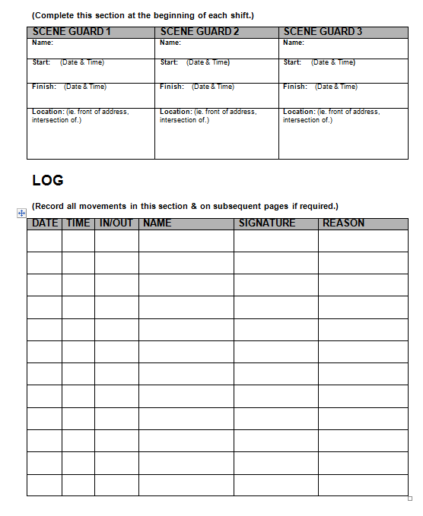
Crime Scene Management

Slide 19
Search Warrants Searching

Slide 20
Searching
What should you be looking for?
Mobile telephones;
Computers;
Hard drives, USB’s, Memory Cards etc;
Digital camera’s;
Clothing;
Household items (which may appear in imagery);
Receipts (payments for LDCA);
Handwritten notes (passwords, names etc);
Internet access records and accounts; and
Financial documents, including banking documents.
Notes:
ACTIVITY (2 minutes):
Ask the participants to consider what types of evidence are they likely to find in a crime scene involving a foreign child sex offenders.
ANSWER:
Mobile telephones;
Computers;
Hard drives, USB’s, Memory Cards etc;
Digital camera’s;
Clothing;
Household items (which may appear in imagery);
Receipts (payments for LDCA);
Handwritten notes (passwords, names etc);
Internet access records and accounts; and
Financial documents, including banking documents.
This list is not exhaustive!

Slide 21
Searching
Things to remember when searching:
Don’t just focus on electronic items. Other common household items may be of significance to the investigation (bedding, clothing etc);
Remember to look for items that may identify a secondary crime scene (hotel receipts, car keys etc);
Do the items in the premises match the offender’s histology (eg: if children's clothes are found, does the offender have children); and
Electronic storage devices may be disguised as other common household items.
Notes:
Things to remember when searching:
Don’t just focus on electronic items. Other common household items may be of significance to the investigation (bedding, clothing etc);
Remember to look for items that may identify a secondary crime scene (hotel receipts, car keys etc); and
Do the items in the premises match the offender’s histology (eg: if children's clothes are found, does the offender have children).
Electronic storage devices may be disguised as other common household items (acknowledge they will be getting a presentation on DF later in the program)

Slide 22
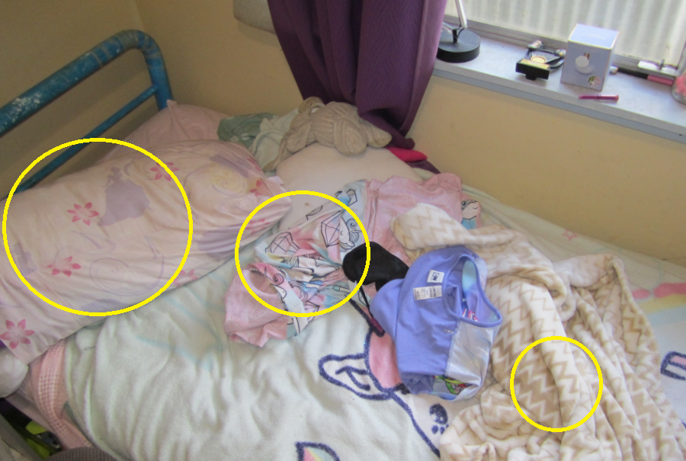
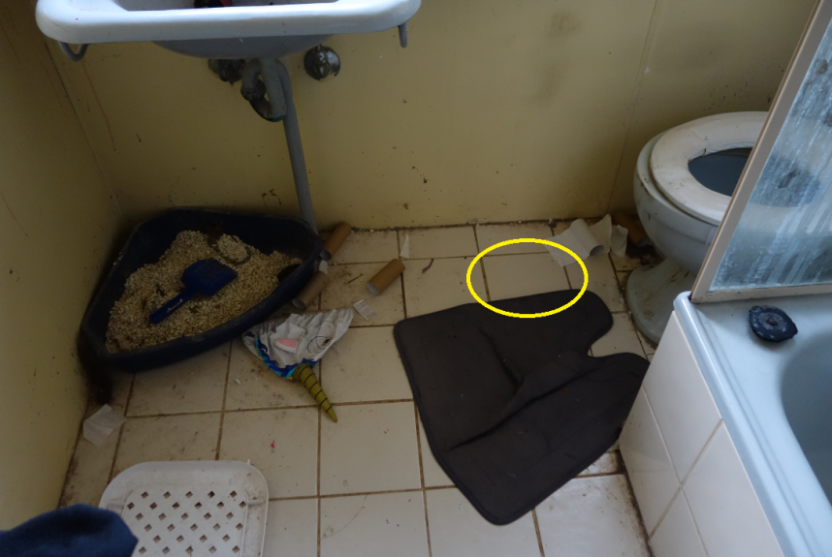
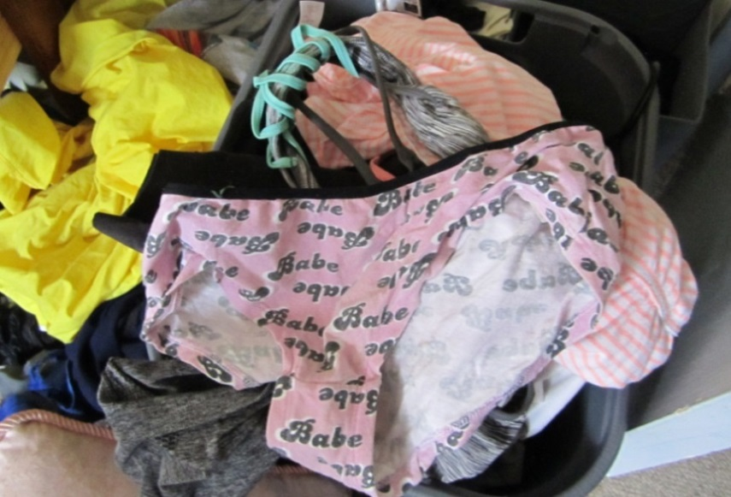
Searching
Notes:
Add in Rimmer images (from video/twitter compared to bedding, underwear, tiles, bunny)

Slide 23
Searching
How does good searching contribute to preventing, detecting and disrupting?
Identification of additional victims;
Identification of additional offenders;
Gathering of intelligence to identify modus operandi;
Highlights intelligence and legislative gaps that need to be filled;
Ensures best evidence is presented to support a successful prosecution; and
Prevents re-victimisation through distribution of images and video.
Notes:
How does good searching contribute to preventing child sex tourism?
ACTIVITY:
Ask the participants to consider how good searching principles contribute to preventing child sex tourism.
ANSWER:
Identification of additional victims;
Identification of additional offenders;
Gathering of intelligence to identify modus operandi;
Highlights intelligence and legislative gaps that need to be filled;
Ensures best evidence is presented to support a successful prosecution; and
Prevents re-victimisation through distribution of images and video.

Slide 24
Search Warrants Evidence Handling

Slide 25
Evidence Handling
The admissibility of evidence can be compromised due to the following:
Contamination;
Break in exhibit continuity;
Previous legitimate contact or transfer; and
Examinations by non-forensic trained members:
Destruction of potential physical evidence;
Contamination of items;
Loss of digital data; and
Irreversible damage to items.
Where possible always engage forensics
Notes:
ACTIVITY (2 minutes):
Ask the participants to consider how evidence located during a search warrant can be compromised.
ANSWER:
Contamination;
Break in exhibit continuity;
Previous legitimate contact or transfer; and
Examinations by non-forensic trained members:
Destruction of potential physical evidence;
Contamination of items;
Loss of digital data; and
Irreversible damage to items.
DISCUSS:
Contamination: This is particularly relevant when the offender may be living with multiple people and forensic evidence is important to prove ownership.
Continuity: Where it’s not clear where an exhibit was located (may allow offender to argue the item didn’t belong to them)
Examinations: Particularly electronic data, which is volatile and can be easily lost if interfered with by an untrained examiner. Examinations may also lead to the loss of forensic evidence, including DNA and fingerprints.

Slide 26
Evidence Handling
How can we avoid evidence being compromised?
Document location of item before seizure (photograph/video/note);
Ensure good notes are taken detailing seizure and movement of exhibits;
Record exhibits in a movement log;
Package items separately to maintain forensic integrity and avoid confusion;
Wear proper protective equipment (gloves etc);
Secure items in a locked room (preferably with audit capability); and
Minimise continuity chain where possible.
Notes:
ACTIVITY (2 minutes):
Ask the participants to consider how they can prevent breaks in exhibit continuity
ANSWER:
Document location of item before seizure (photograph/video/note);
Ensure good notes are taken detailing seizure and movement of exhibits;
Record exhibits in a movement log;
Package items separately to maintain forensic integrity and avoid confusion;
Wear proper protective equipment (gloves etc);
Secure items in a locked room (preferably with audit capability); and
Minimise continuity chain where possible.

Slide 27
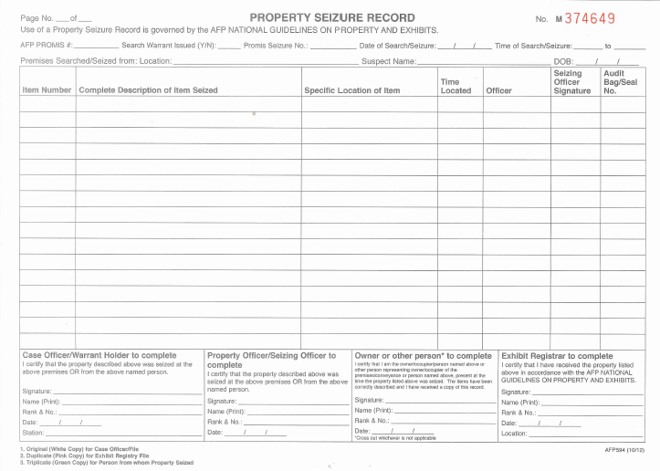
Evidence Handling

Slide 28
Evidence Handling
GOLDEN RULE:
Never touch, change, alter or move anything within a crime scene, until it has been documented, identified and photographed.

Slide 29
Victim Management

Slide 30
Victim Management
Principles for responding to victims:
victims are treated with dignity and respect;
victims are informed of their choices;
victims safety, physical and emotional needs are of primary concern;
consider the involvement of guardians/parents in the offences under investigation;
victim disclosures should only be obtained when essential to the investigative process; and
victims should not be interviewed at the scene. Arrangements should be made for the interview to take place at another location.
Notes:
Principles for responding to victims:
victims are treated with dignity and respect;
victims are informed of their choices;
victims safety, physical and emotional needs are of primary concern;
consider the involvement of guardians/parents in the offences under investigation;
victim disclosures should only be obtained when essential to the investigative process; and
victims should not be interviewed at the scene. Arrangements should be made for the interview to take place at another location.

Slide 31
Victim Management
Ensure the victim/guardian is informed of:
the availability and purpose of a forensic medical examination;
the availability of counselling;
the police role and the need for detailed statements;
the expected length of time the statement taking may require;
the likelihood of having to recount details of the police statement if the matter goes to court;
the interviewing of suspects, the use of bail to prevent further victimisation/victim intimidation; and
the court process and what is required of witnesses.
Notes:
Ensure the victim/guardian is informed of:
the availability and purpose of a forensic medical examination;
the availability of counselling;
the police role and the need for detailed statements;
the expected length of time the statement taking may require;
the likelihood of having to recount details of the police statement if the matter goes to court;
the interviewing of suspects, the use of bail to prevent further victimisation/victim intimidation; and
the court process and what is required of witnesses.

Slide 32
Victim Management
Things to consider while interviewing child victims:
Sensitive approach and recognise vulnerability;
Establish a child sensitive environment and develop rapport;
Determine child’s developmental age;
Identify yourself as a helping person;
Ask the child if he/she knows why they have come to see you;
Establish ground rules (truth and lies);
Ask the child to describe what is happening in their own words;
Begin with open-ended questions and only use direct questions when necessary; and
Consider the child may disclose other victims.
Notes:
Things to consider while interviewing child victims:
All children should be approached with extreme sensitivity and their vulnerability recognized and understood.
Try to establish a neutral environment and rapport with the child before beginning the interview.
Try to establish the child’s developmental level in order to understand any limitations as well as appropriate interactions. It is important to realize that young children have little or no concept of numbers or time, and that they may use terminology differently to adults making interpretation of questions and answers a sensitive matter.
Always identify yourself as a helping person.
Ask the child if he/she knows why they have come to see you.
Establish ground rules for the interview, including permission for the child to say he/she doesn’t know, permission to correct the interviewer, and the difference between truth and lies.
Ask the child to describe what happened, or is happening, to them in their own words.
Always begin with open-ended questions. Avoid the use of leading questions and use direct questioning only when open-ended questioning/free narrative has been exhausted. Structured interviewing protocols can reduce interviewer bias and preserve objectivity.
When planning investigative strategies, consider other children (boys as well as girls) that may have had contact with the alleged perpetrator. For example, there may be an indication to examine the child’s siblings. Also consider interviewing the caretaker of the child, without the child present.

Slide 33
Victim Management
Child victims and court:
The re-victimisation of the child through the giving evidence in court should be mitigated where possible.
Re-victimisation can be achieved through:
Evidence in chief interviews;
Provision of evidence via video;
Close court;
Provision of support person; and
Child friendly questioning techniques.
Notes:
Child victims and court:
The re-victimisation of the child through the giving evidence in court should be mitigated where possible.
Re-victimisation can be achieved through:
Evidence in chief interviews;
Provision of evidence via video;
Close court;
Provision of support person; and
Child friendly questioning techniques.

Slide 34
Victim Management
How does victim management contribute to preventing, detecting and disrupting?
Prevents re-victimisation;
Ensures victims feel safe and protected;
Ensures the victim feels confident to navigate the criminal justice process;
Ensures the best evidence is obtained from the victim;
Educates the community that victim rights come first in the criminal justice process; and
Increases the chance of a positive court outcome.
Notes:
ACTIVITY:
Ask the participants to consider why victim management is important in foreign travelling child sex offender investigations.
ANSWER:
Prevents re-victimisation;
Ensures victims feel safe and protected;
Ensures the victim feels confident to navigate the criminal justice process;
Ensures the best evidence is obtained from the victim;
Educates the community that victim rights come first in the criminal justice process; and
Increases the chance of a positive court outcome.

Slide 35
Suspect Management
Notes:
Members should take note of the layout of the crime scene and pay particular attention to the actions of any suspect present.
Comments made by the suspect should be noted.
A suspect should be removed from the crime scene as soon as practicable to avoid further contamination issues (evidence/memories).
A suspect should not be permitted to undertake any action which may contaminate or destroy evidence, for example:
change clothing
use the toilet unattended
be left unaccompanied
rearrange furniture
clean/remove any item at the scene.
separate suspects and witnesses wherever possible. If suspects and witnesses are allowed to talk, it could interfere with later questioning

Slide 36
Suspect Management
A suspect should be removed from the crime scene as soon as practicable to avoid contamination issues (evidence/victim and witness accounts).
A suspect should not be permitted to undertake any action which may contaminate or destroy evidence, for example:
change clothing
use the toilet unattended
be left unaccompanied
rearrange furniture
clean/remove any item at the scene.
The layout of the crime scene and the actions of the suspect should be recorded.
Comments made by the suspect should be noted.
Notes:
A suspect should be removed from the crime scene as soon as practicable to avoid contamination issues (evidence/victim and witness accounts).
A suspect should not be permitted to undertake any action which may contaminate or destroy evidence, for example:
change clothing
use the toilet unattended
be left unaccompanied
rearrange furniture
clean/remove any item at the scene.
The layout of the crime scene and the actions of the suspect should be recorded.
Comments made by the suspect should be noted.

Slide 37
Suspect Management
How does suspect management contribute to preventing, detecting and disrupting?
Ensures the victim is protected and can’t be intimidated by the suspect;
Ensures witness accounts can’t be influenced;
Prevents the suspect from destroying evidence;
Assists in crime scene control; and
Ensures the safety and wellbeing of the suspect.
Notes:
How does suspect management contribute to preventing, detecting and disrupting?
Ensures the victim is protected and can’t be intimidated by the suspect;
Ensures witness accounts can’t be influenced;
Prevents the suspect from destroying evidence;
Assists in crime scene control; and
Ensures the safety and wellbeing of the suspect.

Slide 38
Canvassing

Slide 39
Canvassing
What is canvassing?
Canvassing involves the identification of persons who can provide evidence to assist your investigation (witnesses).
Why is canvassing important?
Generates lines of enquiry;
Corroborates lines of enquiry; and
Eliminates lines of enquiry.
Canvassing rules:
Keep a good written record; and
Follow-up with formal interview/statement
Notes:
House to house inquiries (i.e. a canvas or door-knock) should be undertaken in a methodical and systematic approach.
Members undertaking such inquiries should be properly briefed before undertaking and should not make follow-up enquiries unless directed to do so.
House to house inquiries should be conducted at a time proximal to the incident, including late night/early morning hours, to obtain the best information possible about the incident and potential witnesses.
An accurate and appropriate narrative of the event should be prepared for those conducting house to house inquiries so they can provide appropriate information to residents in order to both facilitate responses and satisfy curiosity about police action and the incident being investigated.
If no person is at home, a door knock letter or calling card is to be left for the occupants providing a clear point of contact.

Slide 40
Canvassing
How does victim management contribute to preventing, detecting and disrupting?
Identify Suspect/s or Person/s of Interest;
Identify Vehicle/s of Interest;
Identify Witnesses (reluctant / unaware);
Identify Secondary Crime Scene/s;
Recover Exhibits & Other Evidence;
Corroborate or Disprove an Alibi;
Provide a Chronology of Events;
Provide Background Information to Events;
Source Intelligence; and
Promote Community Awareness.
Notes:
ACTIVITY:
Ask participants to consider what information could be obtained from completing a canvass of neighbours to a premises used by foreign travelling child sex offenders.
ANSWER:
How does victim management contribute to preventing, detecting and disrupting?
Identify Suspect/s or Person/s of Interest;
Identify Vehicle/s of Interest;
Identify Witnesses (reluctant / unaware);
Identify Secondary Crime Scene/s;
Recover Exhibits & Other Evidence;
Corroborate or Disprove an Alibi;
Provide a Chronology of Events;
Provide Background Information to Events;
Source Intelligence; and
Promote Community Awareness.
*Highlight community awareness as a by-product of this investigative technique.
It allows Police to educate the community on what the indicators of child
It allows the Police to inform the community that this crime is happening in their environment
It ensures the Police are being seen by the community to be investigating child sex tourism
This contributes to prevention as it builds confidence in the community and encourages witnesses and victims to report child sex tourism to Police.

Slide 41
Witness Management

Slide 42
Witnesses Management
Why is witness management important?
For any investigation, the details of events provided by witnesses are a critical element of the evidence gathered.
Witness evidence is the verbal account of events or knowledge of the facts relevant to the crime.
Witness statements will assist the investigator in forming reasonable grounds to lay a charge and will assist the court in reaching a decision that the charge against an accused person has been proven.
Notes:
ACTIVITY (2 minutes) after reading off slide:
Ask participants to consider why witnesses are important to the investigation of travelling child sex offenders.
Answer:
Why is witness management important?
For any investigation, the details of events provided by witnesses are a critical element of the evidence gathered.
Witness evidence is the verbal account of events or knowledge of the facts relevant to the crime.
Witness statements will assist the investigator in forming reasonable grounds to lay a charge and will assist the court in reaching a decision that the charge against an accused person has been proven.

Slide 43
Witnesses Management
Who are the likely witnesses?
Direct:
Victims
Circumstantial:
Family members of victims;
Financial institutions;
Hotel staff;
Suspect associates;
Airlines;
Transportation;
Telecommunications companies; and
Government officials
Notes:
ACTIVITY (2 minutes) after reading off slide:
Ask participants to consider who might be a witness in a child sex tourism investigation.
Answer:
Direct:
Victims
Circumstantial:
Family members of victims;
Financial institutions;
Hotel staff;
Suspect associates;
Airlines;
Transportation;
Telecommunications companies; and
Government officials
Not an exhaustive list.

Slide 44
Witnesses Management
Witness Statements should:
be obtained as close in time to the incident as possible;
be in their own words;
Include dates and times where possible;
provide as much descriptive detail as possible. Who/What/Where/When/Why;
only include what the witness saw, heard, said and did;
refer to all the relevant events, people, places and dates in a logical way; and
include hand drawn maps/diagrams and attachments referred to in the statement body.
Notes:
Witness Statements should:
be in their own words;
Include dates and times where possible;
provide as much descriptive detail as possible. Who/What/Where/When/Why;
only include what the witness saw, heard, said and did;
refer to all the relevant events, people, places and dates in a logical way; and
include hand drawn maps and attachments referred to in the statement body.
Cambodian Context
Two statements are taken from the witness/victim. The first by Police, the second by the prosecutor
Ask the participants if there are any opportunities within the agreed legal processes in Cambodia to explore more child friendly processes?
Taking of one statement
Video recorded evidence
Ask the participants what risks are associated with the taking of two statements from the same witness/victim
Re-victimisation;
Changes in memory (either due to the natural passage of time, trauma or interference)
If two statements must be taken, then they must be taken in close proximity to one another (within a matter of days)

Slide 45
Witness Management
How does witness management contribute to preventing, detecting and disrupting?
Ensures victims/witnesses understand what is expected of them during the court process;
Provides circumstantial and corroborative evidence to support victim accounts;
Strengthens a prosecution and injects a ‘human element’ into the court process;
Encourages the community to break the culture of silence; and
Promotes Community Awareness.
Notes:
ACTIVITY:
Ask participants to consider what information could be obtained from completing a canvass of neighbours to a premises used to facilitate child sex tourism.
ANSWER:
Ensures witnesses understand what is expected of them during the court process;
Provides circumstantial and corroborative evidence to support victim accounts;
Strengthens a prosecution and injects a ‘human element’ into the court process; and
Encourages the community to break the culture of silence.
Promotes Community Awareness

Slide 46
Suspect Interviews

Slide 47
Suspect Interviews
What do you want to know from your suspect?
Admissions;
Familial relations;
Access to children;
Employment, Voluntary/charity work;
Travel history / Places visited in country;
Purpose of visit to Cambodia;
Knowledge of child exploitation material; and
Each electronic device:
Personal use, other users, access.
Notes:
ACTIVITY (2 minutes):
Ask the participants to consider what information they would want to know from a suspected travelling child sex offender
ANSWER:
Is dependent on the circumstances of the investigation at hand. However some topics to consider include:
Admissions
Familial relations;
Access to children;
Employment and/or Voluntary/charity work;
Travel history Places visited;
Purpose for visit to Cambodia;
Knowledge of child exploitation material; and
Each electronic device:
Personal use, other users, access

Slide 48
Suspect Interviews
How do suspect interviews contribute to preventing, detecting and disrupting?
Facilitates the presentation of evidence to the suspect, which may lead to admissions;
Ensures investigators are able to discount possible defences;
Identify additional avenues of investigation to gather evidence;
Identify any co-offenders;
Identify any unknown victims; and
Gather intelligence regarding modus operandi.
Notes:
ACTIVITY:
Ask participants to consider how suspect interviews can contribute to preventing, detecting and disrupting.
ANSWER:
Facilitates the presentation of evidence to the suspect, which may lead to admissions;
Ensures investigators are able to discount possible defences;
Identify additional avenues of investigation to gather evidence;
Identify any co-offenders;
Identify any unknown victims; and
Gather intelligence regarding modus operandi.

Slide 49
Prevention

Slide 50
Prevention
How does a consistent and reliable Police response contribute to prevention?
General and Specific Deterrence:
Specific Deterrence: Offender; and
General Deterrence: Potential Offenders.
Education to the community:
Builds confidence in Police;
Alerts the community to indicators;
Reassures victims they will be protected; and
Sends a message that the sexual exploitation of children won’t be tolerated.
Notes:
The manner in which Police undertake their investigations, interact with victims and witnesses and engage in the criminal justice process prevents child sex tourism because it breaks the cycle of silenece.
As law enforcement, we have the responsibility to protect the vulnerable and everyone in this room is the keeper of that responsibility. Children are amongst the most vulnerable in our community and if we work together, if we collaborate and learn from each other, then we can show our communities that we are up to the fight.

Slide 51
Questions?

