Slide 1
‘COMBATING CHILD SEXUAL
ABUSE AND EXPLOITATION
IN CAMBODIA’, APLE
APLE Cambodia: July 4th, 2019

Slide 2
WHO WE ARE
Established in 2003 in Cambodia
Dedicated to combating child sexual abuse and exploitation
Primarily focusing on sexual exploitation of children in travel and tourism
Mainly operating in Phnom Penh, Siem Reap & Sihanoukville

Slide 3
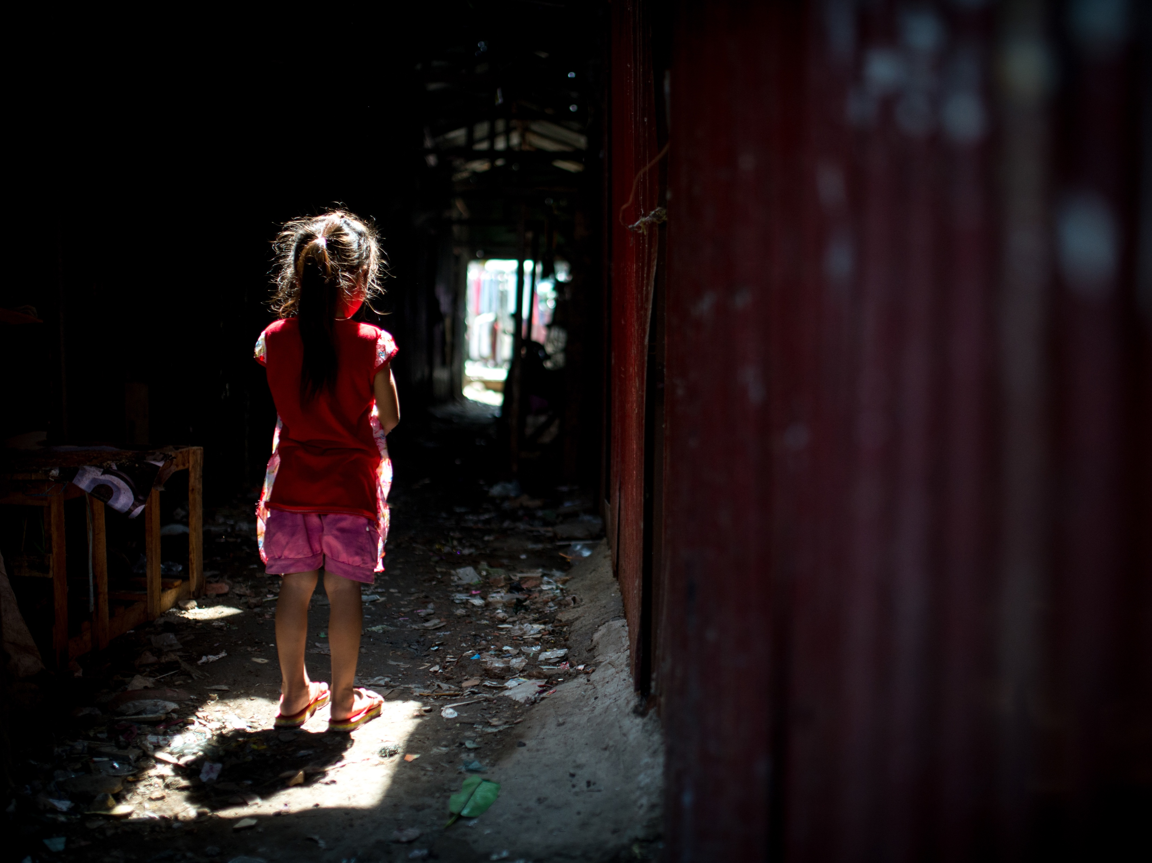
Mission: To strengthen national social and legal mechanisms for the protection of children at risk of, or affected by, child sexual abuse or exploitation

Slide 4
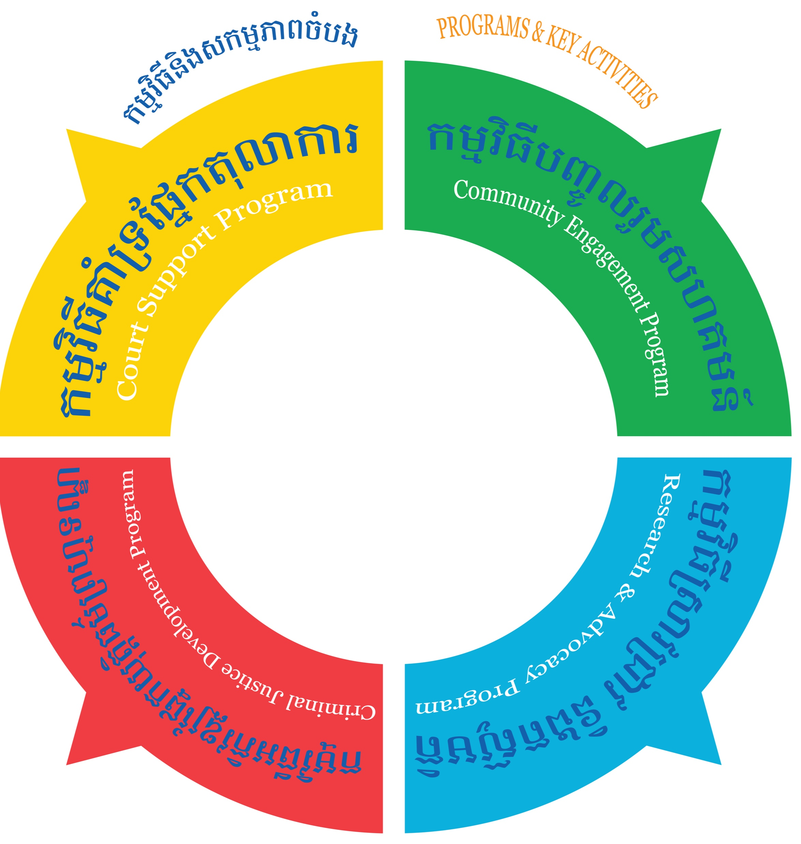
OUR PROGRAM
Criminal Justice Development: Police assistance and capacity building (child-friendly investigative standards)
Court Support: Crisis intervention supports, referrals and legal services incl. legal counseling and representation in court
Community Engagement: Awareness raising, civil reporter network and empowering community based child protection forces
Research and Advocacy: Conducting researches and developing evidence based recommendations

Slide 5
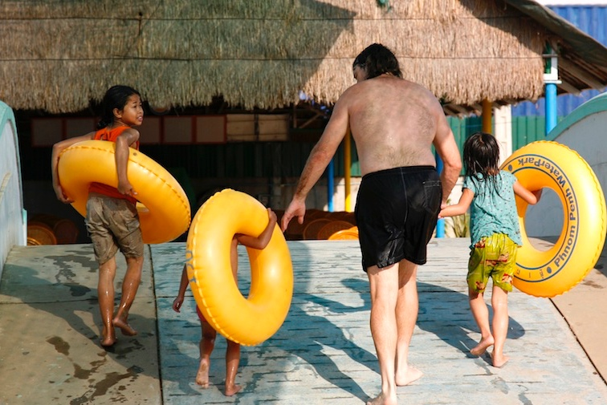
HOW WE PROTECT CHILDREN
APLE receives information about suspected abuse and exploitation via:
24/7 Hotline (phone & Internet) for the public
Information/tips-off from civil reporters, partner NGOs and authorities
Proactive approach in victim identification (case agent deployment, hotspot surveillance, open-source investigation)

Slide 6
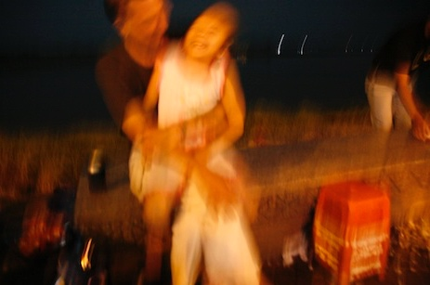
HOW WE PROTECT CHILDREN
Once received, information processed, analysed and documented
Initial analysed information and a formal case report sent to Cambodian police for action
Suspect’s background check request sent to concerned foreign law enforcement
Coordinates case information or evidence across the responsible agencies

Slide 7
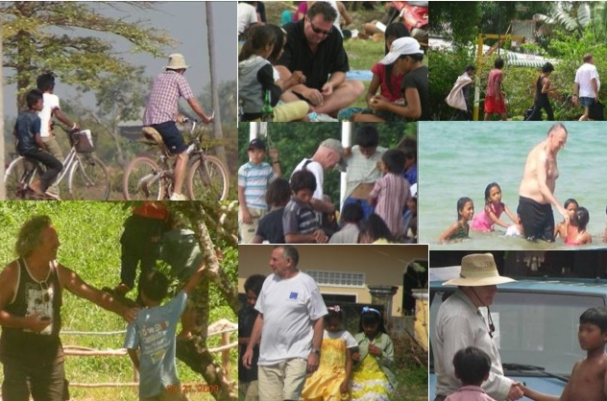
HOW WE PROTECT CHILDREN
Continued assistance in police investigations (victim id, family and documentation tracing, contacts and interview)
Technical support for rescue and raid operations by police
First response: Victim risk and need assessment
Crisis interventions (social, psychological, medical and legal)

Slide 8
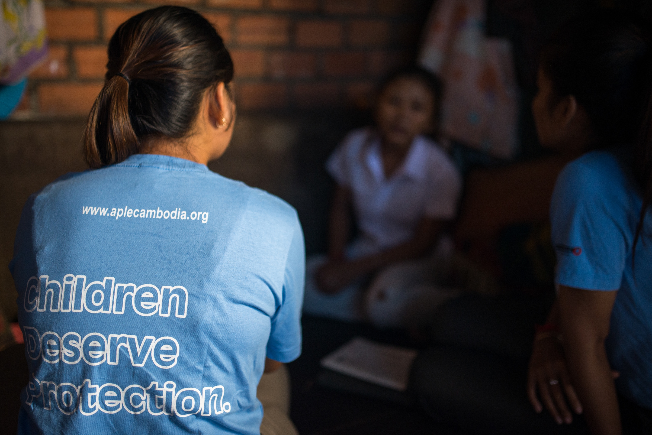
HOW WE PROTECT CHILDREN
Provides legal counseling and option for seeking justice
Offers free of charge legal representation throughout court proceedings
Is responsible for case management and follow-up support (Client visits, case updates, court case monitoring and procedural compliance)
Accompanies/represents victims/civil plaintiffs when testifying and during trial

Slide 9
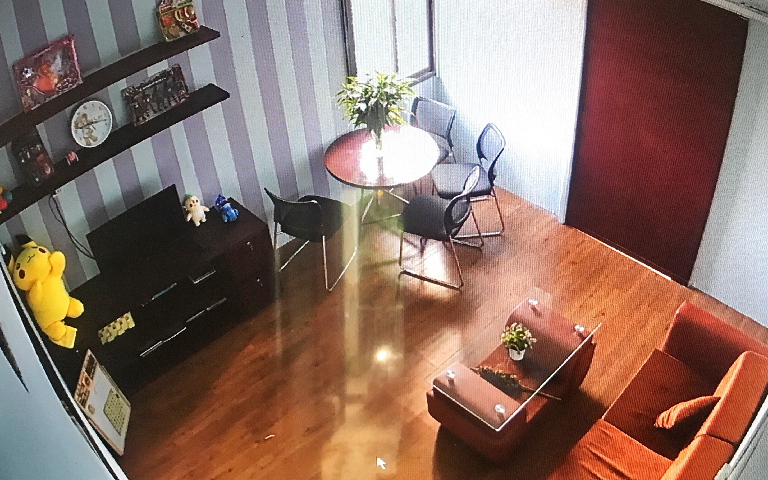
HOW WE PROTECT CHILDREN
Lobbies for child friendly practices in all stages of the criminal proceedings (Police interview, courtroom testimony, medical exam, etc.)
Set up child-friendly interview room in police station

Slide 10
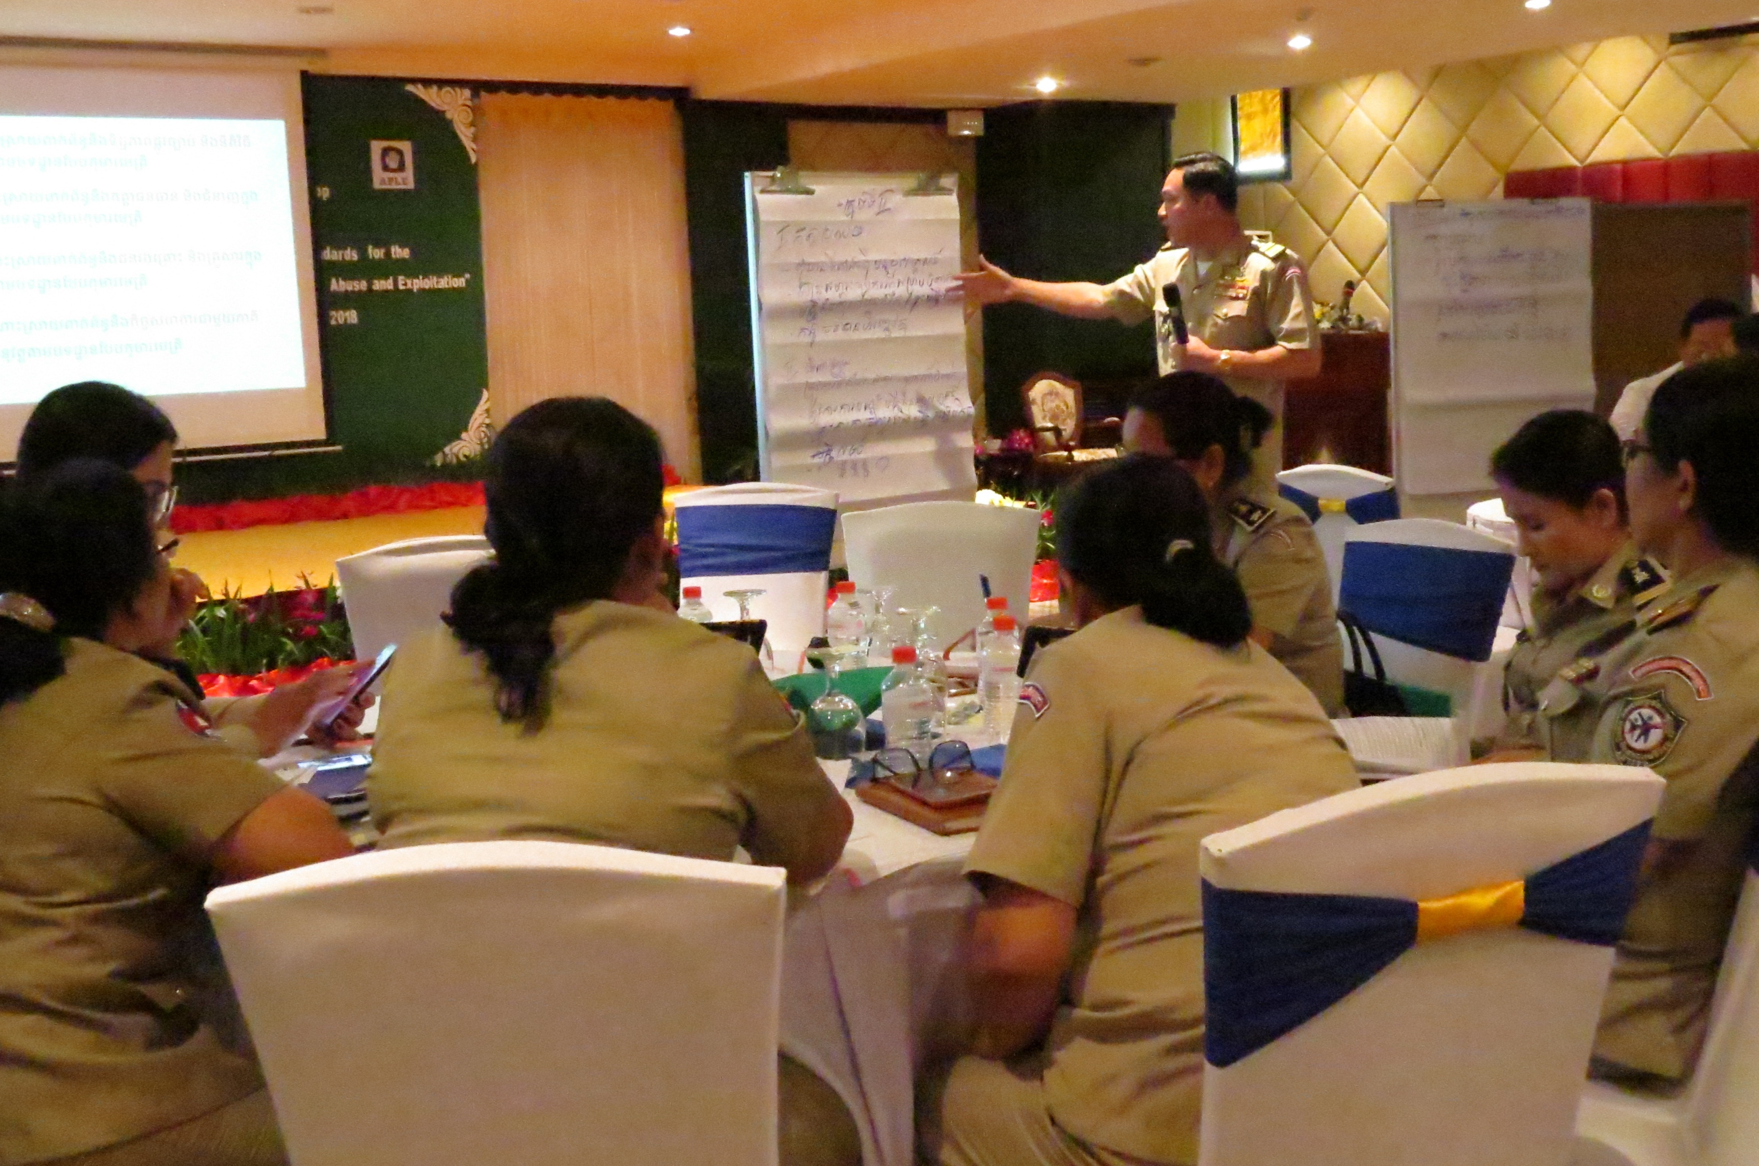
HOW WE PREVENT ABUSE
Building knowledge and capacity of those responsible for protecting children/preventing abuse
Raising public and community awareness (Children, parents, local authorities & private sector)
Media campaigns (Facebook posts, radio talk shows, TV documentaries)

Slide 11
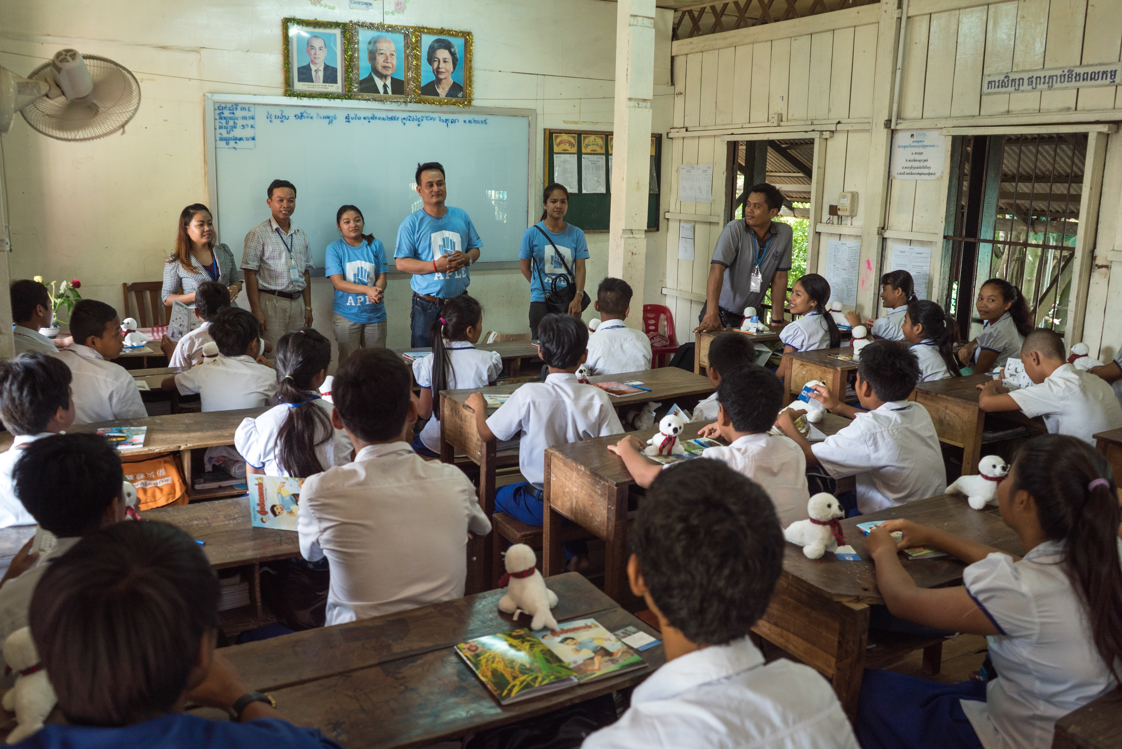
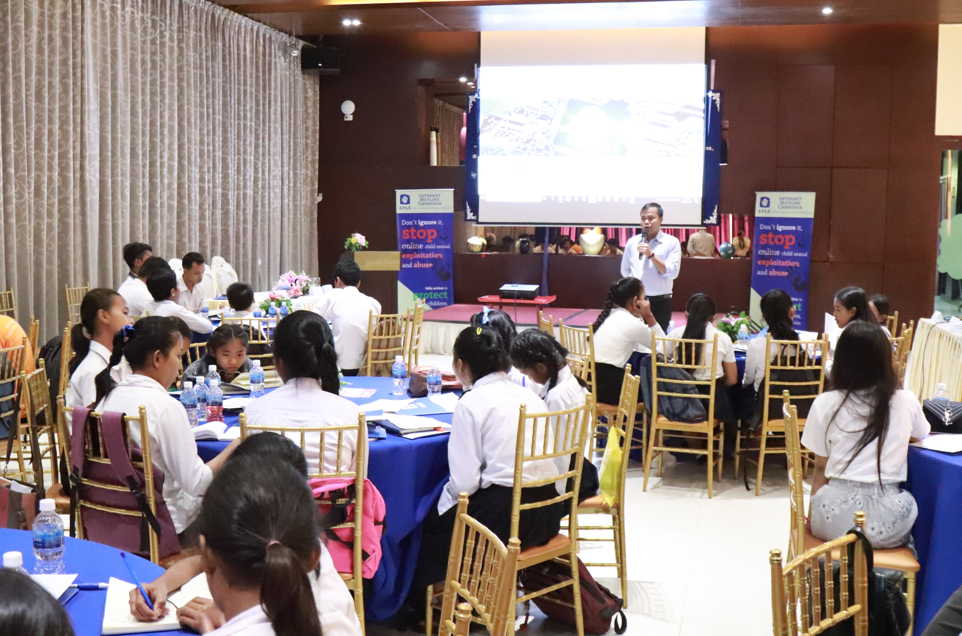
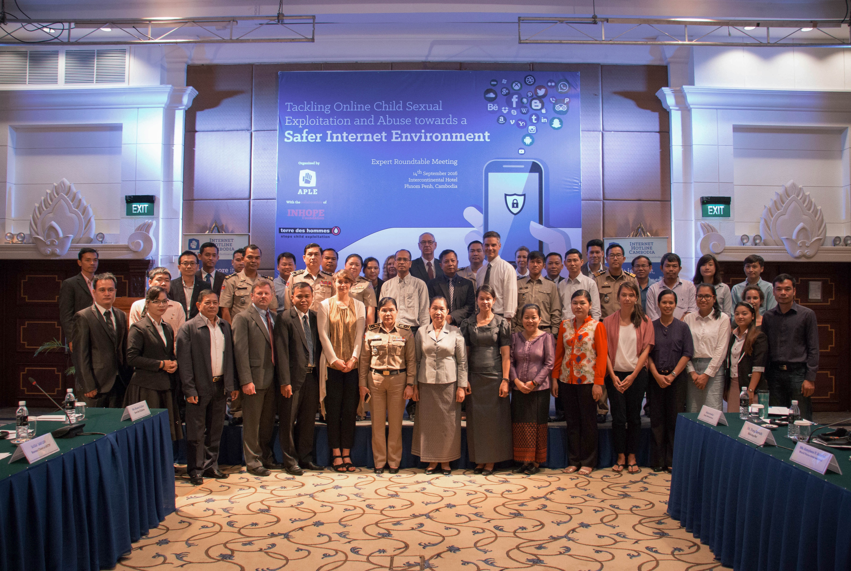
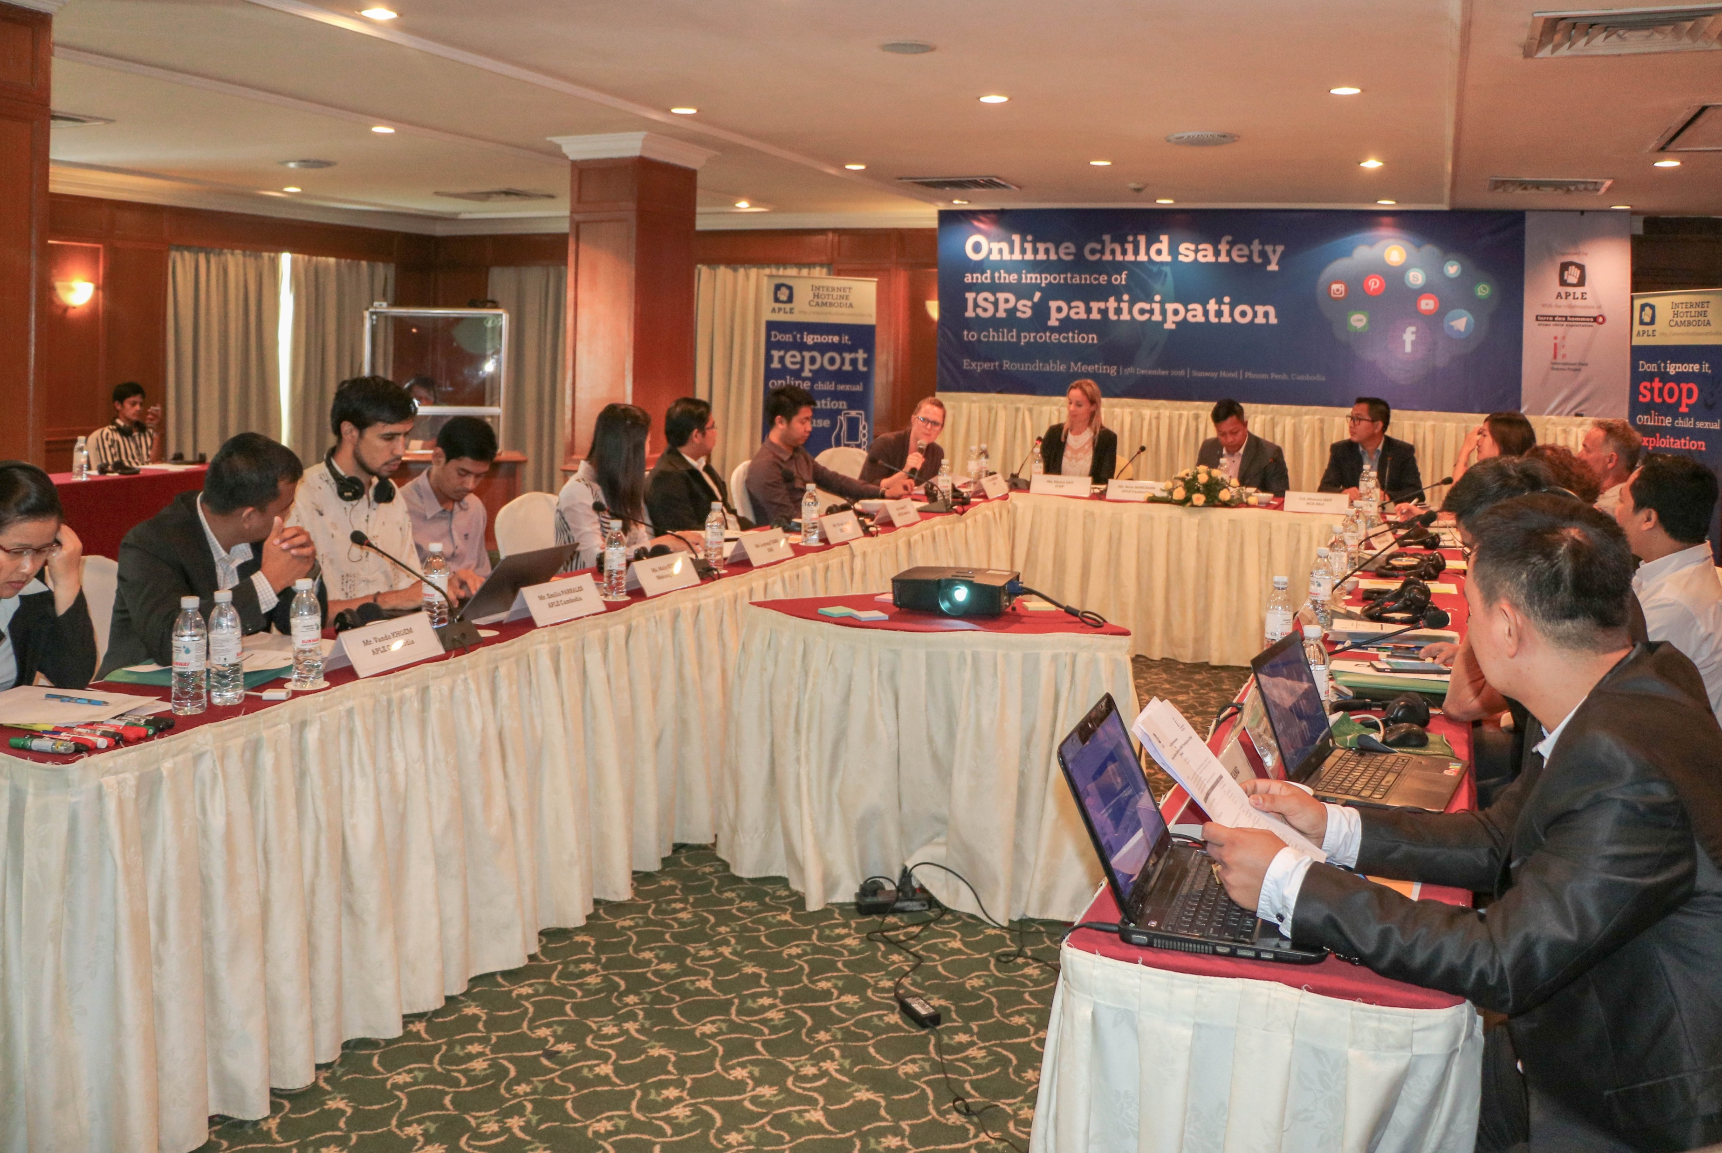
HOW WE PREVENT ABUSE

Slide 12
CHALLENGES
Lacking resources to conduct proactive and thorough cases (legal barrier, personnel, operational cost)
More sophisticated grooming techniques used by traveling sex offenders (Affecting children, families, villages)
Abuse in child welfare organisations/orphanages (Concealed environment, owner’s power of authority, dependence, fear of closure, etc.)
No legislation requiring Employees to provide a criminal check/police clearance (especially those working with children)
Extra-territorial cooperation and legislations not used enough to prosecute traveling child sex offenders

Slide 13
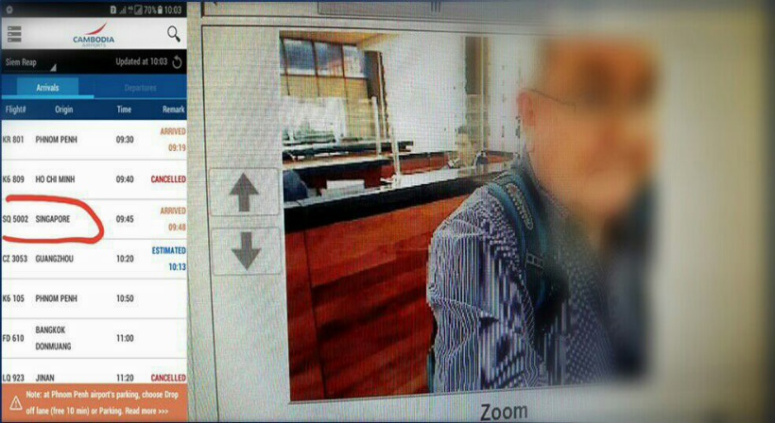
CASE STUDY — Entry Banned
CASE STUDY
Australian suspect
Traveled back and forth to Cambodia
Established contact with Cambodian young adult and his younger brothers and cousins
2013: APLE was alerted of his frequent travels and relationships with children
APLE alerted police promptly
Police pursued the investigation
No abusive disclosure
Cooperation between CNP (AHTJP and GDI) and AFP
Entry ban executed

Slide 14
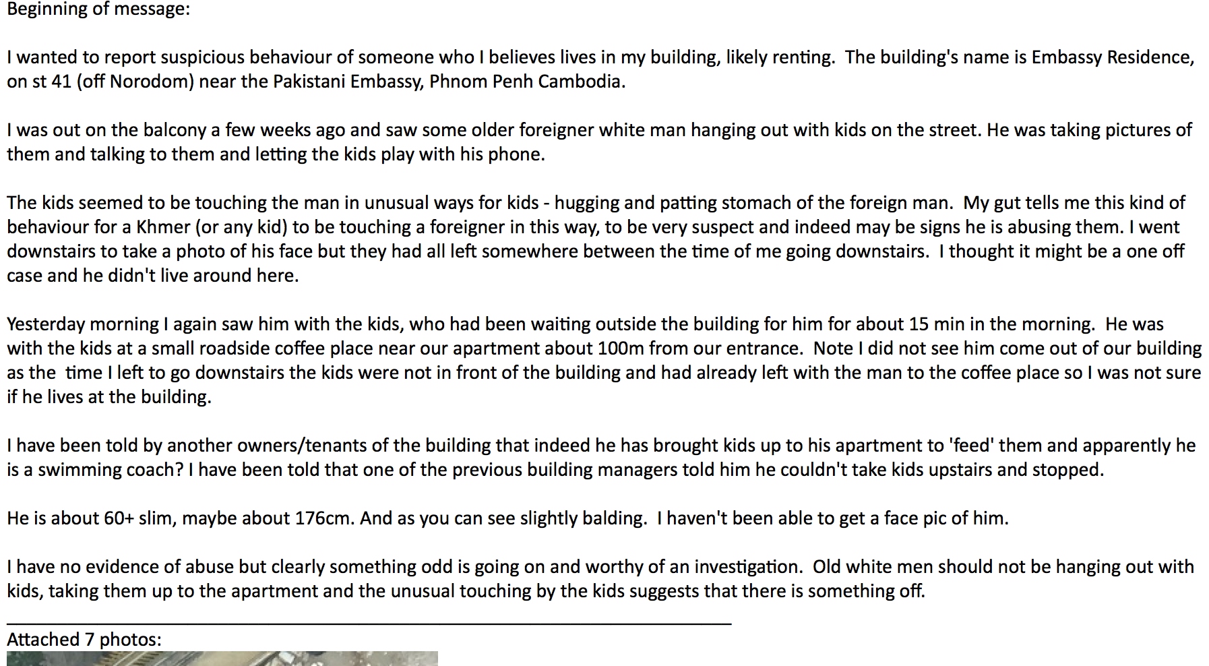
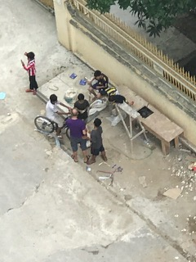
CASE STUDY — Community grooming
CASE STUDY

Slide 15
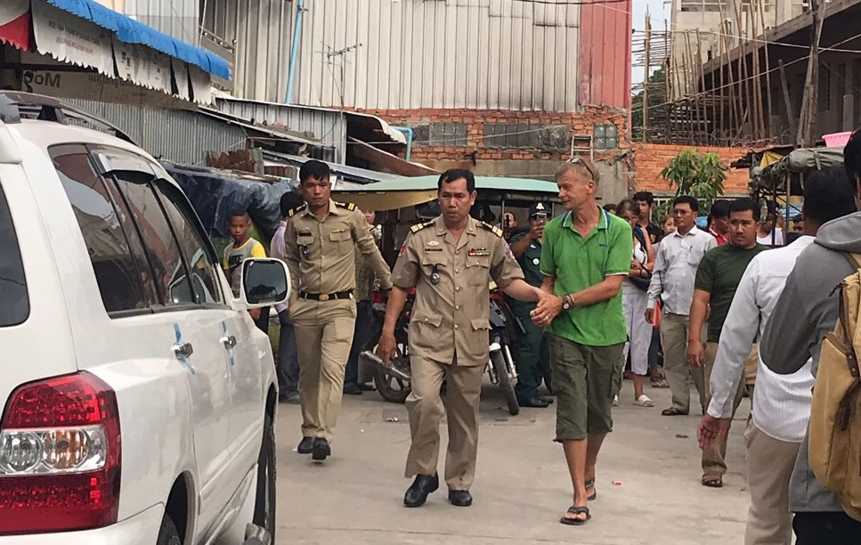
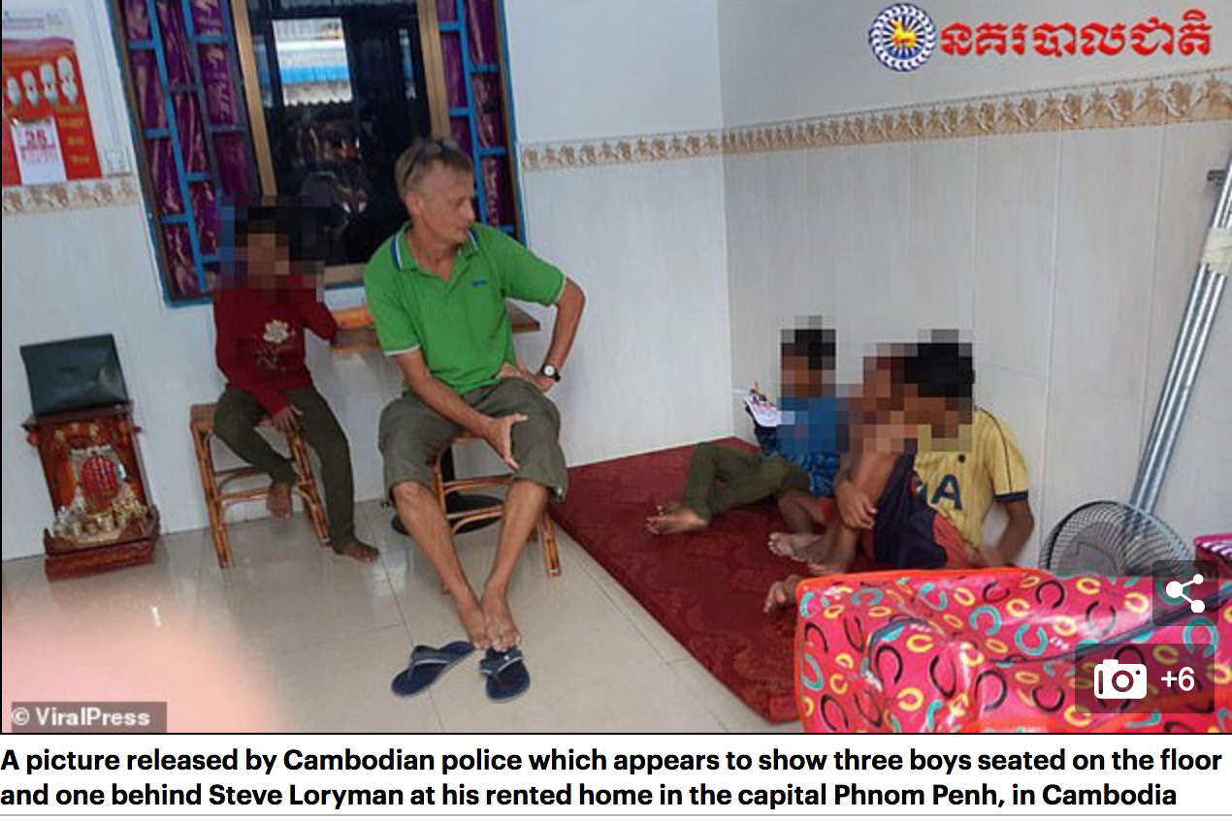
CASE STUDY — Community grooming
CASE STUDY
Loryman, 57, British, teacher and former NGO volunteer
Sept 2018: APLE received a tip-off about his supercilious behaviors in Phnom Penh
Identified Loryman and gathered further intelligence
28 children suspected to have been abused
Referred the case to CNP an contacted NCA for support
Nov, 2018: Loryman was arrested at his home and charged, pending trial

Slide 16
RECOMMENDATIONS
EDUCATE the public and community about grooming techniques
IMPROVE extra-territorial cooperation: Swift information sharing, notification system (between immigration, specialised police & international LE), mutual investigative assistance, expertise support)
STRENGTHEN registration of orphanages and monitoring of their practice (Policy compliance & implementation)
MAKE a criminal check compulsory in law for those working with children
INCREASE government’s resources to protect children (Budget, personnel, equipment, priority)

Slide 17
THANK YOU!
Khoem Vando
Child Protection Specialist
APLE Cambodia, Phnom Penh
Cell: +85592 590 503
Email: k.vando@aplecambodia.org
Site: www.aplecambodia.org

