Slide 1
Australian Federal Police – Intro Slide

Slide 2
Australian Federal Police - Vision

Slide 3
Combatting CSE Online
F/A Paul Onken
Social Media Advisor
AFP Manila

Slide 4
How to use this PowerPoint

Slide 5
Social Media

Slide 6
What is Long Distance Child Abuse (LDCA)?
Definition of LDCA:
“a person using the internet to view, to pay to view, or to provide instructions and view, in real time, child sexual exploitation”.
Notes:
ASK:
What is LDCA?

Slide 7
What is LDCA?
What are the characteristics of LDCA?
The age and gender of the child victim and specific act/s are requested by the offender;
Acts range from nudity to sexual activity between adults and children;
A price is negotiated with the facilitator via online chat for the requested acts;
Funds are sent to the facilitator via an online money remittance service; and
Upon receipt of funds, the abuse or ‘show’ is streamed live online to the offender’s device.
Notes:
ASK:
What are the characteristics of LDCA?

Slide 8
What is LDCA?
Environmental enablers of LDCA?
Access to children;
Internet access;
Reliable money remittance services allowing instant online payment from offender to facilitator;
English is widely spoken; and
Poverty and limited law enforcement reach.
Notes:
ASK:
What environmental factors enable LDCA?

Slide 9
What is LDCA?
What are the law enforcement challenges?
Advances in technology;
Ease of access to the internet;
Tools and knowledge available to offenders to disguise their identity (VPN’s, TOR etc);
Increasing use of the internet by younger children;
International cooperation due to victims and offenders residing in different countries; and
Investigation vs Disruption.
Notes:
Cyber-related child sexual exploitation and abuse poses challenges due to the anonymity of the cyber environment and the related tools and platforms available to offenders to engage with potential victims and mask their true identity.
Advances in technology, the ease of access to the internet, tools and knowledge available to offenders to disguise their identity, and increasing use of the internet by younger children all pose challenges to such investigations. For regulatory authorities and law enforcement agencies, the immediate challenge lies in finding ways to mitigate the risks posed by increased anonymity in The Onion Router and the darknet. Additionally, these matters often cross international borders, which can increase complexity. For example, obtaining foreign evidence can be challenging across all crime types.

Slide 10
What is LDCA?
What is the relationship between LDCA and Travelling Child Sex Offender’s (TCSO)?
LDCA often precipitates offenders travelling abroad to commit contact offences;
Australian Registered Child Sex Offenders (RCSO’s) may seek out LDCA as they are unable to travel;
Both involve the exchange of money;
Both are difficult to prevent, detect and disrupt and requires international cooperation.
Notes:
Cyber-related child sexual exploitation and abuse poses challenges due to the anonymity of the cyber environment and the related tools and platforms available to offenders to engage with potential victims and mask their true identity.
Advances in technology, the ease of access to the internet, tools and knowledge available to offenders to disguise their identity, and increasing use of the internet by younger children all pose challenges to such investigations. For regulatory authorities and law enforcement agencies, the immediate challenge lies in finding ways to mitigate the risks posed by increased anonymity in The Onion Router and the darknet. Additionally, these matters often cross international borders, which can increase complexity. For example, obtaining foreign evidence can be challenging across all crime types.

Slide 11
Referrals?
Referrals can come from many sources
NCMEC
Interpol
Other FLEA, including Financial details
Notes:
Cyber-related child sexual exploitation and abuse poses challenges due to the anonymity of the cyber environment and the related tools and platforms available to offenders to engage with potential victims and mask their true identity.
Advances in technology, the ease of access to the internet, tools and knowledge available to offenders to disguise their identity, and increasing use of the internet by younger children all pose challenges to such investigations. For regulatory authorities and law enforcement agencies, the immediate challenge lies in finding ways to mitigate the risks posed by increased anonymity in The Onion Router and the darknet. Additionally, these matters often cross international borders, which can increase complexity. For example, obtaining foreign evidence can be challenging across all crime types.

Slide 12
Notes:
Cyber-related child sexual exploitation and abuse poses challenges due to the anonymity of the cyber environment and the related tools and platforms available to offenders to engage with potential victims and mask their true identity.
Advances in technology, the ease of access to the internet, tools and knowledge available to offenders to disguise their identity, and increasing use of the internet by younger children all pose challenges to such investigations. For regulatory authorities and law enforcement agencies, the immediate challenge lies in finding ways to mitigate the risks posed by increased anonymity in The Onion Router and the darknet. Additionally, these matters often cross international borders, which can increase complexity. For example, obtaining foreign evidence can be challenging across all crime types.

Slide 13
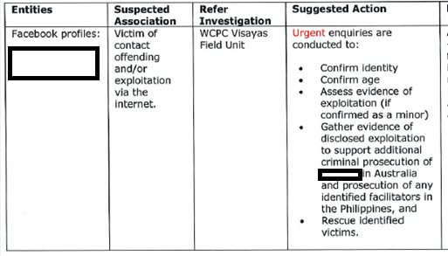
Notes:
Cyber-related child sexual exploitation and abuse poses challenges due to the anonymity of the cyber environment and the related tools and platforms available to offenders to engage with potential victims and mask their true identity.
Advances in technology, the ease of access to the internet, tools and knowledge available to offenders to disguise their identity, and increasing use of the internet by younger children all pose challenges to such investigations. For regulatory authorities and law enforcement agencies, the immediate challenge lies in finding ways to mitigate the risks posed by increased anonymity in The Onion Router and the darknet. Additionally, these matters often cross international borders, which can increase complexity. For example, obtaining foreign evidence can be challenging across all crime types.

Slide 14
Financial referrals
Australia tracks all money that leaves Australia
Reports of ‘suspicious’ transactions to likely LDCA facilitators
Large volumes of money to citizens from multiple counties and offenders is indicative of LDCA

Slide 15
Financial referrals

Slide 16
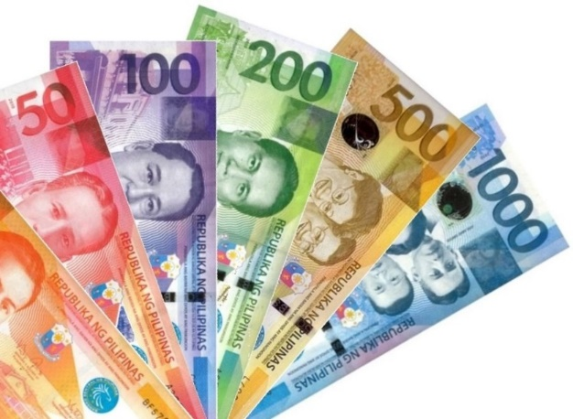
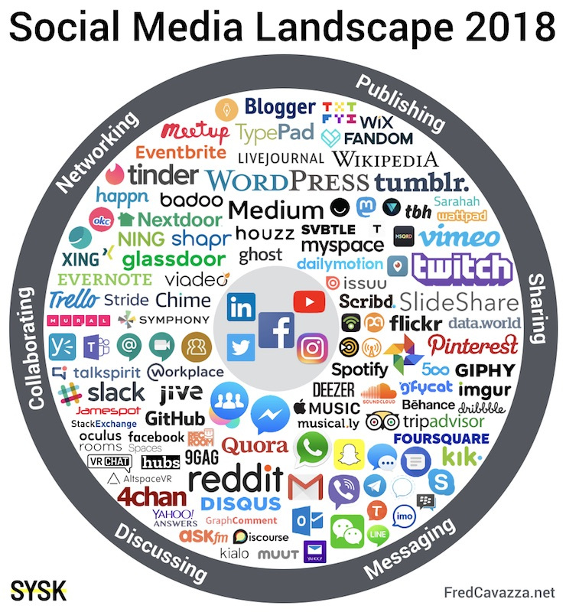
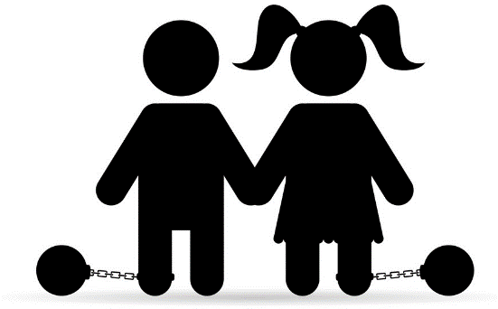
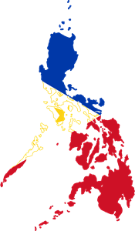
Philippines Online CSE Methodology
Seller/Facilitator
Buyer/Customer
FredCavazza.net

Slide 17
Social Media Indicators
What are some indicators online?
‘Sexy Photos’
Lots of foreign friends
Photos of children – partially clothed
Regular travel overseas to ‘hotspots’

Slide 18
Social Media Indicators

Slide 19
What evidence do we collect?
When looking at the social media accounts of possible offenders what evidence are we trying to capture?
Usernames
Photos
Chat Logs
Associates
Witnesses

Slide 20
How do we collect?
Screenshots
Time and date stamp
Hash Value
Police Statement

Slide 21
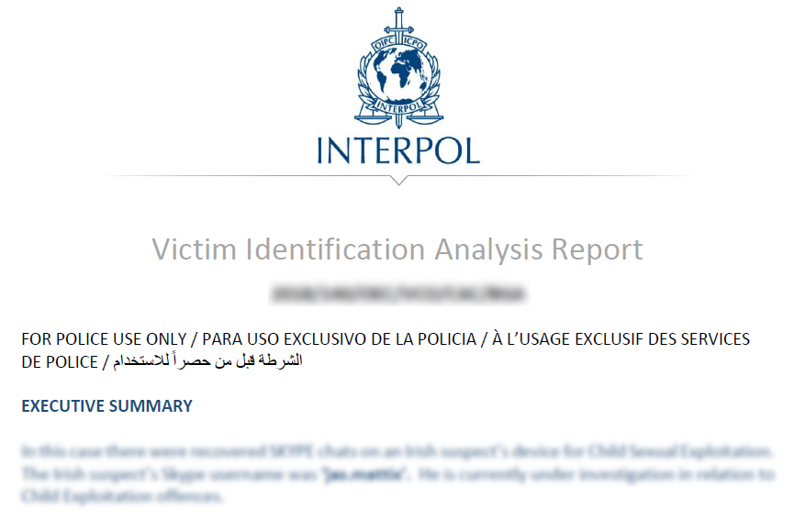

Slide 22
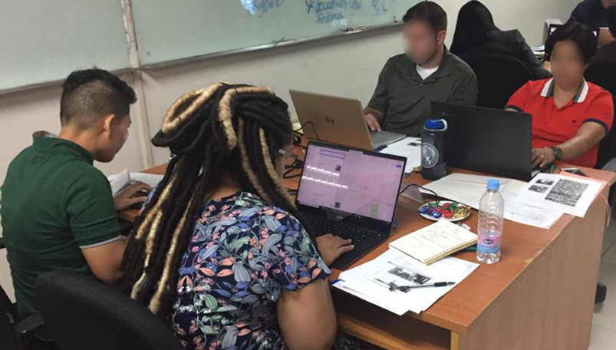
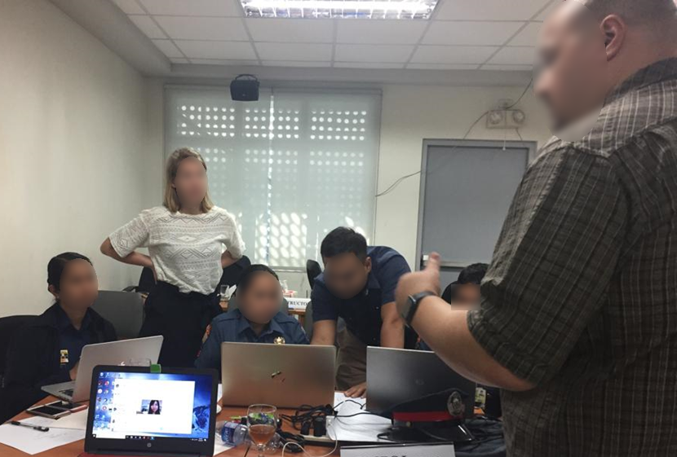
Open source research
Social media investigation
Undercover online engagement
Undercover money transfers
Physical surveillance
Tactical planning

Slide 23
Seller/Facilitator
UNDERCOVER
FredCavazza.net
Notes:
PAUL

Slide 24
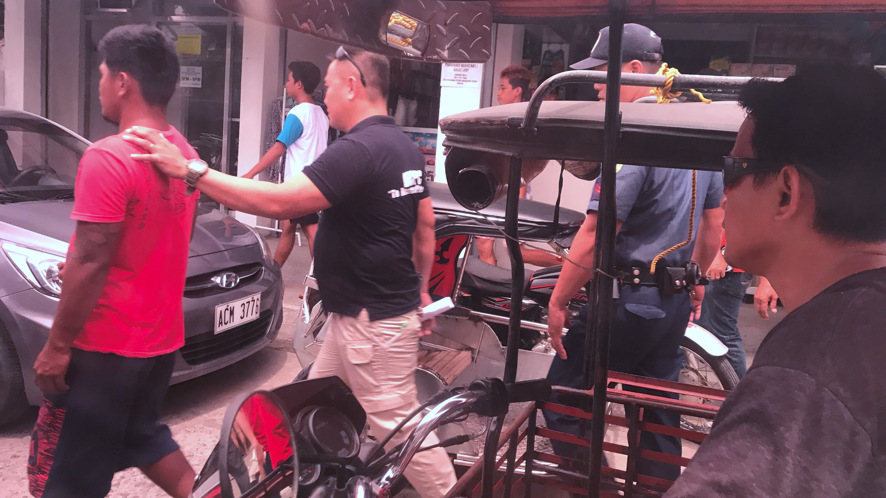

Slide 25
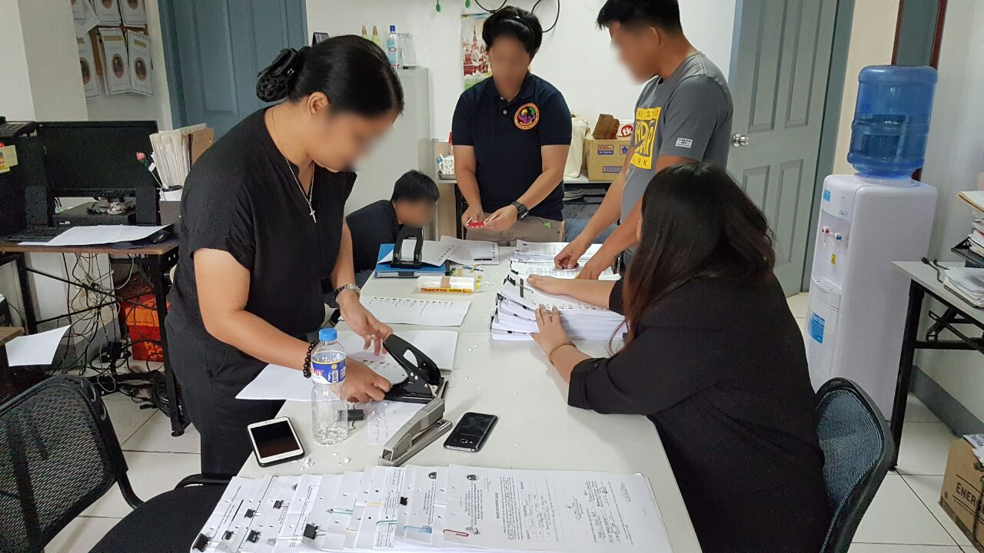

Slide 26
Australian Federal Police – Intro Slide

