Slide 1
Cambodia Child Sexual Exploitation Training Conference (July 2019)
Digital Forensics
Peter HANCOX
Digital Forensics & Cybercrime Advisor – Jakarta
International Operations

Slide 2
Session Overview
This session will cover the role of Digital Forensics in Child Sexual Exploitation investigations, including:
  What is Digital Forensics?
  What are AFP and Cambodian National Police DF capabilities?
  Current Trends and Issues
  Search Warrants – Importance of DF
  International Standards & Admissibility of Evidence
  AFP DF Statements and Reports for Court
  *Plus, demonstrations (acquisitions, analysis, etc) for your awareness of DF tools and tradecraft

Slide 3
Main purpose of this session…
I want to show you a basic overview and promote:
  The importance of Digital Forensics
    Early engagement and investigation planning
    Search warrants (pre seizure)
    The laboratory (post seizure)
  DF Technical capabilities
  CNP DF – use them! (they are your specialists)
Digital Forensics is relatively new in Cambodia
Cambodia is beginning to turn its attention to cyber-enabled crime

Slide 4
Let’s begin with some interesting stats!

Slide 5
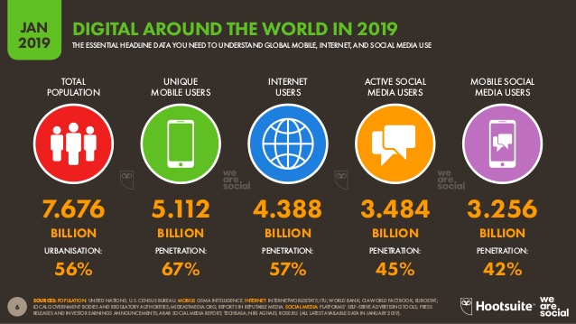

Slide 6
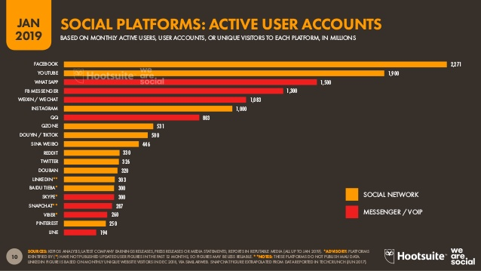

Slide 7
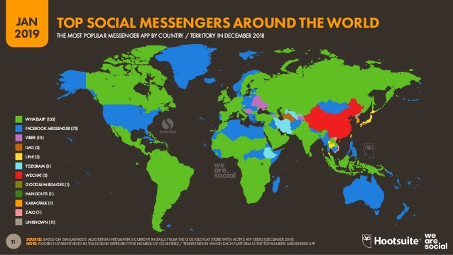

Slide 8
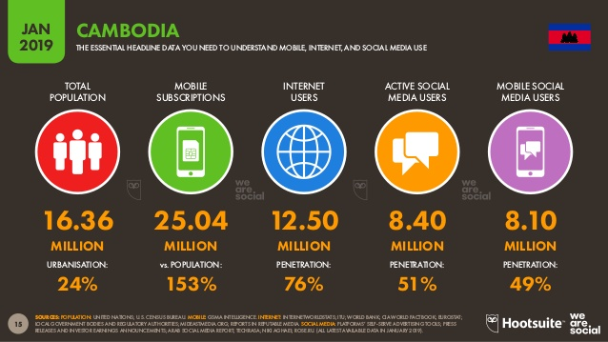

Slide 9
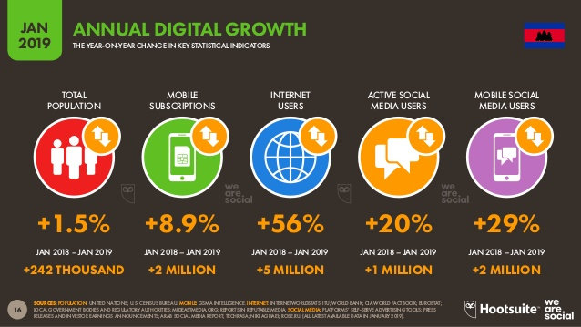

Slide 10
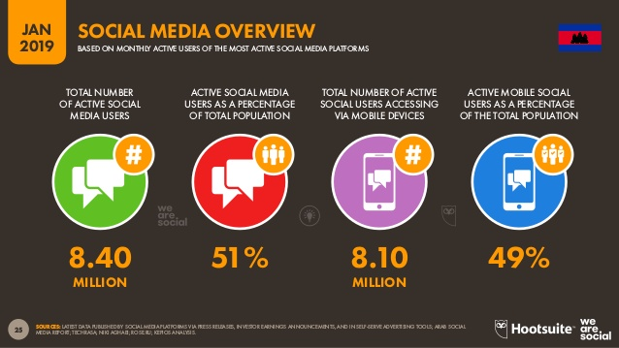

Slide 11
What is Digital Forensics?
Digital Forensics is the preservation, acquisition, and analysis of data contained on electronic devices such as computers, external storage devices and mobile phones.

Slide 12
Role of Digital Forensic Examiner
Attendance at search warrants
Examination of: CCTV, computers, mobiles, printers, PDAs, USB devices = Any electronic items that may hold evidence
Obtaining a forensically sound copy of electronic evidence
Data recovery (deleted files)
Password recovery and Decryption
Interpreting evidential material and report production
Court attendance to provide factual and expert opinion evidence

Slide 13
Electronic investigation Life Cycle
Planning
Scene Attendance
Identification
Preservation
Acquisition
Processing
Examination
Reporting
Courtroom Testimony
Pre seizure
Post seizure

Slide 14
Electronic investigation Life Cycle
Planning
Scene Attendance
Identification
Preservation
Acquisition
Processing
Examination
Reporting
Courtroom Testimony
Reviewing Forensically Acquired Electronic Data

Slide 15
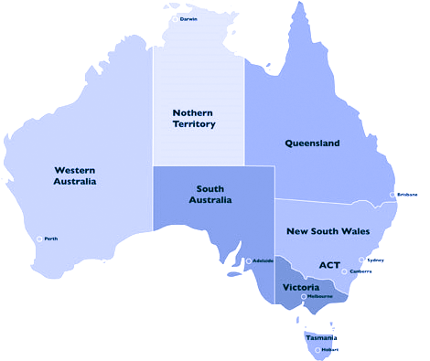
AFP Digital Forensics – Locations
Brisbane
Perth
Sydney
Adelaide
Canberra
Melbourne

Slide 16
Who do AFP DF Support?
AFP Digital Forensics support the following Investigation types:
  Counter Terrorism
  Child Sexual Exploitation
  Cyber Crime
  People Smuggling
  Fraud & Anti-Corruption
  Drugs (Import/Exportation)
  International Operations

Slide 17
CNP Digital Forensics
Part of the Anti Cyber Crime Department established in September 2015
CNP Digital Forensics Team Structure:
Chief of Office
First Response Section
Mobile Forensic Section
Computer Forensic Section
Deputy Chief of Office
Malware Analysis Section

Slide 18
Admissibility of DF Evidence in Court
Admissibility – the quality of being acceptable or valid
Basic standards in Digital Forensics include:
  Integrity of data i.e. write-protection, hashing
  Verification of results
  Chain of Custody principles
  Repeatability of findings
  Quality of DF report and interpretation of findings
We will go into this in greater detail throughout this session

Slide 19

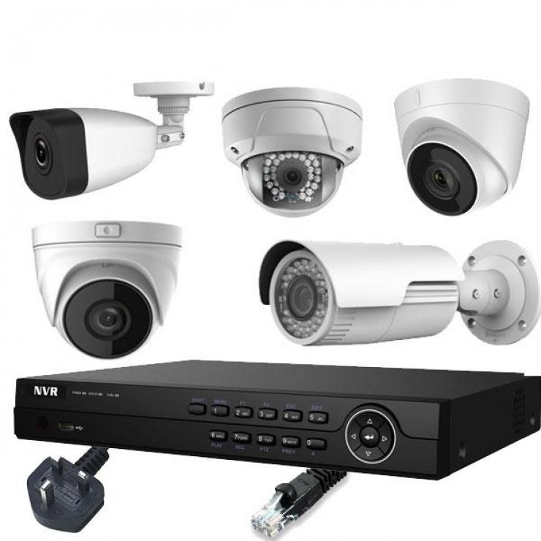

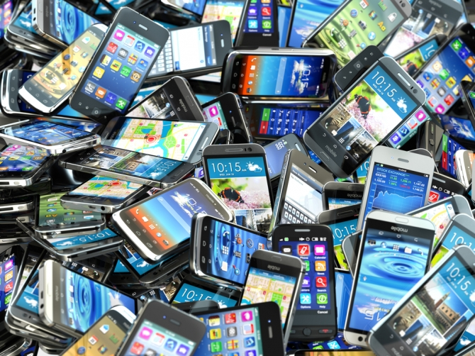
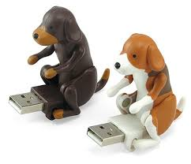
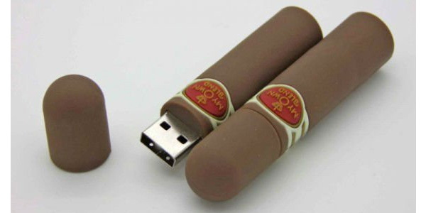
Source of Electronic Evidence

Slide 20

Sources of Electronic Evidence

Slide 21
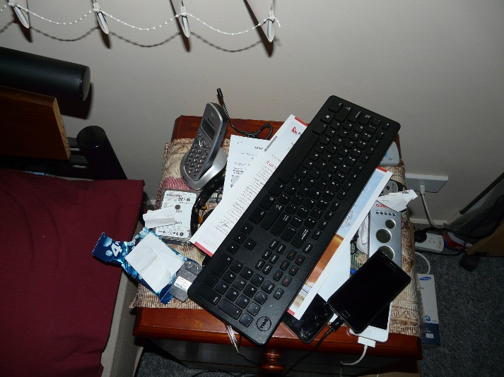
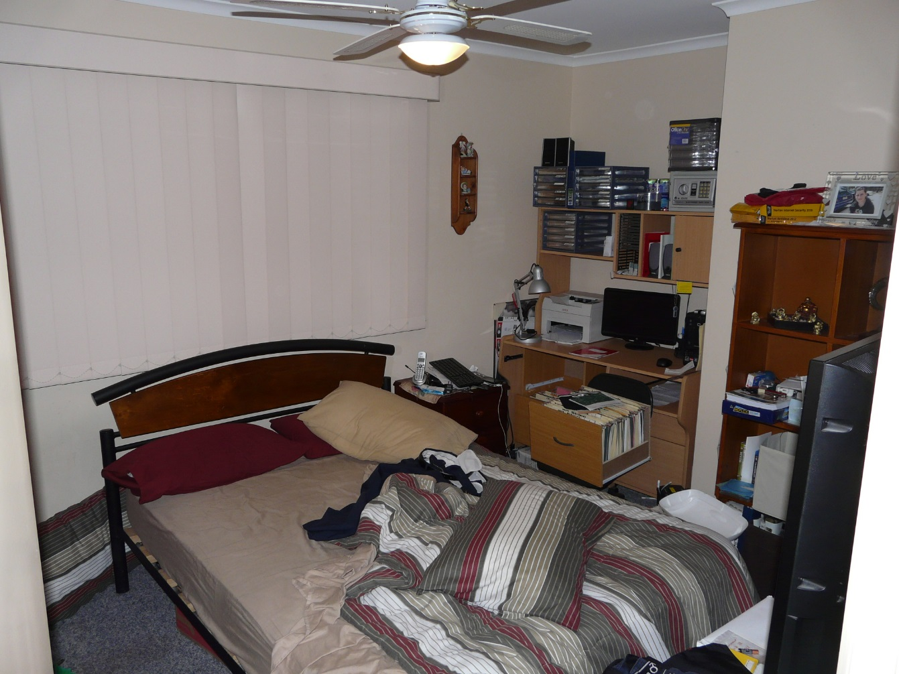
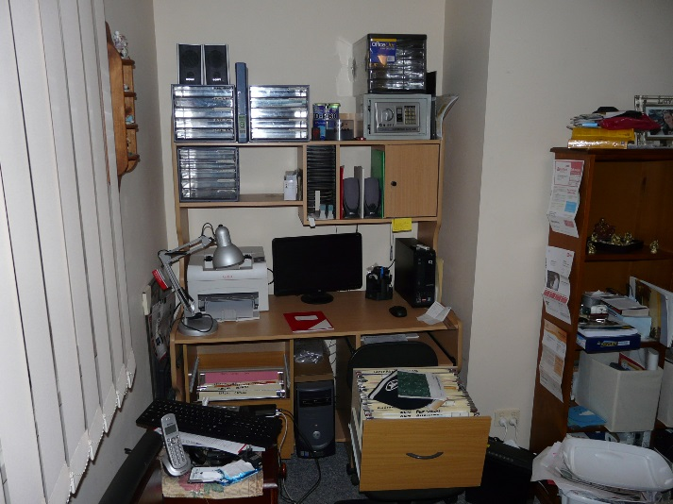
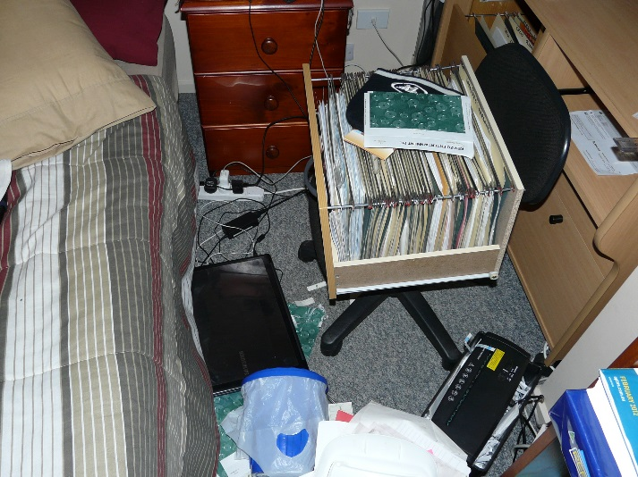
160GB ‘Fujitsu’ HDD containing:
567 x child pornography picture files
173 x child pornography video files
‘Samsung Galaxy S II’ containing:
Indicative CP Internet history
‘Apple iPhone 4’ containing:
Indicative CP Internet history
‘Dell’ midi tower containing:
71 x child pornography picture files
6 x child pornography video files
‘Samsung RC720’ laptop containing:
1,911 x child pornography picture files
2,482 x child pornography video files

Slide 22
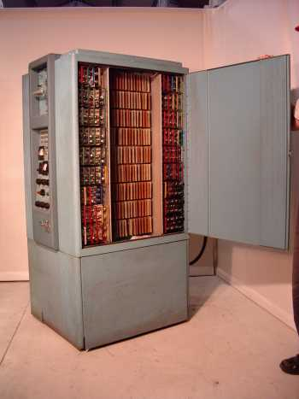
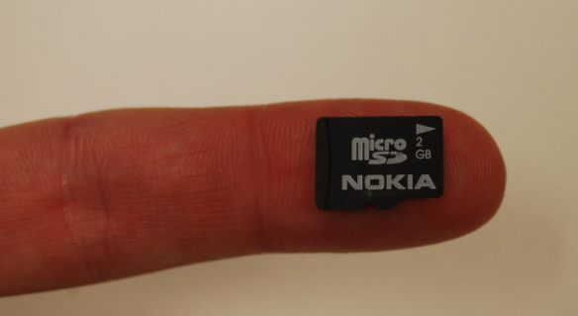
Challenges – Data Volumes
This would fit 10 Microsoft Word documents with 1 word in each document
496,000+ times
more storage
32GB microSD card
1960s computer

Slide 23
Challenges – Data Volumes
Needle in a haystack...
MicroSD Card

Slide 24
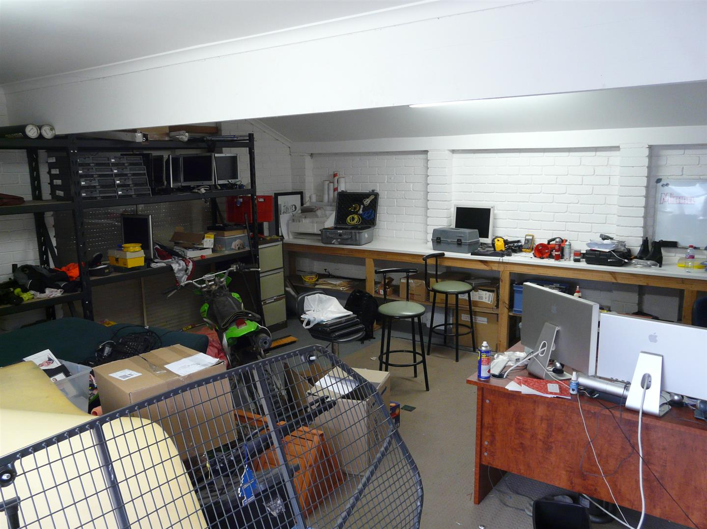
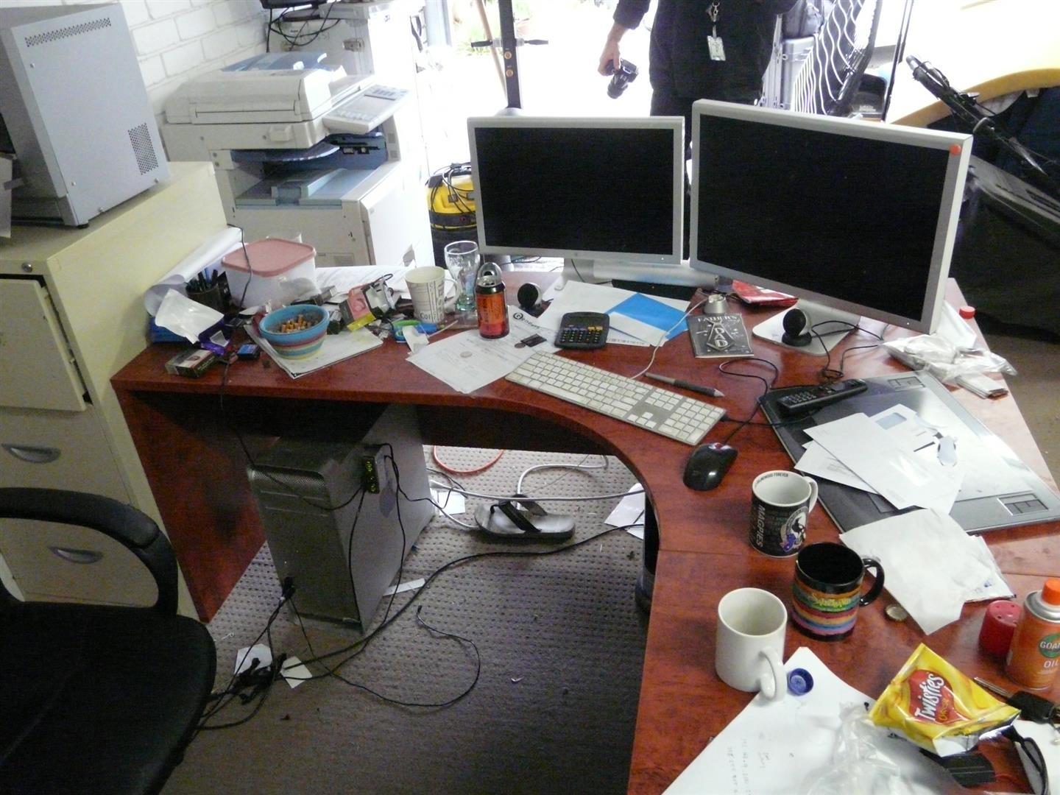
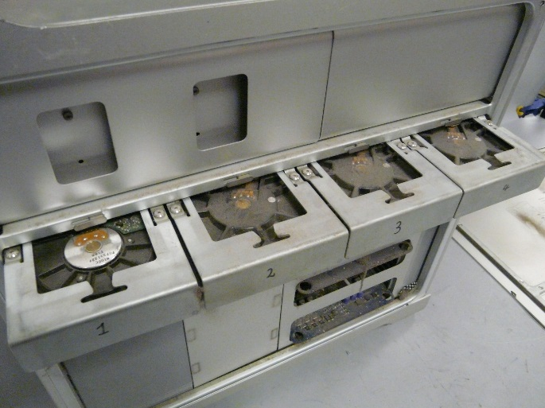
Challenges – Data Volumes

Slide 25
Challenges – Data Volumes
Amount of seized data is growing exponentially. 4TB HDDs can take 36+ hours to image/acquire
Modern smart phones have come with large built-in memory. Can take 2-24 hours+ to download
Keyword searches are now taking days instead of hours
People commonly own multiple computers and mobile phones, which takes investigators much longer to review and analyse

Slide 26
Awareness Demonstration
Basic principles of Admissible Evidence in DF
  Acquisition & Integrity of Data
  Verification
  Repeatability
USB Exhibit – Acquisition
  USB flash memory drive exhibit
  Importance of verification process
  Explain hashing (with demonstration)

Slide 27
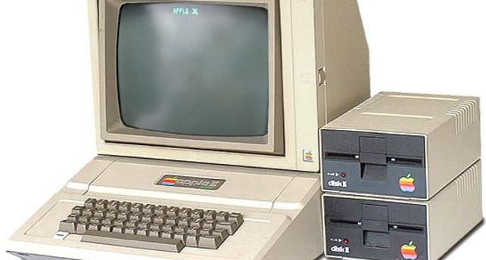
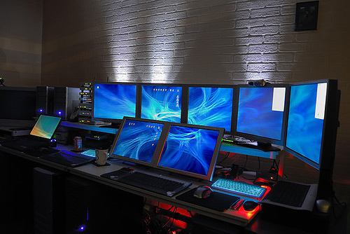
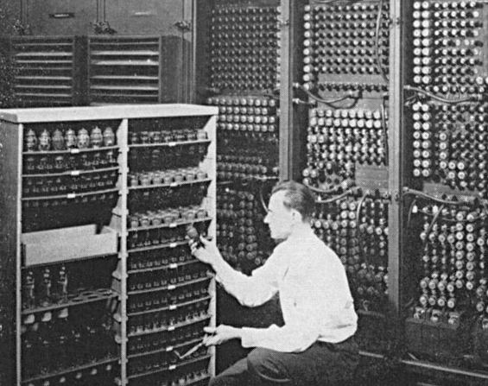

The Changing Face of Electronic Evidence

Slide 28





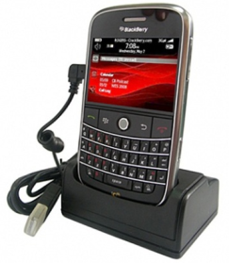
Historically

Slide 29















Now…

Slide 30

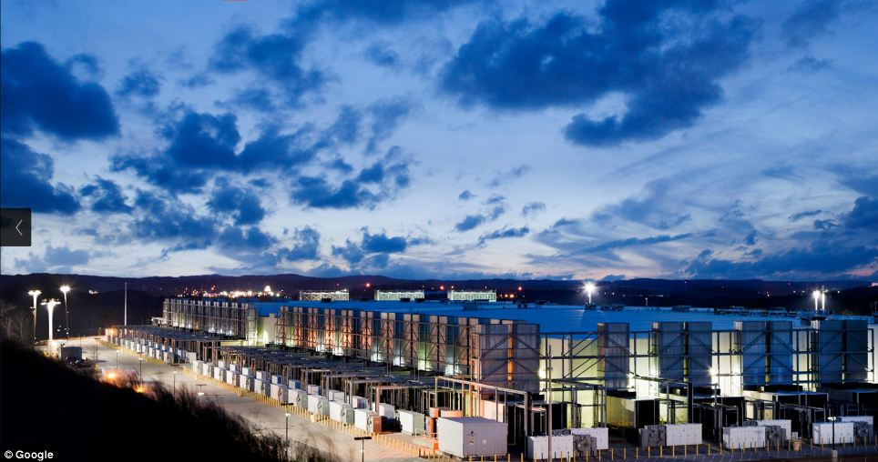
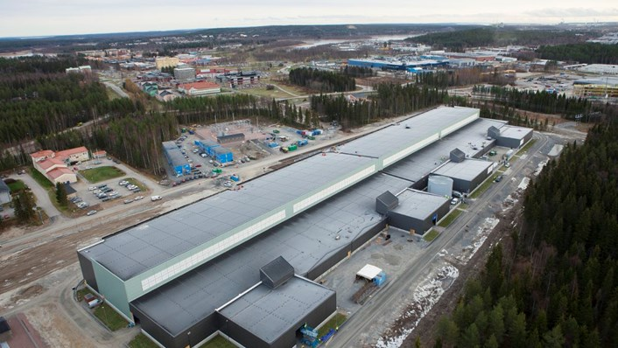
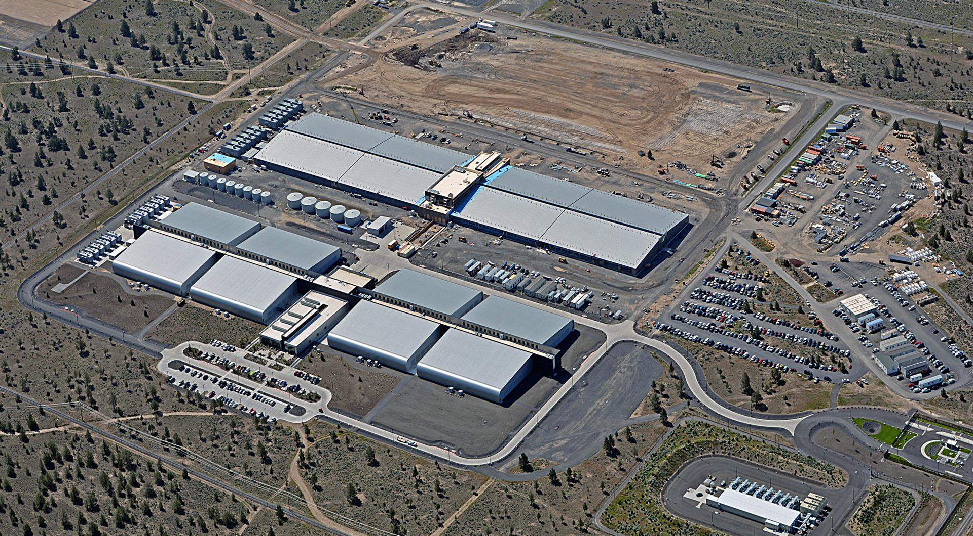
Now…

Slide 31
Cloud Computing
Information potentially available in the Cloud:
  Account names
  IP addresses
  Registration details (name, address, etc)
  Payment / Credit Card details
  Other linked or associated accounts
  Contact lists, Task lists, Friend lists
  Chat logs
  Stored files
  Emails
  Cryptocurrency / Wallets

Slide 32
Online or Cloud Content
Capturing Tools
Can be used for capturing basic online or cloud data while maintaining data integrity
Tools for screen capturing, web page saving, etc:
  Greenshot
  FastStone Screen Capture
  Print to PDF (PDFCreator)
  VMWare “Capture Movie”
  HTTrack Website Copier
  Hunchly
  SnagIt
  Camtasia
  WPS (Web Page Saver)

Slide 33
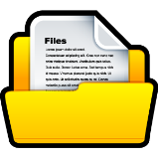


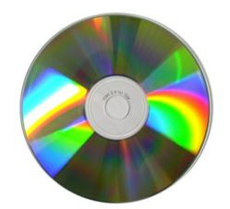
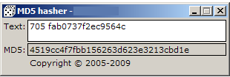




Integrity of Captured Content

Slide 34
Awareness Demonstration
Screen Capture Techniques
  Recording a video of screen content
  Capturing a web page
  Creating an Evidence Container

Slide 35
Challenges – Encryption
More and more people are using encryption
On an Apple Macintosh, user encryption is built-in
Encrypted mobile phones
Programs such as VeraCrypt can be downloaded free of charge and are very easy to use
Advanced vendor encryption (e.g. Microsoft Office)

Slide 36
Awareness Demonstration
Password Cracking
  Windows User Account
  Microsoft Word
  Zip Archive

Slide 37
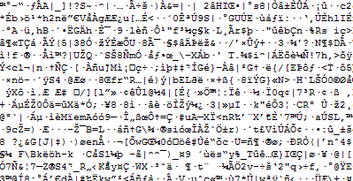
Challenges – Encryption
What is encrypted data?
Needs a password, a key, a hardware device to be decrypted and turned into a viewable file(s)
Example of encrypting a file using True/VeraCrypt
ENCRYPTION!!!

Slide 38
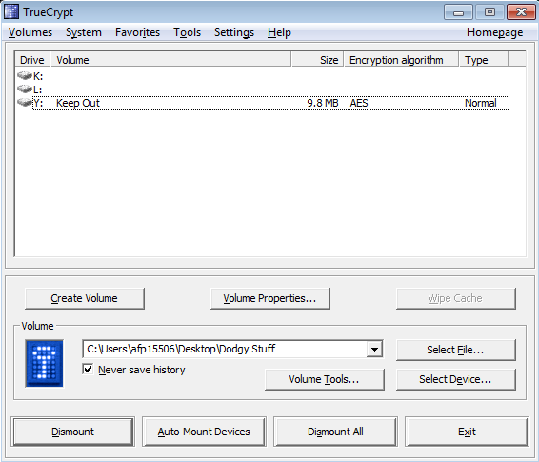

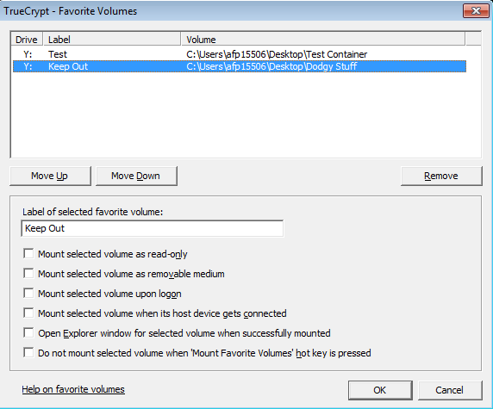
Challenges – Encryption

Slide 39
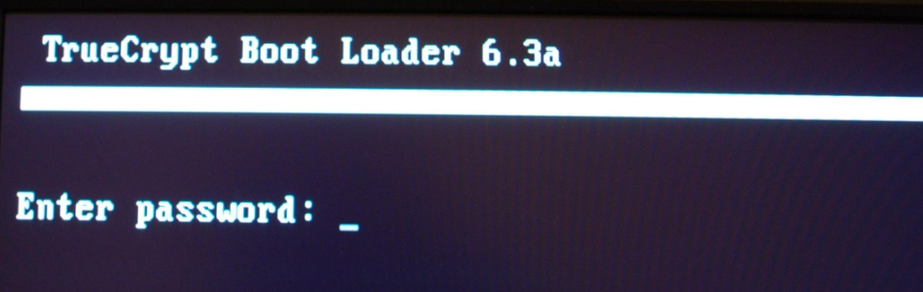
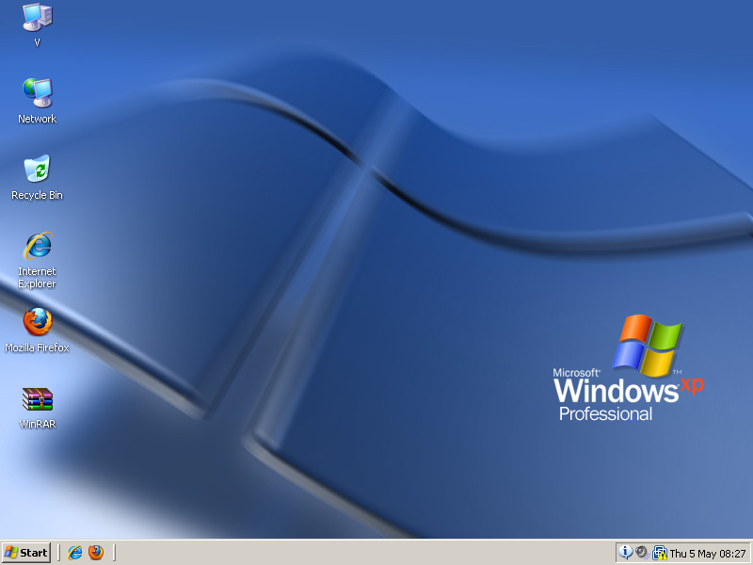

Challenges – Encryption
Password: “peter123”
Password: “letmein567”

Slide 40
Awareness Demonstration
Encryption using VeraCypt
  Creating encrypted containers
  Hidden volumes within containers (2 x passwords)
  Identifying potential encrypted containers

Slide 41
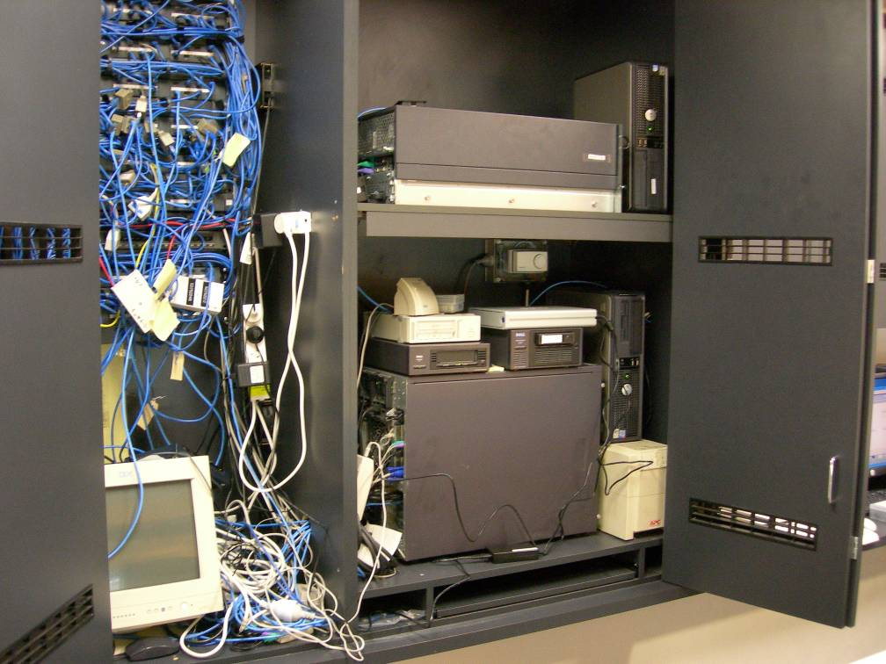
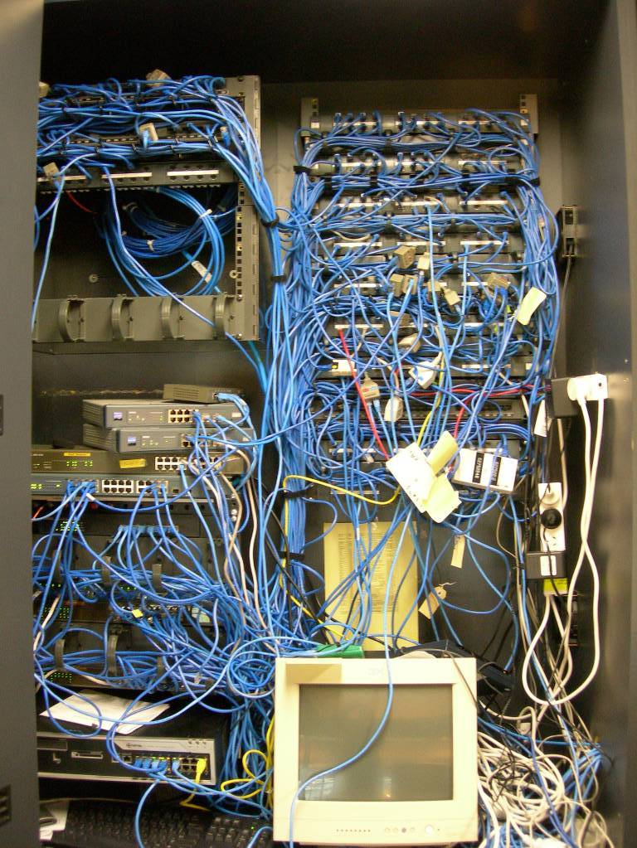
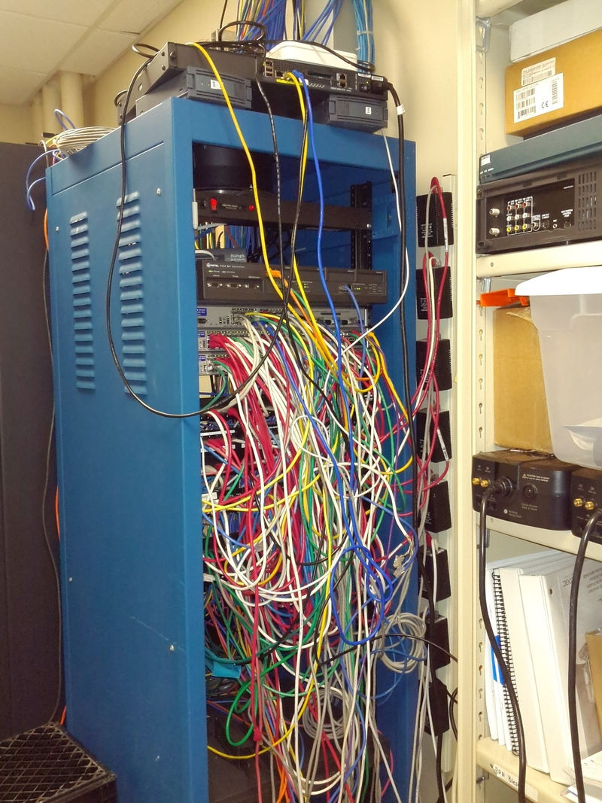
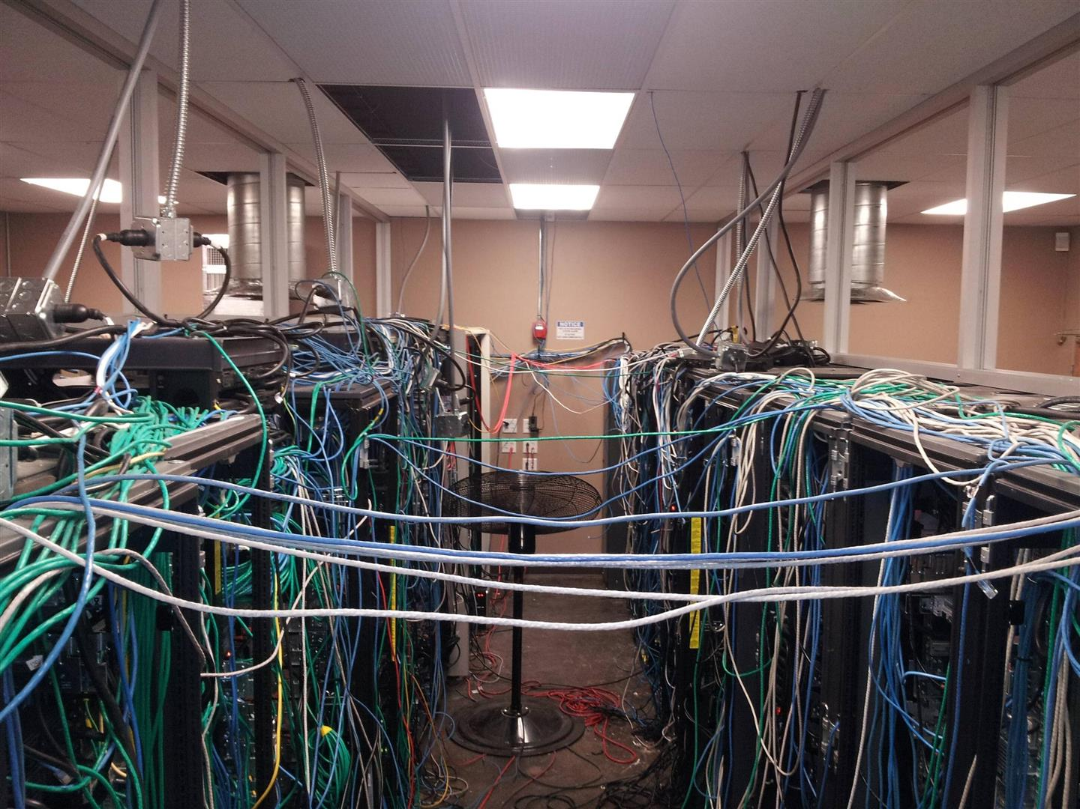
Challenges – Business Settings

Slide 42
Challenges – Business Settings
Sometimes may require assistance from Administrators (who are not always on-site)
Can be complex and contain large amounts of data
Offsite storage is common
‘Live’ forensics or examinations is typically required

Slide 43
Awareness Demonstration
‘Live Forensics’ & Archiving Accounts
  Memory dumps – very important
  Running processes
  USBs recently connected
  Wi-Fi passwords
  Gmail & Facebook Archiving

Slide 44
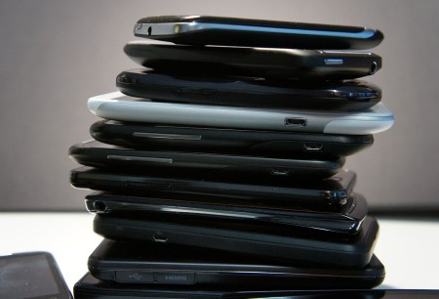
Mobile Phone Forensics

Slide 45
Mobile Phone Forensics
I can talk about mobile phone forensics for weeks!
BUT, here are a couple of important things to note…

Slide 46
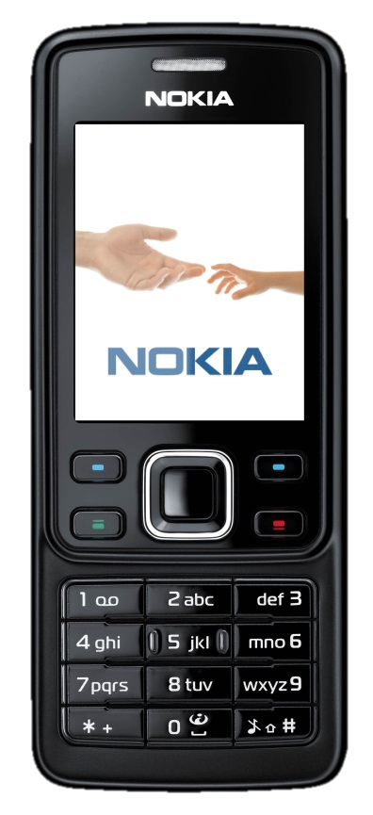
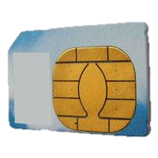
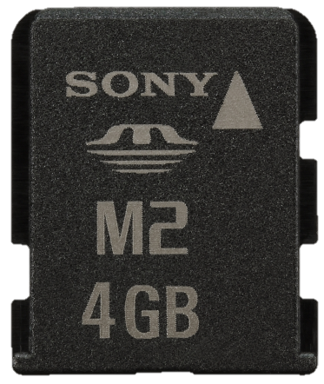
Times have changed with Mobile Forensics
Gone are the days of a simple examination process:

Slide 47
Today it’s much more complex…
Encrypted handsets
Biometrics
Cloud storage
Data capacity i.e. 1TB built-in storage + memory cards
Encrypted applications
Difficulties in extracting data e.g. JTAG and chip-off
Have a look at your own device…

Slide 48
HOW SECURE IS YOUR DEVICE?
  ENCRYPTED DEVICE MEMORY?
  ENCRYPTED MEMORY CARD?
  OPERATING SYSTEM UPDATES?
  LATEST SECURITY PATCHES?
  PASSWORD PROTECTED?
  BIOMETRIC / FACE /FINGER?
  SWIPE PIN CODE SMUDGE TEST?
  FIND MY DEVICE/iPHONE ENABLED?

Slide 49
  PHYSICAL OR LOGICAL EXTRACTION AVAILABLE?
  FILE SYSTEM EXTRACTION AVAILABLE?
  MTK BACKUP AVAILABILITY?
  ROOT / JAILBREAK AVAILABLE?
  RECOVERY PARTITION INSTALLED?
  LOCK SCREEN VULNERABILITY?
  JTAG / CHIP OFF AVAILABLE?
  CLOUD BACKUP ENABLED / PC SYNC?
  ENCRYPTED APPLICATIONS?

Slide 50
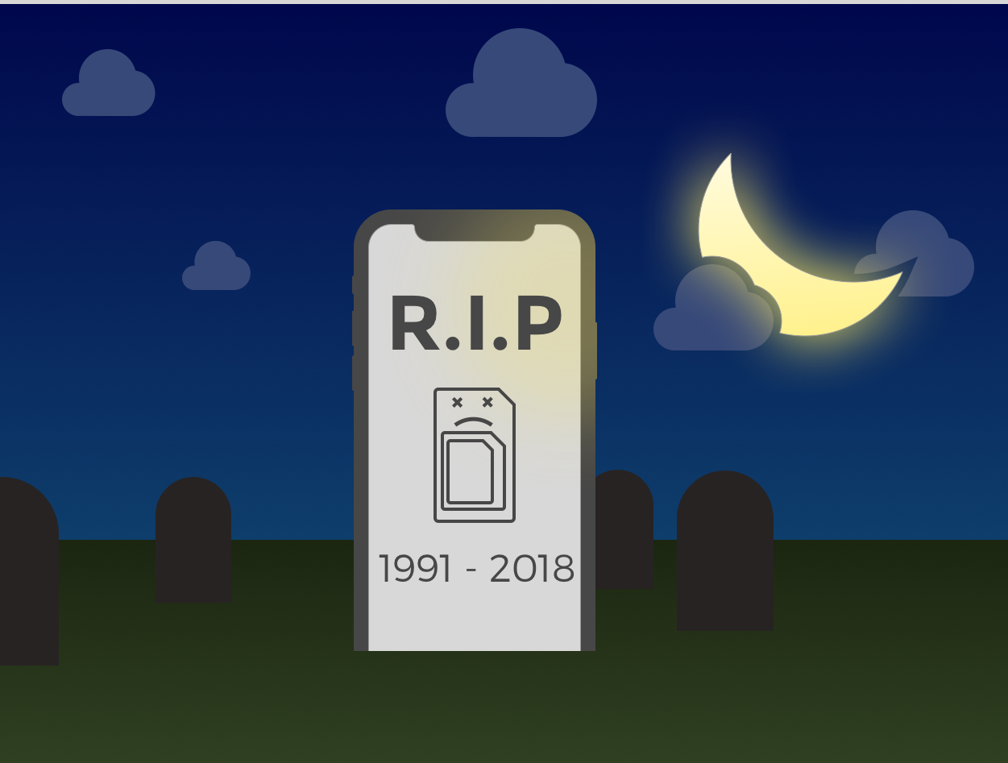
Future: e-SIM

Slide 51
Future: e-SIM
Devices in the next few years will likely have a virtual SIM card functionality, and not require a telco issued SIM card.
This functionality is referred to as ‘e-SIM’
New Apple iPhones using dual SIMs (1 being an e-SIM
Virtual SIMs will be downloaded over the air
May make it easier for criminals to hide multiple SIM usage

Slide 52
Potential Evidence Related to Mobile Phones
Source | What Evidence | Description
Budget/Feature Phone | Hardware | Date and Time, IMEI
 | User Created Information | Address Book, SMS, Calendar, Calls.
SMART Phone | User Created Information | Photographs, video, audio, GPS waypoints, stored voicemail, misc. files.
 | Internet Related Information | Online accounts, purchased media, email, internet usage; social networking.
 | Installed 3rd Party Applications | Alternate messaging platforms, additional capabilities.
Local Workstation | Transferred Information | Tethered devices, back ups of handsets, back up of purchased media

Slide 53
Potential Evidence Related to Mobile Phones
Source | What Evidence | Description
Carrier | Tracking Information | Connected cell towers, location of handset.
 | Usage Information | Billing Information; call registers; internet/data usage; messages not delivered.
SIM Card | Identifiers | Subscriber identifier (IMSI); SIM card identifier (ICC-ID)
SIM Card | Usage Information | SMS; Address book, last dialed numbers; last cell tower;

Slide 54
Types of Phone Extractions
A logical extraction copies user data from areas of the storage media that hold existing data only.
A file system extraction copies user and system data from areas of the storage media that hold data only.
A physical extraction involves copying data from the device's storage media, including deleted data (closest to a forensic ‘bit for bit’ image).
A logical extraction may be faster than a physical extraction
Some devices cannot be physically extracted.
Logical extractions may recover some deleted data depending on the phone and operating system version.

Slide 55
Types of Examinations
Logical
SMS
Call Logs
File System
SMS
Files
Physical
SMS
Contacts
Media
App data
Contacts
Call Logs
Media
App data
Hidden Files
Contacts
Call Logs
Media
App data
Files
Hidden Files
Deleted Data

Slide 56

Types of Examinations
Chip off & Decryption
JTAG
Physical
Logical and File System
Logical
Manual Examination

Slide 57
Awareness Demonstration
Mobile Phone Extraction
  Logical extraction using Cellebrite UFED 4PC
  Overview of acquired data in Cellebrite Physical Analyzer

Slide 58
Legislation Relevant to DF
Crimes Act 1914
  Electronic Evidence primarily in Sections 3K – 3Z
Legislation relevant to Digital Forensics:
  3K – the ‘14-day Provision’
  3L(1) – operate electronic equipment at premises
  3LA – compel POI to provide information or assist
  3ZQV – electronic equipment may be operated after it has been seized or moved
I will explain these concepts in more detail

Slide 59
Recent Visits to Cambodia
3-7 June 2019
Digital Forensics & Cellebrite UFED Training:
  Search warrants – triaging of devices
  Write-protection and forensic integrity of evidence
  Standard Operating Procedures and BPGs
  Acquisition techniques
  Analysis tools
  Mobile phone forensics using Cellebrite UFED

Slide 60
Recent Visits to Cambodia
3-9 April 2019
Request for AFP Digital Forensics to assist CSE investigation
Hosted by CNP Anti Cyber Crime Department
Fifteen (15) electronic exhibits – large amount of data to be acquired in short period of time
AFP required forensic copy of all electronic items for further investigation
Gained good understanding of CNP DF capabilities and current issues they face
CNP DF exposed to how AFP DF perform role

Slide 61
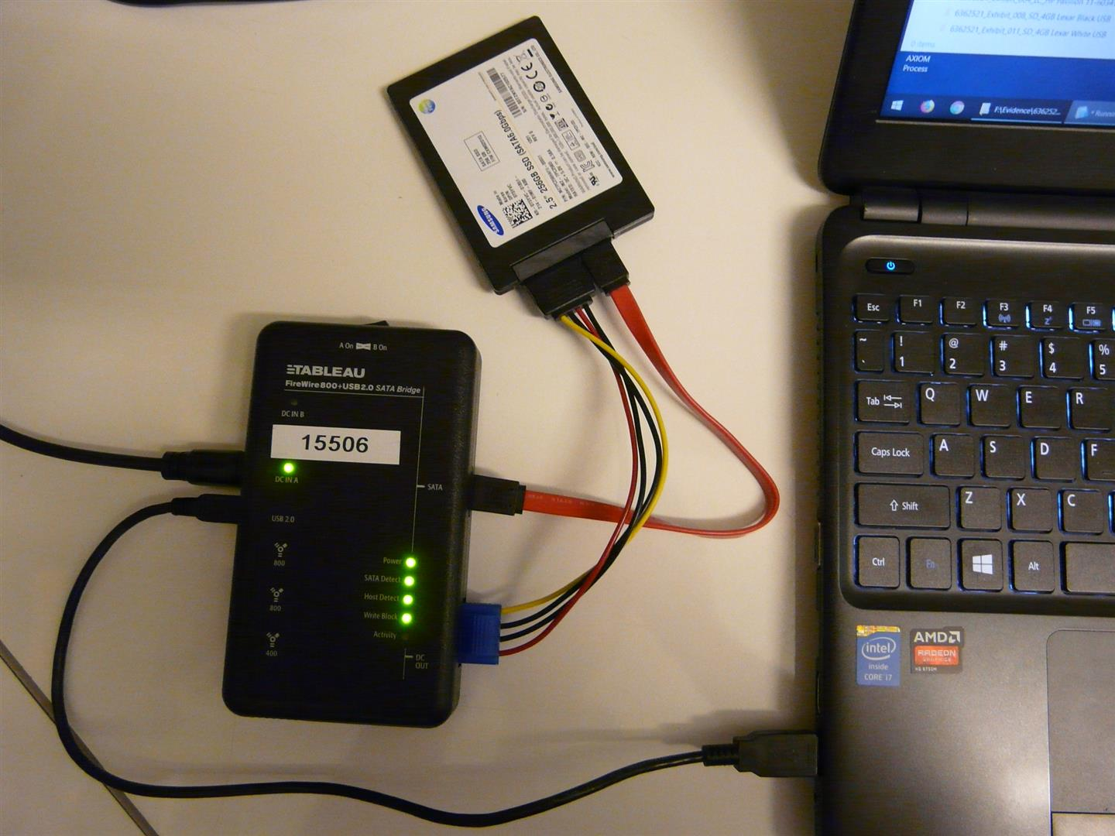
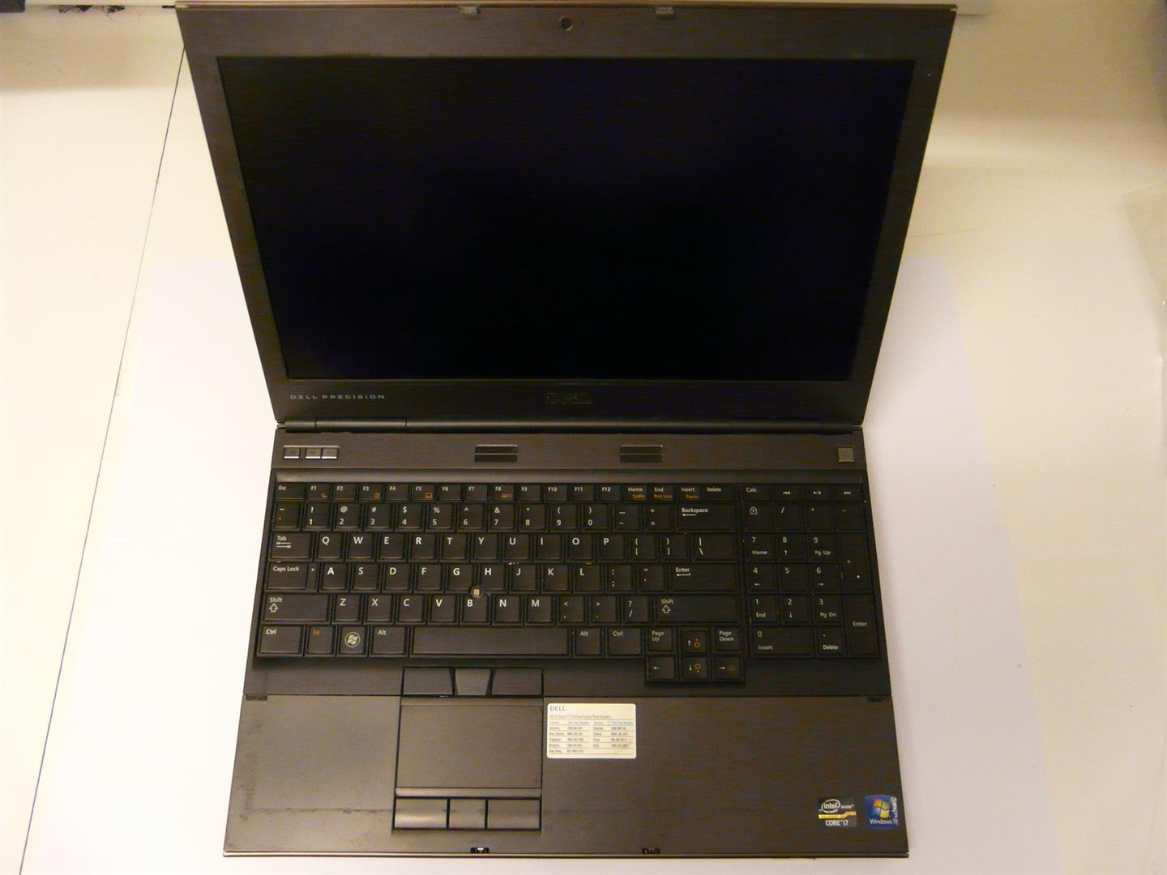
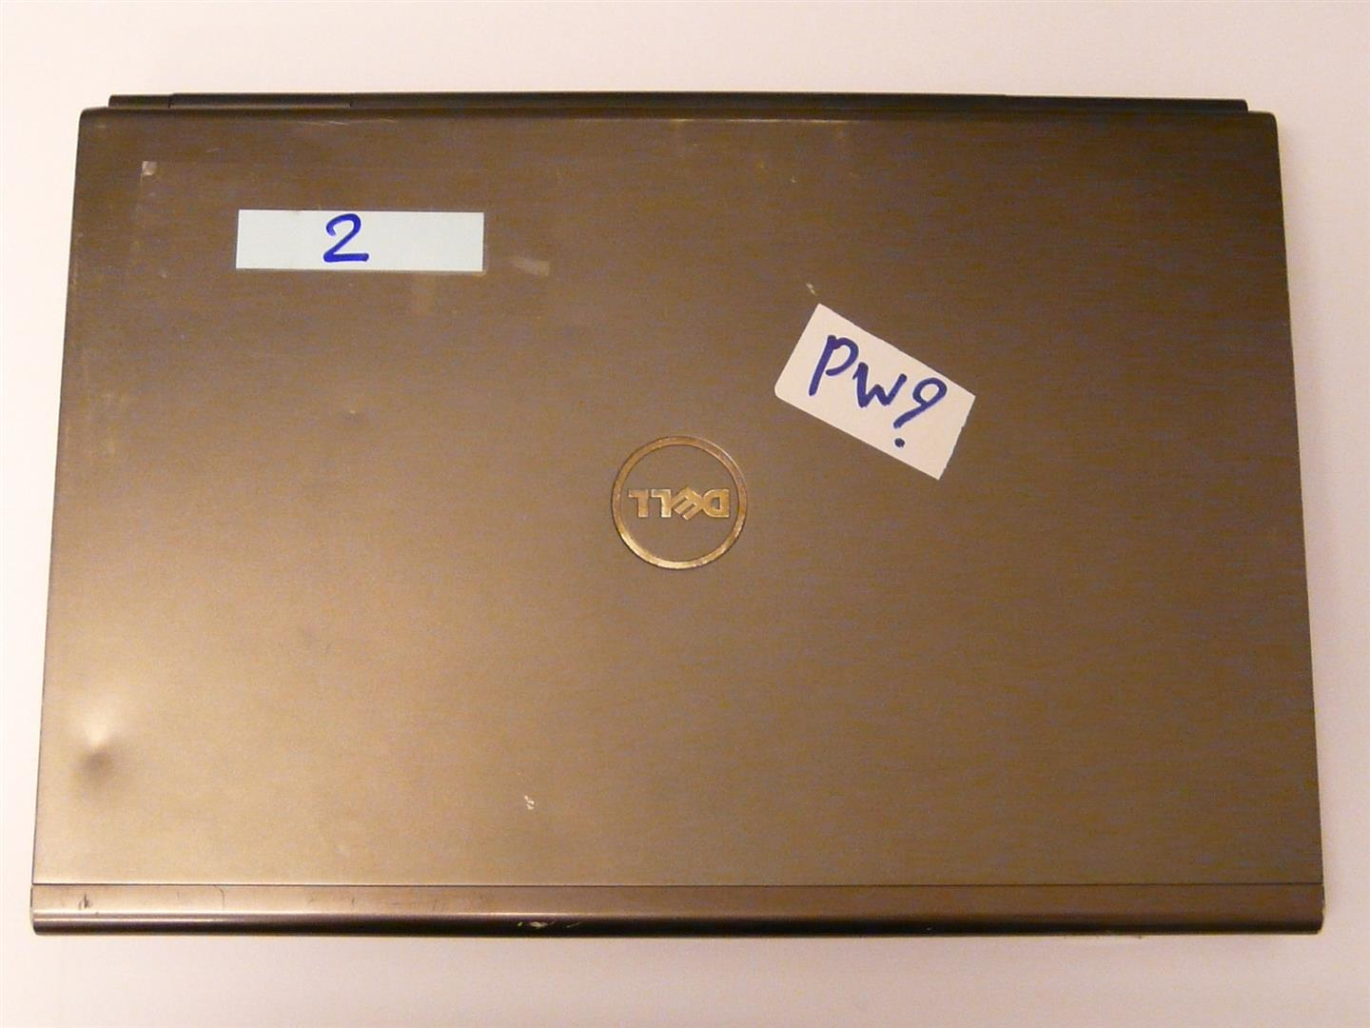
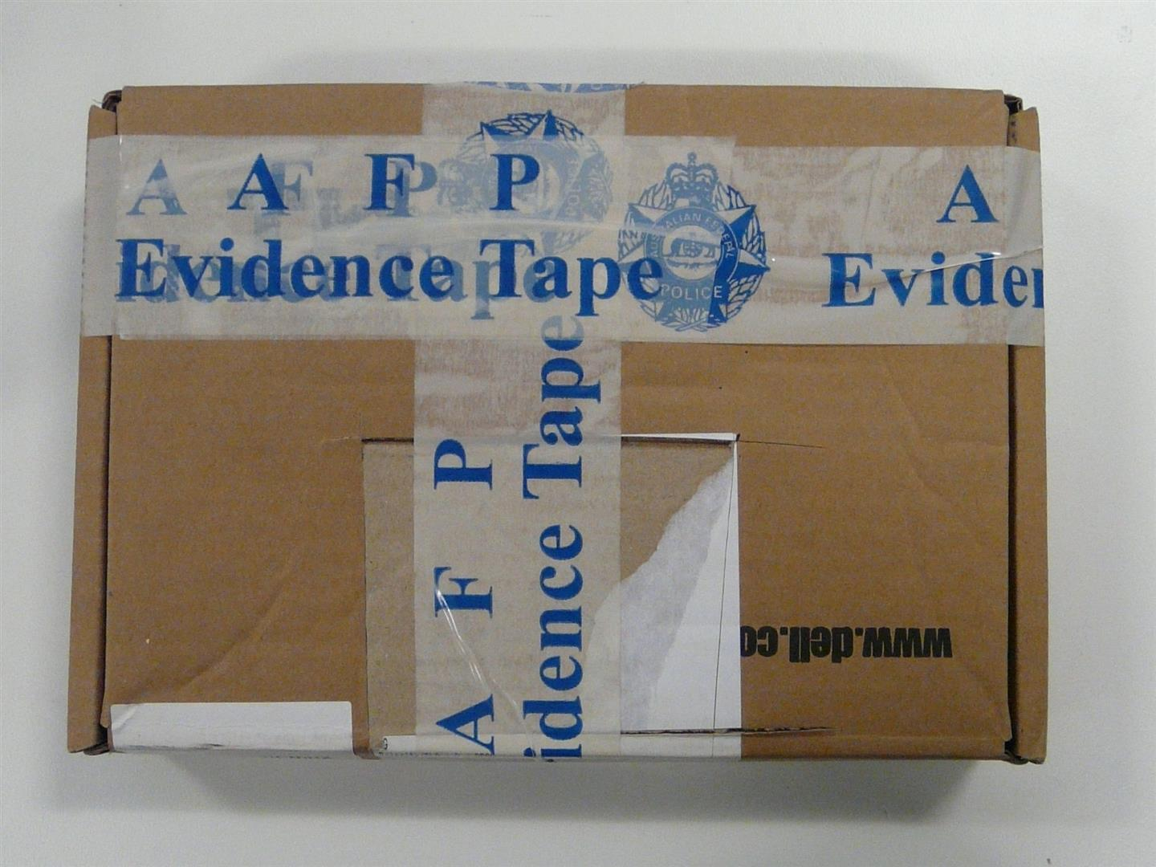
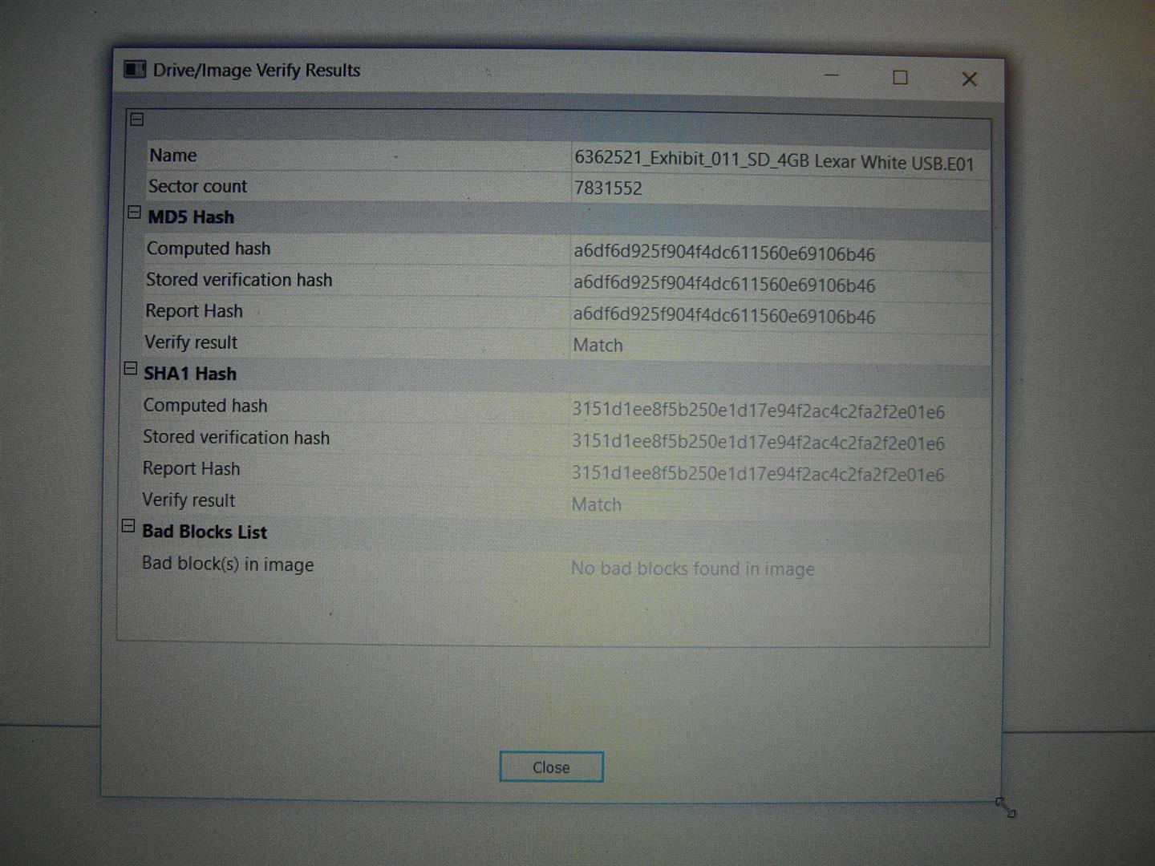
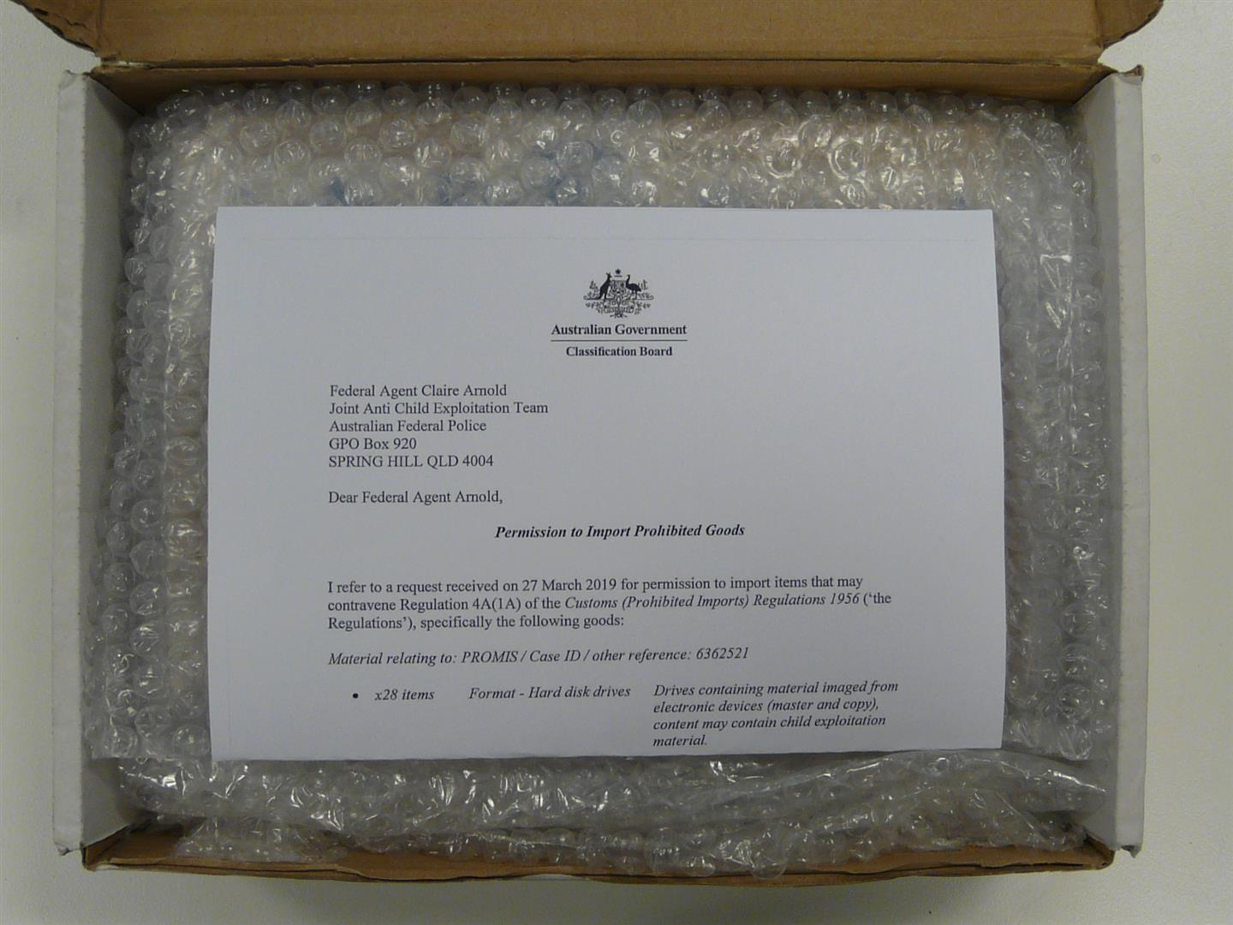

















Recent Visits to Cambodia
As per demonstrations, the same practices were used in this CSE assist

Slide 62
How can CNP Digital Forensics assist with your investigations?
CNP DF are your Subject Matter Experts who can:
  Help explain technical concepts
  Provide guidance on electronic evidence
  Assist at search warrants i.e. Triaging of items
  Utilise ‘best practices’ to ensure integrity of electronic evidence is forensically sound i.e. admissible for Court

Slide 63
CNP Digital Forensics
CNP DF are aware of:
  The importance to document everything before, during and after processing an electronic exhibit
  Producing thorough case notes, taking photographs, recording examination steps/actions
  Ensuring correct Chain of Custody procedures are followed

Slide 64
CNP DF can assist with important examination questions at search warrants, including:
Should you leave the device on?
What if the device is powered off already at the scene?
What should you do with password protected and other encrypted devices?
How do we securely isolate phones from a network?

Slide 65
Triaging at
CSE Search Warrants
AFP attend almost every CSE search warrant
Triaging (or previewing) devices at search warrants can assist investigations in many ways:
  On-site discovery of evidence leading to immediate confessions
  Access to ‘live’ data on devices running encryption
  Minimise amount of exhibits seized, therefore minimising items previewed in the laboratory
  Access to, and archiving of, online accounts e.g. Facebook, Gmail
  Securing mobile devices are isolated from network
  Ensuring the integrity of data on electronic devices

Slide 66
Revision of Phases of Digital Forensic Process:
Identification & Seizure
Acquisition
Analysis
Reporting
How do we piece all of these phases together to present to the Courts?

Slide 67
AFP Digital Forensic
Statements & Reports
DF Statement:
  Introduce Examiner and Report
DF Report:
  Search Warrant Attendance
  Chain of Custody
  Assumptions, Limitations and Processes
  Summary of Examinations
  Introduce Exhibits and Analysis of Findings
Here are some examples…

Slide 68
Final Tips for Your Investigations
In cyber-enabled crimes (such as CSE matters), Digital Forensics are extremely important.
Engage with DF early in the investigation for advice on technical concepts such as VPNs, better practice guides, encryption issues, mobile phones, etc
You must try to use DF at search warrants for triaging of devices, also to correctly capture ‘live’ data at the premises, archiving online accounts, etc

Slide 69
Final Tips for Your Investigations
Schedule regular meetings with CNP DF to discuss current issues, trends, awareness of new technology and software
Remember, CNP DF are your specialists, they can help you pre/during/post resolution phases

Slide 70
Take your CSE Investigations
Tech Knowledge to a New Level!
Build your knowledge base and skills
Digital Forensics, Incident Response, Malware Analysis, Cybersecurity, etc, are specialist areas which are always changing
If you are a digital forensic examiner, investigator, or prosecutor, you should try to familiarise yourself with the following list of tools, forums, and certifications…

Slide 71
CompTIA (https://www.comptia.org) provides a fundamental knowledge base
  A+, Network+, Security+
International Society of Forensic Computer Examiners (https://www.isfce.com) – certification and forum
International Association of Computer Investigative Specialists (https://www.iacis.com) – cert and forum
Be comfortable with different operating systems
  Computers: Windows, Mac OS, Linux
  Phones: Android, iOS, Windows

Slide 72
SANS (https://www.sans.org)
  Various certifications
  DFIR SIFT Workstation
Kali Linux – Ethical hacking
USB Forensic Bootable Environments:
  Paladin
  Caine
  Linux Tails – Anonymous activity on Dark Web
SWGDE (https://www.swgde.org) – workflows, best practice guides, etc

Slide 73
Closing thoughts…

Slide 74
Any Final Questions?

Slide 75
Thank you very much for your attention…

