Slide 1
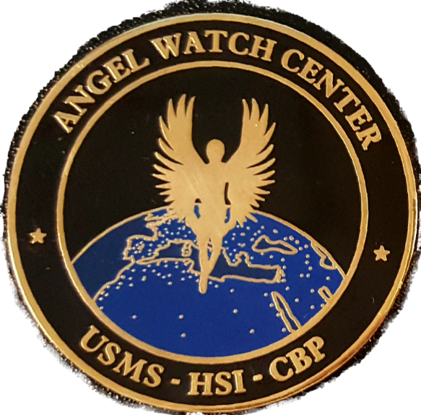
Child Exploitation investigations unit
Angel watch Center

Slide 2
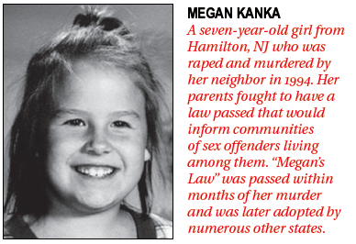
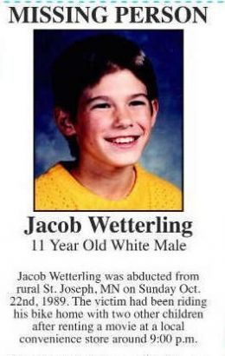
Angel Watch Center
US Sex Offender Laws
Jacob Wetterling Act of 1994
Established guidelines for states to track sex offenders
Megan’s Law of 1996
Provided for the public release of sex offender information
Pam Lychner Sex Offender Tracking and Identification Act of 1996
Established the National Sex Offender Registry (NSOR)
Adam Walsh Child Protection and Safety Act of 2006
Requires sex offenders to notify local law enforcement of any intended
foreign travel at least 21 days prior to departure

Slide 3
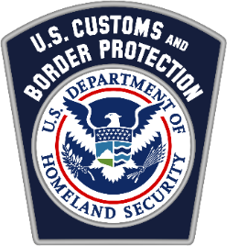
Operation Angel Watch Background
Angel watch center
2010 – AW was adopted by HSI Cyber Crimes Center (C3) as a proactive effort to combat child sex tourism
The operation expanded to national level targeting (all 50 U.S. states and U.S. territories)
Began identifying traveling sex offenders with previous convictions involving sex crimes against children
Coordination with Customs & Border Protection (CBP) and U.S. Marshals Service (USMS) was increased
Information sharing with foreign law enforcement expanded
USMS partnered with AW by working with state and local law enforcement to ensure offenders were complying with their registry requirements.

Slide 4
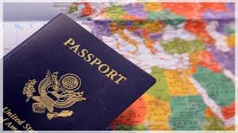
Angel watch center
International Megan’s Law (IML)
February 8, 2016: U.S. Congress passed & President Obama signed the International Megan’s Law to Prevent Child Exploitation and Other Sexual Crimes Through Advanced Notification of Traveling Sex Offenders
The statute formalized creation of the Angel Watch Center (AWC) located at C3 (Northern VA)
The law mandated that all covered child sex offenders with a current duty to register to be issued a passport bearing the IML endorsement identifying them as a child sex offender
Covered sex offenders are mandated to provide notice of international travel to the appropriate official as well as provide their flight information including anticipated dates, address or other contact information while outside of the U.S., purpose for travel, etc. The sex offender must also continue to update any changes to this information.

Slide 5
Angel Watch Center
Angel watch center
The AWC is located within HSI’s Cyber Crimes Center in Northern Virginia
Provides notification to foreign nations through our Attaché offices regarding the travel of convicted child sex offenders
HSI, USMS, CBP and U.S. State Department partnerships
Strengthened coordination efforts among agencies involved
Provision for DOS to mark U.S. passports
Expansion of international partnerships

Slide 6
Angel watch center
Angel Watch Traveling Child Sex Offender (TCSO)
Notification Process
HSI analysts and their CBP partners identify TCSOs by comparing flight passenger
manifests to the National Sex Offender Registry (NSOR)
The NSOR is a component of National Crime Information Center (NCIC) database - a computerized index of criminal justice information available to Federal, state, and local law enforcement.
Biographical data and other identifiers associated with the passenger data, sex offender registration and conviction information is reviewed thoroughly to determine if the passenger is subject to the provisions of IML.

Slide 7
Angel watch center
Angel Watch TCSO Notification Process (Cont.)
Additional research is conducted to analyze travel patterns
Analysis of open source and social media activity is performed
All available information is considered to determine whether or not notification is appropriate.
A notification is sent to the respective HSI Attaché office or CBP Liaison as well as to the USMS
Notification includes the TCSOs identifiers, flight information, relevant open source/social media information (if available) and the NSOR record or state public sex offender registry information.

Slide 8
Angel watch center
DHS/ U.S. Department of State Coordination
In accordance with International Megan’s Law, the Angel Watch Center works with the Department of State to identify covered child sex offenders who are required to receive a passport endorsement.
The endorsement will state the following: THE BEARER WAS CONVICTED OF A SEX OFFENSE AGAINST A MINOR, AND IS A COVERED SEX OFFENDER PURSUANT TO 22 USC 212B(C)(1).

Slide 9
Angel watch center

Slide 10
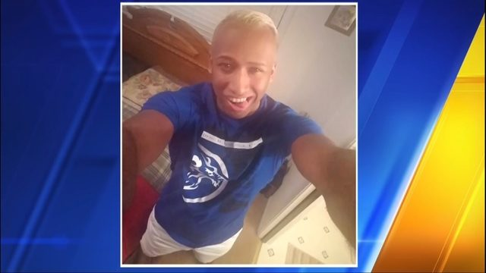
Angel watch center
Angel Watch Center Success / Case Development
CASE STUDY 1:
On 2/28/2018, Leonard LEWIS was referred through the AWC to the CBP liaison in
London, U.K. based on his status as a registered sex offender and 2011 conviction
for possession of sexual exhibition of a minor.
During an inspection by the UK Border Force, child pornography was discovered on LEWIS’
phone. LEWIS was arrested and deported back to the U.S.
Additional research indicated that the subject was likely traveling to the UK to take part in a
youth cheerleading camp.
HSI received and confiscated the electronic devices and searched LEWIS’ home which led to the discovery of more than 5,000 images and 2,000 videos of child pornography.
At least two minor victims who were coached by LEWIS have come forward as a result. The case is pending.

Slide 11
Angel watch center
Angel Watch Center Success
HSI Phnom Penh, CNP & GDI
In February, 2019 HSI Phnom Penh received information about USC, Edward MARISPINI, that stated MARISPINI, while working at an international school in Phnom Penh was inappropriately touching the students. After witnessing this behavior, a teacher at the school (reporting party) conducted an online search of the subject and found that MARISPINI was a Registered Sex Offender from the State of Minnesota.
HSI contacted Angel Watch who worked with the USMS and State Department, and based on MARISPINI’s conviction for child molestation, and Meagan’s Law, MARISPININ’s U.S. Passport was revoked. This revocation led to MARISIPINI being in violation of Cambodia’s Immigration Laws.
HSI Phnom Penh officially requested CNP and GDI to assist in locating/detaining MARISPINI and then deport him back to the U.S. based on his unlawful presence in Cambodia.
On February 19, 2019, MARISPINI was detained by CNP outside the U.S. Embassy and transported to GDI until he was transported to the Phnom Penh International Airport and deported to the U.S.

Slide 12
Angel watch center
Proactive Efforts
Angel Watch notifications are provided to foreign law enforcement authorities to utilize as they deem appropriate.
Angel Watch notifications are NOT an effort:
to restrict the travel of U.S. persons
to generate an arrest for every notification
to monitor all activity of registered child sex offenders

Slide 13
Angel watch center
Fiscal Year Statistics
FY 2015
2172 notifications / 1067 denials
FY 2016
1780 notifications / 1089 denials
FY 2017
2060 notifications / 1276 denials
FY 2018
3453 notifications / 1444 denials

Slide 14
Angel watch center
HSI Phnom Penh Fiscal Year (FY) Statistics
FY-October 1st -September 30th
FY 2017
11 notifications / 9 denials
FY 2018
19 notifications / 15 denials
FY 2019
3 notifications / 2 denials

Slide 15
Q
A
&
Protecting the Homeland with Honor, Service, and Integrity

