Slide 1
HALF PHOTO SLIDE PAGE TITLE
FOR QUOTES AND SUCH
HSI
Homeland Security Investigations
NCMEC

Slide 2
CyberTipline
CyberTips submitted by ESPs and the Public (99%/1%)
CyberTips sent to LE via “VPN”/Downloader
Generally to state and locals domestically
To HSI Attaché Offices and designated foreign LE agencies for overseas leads
100 Countries covered as of June, 2018
Offer to specific investigator if investigator previously queried the target
Notes:
2014 reports totaled over 1.1 million CyberTipline reports (ESPs and Public). 2015 – jumped to 4.4 million. 2016 – jumped to 8.29 million and 2017 – 10.2 million. So far this year (2018), we’ve received over 7 million.

Slide 3
Explanation of a Cybertip Submitted By Facebook
Information Provided By Industry
Notes:
Has anyone ever worked a Facebook report?

Slide 4
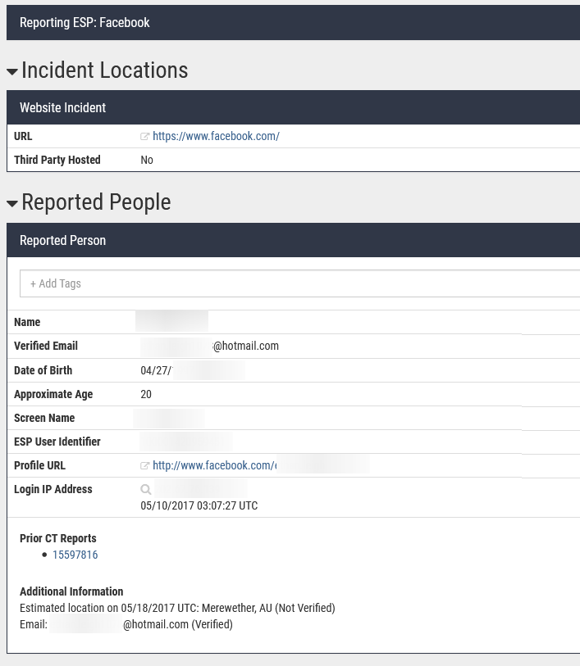
Who is the Individual Reported?
Email address provided by user during account creation and verified by Facebook
Date of birth; not verified by Facebook
Facebook User ID
IP address with date and time
1000000xxxxxx
*Now providing last non-mobile/cellular IP address with date and time*
Notes:
Overall view of general FB reports; we receive high volume of these reports especially that resolve internationally; will say verified if FB has been able to verify it; they provide lots of info

Slide 5
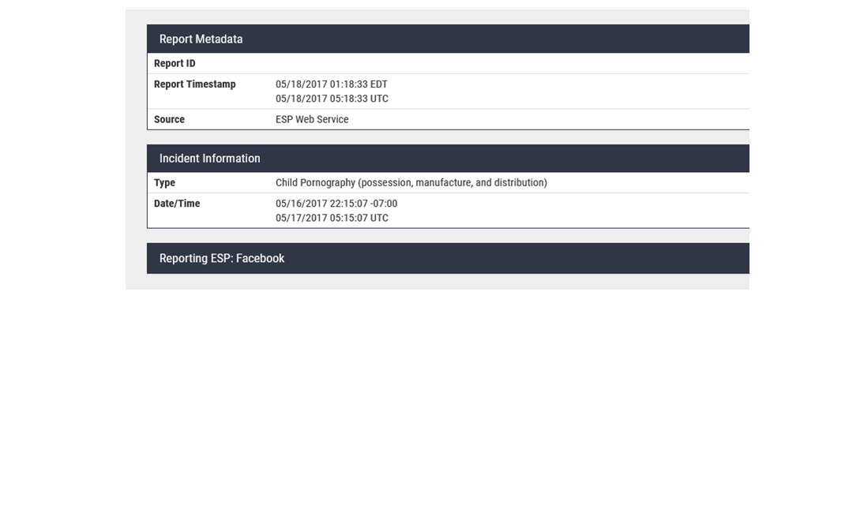
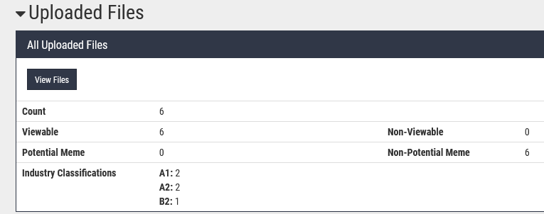
When Did It Happen?
Varies and may not be associated with reported IP address
Notes:
Typically dont rely on this as it varies by company but each company will have a template in the report with an explanation so be sure to refer to that

Slide 6
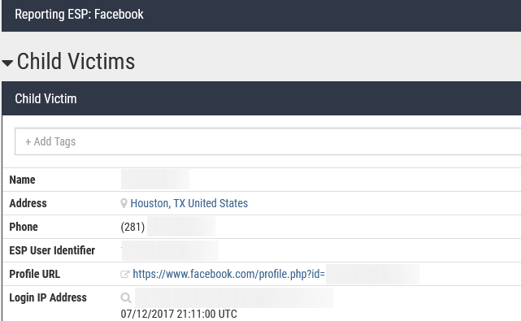
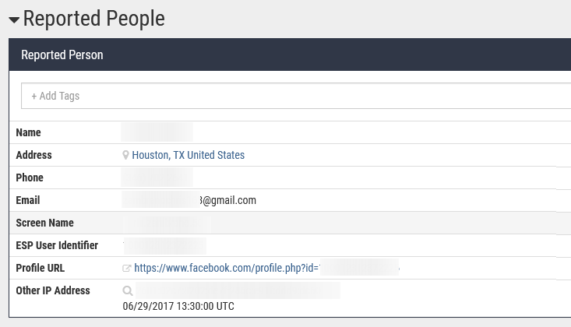
Facebook “Manual” Report
ESP escalation
Child Victim information
Reported User information
Additional Information section can contain information such as additional accounts and chats

Slide 7
NCMEC Classifications
NCMEC provides leads to an established law enforcement VPN that fall into four different categories
A Priority 1 report indicates current or imminent risk to an individual.
A Priority 2 report indicates possible risk to an individual in the near future or is otherwise time sensitive.
A Priority 3 report can be instances where additional information is required to determine possible risks and a priority.
A Priority E report is a report submitted by a registered Electronic Service Provider.

Slide 8
NCMEC FY Stats for Cambodia
October 1, 2018-June 1, 2019- 24,167 NCMEC reports generated.
October 1, 2017-September 30, 2018- 58,319 NCMEC reports generated.
October 1, 2016-September 30, 2017-3,723 NCMEC reports generated.

Slide 9
NCMEC/HSI Success Stories
In January 2019, HSI Ho Chi Minh City (HCMC) received a CyberTip report from NCMEC regarding a Google user who was uploading images of hands-on abuse of a minor female.
HSI HCMC provided this information to the Vietnam Ministry of Public Security (MPS). The investigation identified a 20-year-old Vietnamese citizen (KIEN) and showed the abuse occurred at his residence with his 10-year-old niece.
On March 8, 2019, MPS and HSI HCMC reported the arrest of KIEN who admitted to molesting his niece and collecting images of child pornography over a long period of time.

Slide 10
NCMEC/HSI Success Stories Cont.
On March 1, 2019, HSI Santo Domingo and its Transnational Criminal Investigative Unit (TCIU) Task Force executed two residential search warrants and two arrests warrants based on a NCMEC CyberTip report.
After receiving the CyberTip from NCMEC, HSI Santo Domingo TCIU identified the IP addresses used to upload and share child sexual images/abuse which lead to the arrest of a 20-year-old Dominican male middle school school teacher and a 28-year-old Dominican male for violation of Dominican law.

Slide 11
NCMEC/HSI Phnom Penh
Questions?

