Slide 1

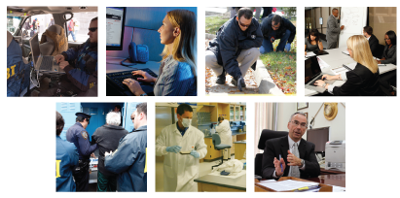
FBI 2019
CHILD SEX TOURISM BRIEFING

Slide 2
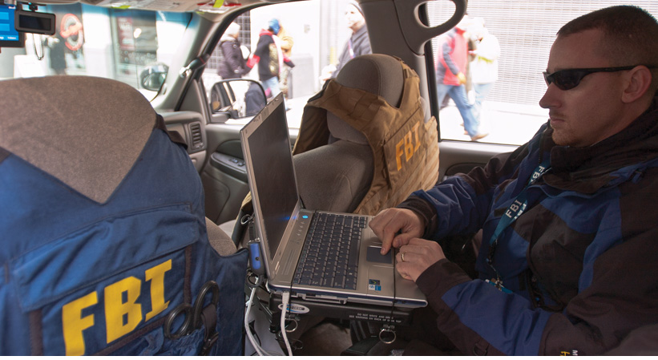
OVERVIEW

Slide 3
TODAY’S FBI
Intelligence-driven and threat-focused
National security organization with both intelligence and law enforcement responsibilities
Dedicated cadre of 36,000 agents, analysts, and professional staff
Protects the United States from terrorism, espionage, cyber attacks, and major criminal threats
Provides our partners with services, support, training, and leadership
Notes:
The FBI is considered the premier security and crime-fighting force on the planet.
The Bureau reports to both the Attorney General and Director of National Intelligence – it has dual functions as an intelligence and law enforcement agency.
The FBI’s investigative responsibilities are considerable and far-reaching.
The Bureau is a key part of our country’s national security team and addresses terrorism, espionage, weapons of mass destruction, and cyber crime. The FBI is the United States’ lead domestic intelligence agency and takes the lead in detecting, preempting, and disrupting terrorism in the United States.
At the same time, the FBI also plays a role in protecting local communities, from rescuing kidnapped children to dismantling street gangs, and from catching murderers to stopping scams that defraud the American people.
On any given day, the FBI is rooting out public corruption, recovering stolen art, protecting corporate trade secrets, and taking down organized crime networks.

Slide 4
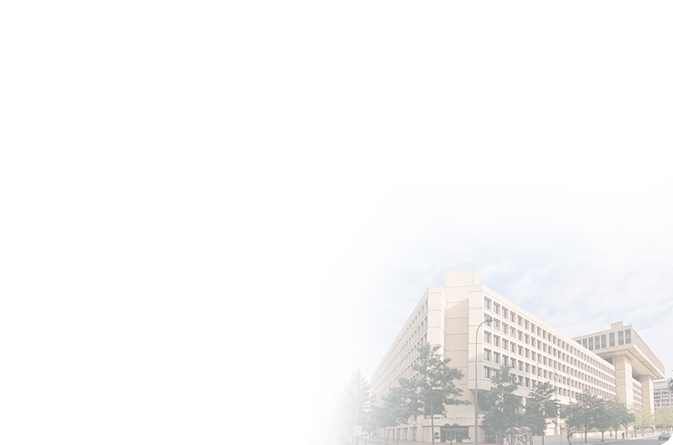
FBI HEADQUARTERS
Personnel at FBI Headquarters in Washington, D.C., organize and coordinate FBI activities around the world, set investigative priorities, oversee intelligence activities and major cases, and manage resources, technology, and staffing.
As the FBI has grown, some HQ functions have moved to other locations:
  FBI Laboratory, Operational Technology Division, and FBI Academy in Quantico, VA
  Criminal Justice Information Services (CJIS) in Clarksburg, WV
  FBI’s Counterterrorism Division is co-located with CIA’s Counterterrorism Division and the National Counterterrorism Center in Virginia
FBI Headquarters is organized into five main branches, each of which is composed of multiple divisions that carry out the Bureau’s mission:
  National Security Branch
  Criminal, Cyber, Response, and Services Branch
  Human Resources Branch
  Science and Technology Branch
  Information and Technology Branch
Notes:
FBI Headquarters
At FBI Headquarters in Washington, D.C., personnel from a wide range of disciplines organize and coordinate FBI activities around the world. They set investigative priorities, oversee intelligence activities and major cases, and manage the organization’s resources, technology, and staffing.
As the FBI has grown, some Headquarters functions have moved to other locations. The Laboratory, Operational Technology Division, and FBI Academy are located in Quantico, Virginia. The Criminal Justice Information Services Division is located in Clarksburg, West Virginia. The FBI’s Counterterrorism Division is co-located with the Central Intelligence Agency’s Counterterrorism Division and the National Counterterrorism Center in a state-of-the-art facility in Virginia. Other specialized facilities, such as high-tech computer forensics centers, are housed at various locations across the country.
FBI Headquarters is organized into five main branches, each of which is composed of multiple divisions that carry out the Bureau’s mission:
National Security Branch
Created in September 2005, the National Security Branch unites the capabilities of the FBI’s national security operations into a single, seamless force — combining the missions and resources of the counterterrorism, counterintelligence, weapons of mass destruction, and intelligence elements under the leadership of a senior Bureau official.
Criminal, Cyber, Response, and Services Branch
The Criminal, Cyber, Response, and Services Branch is responsible for investigations of white-collar crime, violent crime, organized crime, public corruption, civil rights violations, and drug-related crime. It also oversees all computer-based crime related to counterterrorism, counterintelligence, and criminal threats against the United States.
Human Resources Branch
The Human Resources Branch supports the FBI’s human capital needs, enhancing and expanding the capabilities of Bureau employees and partners. It directs the FBI’s leadership development efforts, all human resources programs, training and research, and the security of people, information, operations, and facilities.
Science and Technology Branch
Established in July 2006, the Science and Technology Branch centralizes the FBI’s scientific and technological capabilities and functions. Its highly trained professionals support the FBI and its partners by discovering, developing, and delivering state-of-the-art tools and techniques to collect, analyze, and share information and evidence.
Information and Technology Branch
The Information and Technology Branch delivers reliable and effective technology solutions to fulfill the FBI’s mission, leads the strategic direction for the FBI’s information technology, and promotes and facilitates the creation, sharing, and application of FBI knowledge products to improve overall effectiveness.

Slide 5
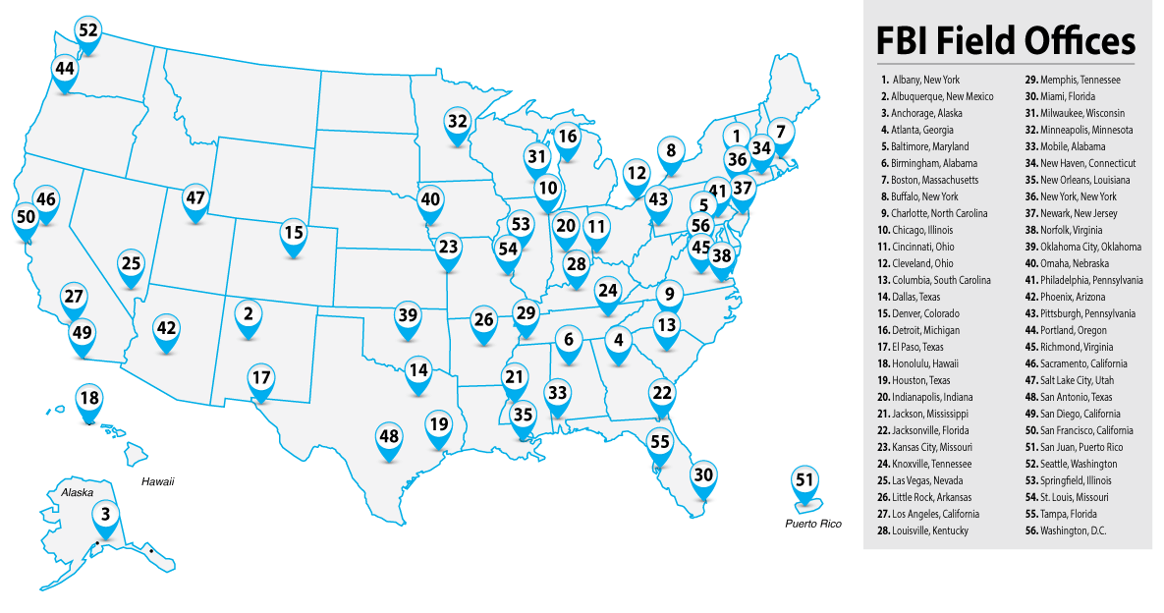
FBI FIELD OFFICES
The nuts-and-bolts work of the FBI is done in its 56 field offices and their approximately 380 satellite offices, known as resident agencies
In these offices, special agents, intelligence analysts, and other professionals collect intelligence and conduct investigations to build cases for prosecution
A Special Agent in Charge (SAC) oversees each field office
The largest field offices in New York City, Los Angeles, and Washington, D.C., are headed by an Assistant Director in Charge (ADIC)
Notes:
Field Offices
The nuts-and-bolts work of the FBI is done in its 56 field offices and their approximately 380 satellite offices, known as resident agencies.
In these offices, special agents, intelligence analysts, language specialists, surveillance experts, and other professionals collect intelligence and conduct investigations to build cases for prosecution. These teams investigate clues, track down leads, and work with local law enforcement and other partners to arrest terrorists, spies, and criminals of all kinds.
A Special Agent in Charge (SAC) oversees each field office, except for the largest field offices in New York City, Los Angeles, and Washington, D.C., which are headed by an Assistant Director in Charge (ADIC).

Slide 6
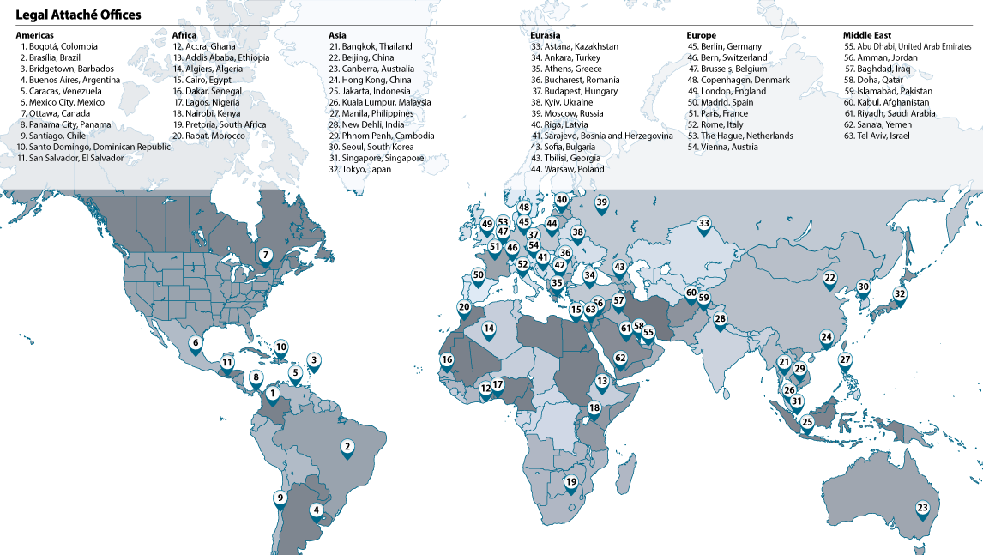
INTERNATIONAL OFFICES – LEGATS
The Bureau’s 63 international offices — known as legal attachés, or legats — and 15 legat sub-offices, coordinate the FBI’s work with intelligence and law enforcement agencies worldwide
Each is located in a U.S. Embassy and headed by a special agent
Each legat works with law enforcement and security agencies in the host country to coordinate investigations of mutual interest
Notes:
International Offices (Legats)
The threats posed by criminal and terrorist groups that cross borders require the FBI to work seamlessly with intelligence and law enforcement agencies around the world. The critical work of coordinating these activities is primarily conducted in the Bureau’s 63 international offices — known as legal attachés, or legats — and 15 legat sub-offices.
These offices, located in U.S. Embassies, are each headed by a special agent.
Each legat works with law enforcement and security agencies in the host country and its area of responsibility to coordinate investigations of interest to both countries. The rules for joint activities and information sharing are generally spelled out in formal agreements between the United States and the legat’s host country.
In addition to the work of legats, the Bureau often deploys agents and crime scene experts to assist in the investigation of attacks in other countries as requested, and stations personnel overseas in such global partnerships as Interpol and Europol.

Slide 7
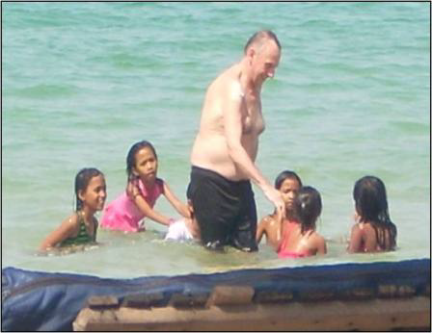
CHILD SEX TOURISM

Slide 8
CHILD SEX TOURISM OFFENDERS
Primarily male, many over age 50
Often assume positions with access to children
Rationalize their acts of exploitation
  Believe child sex tourism is “culturally acceptable”
  “I’m helping them”
Situational and Preferential offenders
Don’t believe they will get caught
  Assume local citizens reluctant to report
Don’t stop until they are caught

Slide 9
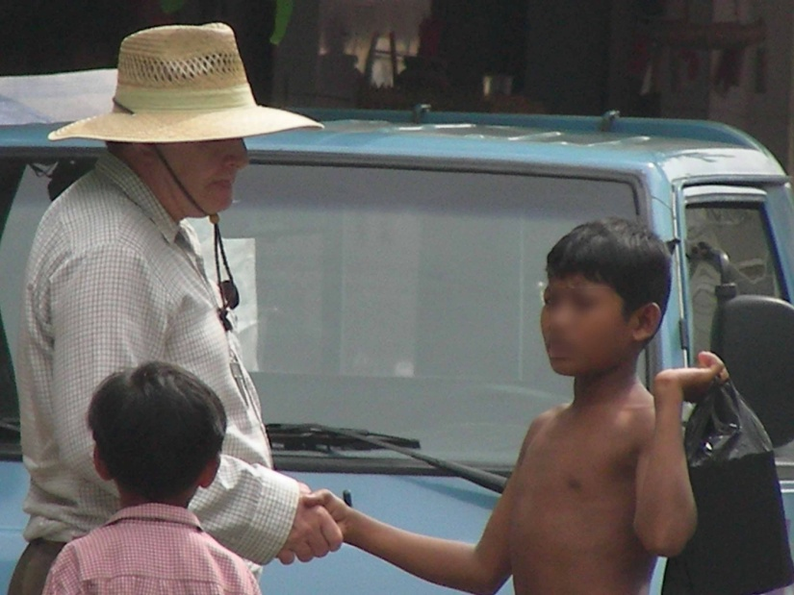
VENUES OF CST EXPLOITATION
Establishment based
Street / Family based
Professional Engagement / Pseudo- caregiver
Internet / Webcam-based

Slide 10
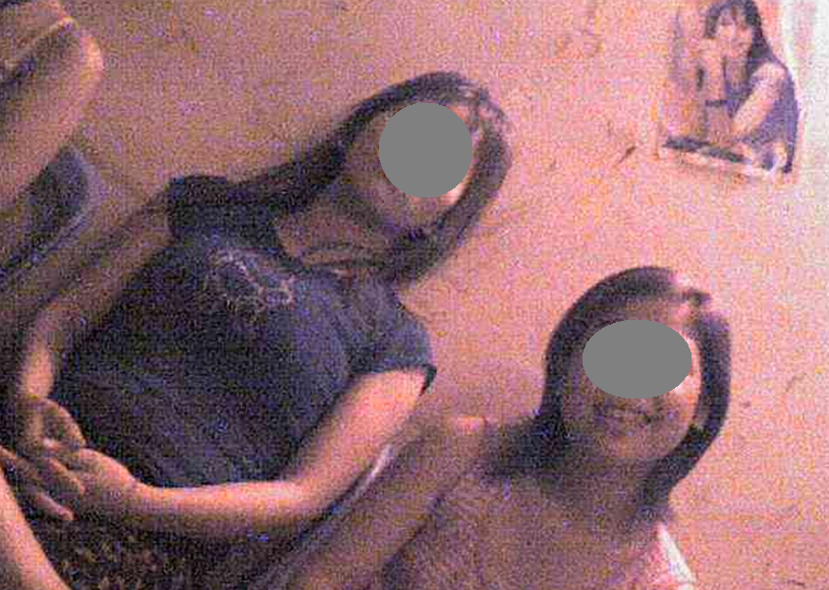
ESTABLISHMENT-BASED EXPLOITATION
Brothels
Beer Gardens
Karaoke Bars
Massage Parlors
Bars/ Night Clubs

Slide 11
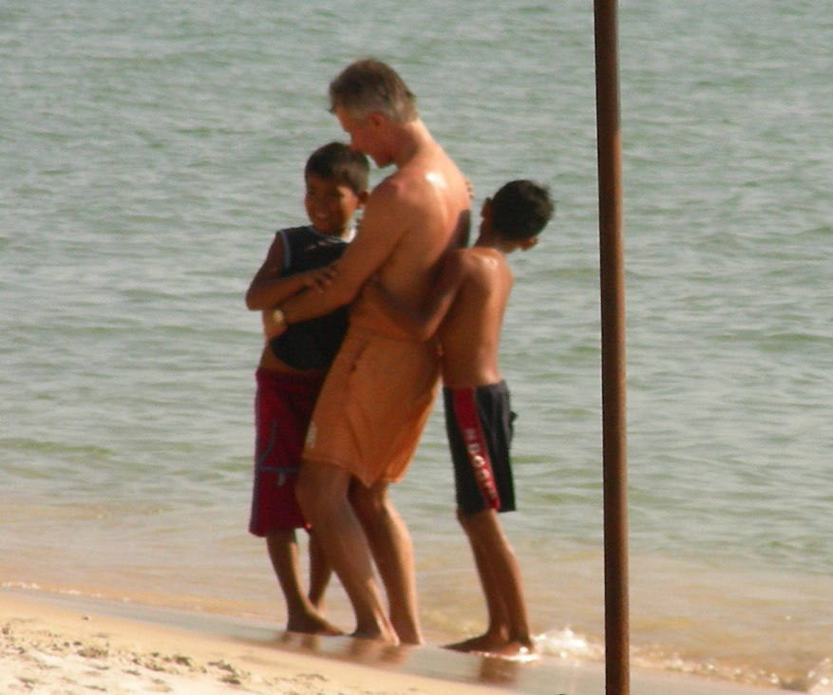
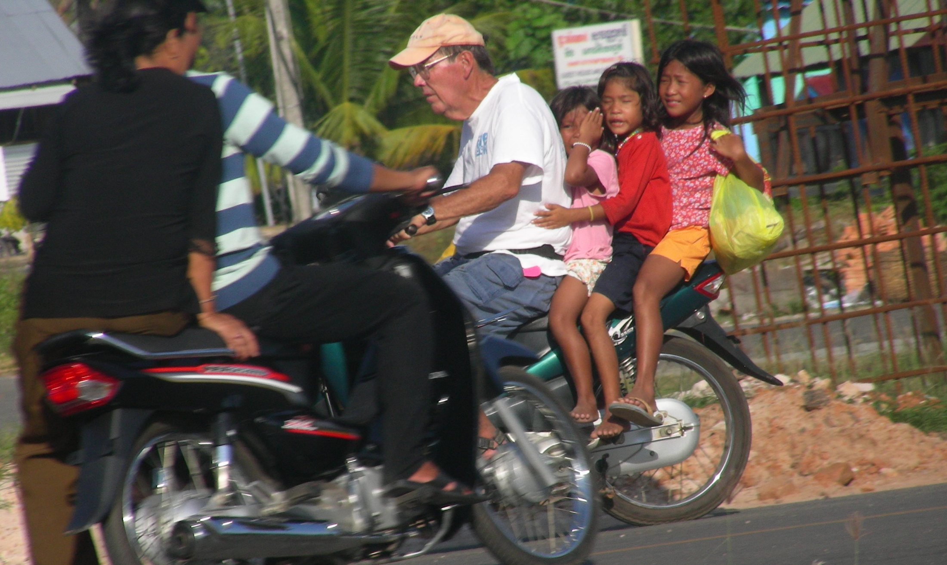
STREET/FAMILY-BASED
Beaches
Tourist attractions
Restaurant / ex-pat areas
Rural areas with poor families

Slide 12
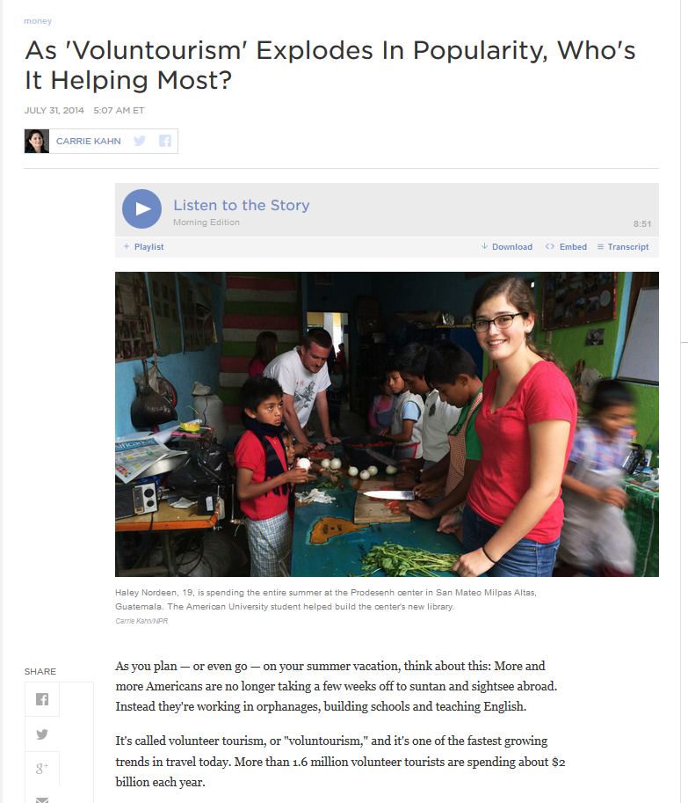
PROFESSIONAL ENGAGEMENT
Teachers, child-focused NGOs, orphanages, pediatricians, volunteers
  “Volun-tourism”
  “Orphanage Tourism”
Character not a mitigator of
  Risk
  Subjects can do both good
  and bad

