Slide 1
CST INVESTIGATIVE STRATEGY
Parallel investigations (Foreign police and FBI)
No foreign FBI authority--actions only with foreign approval
FBI support including:
Undercover Agents
Technical / Recording devices
Subject interviews by Local Police and/or FBI
Computer forensics
Child forensic interviews and services
Prosecutions can occur in Foreign Country, USA or both

Slide 2
CST INVESTIGATIVE STRATEGY
Identify U.S. Citizen targets from:
Foreign Police
Non-governmental Organizations (NGO)
Informants / cooperating defendants
Citizen complaints
U.S. records of child sex offender travel history

Slide 3
CST INVESTIGATIVE STRATEGY
Overall Goals
Recover child victims from abusive situations
Arrest and prosecute subjects for child sex offenses
Foreign (local) law
U.S. Law
Deport / Block prior child sex offenders from entering Child Sex Tourism Hotspot countries

Slide 4
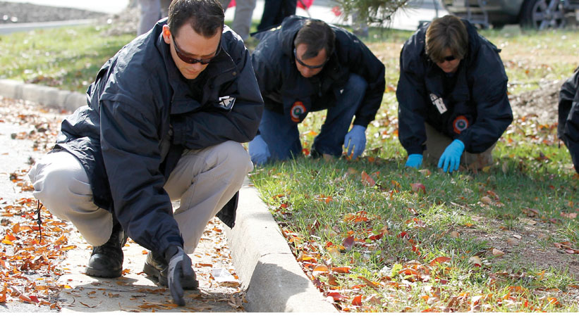
INVESTIGATIONS

Slide 5
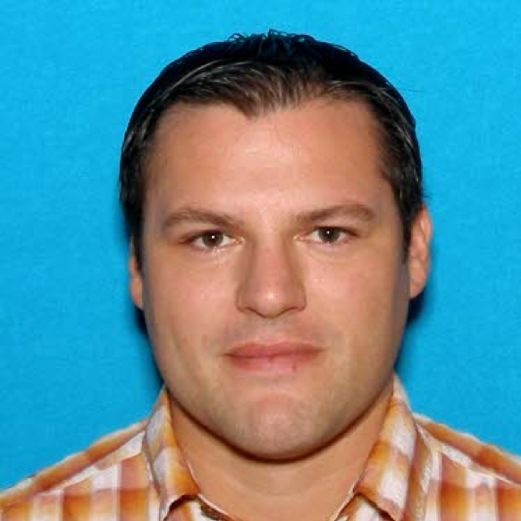
Daniel Stephen Johnson
August 2013 – request for assistance from Oregon
Indicted and state warrant for prior abuse
Traveled to Cambodia in 2013
Revocation of US passport
Notes:
Toledo PD in Oregon requested investigative assistance from FBI to locate, arrest and extradite Johnson.
Inmate had disclosed he had been abused by his foster mother’s brother (Johnson) 12 years earlier.
Inmate and his brother were interviewed and disclosed abuse by Johnson
Inmate was re-interviewed and revealed that Johnson was overseas doing charity work for a church.
One of the victims ultimately committed suicide in June 2013.
Indicted by Lincoln County Oregon and state arrest warrant issued August 2013.
one count sodomy in second degree
One count Sex Abuse in First Degree
Three Counts Sodomy in Third degree
Found travel records to Asia May 2013 – traveled to Thailand and walked over border in September 2013
FBI requested revocation of passport based on warrant – allow for immigration arrest

Slide 6
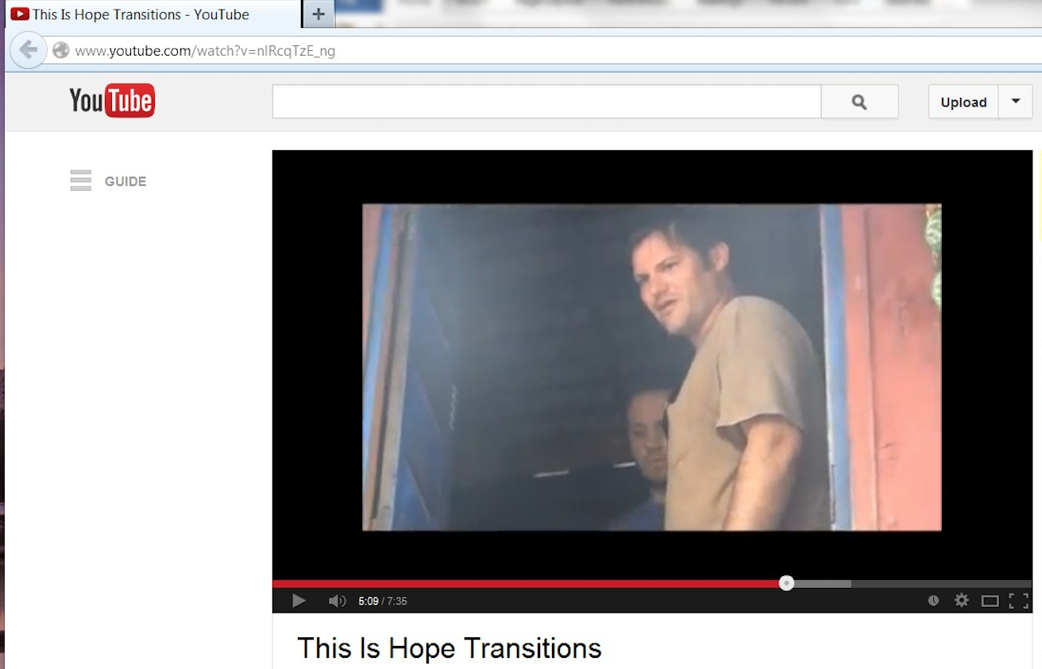
Daniel Stephen Johnson
Located at Hope Transitions
Working as Director
.
Notes:
Affiliated with Skyline Baptist Church in Oregon – hope transitions ministry
Jonson found on Hope Transitions youtube videos.
NGO located Johnson
Found at Hope Transitions Orphanage

Slide 7
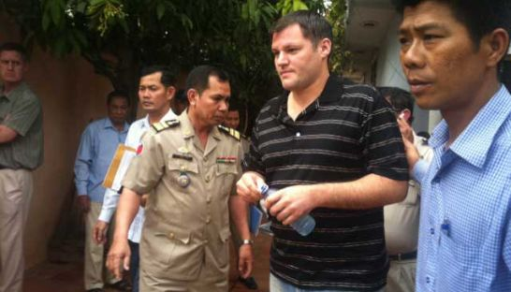
Daniel Stephen Johnson
Arrested in December 2013
Passport revoked/state warrant
Notes:
arrested on 12/9/2013 by GDI on immigration due to passport being revoked

Slide 8
Daniel Stephen Johnson
CNP interviewed children at orphanage
Three disclosed immediately
Two additional disclosures
Multiple devices seized
No CAM but other useful intelligence
Orphanage found to be unregistered
Closed and children sent to safe shelters
Notes:
Three Children disclosed abuse by Johnson
More interviews = two more disclosures
At the time of his arrest, multiple devices were seized.
2 cell phones
5 thumb drives
1 video camera
2 digital cameras
1 laptop
1 external hard drive
1 cpu
Center was closed because it was found to be unregistered. Children sent to various safe shelters

Slide 9
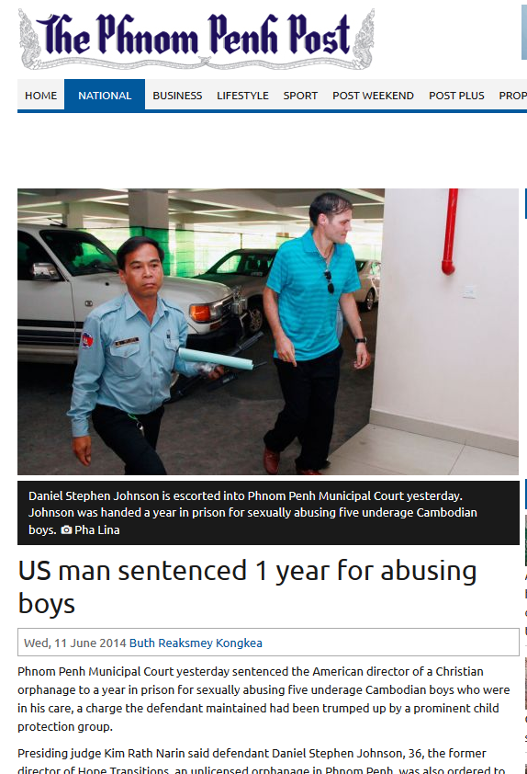
Daniel Stephen Johnson
In Cambodia:
Charged with indecent acts against 5 boys under 15
Sentenced to one year in prison
Plus 4 million Riel ($1000 USD)
Violation of Cambodian Anti-Human trafficking and Exploitation Law.
Notes:
Charged in PN Municipal Court with indecent acts committed against 5 boys under the of 15
Sentenced to one year in along with a fine of 4 million Riel ($1000 USD)violation of Cambodian Anti-Human trafficking and Exploitation Law.

Slide 10
Daniel Stephen Johnson
FBI Investigation continues…
Re-interview victims with CAFIs
Interviews with witnesses both in US and Cambodia
Johnson had been traveling to and volunteering in Cambodia since 2000
Forensic review of devices
Search warrants to view
Notes:
Meanwhile…FBI investigation continues investigation
CAFI Interviews with victims
Victims disclosed to CNP but many recanted during FBI interviews – 7 interviewed by CAFI
FB messages showing Johnson dissuading victims from talking about abuse

Slide 11
Daniel Stephen Johnson
Victims who had previously disclosed started recanting
Johnson had gained access to Facebook in prison and was dissuading them from disclosing
Sending money through his brother
Indicted on Title 18 USC, § 2423(c) - Illicit Sexual Conduct in a Foreign Place
Arrest warrant issued and deported back to Oregon
Notes:
December 2014 – arrest warrant issued pursuant to federal indictment in District of Oregon.

Slide 12
Daniel Stephen Johnson
Second round of CAFI interviews in 2017
Ultimately 12 victims disclosed abuse dating back to 2005
Followed by a superseding indictment
Title 18 USC § 2423(c) - Engaging in Illicit Sexual Conduct in a Foreign Place.
Title 18 USC § 2423(b) - Travel with Intent to Engage in Illicit Sexual Conduct.
Title 18 USC § 2241(c) - Aggravated Sexual Abuse.
Notes:
Meanwhile…FBI investigation continues investigation
Victims disclosed to CNP but many recanted during FBI interviews – 7 interviewed by CAFI
FB messages showing Johnson dissuading victims from talking about abuse

Slide 13
Daniel Stephen Johnson
Trial in May 2018
12 victims testify
Found guilty on all counts
Sentencing in January 2019
Life in prison to be served concurrently with a 180-year sentence
Notes:
Trial in May 2018 - Found guilty on all counts
January 2019 Sentenced to life in prison to be served concurrently with a 180-year sentence on other counts. (currently 41 years old)

Slide 14
U.S. Department of Justice
Federal Bureau of Investigation
Office of Public Affairs
Washington, D.C. 20535

