Slide 1
តើច្បាប់គឺជាអ្វី?
Notes:
Cambodian Officer to give a presentation about the law relating to child sexual exploitation in tourism and online child sexual exploitation.

Slide 2
តើមានច្បាប់អ្វីខ្លះនៅកម្ពុជា?
ដូច្នេះ តើមានច្បាប់អ្វីខ្លះដែលបានអនុម័តនៅក្នុងប្រទេសកម្ពុជាដែលជាប់ទាក់ទងនឹងជនល្មើសផ្លូវភេទបរទេសលើកុមារ?
Notes:
INVITE
Invite a representative from Cambodia Prosecutor’s Office to deliver a short session
(15 mins) to explain the laws in Cambodia which relate to child sexual exploitation
and which could be used for cases of child sex tourism and online child sexual
exploitation.
The following topics should be covered:
What is the law in Cambodia?
What are the penalties for child sexual exploitation in Cambodia?
What are some examples of how the law has been applied in Cambodia?

Slide 3
ជំនាញស៊ើបអង្កេត ដោយ Jarryd Dunbar

Slide 4
ការធ្វើឲ្យប្រសើរឡើងការសម្ភាសន៍ជាមួយជនល្មើស ដោយ Patrick Tidmarsh

Slide 5
ព័ត៌មានបន្ថែមអំពីជនល្មើស
Notes:
EXPLAIN
We learned yesterday that we all have certain ‘stereotypes’ regarding child sex offenders’.
In order to more effectively protect children, police need to understand offenders. How do they think? How do they operate?
When we understand the psychology of offenders, we are better equipped to prevent and intercept child sex crimes.

Slide 6
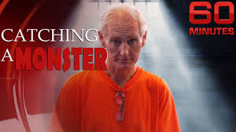
តើជនល្មើសប្រតិបត្តិការយ៉ាងដូចម្តេច?
https://www.youtube.com/watch?v=fsCDcf63x8k
Notes:
VIDEO
Introduce the video. Provide background on the Peter Scully case.
ASK
Before beginning the video, ask participants the following analytical questions for their viewing:
What do you notice about the attitude of the offender?
How does the offender respond to the media journalist?

Slide 7
ការស៊ើបអង្កេតអំពីការធ្វើអាជីវកម្មលើកុមារតាមអនឡាន ដោយ Paul Onken

Slide 8
ករណីសិក្សាអំពីការស៊ើបអង្កេតដោយ Paul Onken

Slide 9
ករណីសិក្សាអំពីការស៊ើបអង្កេត ដោយ Farid El Hamouti

Slide 10
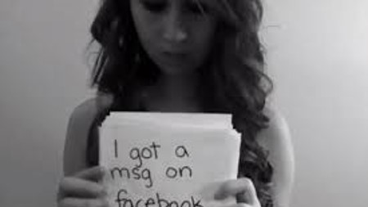
រឿងរ៉ាវរបស់ កុមារអាមិនដា ថូត Amanda Todd’s story
https://www.youtube.com/watch?v=ni-Y3wU92iU
Notes:
VIDEO – Show video and explain the situation of online sexual exploitation by foreign offenders.
HANDOUT – Amanda Todd News Story

Slide 11
ករណីសិក្សាអំពីការស៊ើបអង្កេត ដោយ Napol Woraprateep – Thailand DSI Joseph Thorn - AFP

Slide 12
ការធ្វើកោលសវិច្ច័យដោយឌីជីថុល

Slide 13
ការធ្វើឲ្យប្រសើរឡើងការចូលរួមរបស់នគរបាលជាមួយជនរងគ្រោះជាកុមារ ដោយ Jarryd Dunbar

Slide 14
ការការពារកុមារពីជនល្មើសបរទេសរួមភេទលើកុមារ ពិភាក្សាតាមក្រុម ភ្នំពេញ ២០១៩

Slide 15
តើយន្តការអន្តរជាតិមានអ្វីខ្លះ? ដោយ Jarryd Dunbar

Slide 16
តើអ្នកផ្សេងទៀតកំពុងធ្វើអ្វី ? What are others doing?
តើអ្នកផ្សេងទៀតកំពុងធ្វើអ្វី ?
What are others doing?
Notes:
So, let’s learn from the activities of other police and stakeholders around the world.

Slide 17
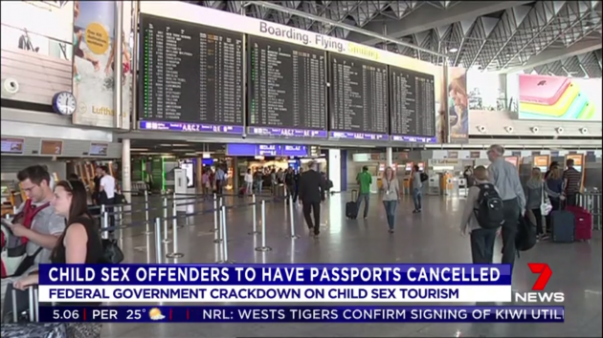
តើរដ្ឋាភិបាលផ្សេងទៀតកំពុងធ្វើអ្វី ?

Slide 18
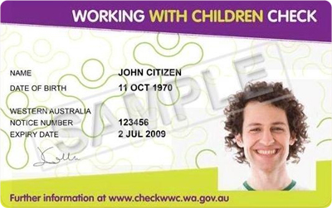
តើនគរបាលផ្សេងៗទៀតកំពុងធ្វើអ្វី ?
ប្រទេសអូស្រ្តាលី
ការធ្វើការងារជាមួយកុមារ ដើម្បីពិនិត្យ -
នគរបាលអូស្រ្តាលីមានអាណត្តិដើម្បី
ពិនត្យ/ដំណើរការបញ្ជាក់គ្រប់បុគ្គលិកទាំងអស់ (អ្នកមានប្រាក់ឈ្នួល និង អ្នកស្ម័គ្រចិត្ត) ដែលធ្វើការជាមួយកុមារ
Notes:
EXPLAIN
Governments around the world are introducing formal systems to protect children from those who pose a risk to their safety.
In Australia, the Government has introduced a mandatory ‘Working with Children Check’ (WWC) . The Working With Children Check is a formal police clearance process to prevent people with a prior history of child sexual abuse from working in directly with children.
Any staff in paid or voluntary employment who work in occupations that directly engage with children (such as teachers, medical staff, non-government organisations, child care workers, faith based organisations, sporting group staff) must apply to the Australian Police for the Working With Children Check.
Employers, volunteer organisations and agencies must ensure that any of their staff or volunteers who work with children have the formal registration card with photographic identification.
For this system to be effective, the national police must have a central database that records the criminal history of their country’s citizens.
While it is recognised that the majority of child sex offenders do not have a criminal record (because their crimes are undetected/unreported), this is still an effective measure to prevent known child sex offenders from having inappropriate access to children.
ASK
If your government does not yet have a formal police database, what other vetting mechanisms can be instituted to screen employees who work with children?

Slide 19
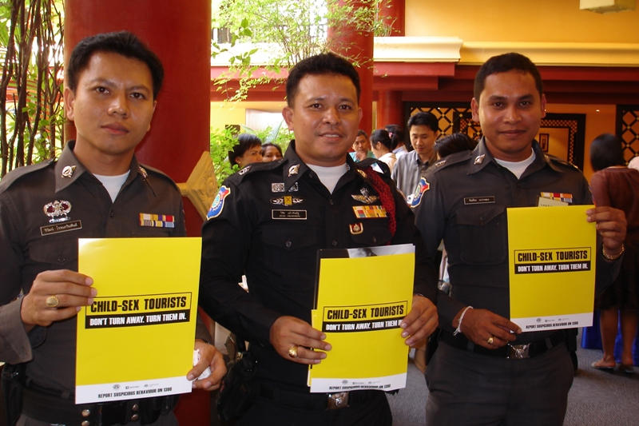
តើរដ្ឋាភិបាលផ្សេងៗទៀតកំពុងធ្វើអ្វី ?
ប្រទេសអាស៊ាន
ប្រទេសជាសមាជិកអាស៊ានទាំងអស់បានចូលរួមរៀបចំយុទ្ធនាការការពារកុមារ
នគរបាលទេសចរណ៍បានចែកចាយ/ផ្សព្វផ្សាយក្នុងយុទ្ធនាការអំពីចំណុចទប់ស្កាត់ការរួមភេទលើកុមារ
Notes:
EXPLAIN
ASEAN Regional Education Campaign
ASK
What campaigns are you already running? How could you involve the tourism industry in the campaign?

Slide 20
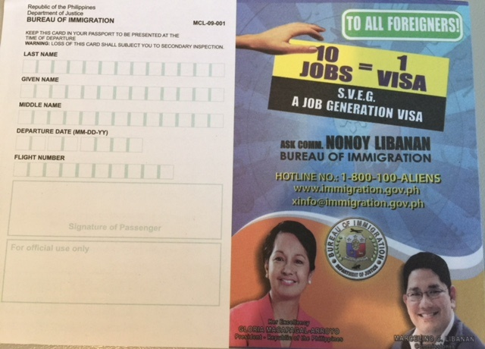
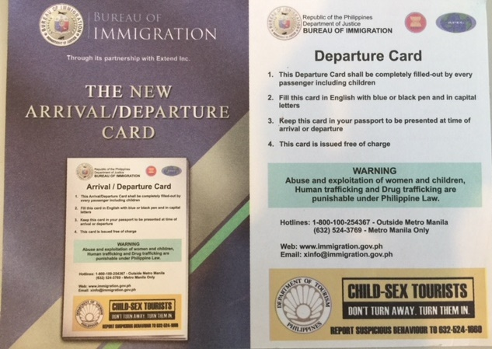
តើផ្នែកអន្តោប្រវេសន៍ធ្វើអ្វី?
Notes:
EXPLAIN
In all countries, the websites of tourism ministries are frequently visited by international travellers. The Ministry of Tourism in Cambodia welcomes overseas visitors, but makes its commitment to child protection very clear through the inclusion of a child protection campaign message on the front page of their website.
ASK
What information do you provide on your Government websites to keep children safe from sexual exploitation in tourism?
How can you better promote your commitment to keep children safe from sexual exploitation in tourism?

Slide 21
នគរបាលអន្តរជាតិ INTERPOL
នគរបាលអន្តរជាតិ (Interpol)
អង្គភាពនគរបាលអាំងទែប៉ូលខាងទប់ស្កាត់បទឧក្រឹដ្ឋប្រឆាំងកុមារ (Interpol Crimes Against Children Unit) បានផ្តល់សេវាកម្មដូចខាងក្រោម៖
អត្តសញ្ញាណកម្មជនរងគ្រោះ
ទិន្ន័យ ISCE Database:
ជួយស្រាវជ្រាវអក្សរសម្ងាត់កុំព្យូទ័រ(Encryption Reversal)
ការរាយការណ៍តាមអនឡាញ (Online Reporting)
.

Slide 22
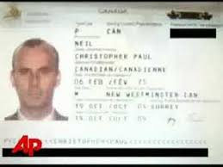
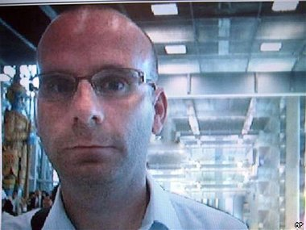
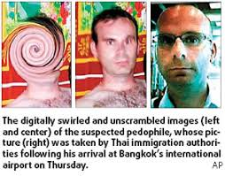
នគរបាលអន្តរជាតិ INTERPOL
Notes:
EXPLAIN the Interpol tools.
HANDOUT : Christopher Neil Media Story

Slide 23
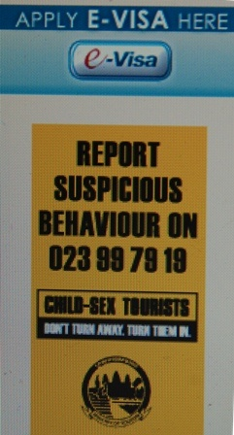
តើរដ្ឋាភិបាលផ្សេងទៀតកំពុងធ្វើអ្វី ?
ប្រទេសកម្ពុជា
http://www.tourismcambodia.org/
ក្រសួងទេសចរណ៍ផ្សព្វផ្សាយសារស្តីពីការការពារកុមារនៅទំព័រមុខនៃគេហទំព័ររបស់ខ្លួន
មានមនុស្សចូលមើលច្រើនជាង ២០០០ នាក់ក្នុងមួយថ្ងៃ
Notes:
EXPLAIN
In all countries, the websites of tourism ministries are frequently visited by international travellers. The Ministry of Tourism in Cambodia welcomes overseas visitors, but makes its commitment to child protection very clear through the inclusion of a child protection campaign message on the front page of their website.
ASK
What information do you provide on your Government websites to keep children safe from sexual exploitation in tourism?
How can you better promote your commitment to keep children safe from sexual exploitation in tourism?

Slide 24
តើរដ្ឋាភិបាលផ្សេងទៀតកំពុងធ្វើអ្វី ?
ប្រទេសអាល្លឺម៉ង់, ប្រទេសអូស្រ្តាលី និងស្វីហ្សឺឡែន
កិច្ចសហប្រតិបត្តិការបីប្រទេស (Tri-nation Cooperation)
រដ្ឋាភិបាលអាល្លឺម៉ង់, ប្រទេសអូស្រ្តាលី និងស្វីហ្សឺឡែន បានរួបរួមគ្នារៀបចំយុទ្ធនាការក្នុងបីប្រទេសដែលនិយាយភាសាអាល្លឺម៉ង់ឲ្យបញ្ឈប់អាជីវកម្មផ្លូវភេទលើកុមារក្នុង វិស័យទេសចរណ៍
Notes:
EXPLAIN
Significant child protection outcomes can be achieved when countries cooperate. Recently, Germany, Austria and Switzerland joined forces to conduct a campaign to prevent child sexual exploitation in travel and tourism by citizens of German-speaking countries.
ASK
Consider which international governments are your most strategic partners in keeping children safe from sexual exploitation in tourism?
How do you currently cooperate? How can you improve your cooperation in future?

Slide 25
តើរដ្ឋាភិបាលផ្សេងទៀតកំពុងធ្វើអ្វី ?
ប្រទេសអូស្រ្តាលី
“Safe Traveller.com”
គេហទំព័ររបស់រដ្ឋាភិបាលប្រទេសអូស្រ្តាលីសម្រាប់អ្នកធ្វើដំណើរបានផ្តល់ការព្រមានថា ការធ្វើអាជីវកម្មផ្លូវភេទលើកុមារប្រឆាំងនឹងច្បាប់នៃប្រទេសទាំងនៅក្នុង និងនៅក្រៅប្រទេសអូស្រ្តាលី
(Australian Government website for travellers which provides warnings that child sexual exploitation is against the law in Australia and overseas)
.
Notes:
EXPLAIN
The Australian Government’s Department of Foreign Affairs coordinates a ‘Smart Traveller’ website which provides travel alerts and advice for Australian travellers before they depart on international travel.
The Smart Traveller website includes messages to warn Australian travellers that the sexual exploitation of children in travel and tourism is a crime in Australia and overseas.

Slide 26
តើនគរបាលផ្សេងទៀតកំពុងធ្វើអ្វី ?
ប្រទេសកម្ពុជា
របាយការណ៍តាមប្រព័ន្ធហតឡាញជាតិ
ក្រសួងមហាផ្ទៃបានចងក្រងរបាយការណ៍ប្រចាំខែទាំង​អស់ដែលទទួលបានតាមទូរស័ព្ទអំពីការការពារកុមារ។ ព័ត៌មាននេះនាយកដ្ឋានផ្សេងៗ​ និងភាគី/ដៃគូរផ្នែកការពារកុមារអាចទាញយកបាន។
ក្រសួងមហាផ្ទៃ
នៃព្រះរាជាណាចក្រកម្ពុជា ?
Notes:
EXPLAIN
The Cambodian Ministry of Interior receives support from World Vision and UNICEF to operate a national, toll-free reporting hotline. The hotline is staffed by English, Khmer and Vietnamese speaking operators.
Importantly, the hotline staff collect targeted data including:
Number of calls received
Types of cases
Victim details (age/gender)
Location
Type of follow-up
This data is compiled into a central database and generated into monthly reports which are made available to other government departments and child protection stakeholders.
Information contained in these reports enables government, police and stakeholder to monitor the situation of child sexual exploitation and manage emerging trends.
ASK
What are the benefits of collecting, recording and sharing this data with relevant government officials and child protection stakeholders?

Slide 27
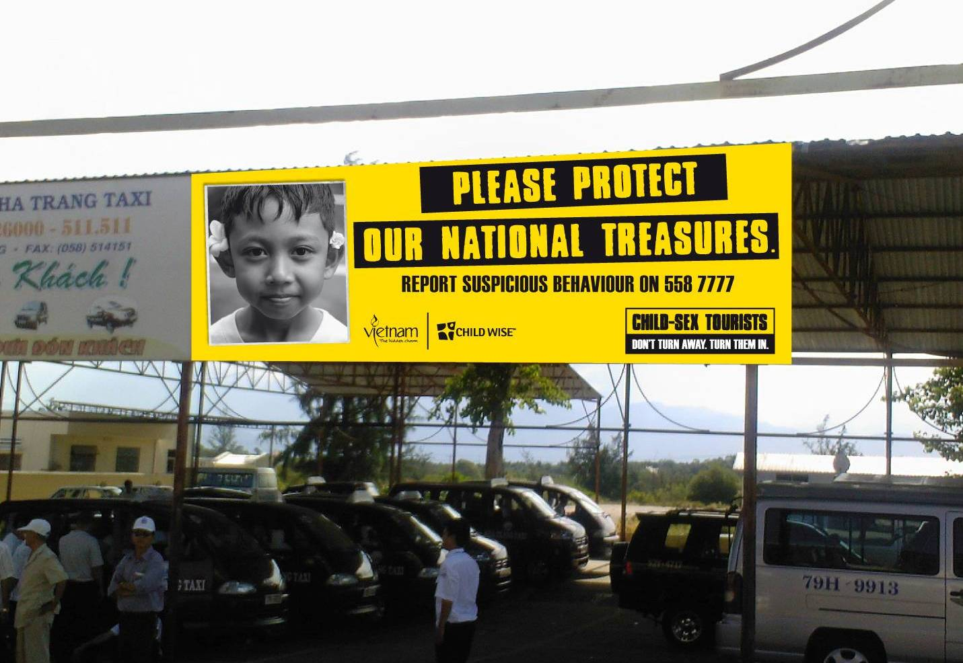
ចុះនៅតាមអាកាសយាន្តដ្ឋាន? What about airports?
ជើងយន្តហោះ
Airlines
.
Notes:
This is an example of a billboard that was displayed by the Vietnam Ministry of Tourism at Nha Trang Airport in central Vietnam. Nha Trang was considered a high-risk location for offenders from Germany, Russia and other European destinations.

Slide 28
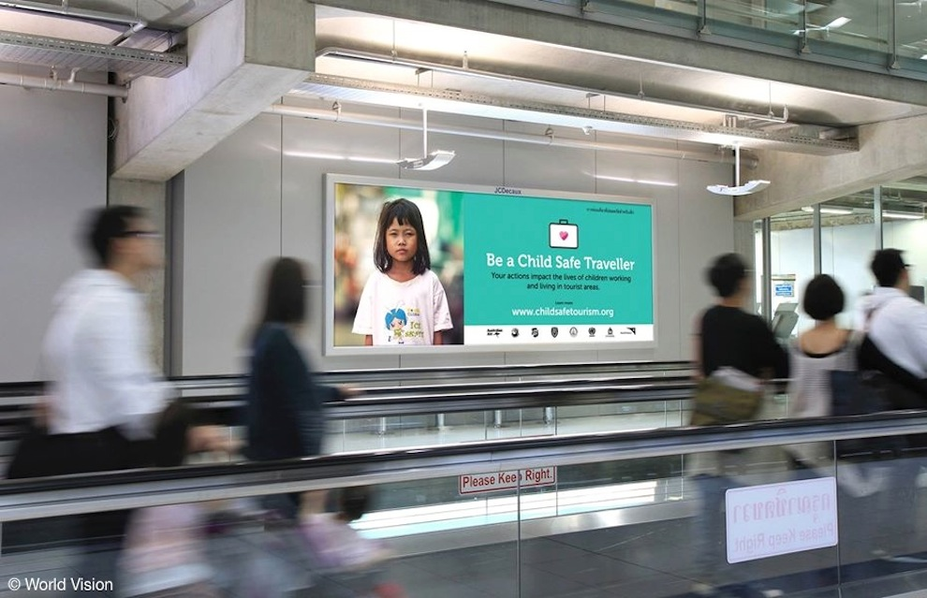
What are airports doing?
តើនៅតាមអាកាសយាន្តដ្ឋានគេកំពុងធ្វើអ្វី?

Slide 29
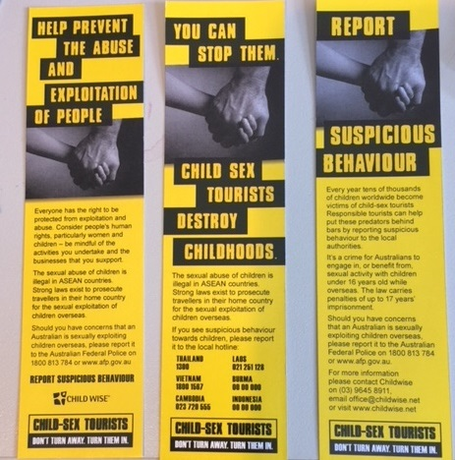
What are airports doing?
តើនៅតាមអាកាសយាន្តដ្ឋានគេកំពុងធ្វើអ្វី?

Slide 30
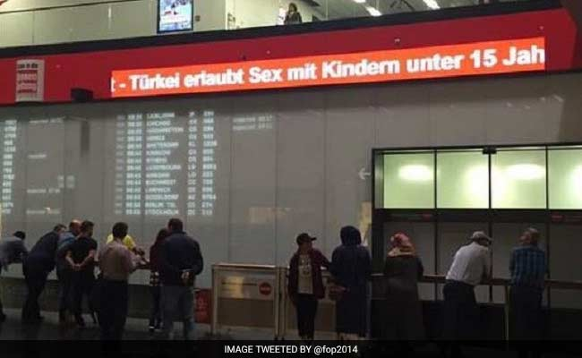
តើនៅតាមអាកាសយាន្តដ្ឋានគេកំពុងធ្វើអ្វី?

Slide 31
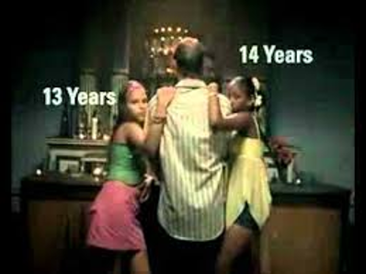
តើខាងអាកាសចរណ៍គេកំពុងធ្វើអ្វី? What are airlines doing?

Slide 32
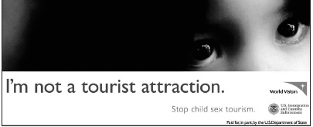
What are NGOs doing?
តើអង្គការមិនមែនរដ្ឋាភិបាលកំពុងធ្វើអ្វី?
ខ្ញុំមិនមែនទាក់ទាញអ្នកទេសចរណ៍ទេ?

Slide 33
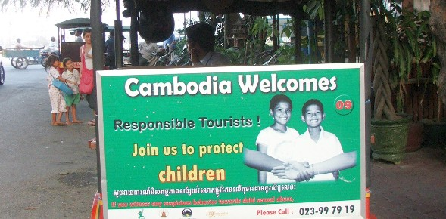
តើអ្នកបើកបរទុកទុកកំពុងធ្វើអ្វី?

Slide 34
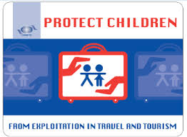
តើ UNWTO កំពុងធ្វើអ្វី?

Slide 35
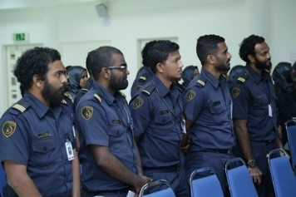
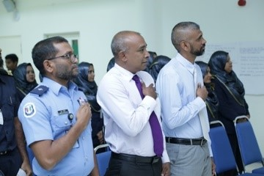
ការបណ្តុះបណ្តាលនគរបាល Maldives Police

Slide 36
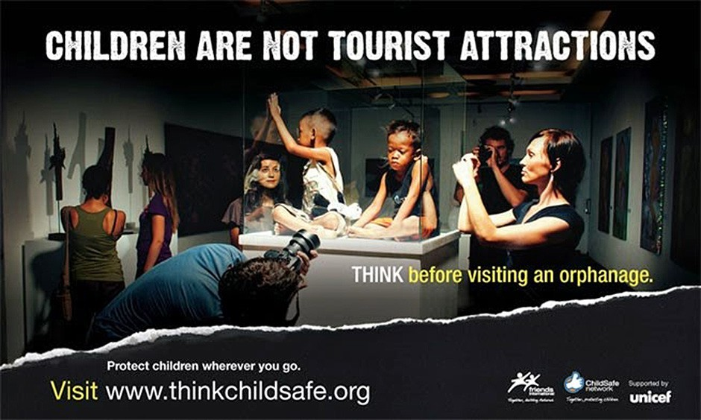
តើអង្គការមិនមែនរដ្ឋាភិបាលកំពុងធ្វើអ្វី?

Slide 37
តើប្រទេសផ្សេងៗទៀតកំពុងធ្វើអ្វី?
និយាយថា​ ទេ
ចំពោះទេសចរណ៍ផ្លូវភេទលើកុមារ?

Slide 38
តើនគរបាលផ្សេងៗទៀតកំពុងធ្វើអ្វី?
ប្រទេសអូស្រ្តាលី
ការធ្វើទេសចរណ៍ផ្លូវភេទលើកុមារ -របាយការណ៍តាមអនឡាន
ទម្រង់អនឡាញរបស់នគរបាលសហព័ន្ធអូស្រ្តាលី (Australian Federal Police online form) អនុញ្ញាតឲ្យសារធារណៈជនរាយការណ៍អំពីឥរិយាបទគួរឲ្យសង្ស័យ ដែលអាចសំគាល់ថាកុមារអាចស្ថិតក្នុងហានិភ័យនៃការធ្វើអាជីវកម្មផ្លូវភេទ
.

Slide 39
អំពីក្រម (THE CODE)
ក្រម (ជាពាក្យសង្ខេប៖ “ក្រមប្រតិបត្តិក្នុងការការពារកុមារពីការធ្វើអាជីវកម្មផ្លូវភេទលើកុមារក្នុងការធ្វើដំណើរ និងទេសចរណ៍”) គឺជាការផ្តួចផ្តើមនាំមុខ និងជាការទទួលខុសត្រូវក្នុងវិស័យឧស្សាហកម្មទេសចរណ៍(industry-driven responsible tourism initiative) និងមានបេសកកម្មដើម្បីផ្តល់ការយល់ដឹង ឧបករណ៍ផ្សេងៗ និងការគាំទ្រឧស្សាហកម្មទេសចរណ៍សំដៅទប់ស្កាត់ការធ្វើអាជីវកម្មផ្លូវភេទលើកុមារ
យើងការពារកុមារពីទេសចរណ៍ផ្លូវភេទ

Slide 40
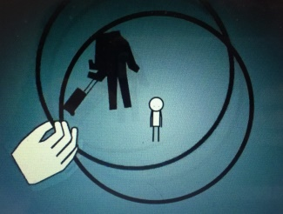
What is the private sector doing?
តើវិស័យឯកជនកំពុងធ្វើអ្វី?
https://www.youtube.com/watch?v=eTFu9Zpz-Bg
Notes:
EXPLAIN:
This video provides an important refresher about ‘What is child sex tourism and what can the tourism industry do?’.
SHOW VIDEO

Slide 41
តើយើងកំពុងធ្វើអ្វីបានល្អ?
Notes:
ACTIVITY – NATIONAL /PROVINCIAL SCORECARD
Divide the participants into small groups..
Ask the groups to make a list of the successful initiatives being undertaken to keep children safe from sexual exploitation in tourism.
Allow five minutes for the groups to prepare their points.
Ask each team to share one point with the whole group and continue moving from group to group until all points are exhausted.
Add additional points that have not yet been mentioned by the groups, and acknowledge the positive actions and infrastructure that already exist.
EXAMPLES:
Signed international conventions
Laws to protect children
Child Helpline
Child Sex Offender Register
Police training (awareness/response for CSE and victim training)
Etc etc

Slide 42
តើយើងអាចកែលម្អរអ្វីខ្លះ? What can we improve?
Notes:
EXPLAIN
While governments are making many positive steps to keep children safe from sexual exploitation, this is an issue that is escalating around the world. Tourism is rapidly growing, technology is improving, criminal activity is becoming more sophisticated and, as a result, children face serious risks.
But we need to be vigilant in our efforts to address child sexual exploitation. While we have already made many positive steps, there are definite requirements to:
Escalate our current efforts/Address gaps in our child protection system
Improve our child protection activities /Develop and implement new activities
Revise the ways in which we cooperate

Slide 43
តើមានអ្វីកើតឡើង ប្រសិនបើយើងមិនធ្វើអ្វីសោះ? What happens if we do nothing?
សកម្មភាព
គ្មានសកម្មភាព
Notes:
EXPLAIN
Often we attend training and become very enthusiastic. But, when we return to our work, nothing changes.
This training is different. If we don’t change our actions relating to child sexual exploitation in tourism, there are serious negative impacts.
ACTIVITY
Divide into groups and discuss the possible consequences if we don’t take the actions we have proposed.
CONCLUDE
Make concluding comments about the positive impact that the tourism industry can make to child protection.

Slide 44
ឲ្យក្លាយជាវីរជន‌!
Notes:
HANDOUT: BE A HERO
Distribute the handout and remind participants about the actions they can take and key

Slide 45
សំណួរ ? Questions ?
Notes:
EXPLAIN
We can all play a role in keeping children safe.
TASK
Ask the participants to think overnight about how they might protect children through their roles.
ASK
Acknowledge that today’s session has provided an introduction to the sensitive issues of child sex tourism and online child sexual exploitation. Ask the participants if there is anything they would like to ask. If participants prefer to stay behind to ask questions, provide the opportunity.

Slide 46
ត្រូវធ្វើការប្តេជ្ញាចិត្ត!
Notes:
My Commitment
ASK
Ask participants what they intend to do to protect children from sexual exploitation in tourism.
Explain that their commitment should be practical, realistic and actionable. It should be clearly related to their responsibilities.
Encourage participants to write down their commitment.
Ask if any participants are willing to share their commitment with the rest of the group (without pressuring anyone to do so).
Remind participants of the importance of the commitment. That by following their commitment they will make a significant positive impact on the safety of children.

Slide 47
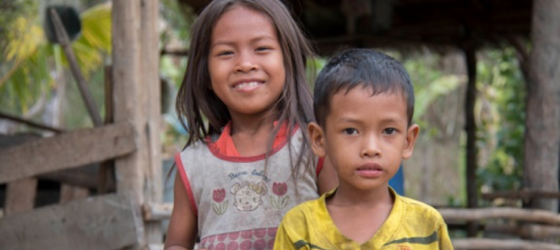
We can protect children!
យើងអាចការពារកុមារបាន!
Notes:
Conclusion. Questions. Certificates.
Conclude with final message of encouragement for all participants to take action to protect children from sexual exploitation in tourism.
Explain that we can do it. And, reinforce that Cambodia is in a strong position to prevent child sexual exploitation in tourism from escalating into a big problem. But, we must start now. And, we must keep our commitment.
The current and future safety of our children depends on us.
Thank everyone for their participation and commitment.

Slide 48
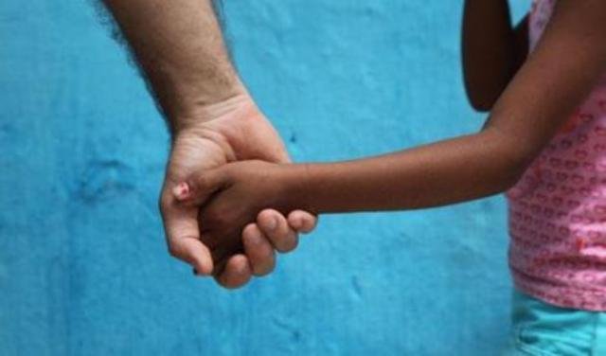
តើខ្ញុំគួរធ្វើអ្វីខ្លះ? What would I do?
សេណារីយ៉ូ
SCENARIOS
Notes:
ACTIVITY: PERSONAL ENCOUNTER ROLE PLAY
Distribute copies of the ‘Role Play Scenario’ to participants (Handout).
Invite volunteers to participate to take on the various roles. Advise the rest of the class they will observe the role play and answer questions at the end.

Slide 49
តើអន្តោប្រវេសន៍អាចធ្វើអ្វី? What can Immigration do?
Notes:
EXPLAIN
So, if we can’t identify child sex offenders by their appearance, how are we meant to protect children?
ASK for ideas for a few moments, then introduce Imigrasi Indonesia to explain their actions

Slide 50
ត្រូវចេះ បង្រៀនក្រុមរបស់អ្នក Be Aware Train Your Team

Slide 51
ព័ត៌មានជាមុនសម្រាប់អ្នកដំណើរ Advance Passenger Information

Slide 52
នគរបាលសហព័ន្ធអូស្រ្តាលីនិយាយាថា មានជនជាតិអូស្រ្តាលីចំនួន ២៥០ នាក់ដែលបានធ្វើដំណើរទៅប្រទេសហ្វីលីពីនកាលពី ៤ឆ្នាំកន្លងទៅ ត្រូវ បានចោទប្រកាន់ពីបទល្មើសផ្លូវភេទលើកុមារ

Slide 53
ការត្រួតពិនិត្យនៅអាកាសយាន្តដ្ឋានអន្តរជាតិ Airport Turnarounds

Slide 54
ជនល្មើសផ្លូវភេទលើកុមារបានបដិសេធមិនឲ្យចូលអាកាសយាន្តដ្ឋានផើតថ៍ (Perth Airport)

Slide 55
ការលុបចោល/មិនទទួលស្គាល់លិខិតឆ្លងដែន Passport Cancellation

Slide 57
ជនល្មើសផ្លុវភេទកុមារដែលត្រូវដកហូតលិខិតឆ្លងដែន

