Slide 1
ASEAN-ACT Webinar 2021 Series: Episode 06 “How women, as influential agents of change, can bridge gender equality gaps in counter trafficking-in-persons responses”
H.E. Chou Bun Eng
Permanent Vice-Chairperson of the National Committee for Counter Trafficking (NCCT) and Secretary of State, Ministry of Interior, Cambodia

Slide 2
1. Overview
Increasing cases of trafficking in persons (TIP) even during COVID-19 pandemic
Characteristics of TIP become more sophisticated with traffickers employing more advanced technology to communicate and lure victims
Unstable economic conditions: smaller labour markets, irregular income and worries over livelihoods, leading to risky decisions
Pulling factors:
availability of employment with better payment in other countries
needs for labour force
no complicated procedure
Recruitment via formal system - formalities, procedure, numbers, and deadlines.
Recruitment via informal system - only contacts with a broker

Slide 3
2. Royal Government of Cambodia’s Response
Ratified the United Nations Convention against Transnational Organized Crime and
Supplementary Protocol to Prevent, Suppress and Punish Trafficking in Persons, Especially Women and Children (2005)
National Law on Suppression of Human Trafficking and Sexual Exploitation (2008)
Mechanism: National Committee for Counter Trafficking (NCCT) (2009)
Led by Deputy Prime Minister, Minister of the Ministry of Interior
21 ministries and 05 technical units as members
National and sub-national structure
Engaging with national and international partner organizations
Collaboration with countries in the region and the world

Slide 4
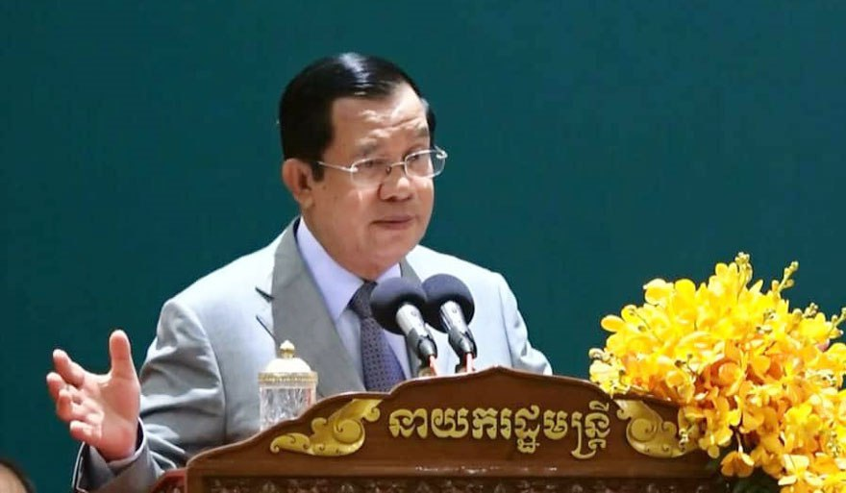
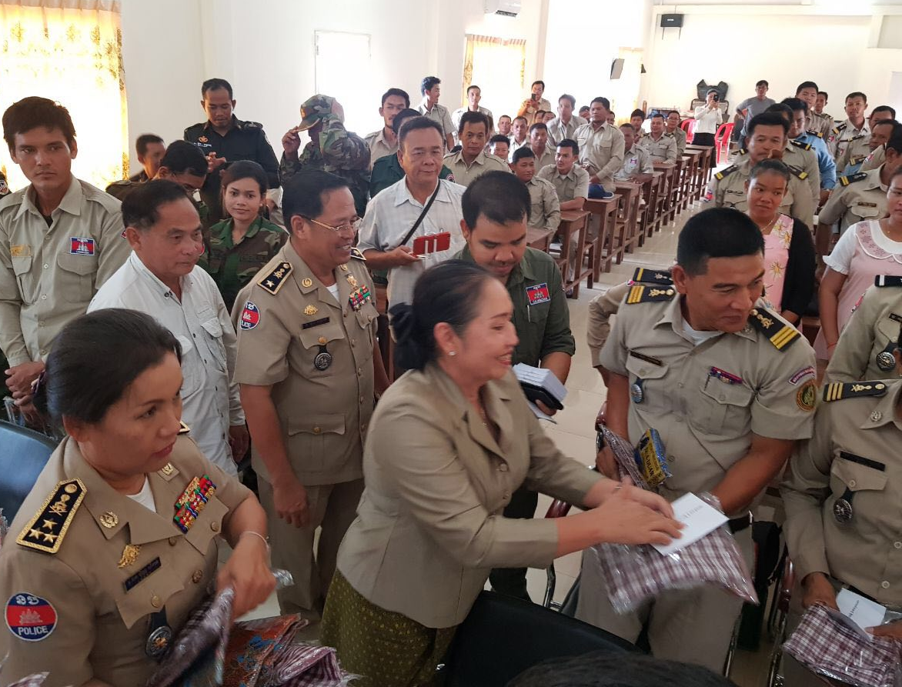
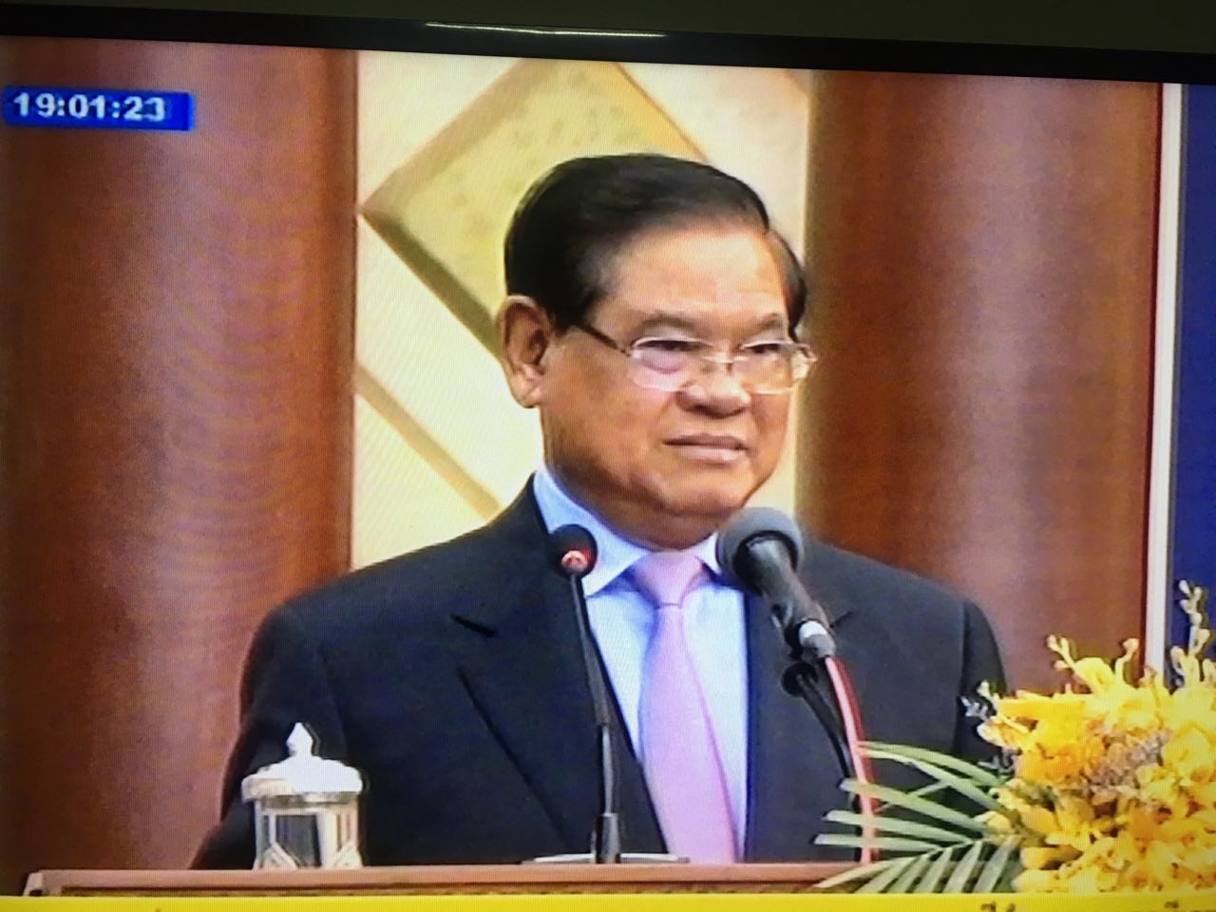
3. Women’s contribution to counter trafficking-in-persons (CTIP) efforts
Samdech Akka Moha Sena Padei Techo Hun Sen,
Prime Minister of the Kingdom of Cambodia
Samdech Kralahom Sar Kheng,
Deputy Prime Minister, Minister of Interior, Chairperson of the NCCT

Slide 5
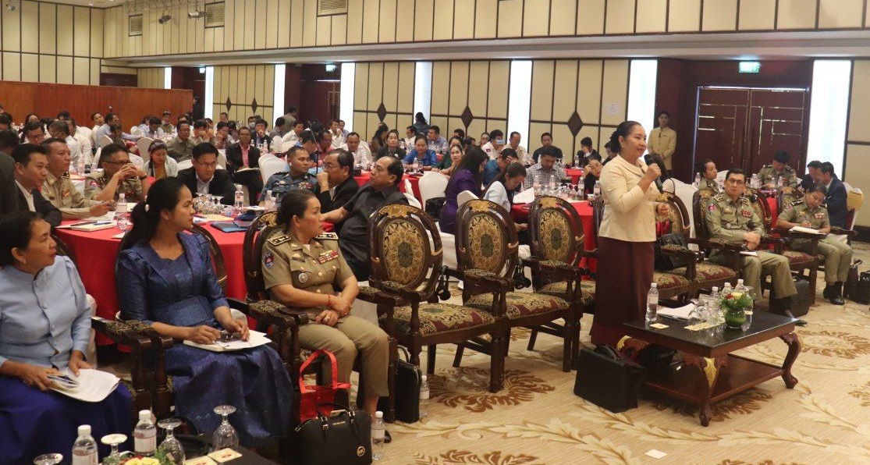
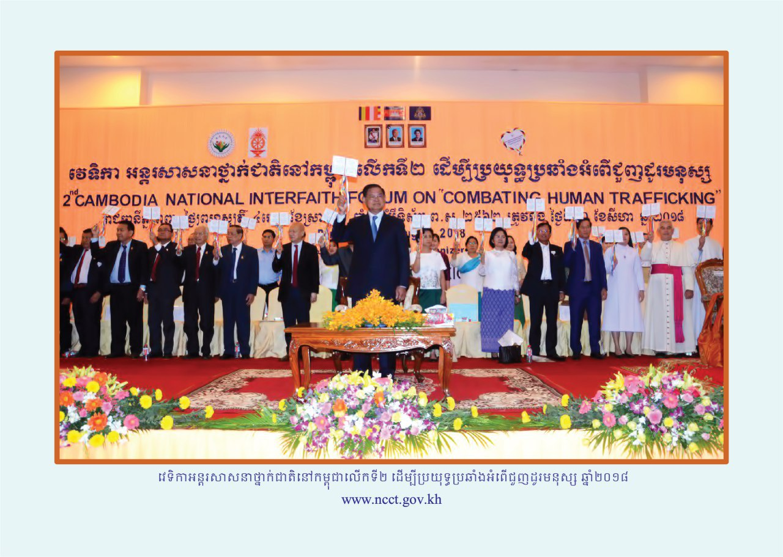
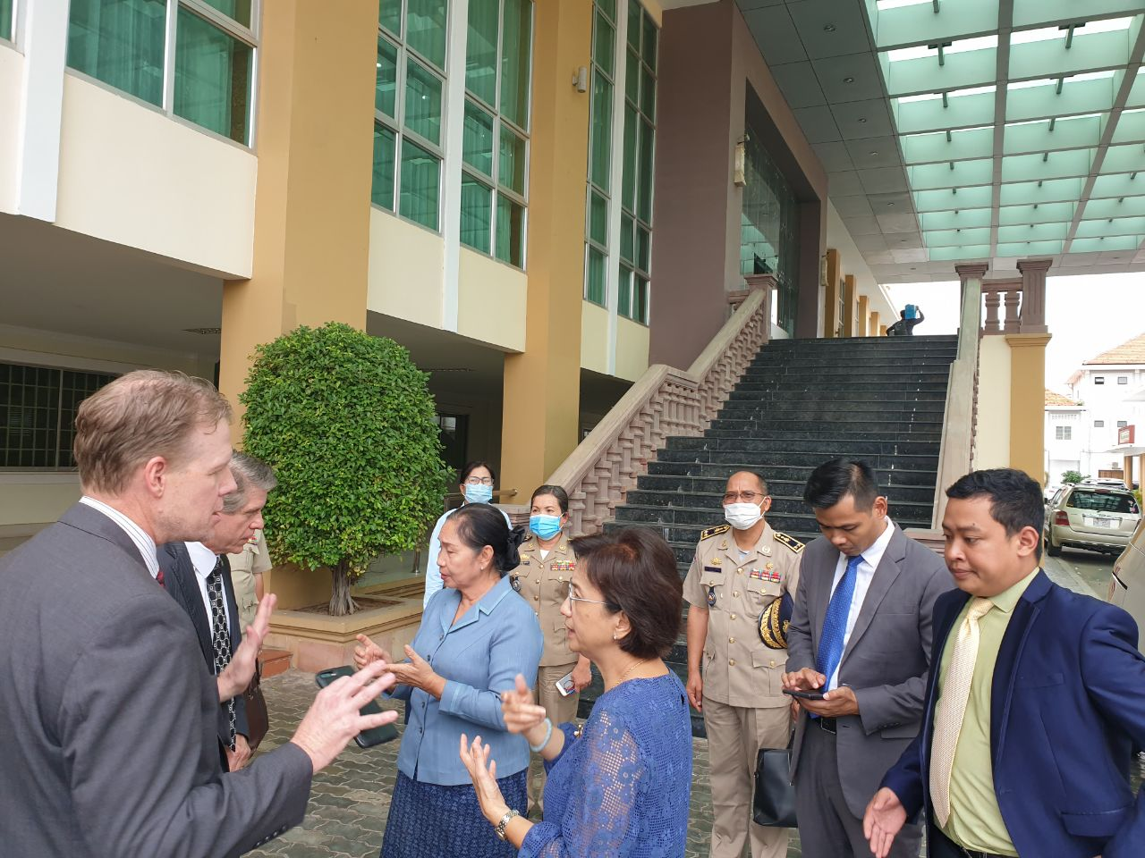
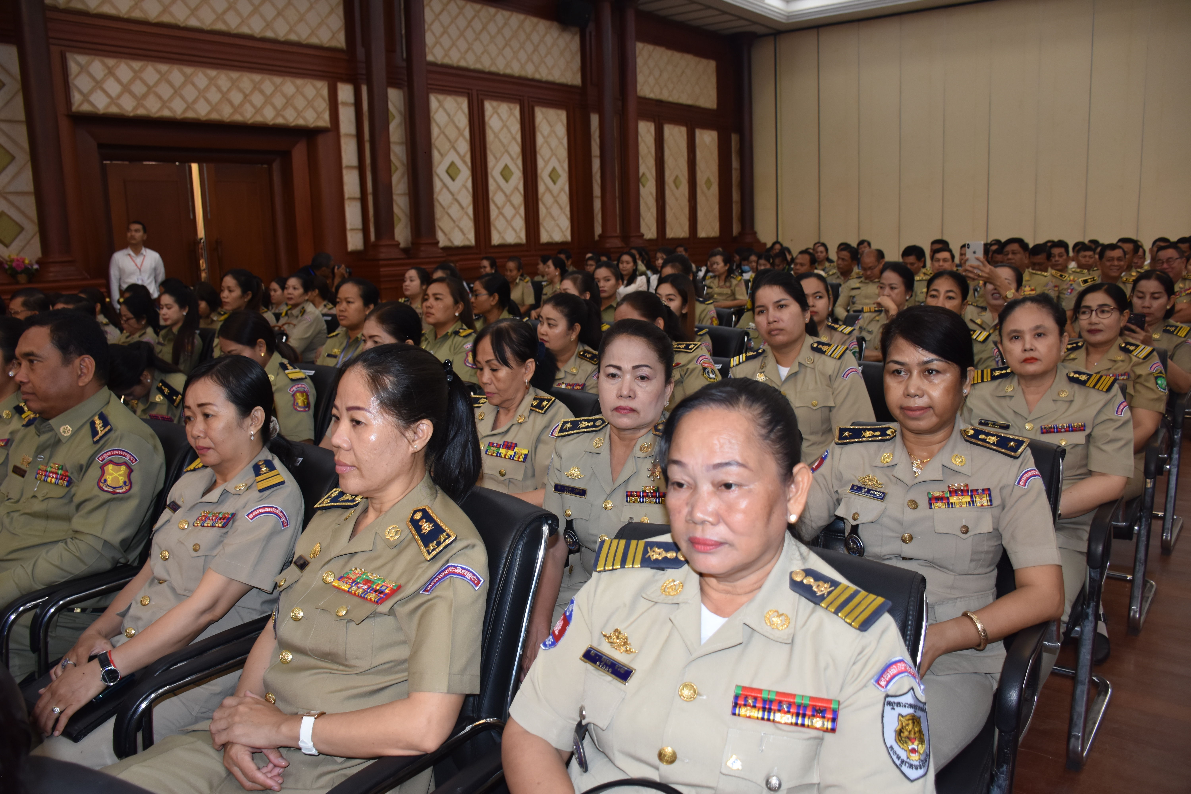

Slide 6
Women’s contributions to policies and laws
Taking part in the development of laws and policies - important actors in providing relevant and significant inputs
Ministry of Justice, Parliament, and Senate - all have female members to engage in the development, review and adoption of laws and policies
Women are parts of the structure of law and policy implementation at both national and local levels, e.g.:
one female deputy national police commissioner is responsible for law enforcement working group,
each 25 capital/provincial level assigns a female deputy police commissioners to lead CTIP effort.
Female judges, prosecutors, and voluntary lawyers providing legal aids to women.

Slide 7
Women in leadership and implementation of policies, laws, and plans
5-year strategic plan (2019-2023)
National and sub-national CTIP action plans
Four main strategies:
(1) Strengthen cooperation in the formulation and implementation of laws, policies, and legal standards;
(2) Promote prevention of all forms of TIP and child sexual abuse;
(3) Strengthen criminal justice system in response to TIP and child sexual abuse; and
(4) Increase the protection of victims, especially women and children.
NCCT: Six inter-ministerial working groups (21 ministries/agencies & 05 technical units), each led by an NCCT Vice Chairperson, who are Ministers of relevant ministries, while the International Cooperation Working Group led by Minister of the Ministry of Women’s Affairs.
The Acting Vice Chairperson of NCCT is women Secretary of State, responsible for leading and facilitating daily tasks.
1 female Minister and 6 female Secretaries of State are member ministries’ representatives.
25 female deputy governors in all the 25 capital/provinces are leading counter trafficking secretariats at Sub-national level.

Slide 8
4. Challenges
Some women are also victims and vulnerable to TIP and sexual exploitation
TIP become more complicated while perpetrators employ sophisticated methods
Advanced technology versus limited technological knowledge among women
For victims abroad: solutions based on cooperation
Victims were still lured to leave the country even during COVID-19 pandemic
From early 2020 to March 2021, 170,000 returned migrant workers
RGC: health care, prevention of transmission of illnesses, and support for people’s livelihood
However, people, especially young girls, still fall prey to being trafficked

Slide 9
5. Addressing Challenges – Ways Forward
Strengthen collaboration with stakeholders and between countries for countering TIP and to protect human rights, women’s rights and child’s rights in any circumstance.
Increase awareness raising on the risks of unsafe migration especially during the spread of Covid-19, by appropriate message delivery method including via social media.
Increase victim-centered investigation and suppression of perpetrators.
Improve mutual legal assistance in criminal justice matters between relevant countries.

Slide 10
5. Addressing Challenges – Ways Forward (Cont’)
Enhanced capacity of front-line officials on the application of gender-based response and victim-centered approache to better protect TIP victims and vulnerable people.
Promote the implementation of tools developed to protect victims of TIP such as Policy and Minimum Standard on the Protection of the Rights of Trafficked Victims (2009) and SOPs with relevant countries
Continue to discuss the development of policies and laws needed to suppress TIP.
Push forward the implementation of ASEAN Convention and its Action Plan, and the Global Compact on Safe, Orderly and Regular Migration, during and post Covid-19 context.

Slide 11
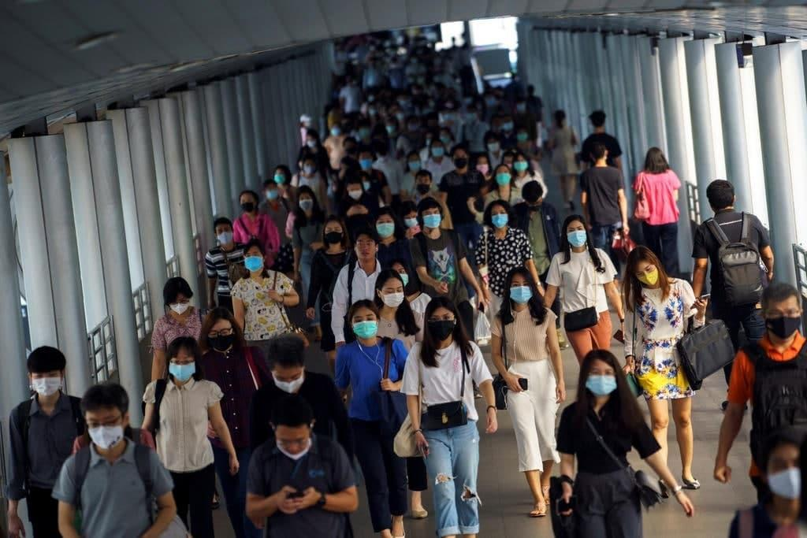
Thank you

