Slide 1
EIGHTH MEKONG REGIONAL WORKSHOP ON ASSISTING VICTIMS OF TRAFFICKING TO BUILD NEW LIVES:EXPLORING “SUCCESSFUL” SOCIAL REINTEGRATION FOR VICTIMS OF TRAFFICKING AND GOOD INITIATIVES TO PROMOTE IT Bangkok, 7-9 March 2018
Ministry of Social Affairs, Veterans and Youth Rehabilitation (MoSAVY)
Presented by Mrs. Prom Sokhun, Director,
Department of Anti-Human Trafficking and Reintegration of Victims
CAMBODIA

Slide 2
OUTLINE
Introduction
Overview of Anti-trafficking Government Law, Policy and System
Partnership on Repatriation
Service Provision and Resources on Repatriation
Partnership on Social Reintegration
Service Provision and Resources on Social Reintegration
Case of “Successful” Social Reintegration
Gaps, obstacles and challenges in Assisting Social Reintegration
Way Forward

Slide 3
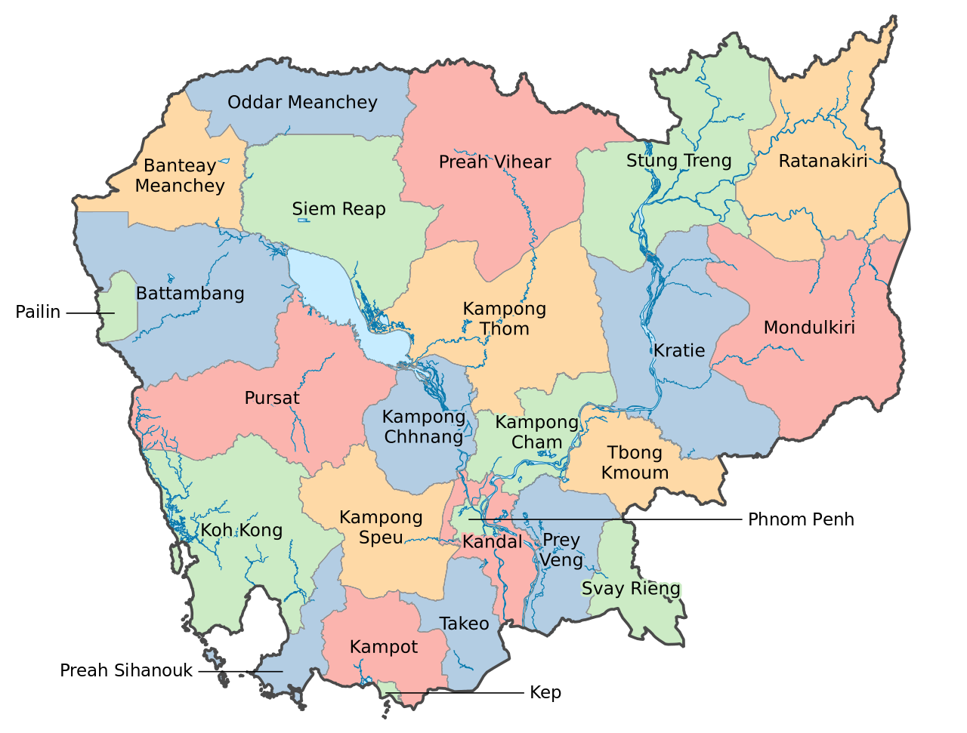
CAMBODIA recognized as a sending, receiving and transit country for trafficking in persons
` 1. Introduction
In-country Trafficking
Rural to urban
Province to province
As a receiving country for Vietnamese and Chinese
as a transit country for…
Vietnamese, Chinese, …
as a sending country to Thailand, onwards to other parts of Southeast Asia, Malaysia, Korea, China and other region

Slide 4
Number of Trafficked Persons Rescued (2015-2017)
Activity and Result Report of NCCT, 2015, 2016 and 2017, Law Enforcement Working Group

Slide 5
2. Overview of Anti-trafficking Government Law, Policy and System
2.1. Key international & Regional legal framework:
Universal Declaration on Human Rights in 1948
International Covenant of Civil and Political Rights in 1976,
Convention on the Elimination of All Forms of Discrimination against Women (CEDAW) in 1981,
Convention on The Rights of the Child (CRC) in 1990,
UN Convention Against Transnational Organized Crime in 2000,
UN Protocol to Prevent, Suppress and Punish Trafficking in Persons, Especially Women and Children (Palermo Protocol) in 2000,
ASEAN Convention on TIP and its Regional Action on TIP in 2015
COMMIT MOU in 2004 and COMMIT Sub-Regional Plan of Action IV (SPAIV) in 2015-2018

Slide 6
2. Overview of Anti-trafficking Government Law, Policy and System
2.2. Domestic Laws and Policies:
Constitution in 1993
Criminal Code in 2009, Criminal Procedure in 2007
Labor Law in 1997
Juvenile Justice Law in 2016
Law on Suppression of Human Trafficking and Sexual Exploitation in 2008 (“LSHTSE”) in 2008,
Sub-decree No.190 on the Management of Sending of Cambodian Workers Abroad through Private Recruitment Agency in 2011,
Guidelines on Forms and Procedures for Identification of Victims of Human Trafficking for Appropriate Services Provision in 2015,
Policy and the Minimum Standards on Protection of the Rights of Victims of Human Trafficking (the “Minimum Standards”) in 2009,
Minimum Standards for Residential Care for Victims of Human Trafficking and Sexual Exploitation in 2014,
A National Five Year Plan of Action for Counter Trafficking (2014-2018),
Policy on Labor Migration for Cambodia (2015-2018),

Slide 7
2. Overview of Anti-trafficking Government Law, Policy and System (Cont’d)
2.3. System/mechanism:
National Committee for Counter Trafficking (NCCT) and its General Secretariats,
6 Working Groups under NCCT (each WG led by one Minister of relevant ministry) ,
Coordinated Mekong Ministerial Initiative against Human trafficking (“COMMIT”),
25 Provincial Committees for Counter Trafficking (PCCT),

Slide 8
3. Service Provision and Resources on Repatriation

Slide 9
4. Partnership on Repatriation
MOU with Thailand in 2014,
Bilateral Agreement in 2005 and SOP with Vietnam in 2009,
MoU with China in 2017
MoU with India in 2018
5. Partnership on Social Reintegration
UN agencies: IOM, UNICEF, UN-ACT
IOs: WV, Winrock, RI, IJM, AIM, Hagar, Hope for Justice
LNGO: Chabdai, CCPCR, CWCC
And Others

Slide 10
5.1. Protection and Reintegration
Under NCCT umbrella, the Protection Working Group led by the Minister of MoSVY,
All victims of both internal and cross-border trafficking have been rescued, protected and supported within the process of case management by all concerned governmental institutions, IOs, local NGOs, UN agencies and private sector with respect to the Policy and the Minimum Standards for Protection of the Rights of Victims of Human Trafficking,
All victims have been supported, provided care, recovered and reintegrated into community. They were recovered and provided with medical check-up, counselling for life option, instant and legal support, sheltering and food, vocational training and life skills.

Slide 11
5.2. The Rights of Victims
Rights of Victims (11):
The right to safety and protection,
The right to individual identity,
The right to privacy and confidentiality,
The right to dignity,
The right to information,
The right to services,
The right to justice,
The right to normality,
The right to participation,
The right to decision-making and
The right to freedom of movement.

Slide 12
6. Service Provision and Resources on Social Reintegration
MoSVY is the Chair of Protection Working Group and responsible for service provision and social reintegration of victims,
MoSVY cooperates with other relevant government institutions and NGOs for making sure victims’ rights respected, victims provided services, rehabilitated and reintegrated into community,
MoJ is responsible for proving legal assistance by collaborating with other concerned government institutions, UN agencies and NGOs,
MoSVY coordinates with other concerned government institutions, UN agencies and NGOs for providing social assistance to victims.

Slide 13
6.1.Case Management
Case Management Steps (10)
The case management process provides a framework for services providers so they can maximize their effectiveness in helping the victims. There are10 steps:
victim identification,
crisis intervention,
referral,
reception,
case planning,
assessment,
recovery,
reintegration,
follow-up and
case closure

Slide 14
7.Case of “Successful” Social Reintegration
7.1. Background of Sophea:
34 years old lady who had worked for a garment factory in Phnom Penh
She was convinced by a broker to marry a Chinese man in China for better income,
Her travel to China through Vietnam was arranged by a broker,
In Vietnam she was arrested by the police and jailed for 5 days,
She was repatriated to Cambodia with facilitation of MoSVY and Chab Dai Coalition.

Slide 15
7. Case of “Successful” Social Reintegration (cont’d 1)
7.2. Social Reintegration:
Sopheap was referred to the RAP Community Home for recovery,
She had health problems with teeth, stomach ache and digestive system,
Sopheap received counselling and regular treatment,
She attended vocational training in sewing skills and life skills,
She is a tailor staff in a Dress Making design shop and earns at least $200/month
She was reintegrated into her family with reintegration support package,

Slide 16
7. Case of “Successful” Social Reintegration (cont’d 2)
7.3 Why the case is presented?
The case is successfully and satisfactorily addressed a number of connected issues, including health, emotional capacity, and employment skills. These connected improvements have led the client to being able to independently support herself as well as continuing to contribute to her family.

Slide 17
7. Case of “Successful” Social Reintegration (cont’d 3)
7.4. Factors made this case “successful”
Establishing trust with client;
Building an effective relationship with the client;
keeping contact with client for identifying more effective solutions;
Encouraging the client so that she commits to receiving more intensive support at RAP community home where needed;
Dealing with critical underlying issues including health needs and emotional skills;
Facilitating successful training and an effective job placement;
Building good relationships and support with trainers and employers for outcome.

Slide 18
8. Gaps, obstacles and challenges in Assisting Social Reintegration
Missing and inaccurate data of identified victims and reintegrated victims,
Funding for provision of reintegration support to victims of trafficking in persons is limited,
Lack of government rehabilitation centers for victims and potential victims repatriated and deported by receiving countries,
Holistic approaches for responding to trafficked persons’ needs are limited,
Language barrier for some victims destination countries (e.g. China)
Each ASEAN member state’s legal instruments are not standardized or consistent to the other member states,
No focal point represents each country of Mekong Region,

Slide 19
8. Gaps, obstacles and challenges in Assisting Social Reintegration (Cont’d)
Coordination among stakeholders for following up the reintegrated victims at sub national level is limited,
Job opportunities in the rural areas are limited,
Victims with serious mental problem
Psychological services are limited
Victims are discriminated against in the community
Some victims hide their background/identity information
Some victims are not willing to file complaints.
Some victims are refused services and not cooperating with competent authority.

Slide 20
9. Way Forward
Plans to improve social reintegration assistance for VOTs
Establish an accurate database for identified and reintegrated victims,
Establish more transit and rehabilitation centers for assisting victims,
Strengthen referral mechanism
Regular monitoring all shelters for providing residential care for victims,
Improve coordination and cooperation among stakeholders for better service delivery,
Mobilize all resources for social reintegration assistance for victims,
Improve follow-up and immediate responses for reintegrated victims,
Promote cooperation with the countries with the existing MOUs and agreements and encourage new MoUs and agreements with relevant countries.

Slide 21
Thank You for Your Attention!

